Slide 1
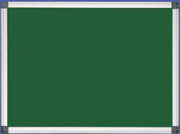
Phonetic Drills
Irina Panova

Slide 2
[θ]
Elizabeth’s birthday
on the third Thursday
of the month.

Slide 3
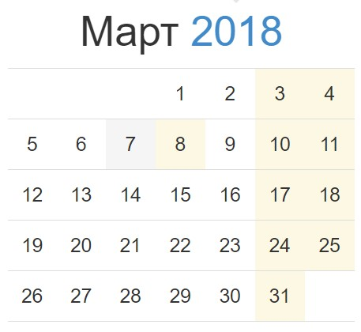
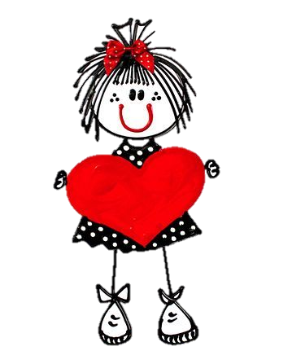
Eliza
beth
[θ]
Elizabeth’s birthday
on the third Thursday
of the month.
Birthday

Slide 4
[ð]
This, that, those, these
Are sitting in the trees

Slide 5


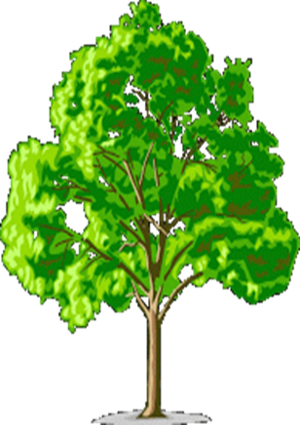

Are sitting in the trees
those
that
these
This

Slide 6

[r]
Three grey rabbits in the grass
Grow roses for us.

Slide 7
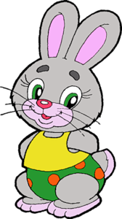
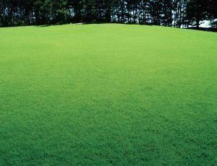
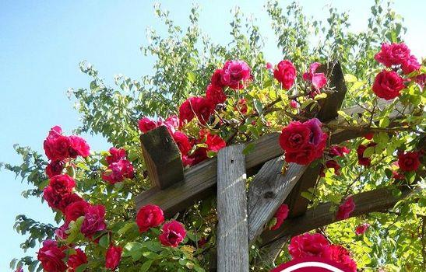
Three grey rabbits in the grass
Grow roses for us.

Slide 8
[l]
Lazy lion is lying smiling
At his lion cubs and lioness

Slide 9
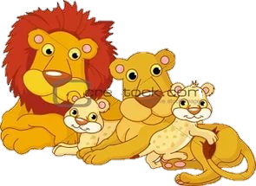
Lazy lion
is lying smiling
At his lion cubs
and lioness

Slide 10
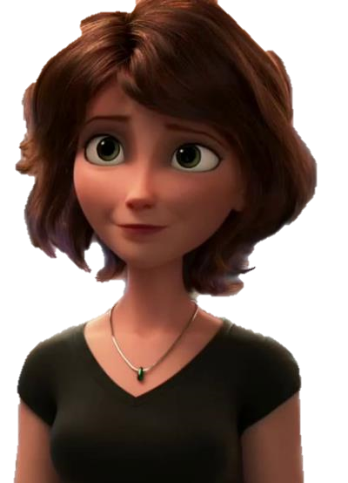
My mother is pretty,
My mother is nice.
She has a small nose
And beautiful eyes.
Her hair is brown,
Her lips are red.
She is always tidy and well dressed

Slide 11


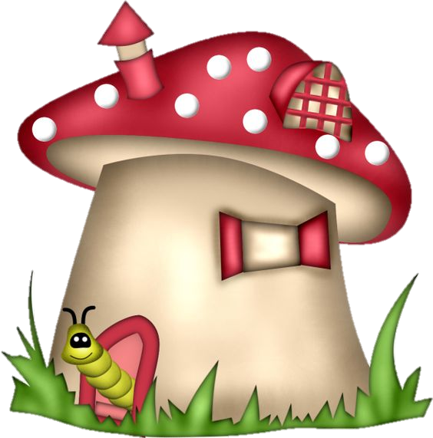
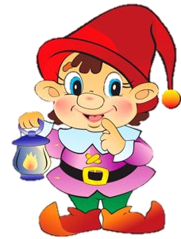
[əʊ]
A small gnome
Lives in a home.
He has got small toes
And a pink nose

Slide 12
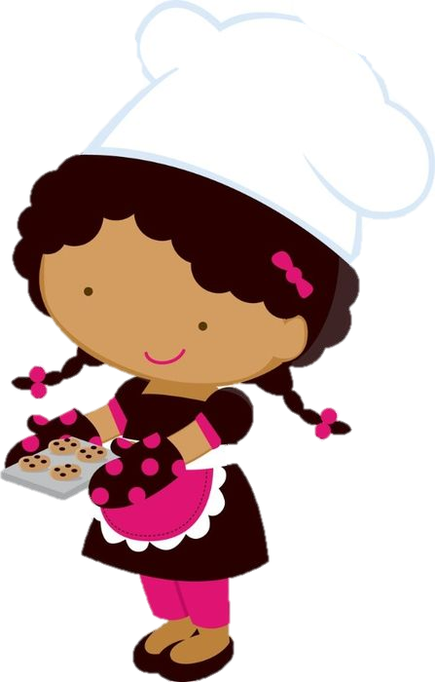

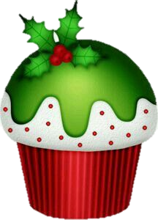
Lucy is a good cook.
She has got a cookery book.
She cooks cookies.
Her cookies are good.
[ʊ]
COOKERY
BOOK

Slide 13
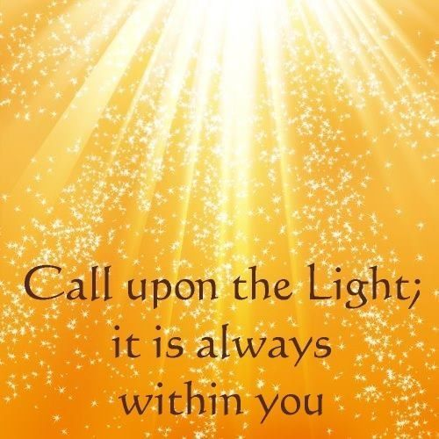
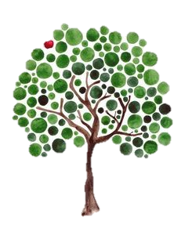
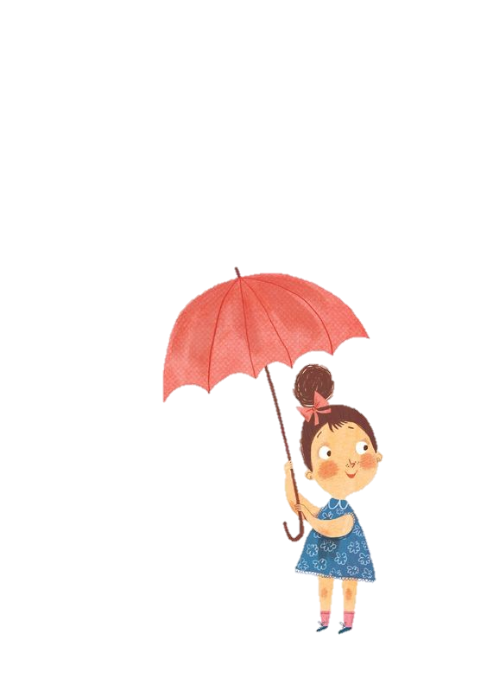
Sh [ʃ]
A sunshiny shower
Shows us its power. Find a shed for an hour!

