Slide 1
I’m going on holiday

Slide 2

A Bus

Slide 3
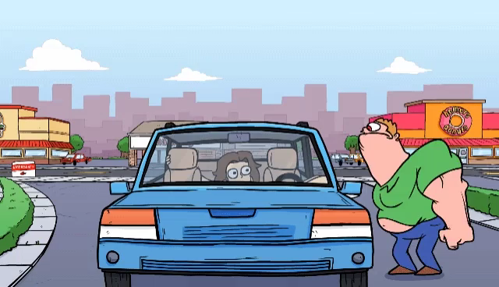
A Car

Slide 4
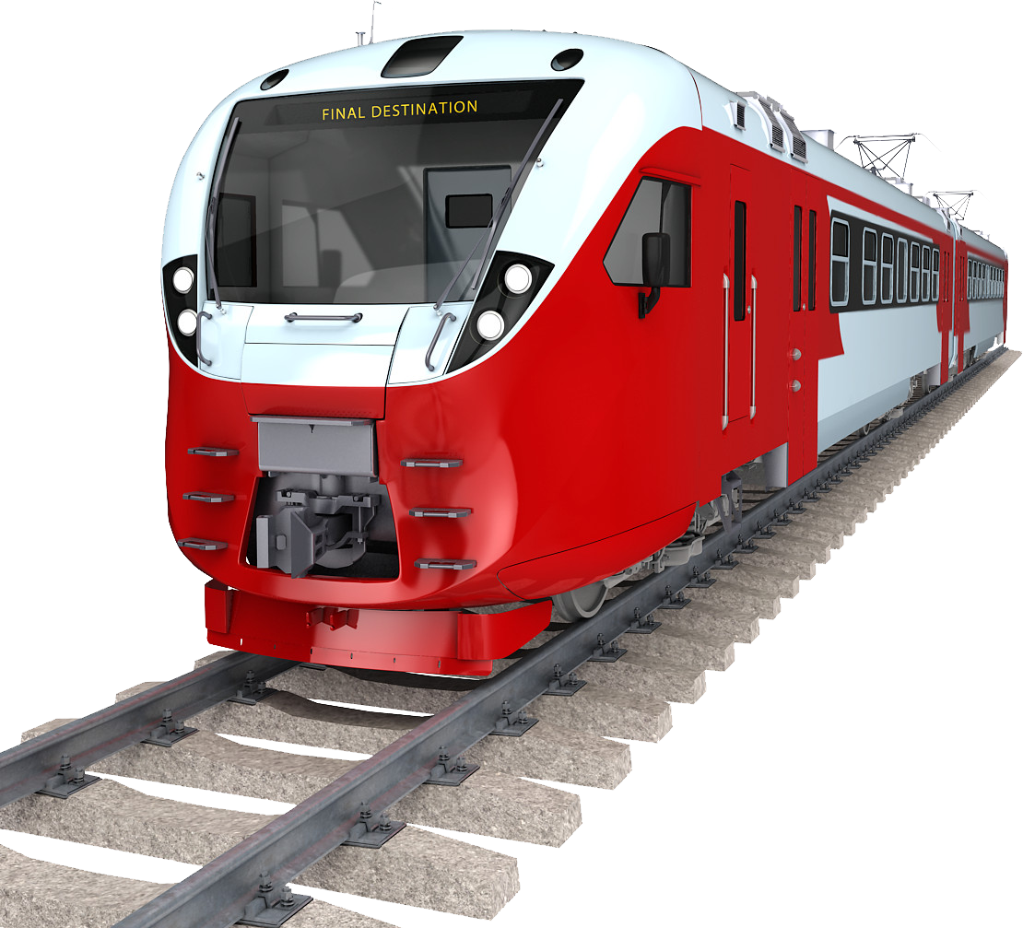
A Train

Slide 5
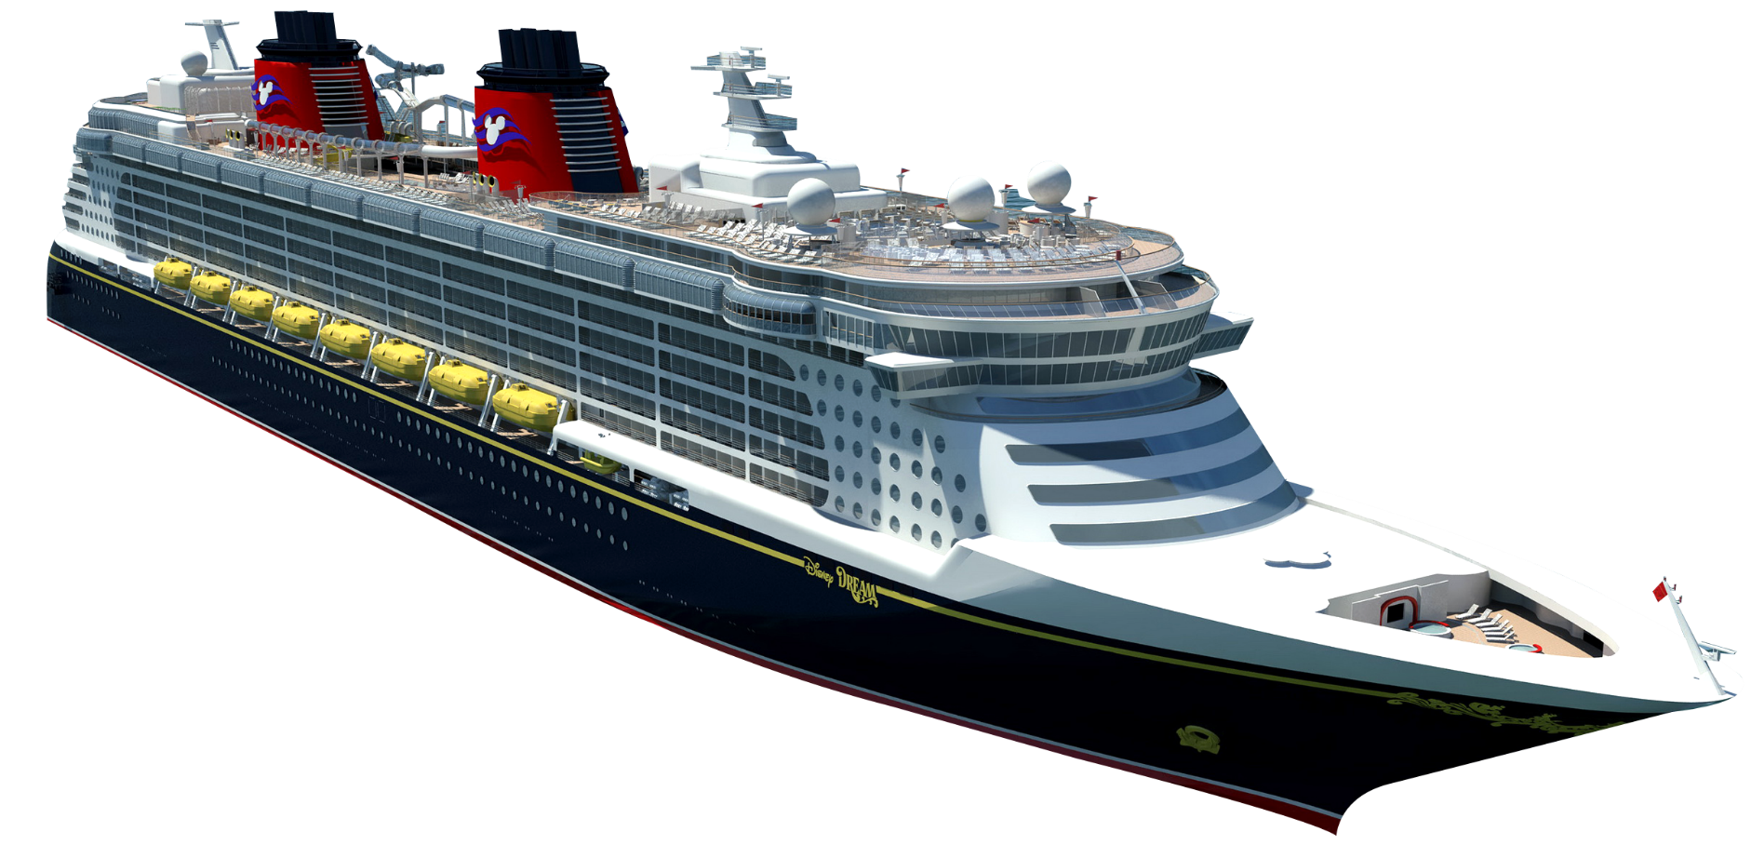
A Ship

Slide 6
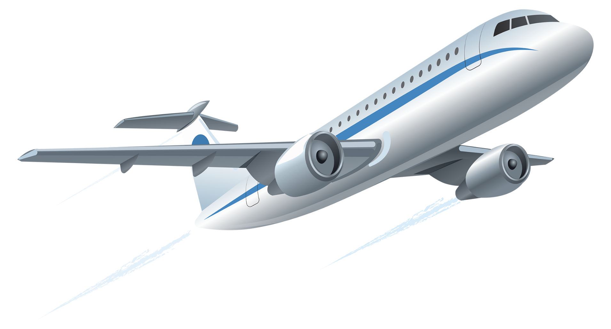
A Plane

Slide 7
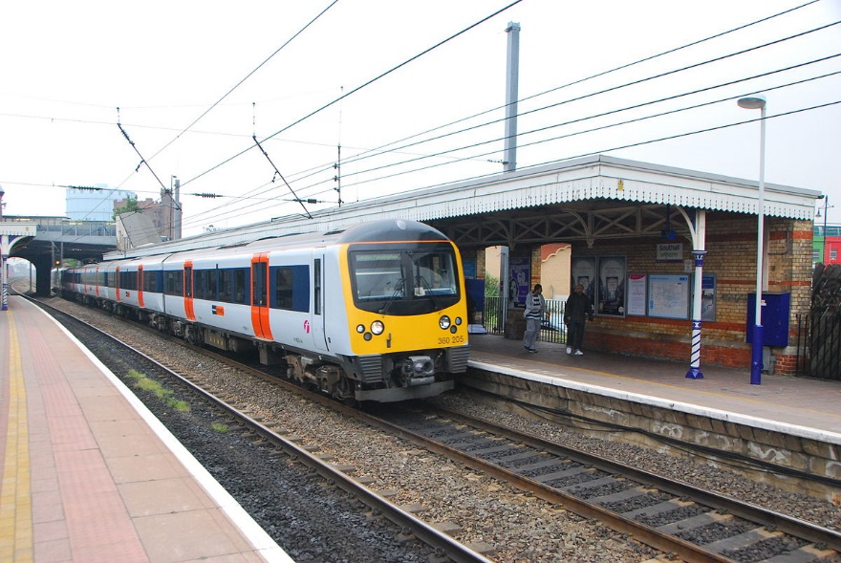
A Railway station

Slide 8
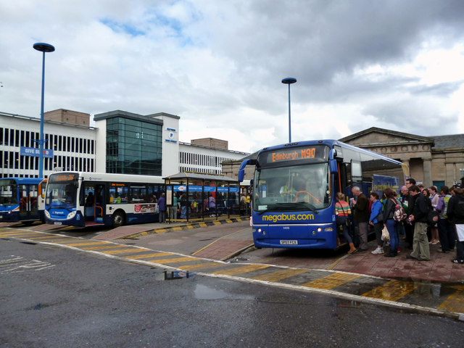
A Bus station

Slide 9
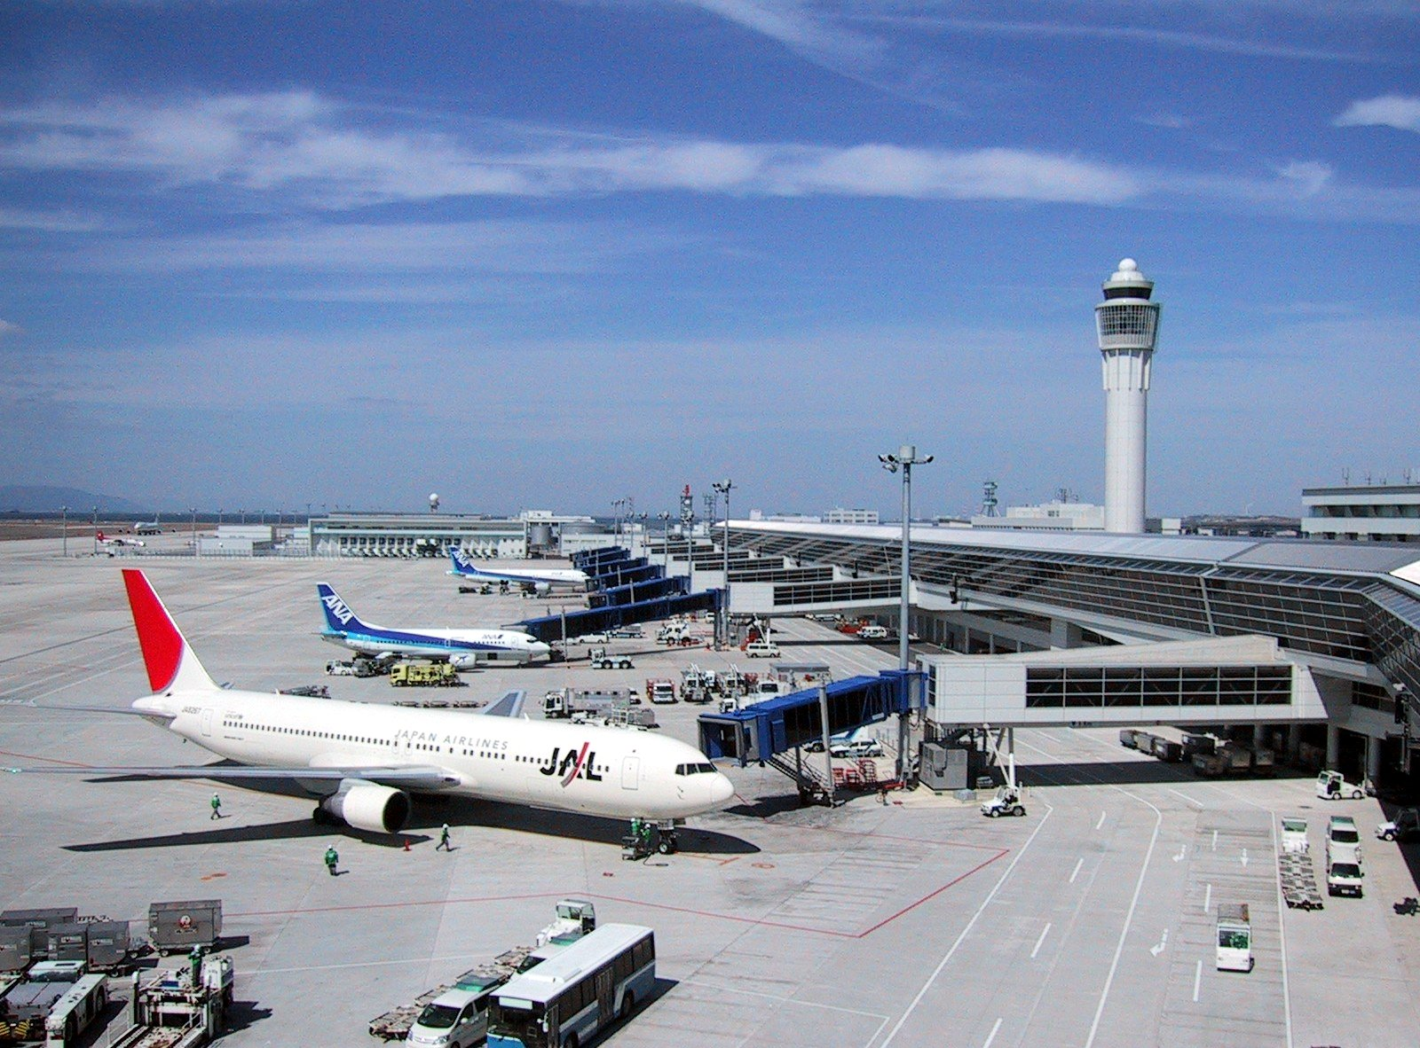
An airport

Slide 10
A car | Автомобиль
A bus | Автобус
A train | Поезд
A ship | Корабль
A plane | Самолет
A railway station | Железнодорожная станция
An airport | Аэропорт
A bus station | Автобусная станция Автовокзал
A ferry | Паром
Leaves | Отправляется
Arrives | Прибывает

Slide 11
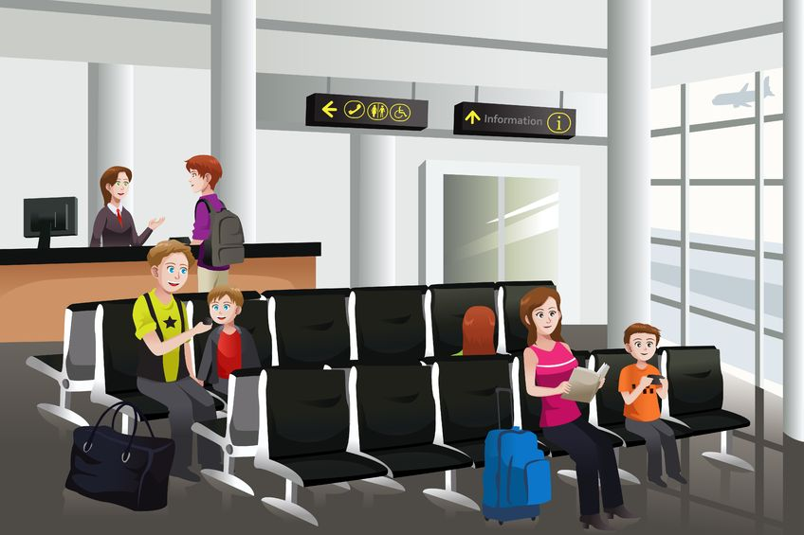
Hi! tell me please, what time does the train leave for Moscow?
The train for Moscow leaves at half past six.
Thank you very much!
Hello! Sir, how can I help you?

Slide 12
The train for Moscow leaves at half past six.
What time does the train leave for Moscow?

Slide 13
Make Ben’s ticket.
Ben: This is my ticket. It’s a plane ticket
Eddy: Where are you going?
Ben: I’m going from Canada to Italy.
Eddy: What time does the plane leave ?
Ben: Half past six.
Eddy: When does it arrive in Italy ?
Ben: It arrives at eleven.

