Slide 1
December, 7

Slide 2
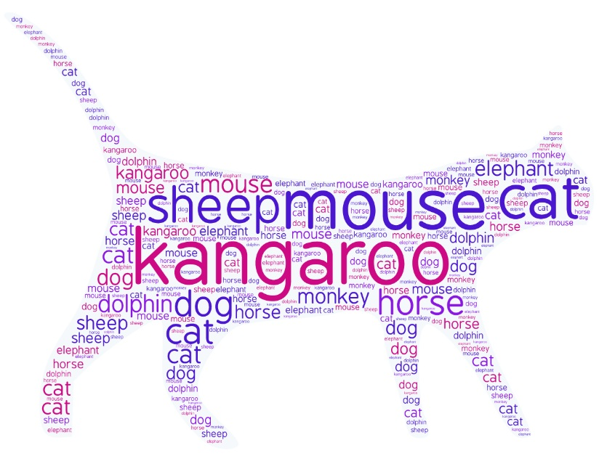

Slide 3
Listen and repeat
/ʤ/ jump, gym, jam, giraffe
/i:/ tree, meat, tea, leaves
/w/ we, what, whale

Slide 4
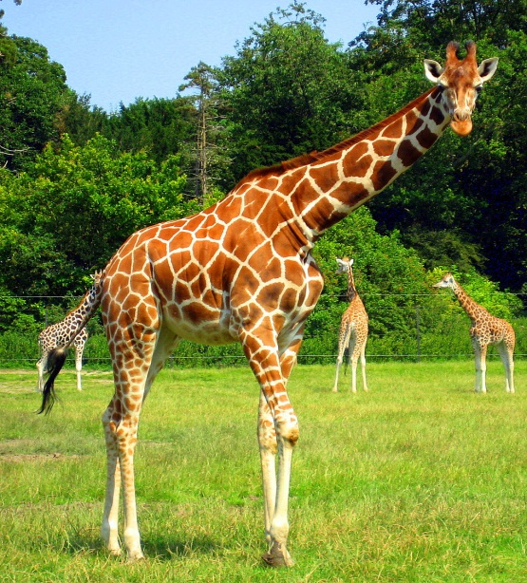
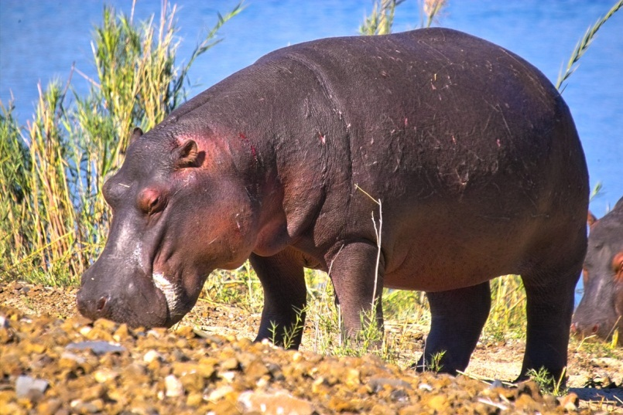
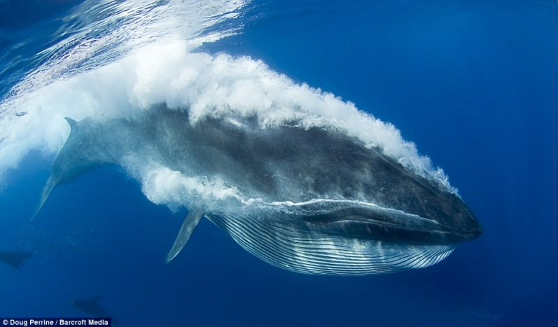
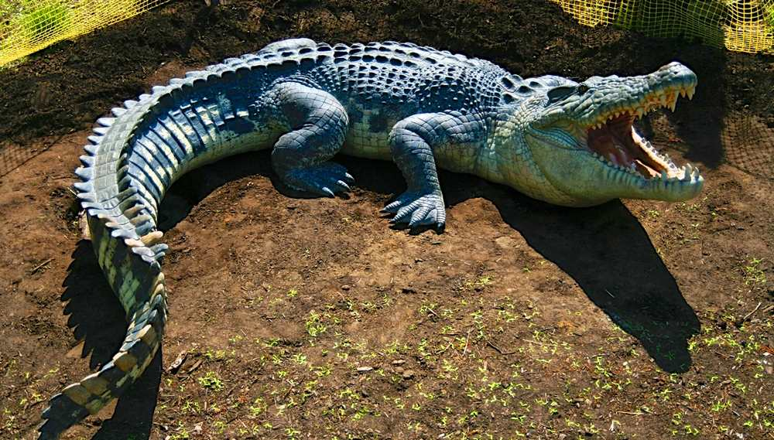
hippo
giraffe
whale
crocodile

Slide 5
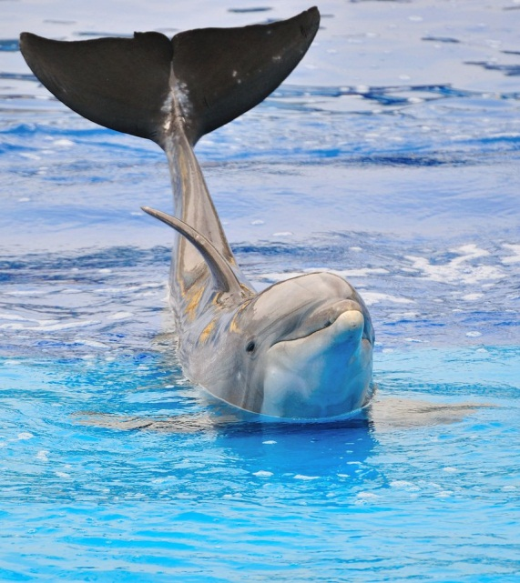
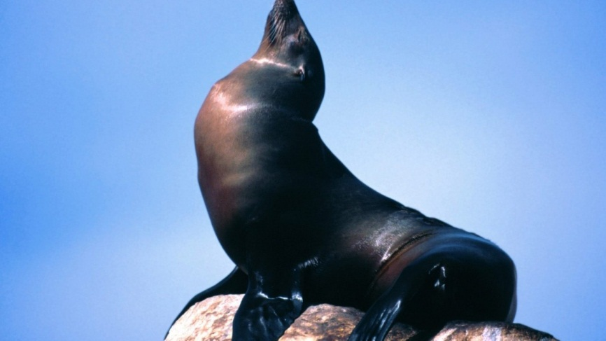
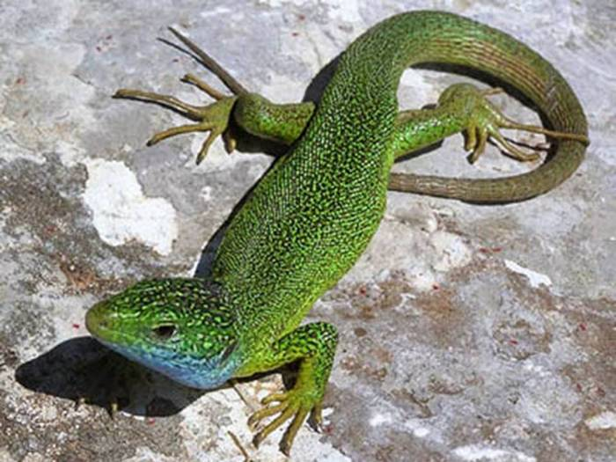
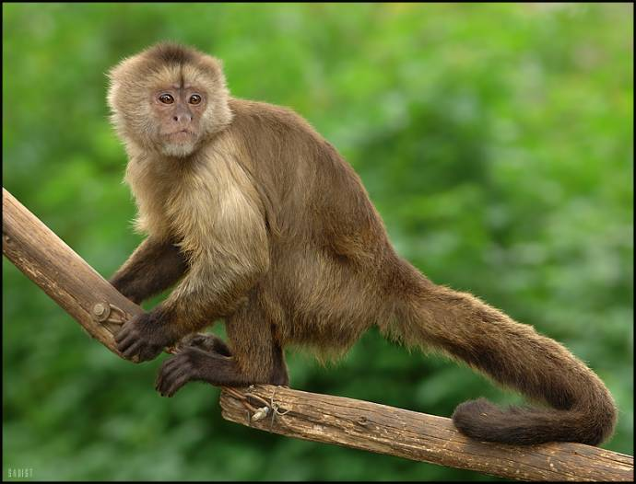
seal
dolphin
lizard
monkey

Slide 6
dolphin
seal
giraffe
hippo
lizard
monkey
whale
crocodile

Slide 7
Complete the sentences.
1. A crocodile likes…..
2. A monkey can…..
3. A whale lives in …..
4. A giraffe is…..
5. A hippo can…..

Slide 9

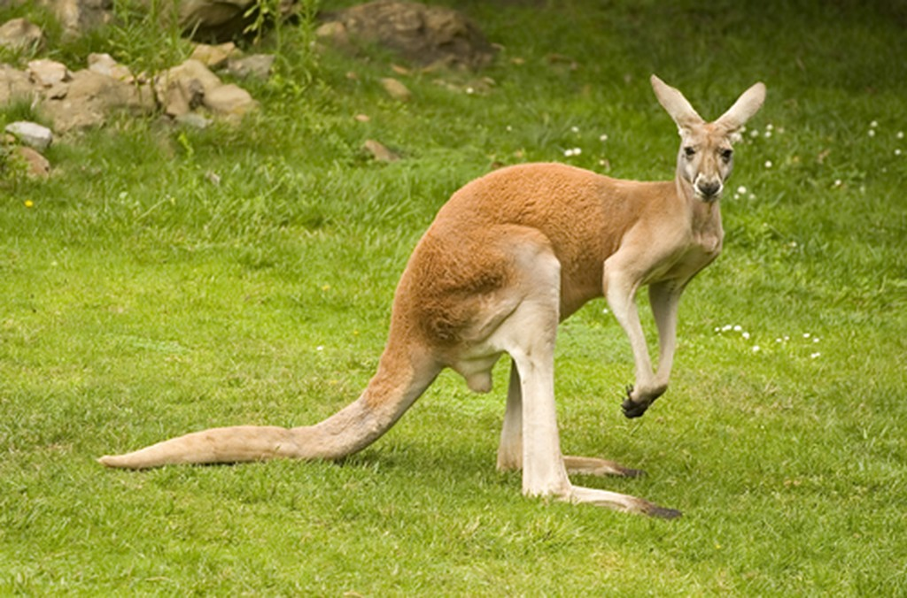

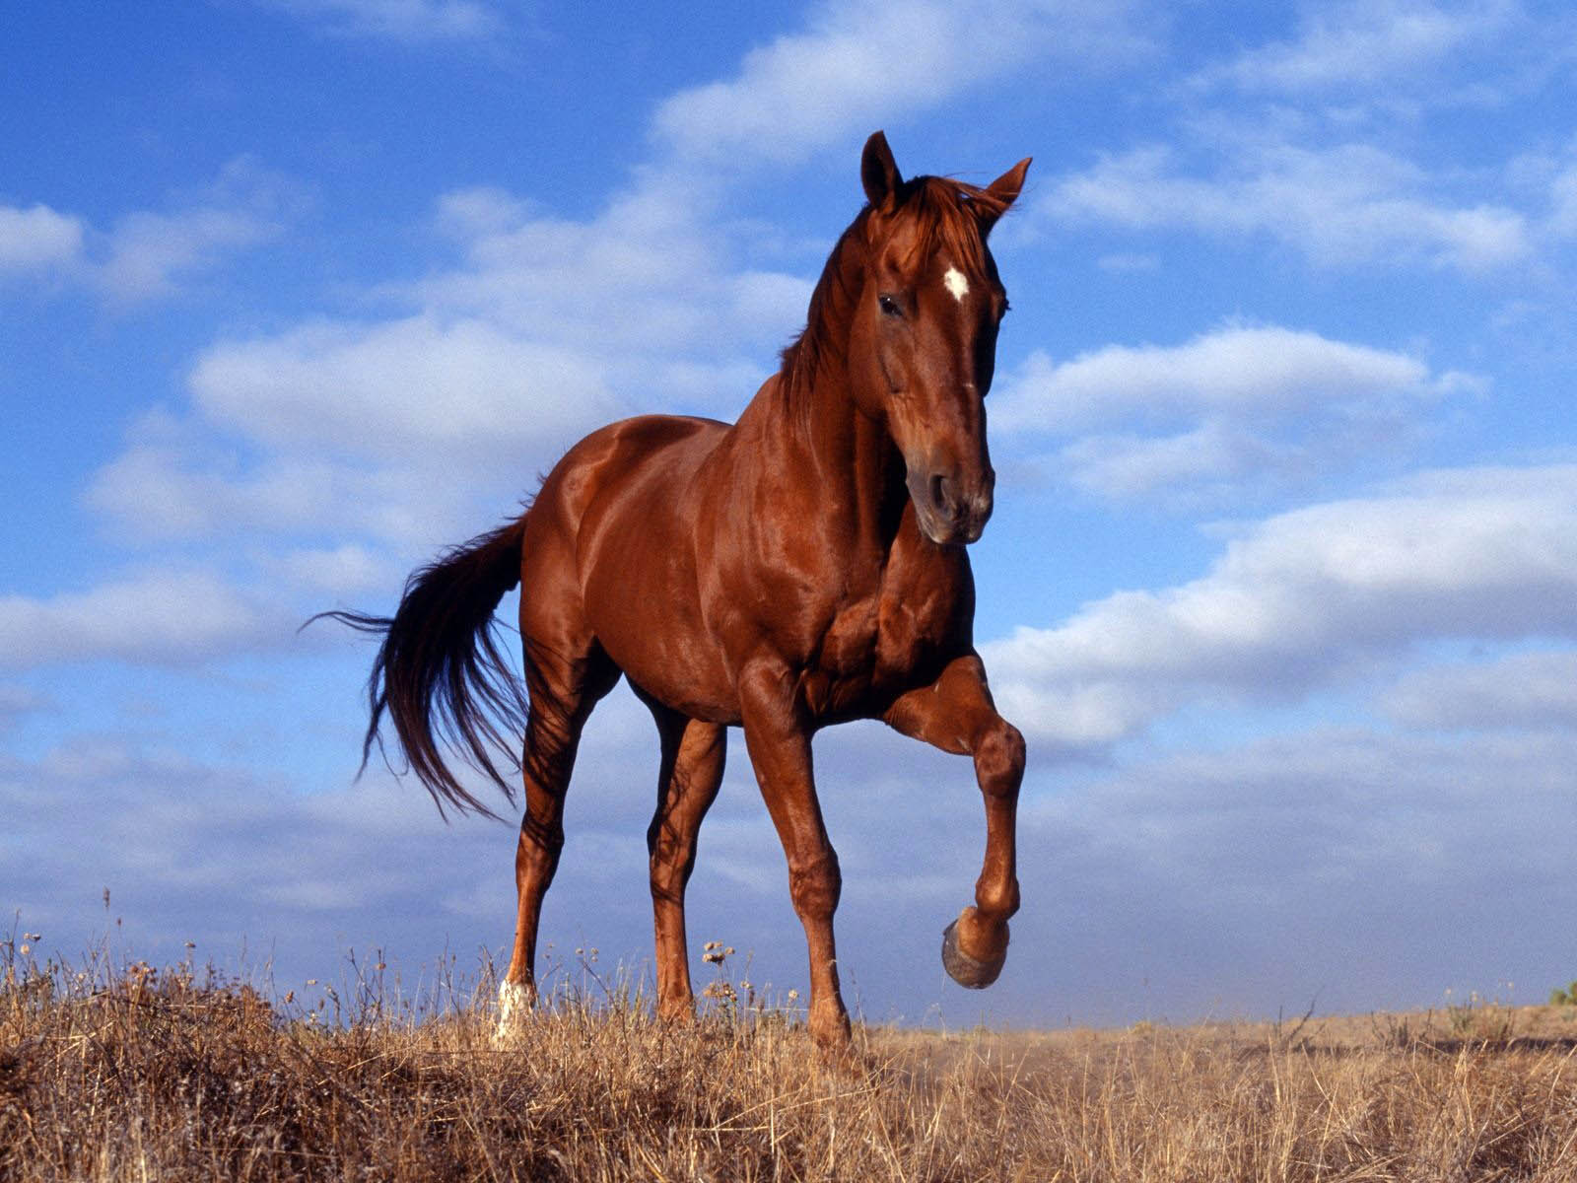

Slide 10
What is the giraffe doing?
It is eating from a tree.

Slide 11
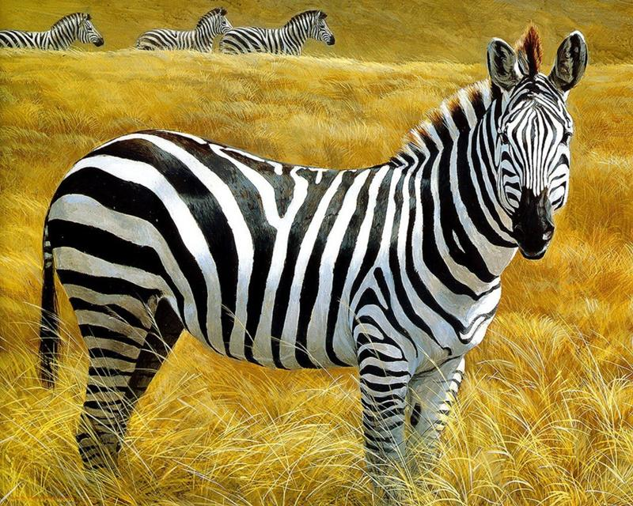

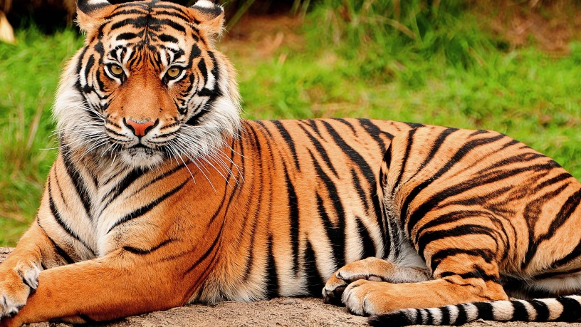
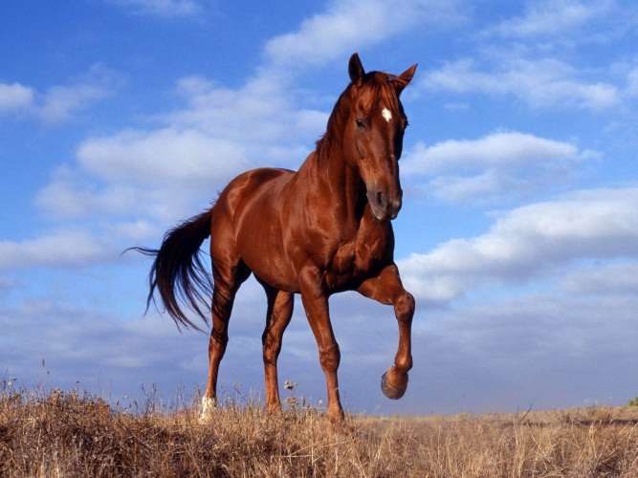
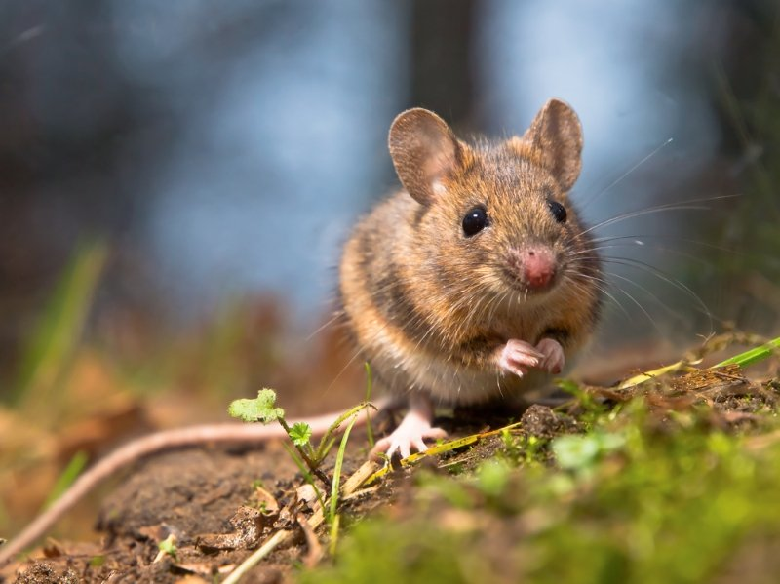

Slide 12

Notes:
Видео фрагмент диалога

Slide 13
I can ….
  name different animals
  speak about different animals

