Slide 1
What has hands but can’t clap?

Slide 2
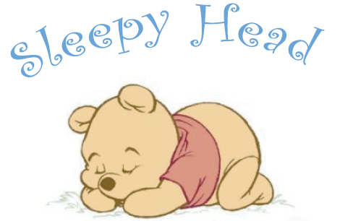
I have no legs, but I can run.
I have no tongue, but I tell everyone:
“Time to start work!”
“Time to go to bed!”
“Time to get up again, you sleepy head!”

Slide 3


Slide 4
Daily routine

Slide 5
proverbs
It’s an early bird that catches
Time is
Time and tide
Better late
Every day is not
No man can do
All work and no play makes
Early to bed, early to rise
Jack a dull boy
two things at once
a worm
money
wait for no man
Sunday
than never
makes a man healthy, wealthy and wise.

Slide 6
collocations
get go go go have have have have come iron watch buy do listen read get
a__________ the laundry
b______________ up
c__________ dinner
d_____________ to bed
e______________ TV
f______________ home
g___________ breakfast
h______________ to work
i_______________ a book
j___________ to music
k_______________ a shower
l_______________ shopping
m_______________ a newspaper
n_______________ the clothes
o_______________ dressed
p_______________ lunch

Slide 7

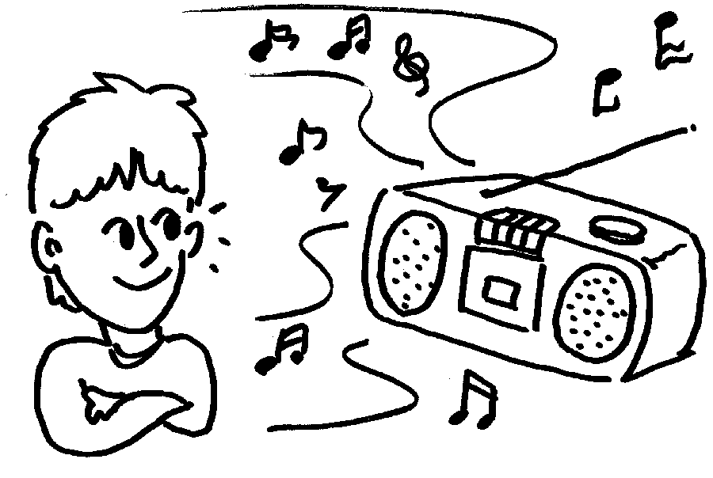
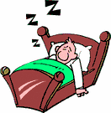

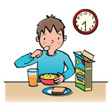

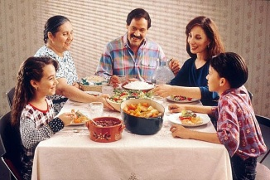
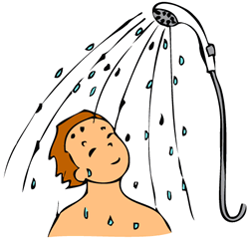
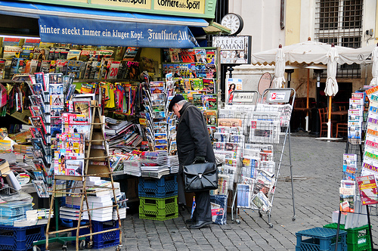
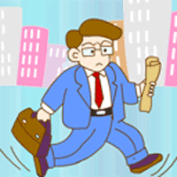
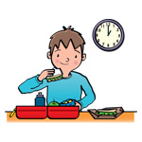
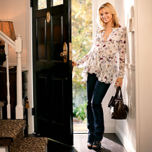
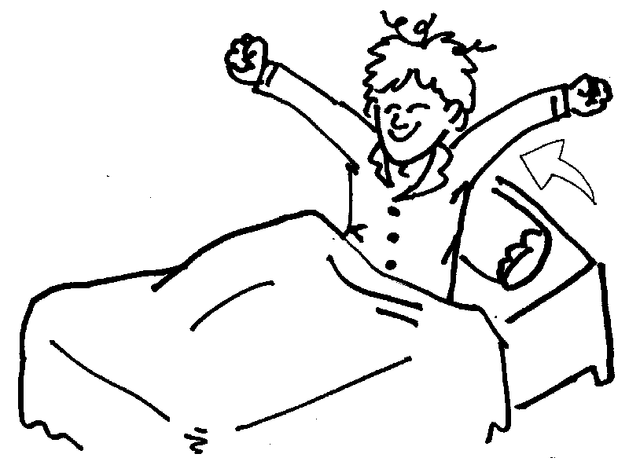
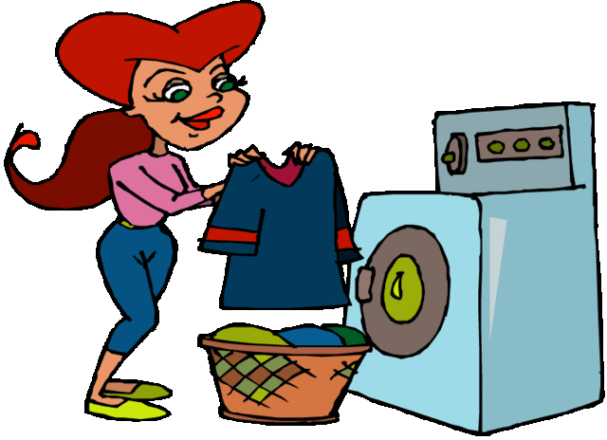

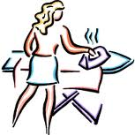

Slide 8
prepositions
___the morning ___the afternoon
____ the evening _______ night
_____five ____ six _____five o’clock
___ Monday

Slide 9
prepositions
In the morning
in the afternoon
in the evening
at five o’clock
at night
from five to six on Monday

