Slide 1
Bad weather
PREPARED AND CONDUCTED BY Nazarova Anna

Slide 2
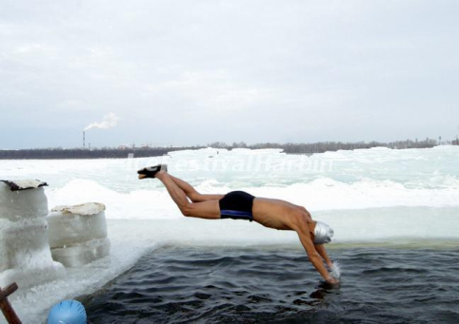
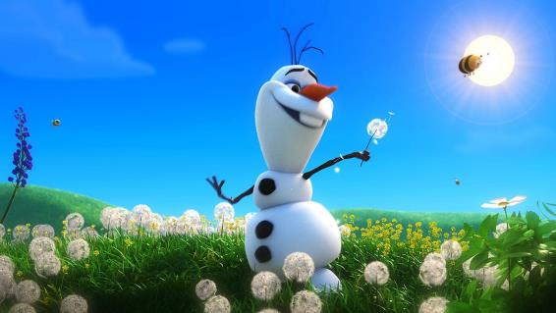
What is wrong?..

Slide 3
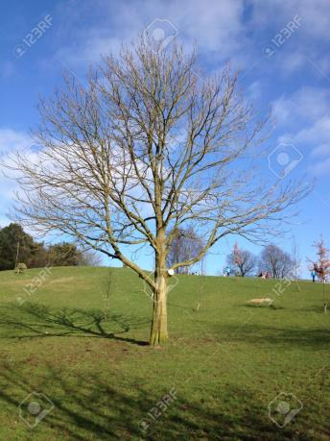
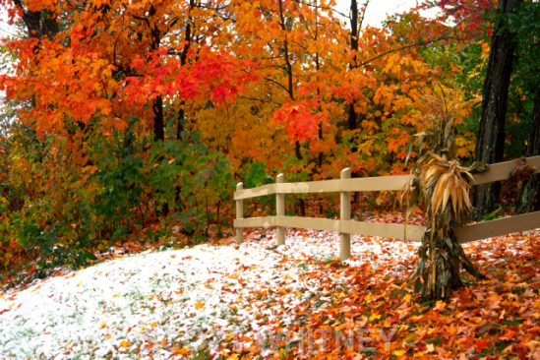
Autumn

Slide 4
1. Are there apples on the trees in November?
2. Can we swim in the river in September?
3. Are there flowers in the fields in October?
4. Can we skate in autumn?
5. Is the weather hot in autumn?
6. Can we see he first flowers in October?
7. Can we see brown or yellow leaves on the ground in autumn?
8. Is autumn frosty?

Slide 5
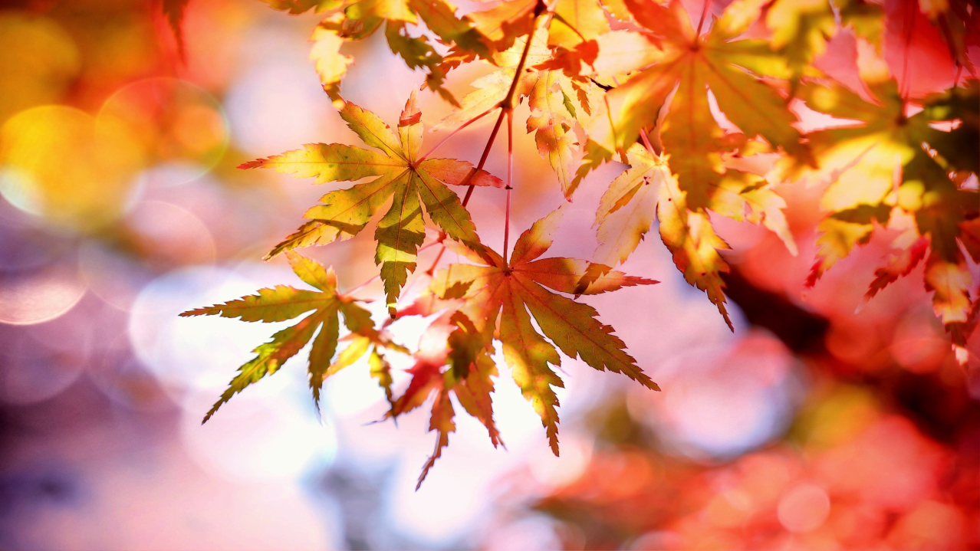

Slide 6
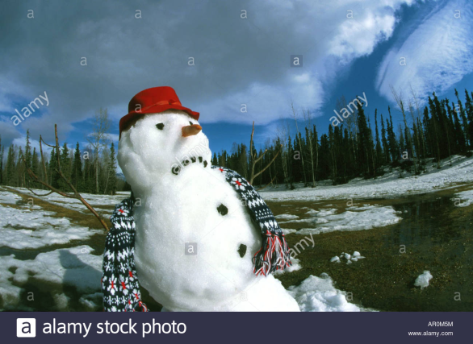
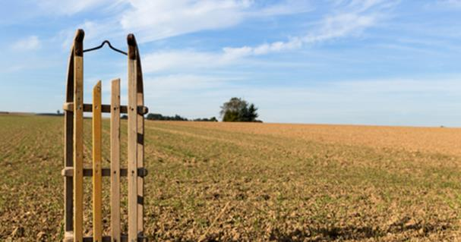
Winter

Slide 7
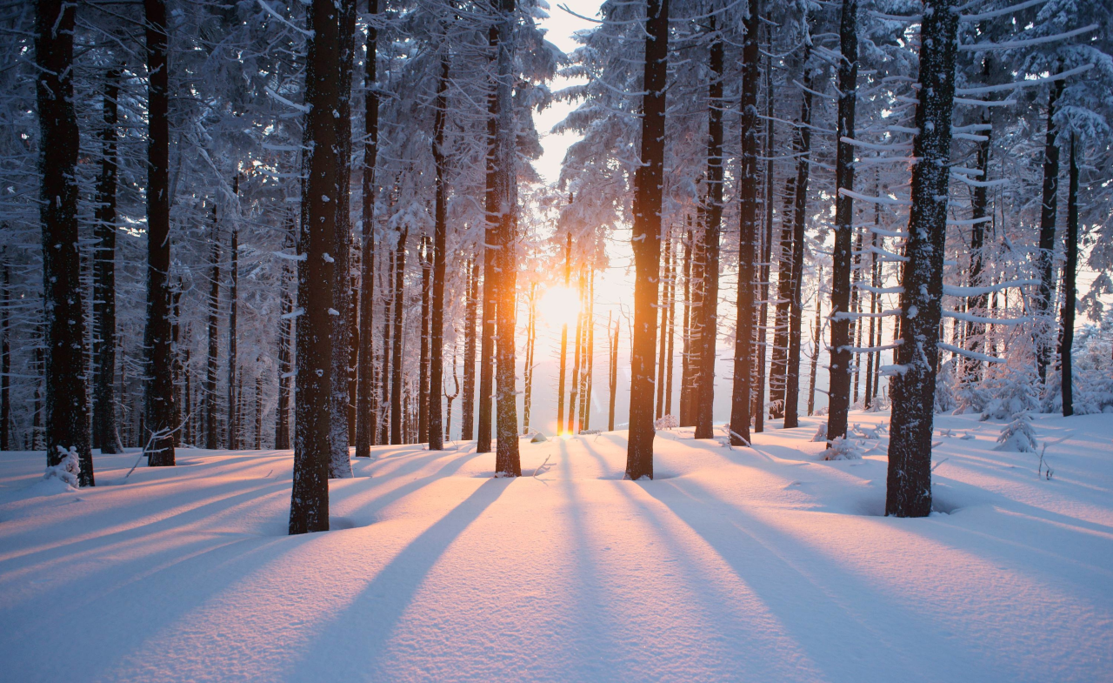

Slide 8
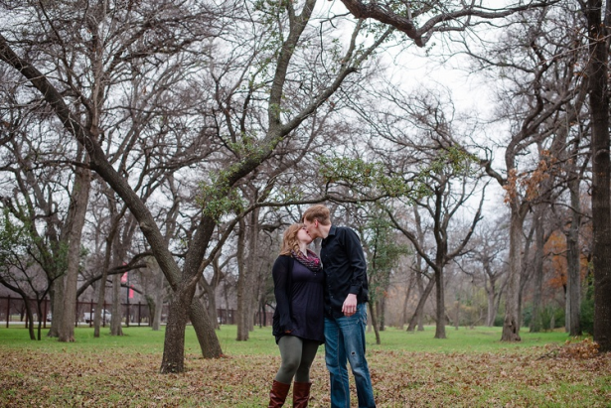
Spring

Slide 9

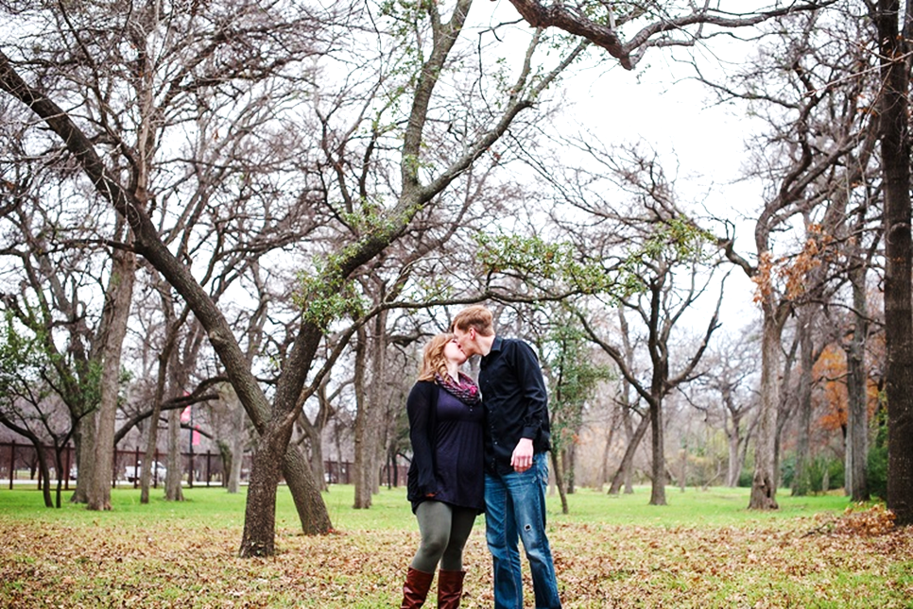



Slide 10
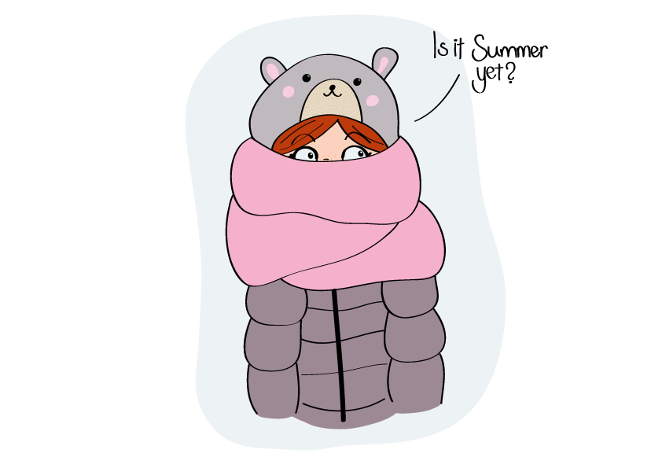
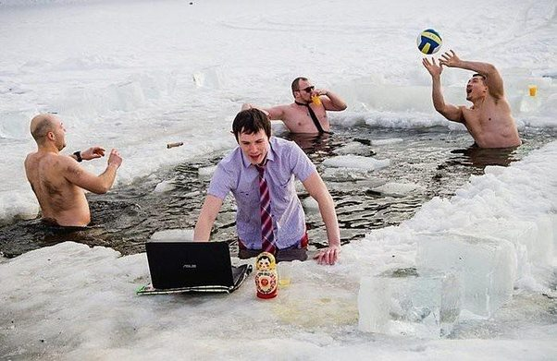
Summer

Slide 11
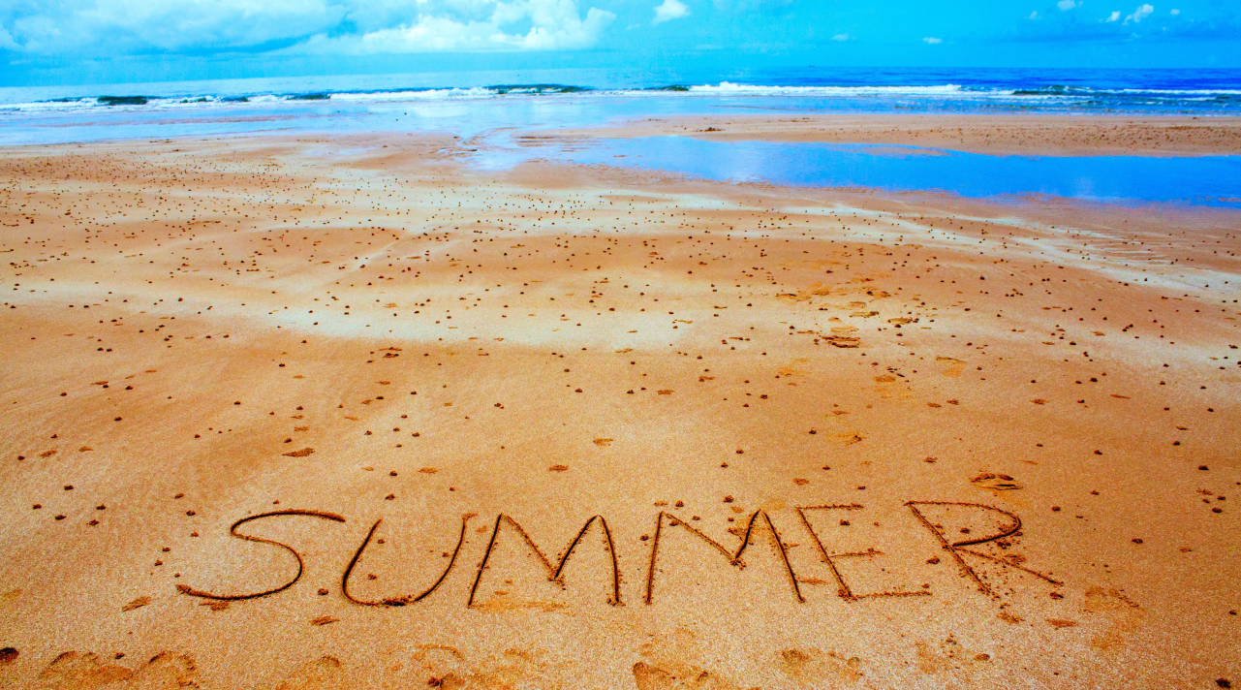

Slide 12
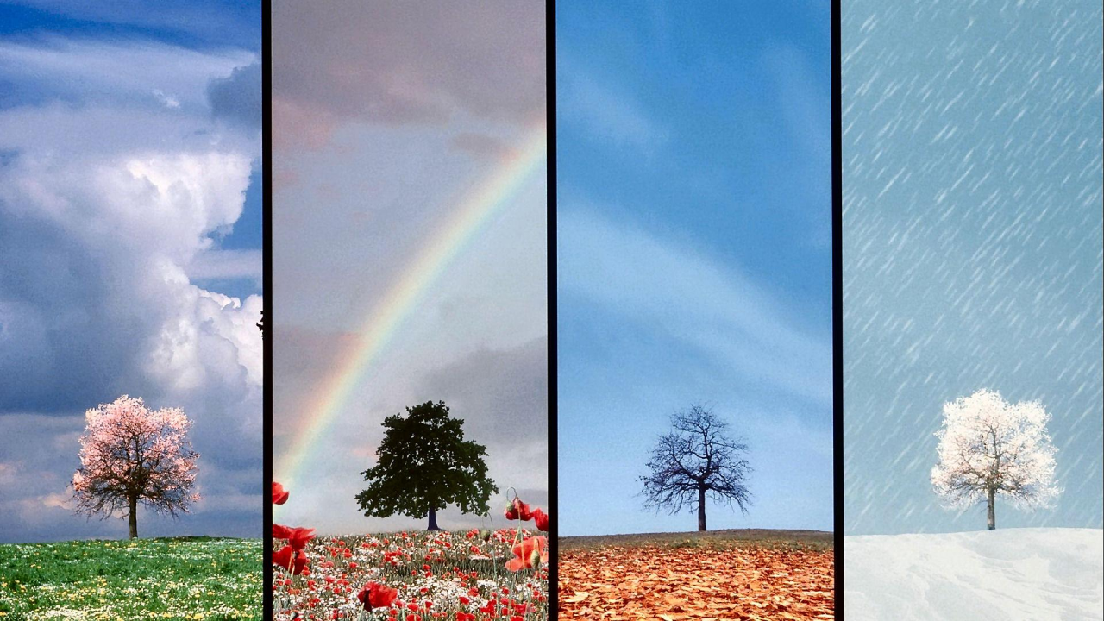
There is no such thing as
BAD WEATHER,
only BAD CLOTHING

