Slide 1
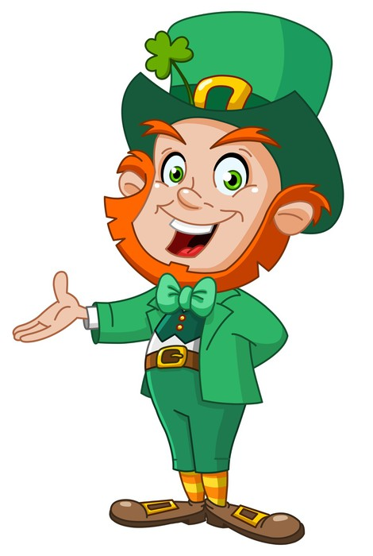

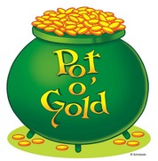
LEPRECHAUN’S
QUIZ

Slide 2

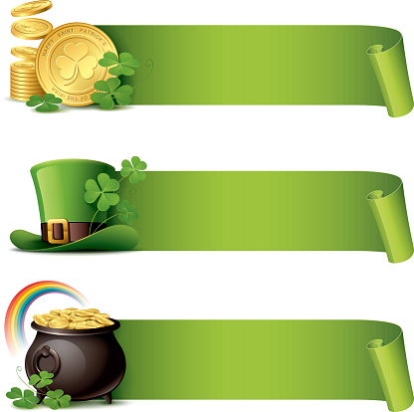

1. What Ireland is a part of the United Kingdom?
a) Northern Ireland
b) Southern Ireland
c) Central Ireland

Slide 3
2. Who is a patron saint of Ireland?
a) St. George
b) St. Andrew
c) St. Patrick

Slide 4
4. What is the capital of Northern Ireland?
a) Belfast
b) Dublin
c) Edinburgh

Slide 5
5. The Irish flag has the following colours: green, white and …?
a) red
b) blue
c) orange

Slide 6
6. What is a poetic name of Ireland?
a) Emerald Isle
b) Emerald Land
c) Green Isle

Slide 7
7. What creatures (according to the legend) has St. Patrick driven out of Ireland?
a) leprechauns
b) fairies
c) snakes

Slide 8
8. What was happened to St. Patrick when he was 16?
he was sold
into slavery
b) he was killed
c) he became the
patron saint of
Ireland

Slide 9
9. Why is St. Patrick’s day celebrated on March 17? On that day …
he arrived in
Ireland
b) he died
c) he drove all the
snakes away
from Ireland

Slide 10
10. Nowadays St. Patrick’s Day is celebrated …
a) all over the world
b) only in Ireland
c) only in the UK,
Ireland and the USA

Slide 11
11. St. Patrick was born in …
a) Wales
b) Ireland
c) Scotland

Slide 12
12. The official colour of St. Patrick’s Day is …
a) blue
b) green
c) orange

Slide 13
13. According to the legend St. Patrick used a shamrock to explain …
a) the Holy Trinity
b) the rebirth of
a spring
c) the cross

Slide 14
14. Irish jig is notable for its …
rapid hand
movements
b) rapid head
movements
c) rapid leg
movements

Slide 15
15. Irish jig was popularized by the world-famous “…” show
a) Riverdance
b) Patrickdance
c) Shamrockdance

Slide 16
16. What magic creatures are the symbols of St. Patrick’s Day?
a) elves
b) fairies
c) leprechauns

Slide 17
17. What does a leprechaun hide at the end of the rainbow?
a) a pot of sweets
b) a pot of gold
c) a pot of silver

Slide 18
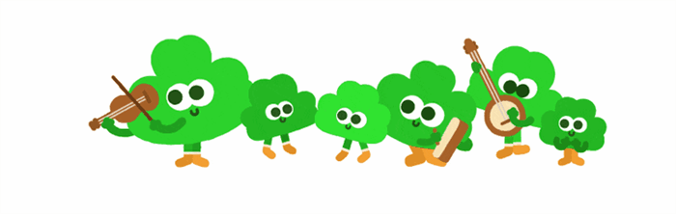
WELL DONE!

