Slide 1
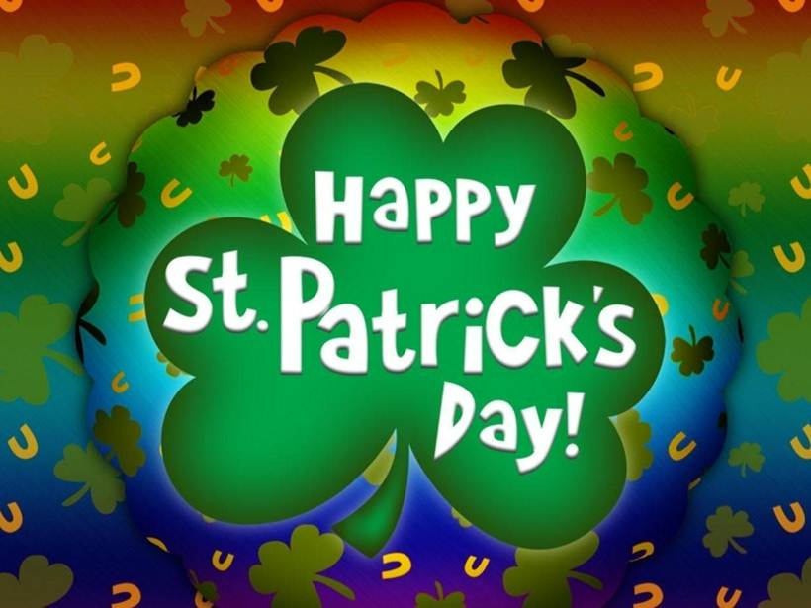

Slide 2
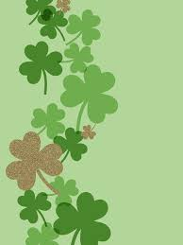
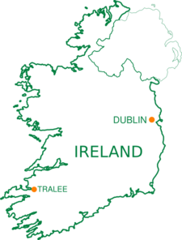

Ireland
Ireland is an island to the northwest of continental Europe
People who live in Ireland are called Irish
The capital of Ireland is Dublin

Slide 3
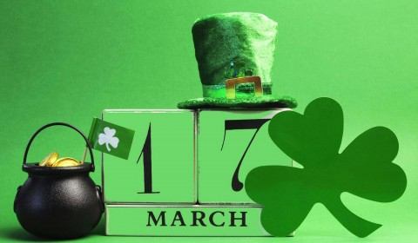
St. Patrick’s Day
St. Patrick’s Day is celebrated each year on March the 17th all over the world

Slide 4

Dublin celebrate
St. Patrick’s Day

Slide 5
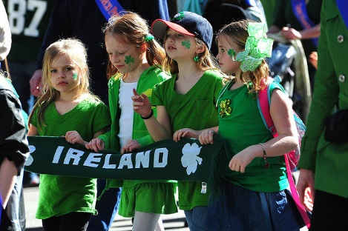
St. Patrick’s Day
St. Patrick’s Day is usually celebrated with a parade. The 1st parade in the USA was held in Boston in 1737

Slide 6
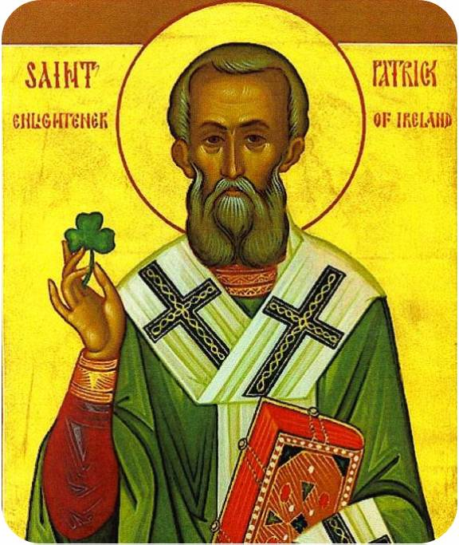
St. Patrick
St. Patrick is a patron of Ireland and a saint who brought Christianity to Ireland

Slide 7
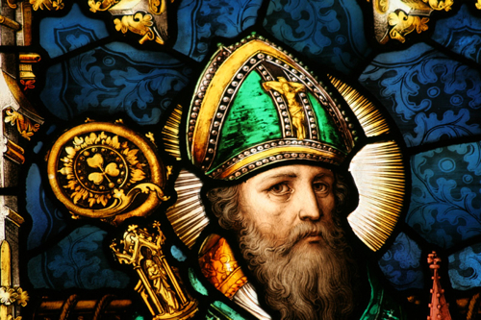
St. Patrick’s Life
St. Patrick was born in Wales in the year 385 and died on March the 17th around the year 460

Slide 8
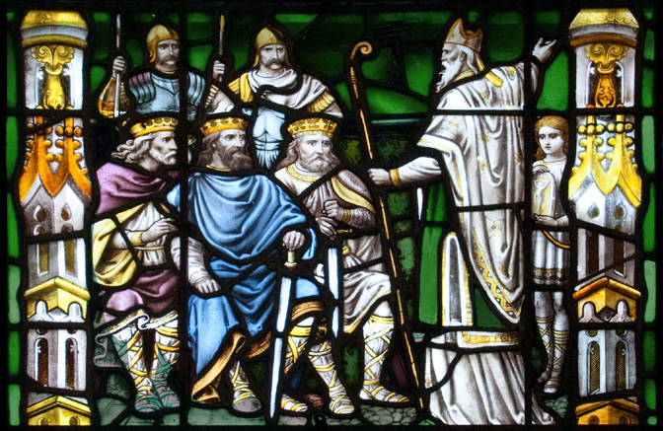
St. Patrick’s Life
At the age of 16 he was captured and sold into slavery in Ireland. He became a very devout Christian and spent 12 years in monastery

Slide 9
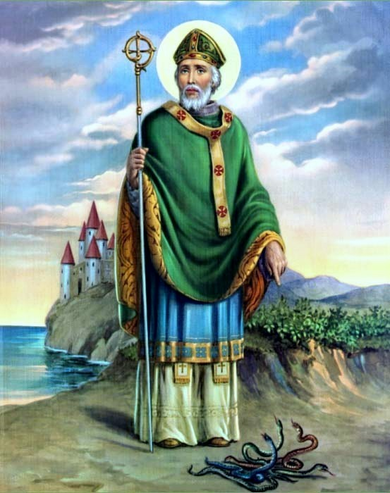
St. Patrick
According to the legend, St. Patrick drove all the snakes in Ireland out of the country

Slide 10
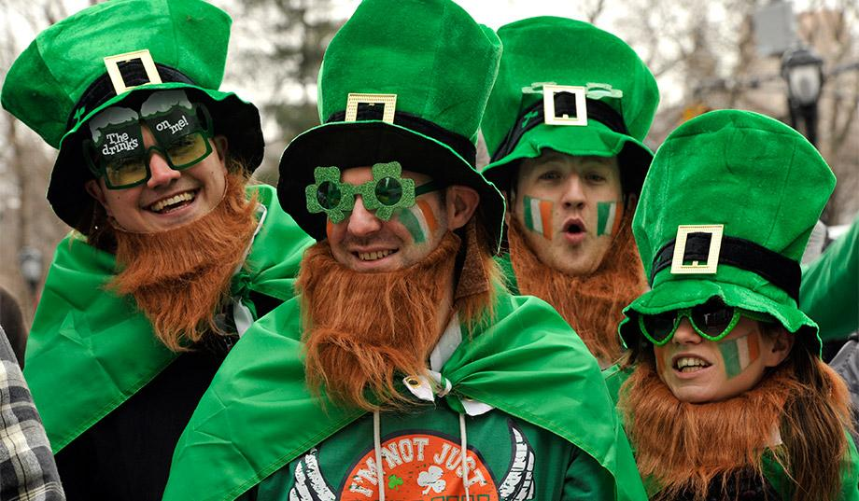
St Patrick’s Day
Green is official color of
Ireland. Ireland is called “Emerald Isle”

Slide 11
The World Goes Green

Slide 12
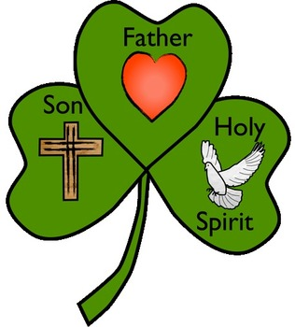
Shamrock
A shamrock is a three-leaved clover
St Patrick used the shamrock to explain the Holy Trinity

Slide 13
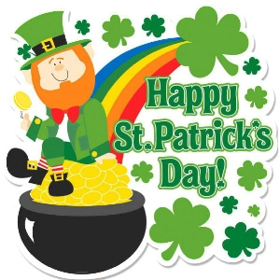
Leprechaun and a pot of gold
Leprechauns are tiny people dressed in green
Leprechauns collect pots of gold
They hide pots of gold at the end of the rainbow

Slide 14
Irish River Dance

Slide 15
Crossword
1
2
3
4
5
6
7
8

Slide 16
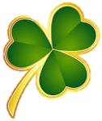
St. Patrick’s Day blessings
May the leprechauns be near you
To spread luck along the way !
Wherever you go and whatever you do,
May the luck of the Irish be there with you!
Have a shamrocking day!
We're all Irish on St. Patrick's Day!
May you find the rainbow's end!

