Slide 1
REPORT FROM BLOCKADE LENINGRAD
(РЕПОРТАЖ ИЗ БЛОКАДНОГО
ЛЕНИНГРАДА)

Slide 2
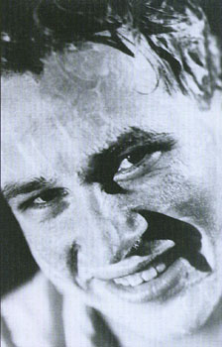
War Correspondent SERGEY STRUNNIKOV

Slide 3
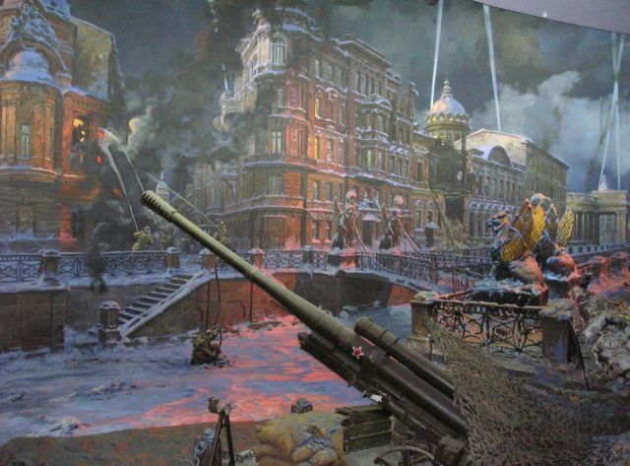
Diorama “Leningrad Blockade”

Slide 4
Pronounce the sounds and read the words with them
[ b ]
break
broke
blockade
[ m ]
mortar
mine
aim
[ t ]
tank
troops
torment
[ s ]
starve
siege
city
[ f ]
photo
front-line
fascists
[ p ]
portion
polyclinics
capture

Slide 5
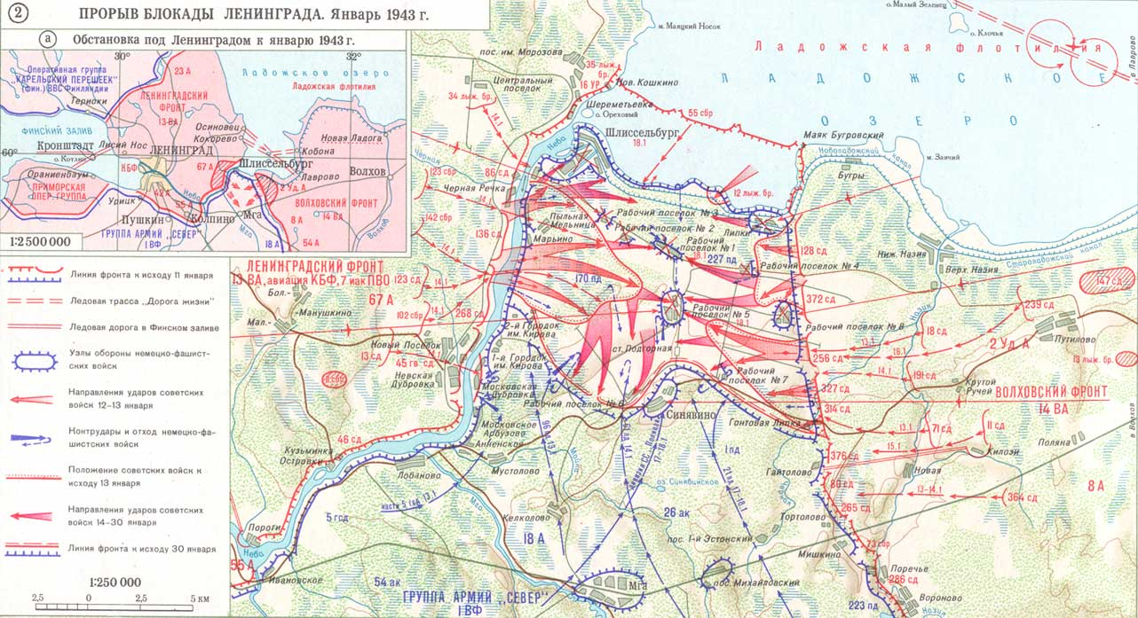

Slide 6
On 27 June 1941, the Council of Deputies of the Leningrad administration organized «First response groups» of civilians. In the next days the entire civilian population of Leningrad was informed of the danger and over a million citizens were mobilized for the construction of fortifications.
From the beginning of the war until the siege lifting in January 1944 Leningrad citizens together with engineer troops of the Leningrad front line built 15 thousand pillboxes, dug 700 kilometers of anti-tank ditches, 25,000 kilometers of open trenches, made more than 100 barricades in streets and on squares to protect their city.
Artillery bombardment of Leningrad was carefully planned by fascists. Each aim had its number. Aim № 9, for example, was the Hermitage, № 69 – the F. Erisman Hospital, № 736 – a school in Baburinsky Lane.
Despite the extremely difficult life during the siege Leningrad people made and repaired more than 2000 tanks, 1 500 airplanes, produced 4 500 weapons, 12 000 mortars and 10 million shells and mines.

Slide 7
Starve
manufacture
Barricade
a narrow street
Hate
barrier
Produce
a short cannon for firing shells
A lane
blockade
Siege
dislike
A mortar
want to eat

Slide 8
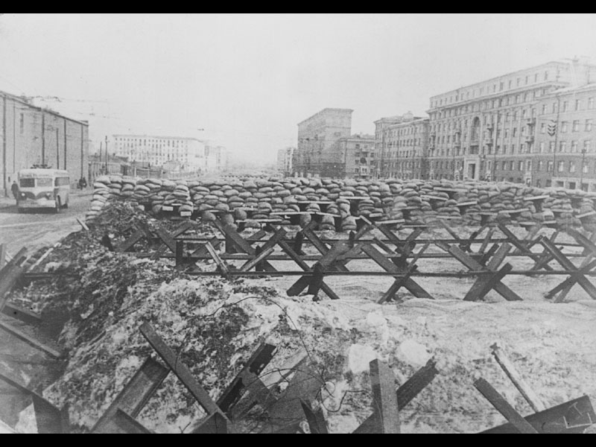
“Hedgehogs” were used to bar the streets of the near-the-front areas. They were made from reinforced concrete, tracks, stakes and barbed wire. S. Strunnikov took a picture of “hedgehogs” near the Kirov Factory. Here you can see one of the typical landscapes of Leningrad in Blockade.

Slide 9
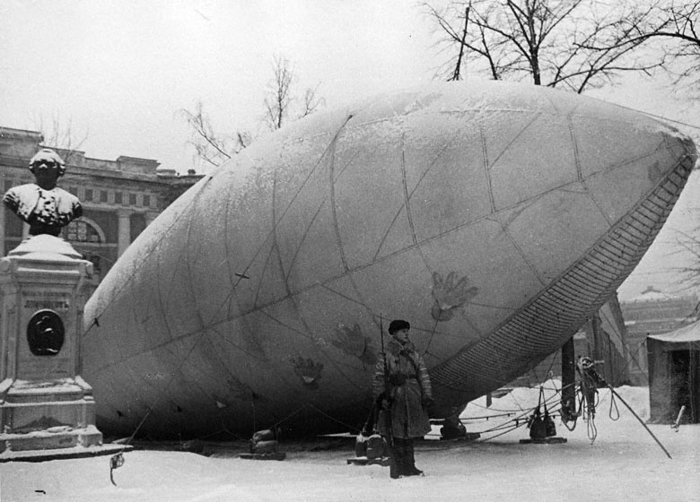
Awaiting the Signal
In December 1942 there were 150 functioning balloon posts. Balloon obstacles were used as subsidiary means of anti-aircraft defence. During the war balloons were raised more than 69 thousand times to prevent the enemy planes from aimed bombing.

Slide 10
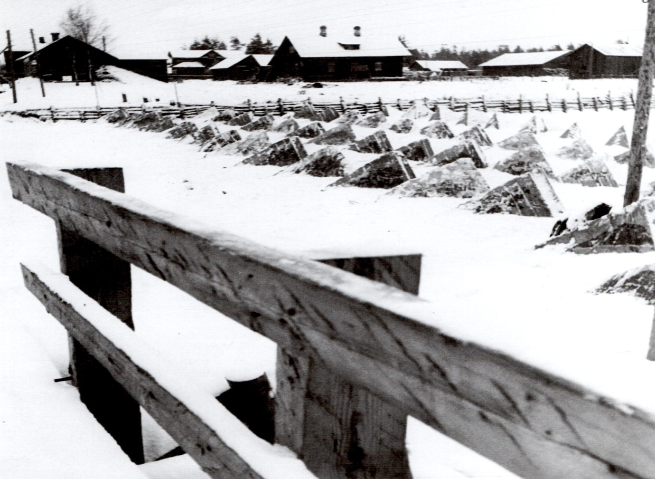
Defence constructions on the outskirts

Slide 11
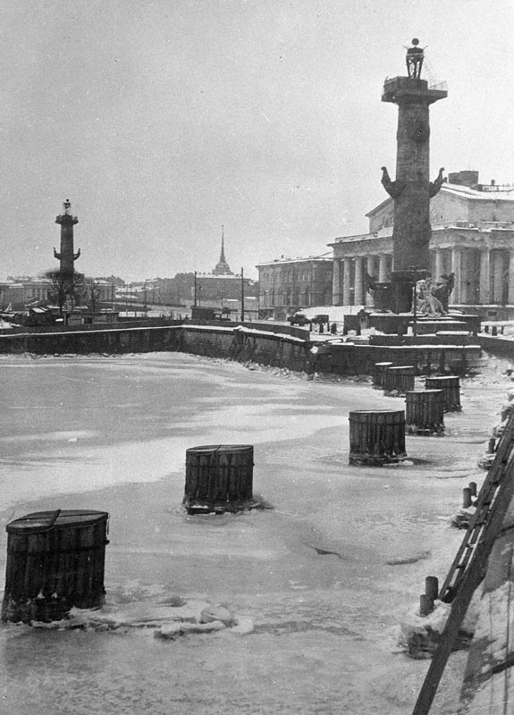
The Vassily Island Spit was bombed very often and in a most fierce way

Slide 12
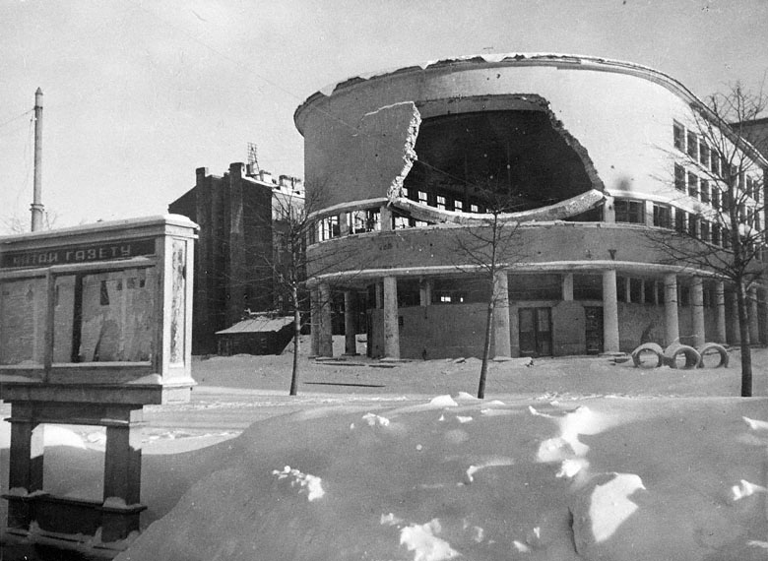
It is one of the destroyed schools of the city. All in all 22 school buildings were demolished, 393 were seriously damaged.
School № 52, Kirovsky District

Slide 13
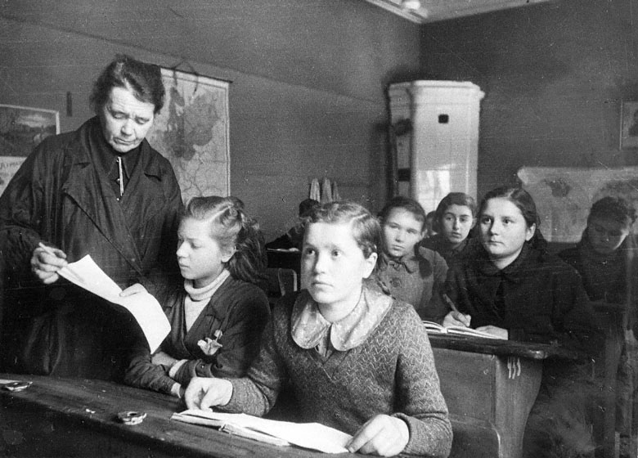
Lesson
In 1942 children in Leningrad studied in 124 schools

Slide 14
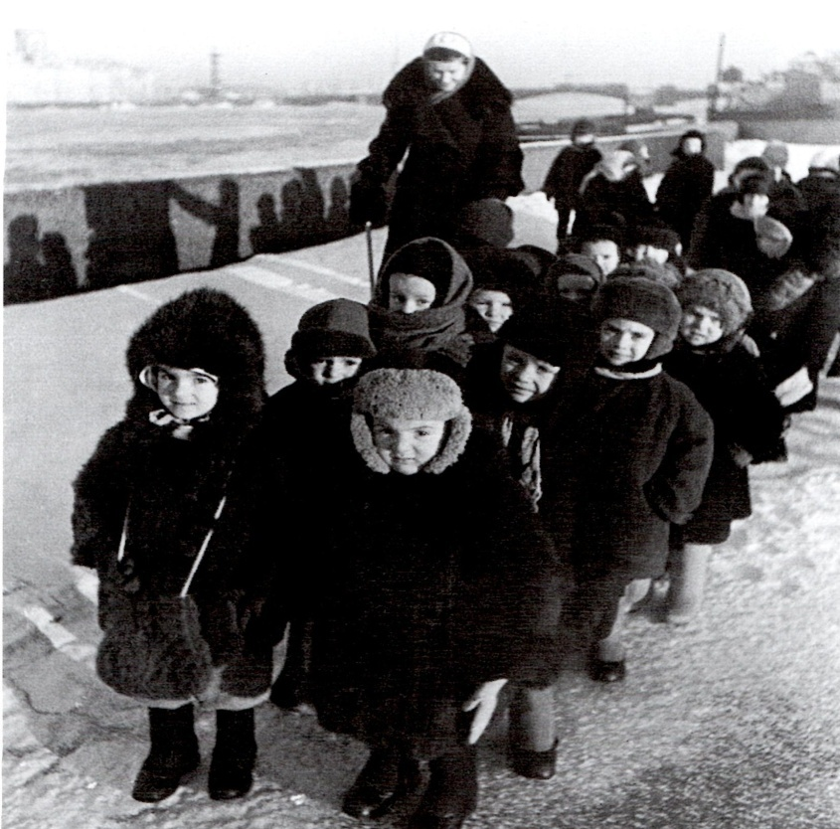
In 1942 more than 2 thousand homeless babies were delivered to infant’s homes and hospitals

Slide 15
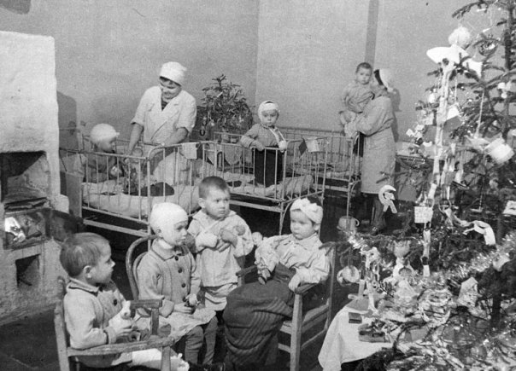
Doctor Rauchfus Hospital could admit 400 children hit by bombing and therapeutic patients

Slide 16
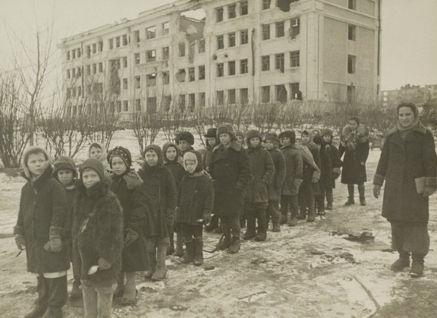
FUTURE GENERATION

Slide 17
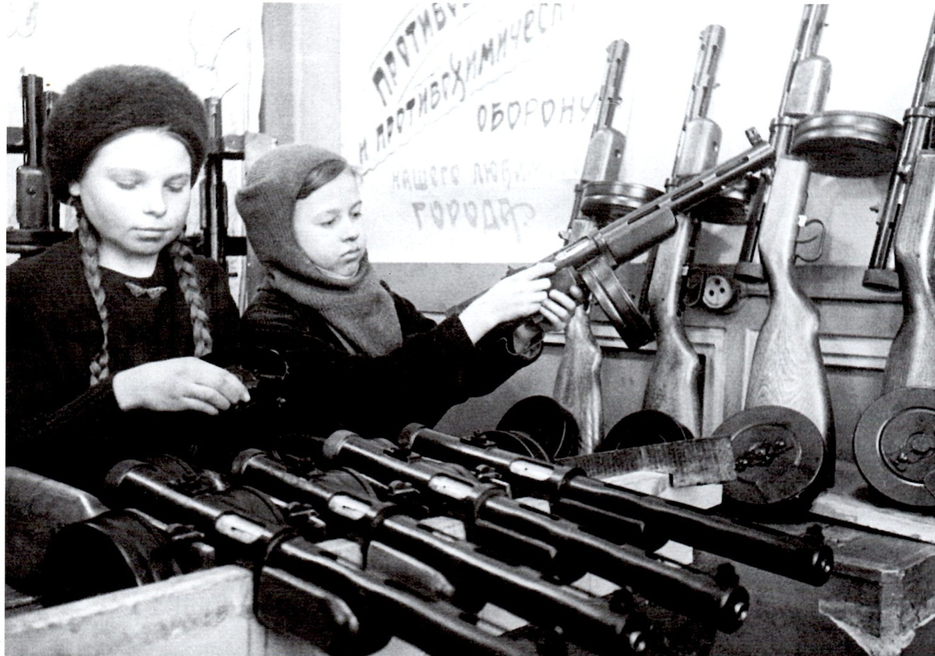
Together they are 30
Девочки-подростки Нина Николаева и Валя Волкова выполняют работы по сборке автоматов ППД.

Slide 18
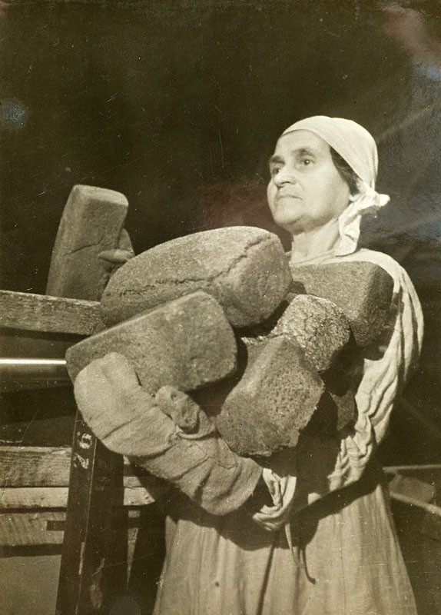
В декабре 1942 в Ленинграде действовали следующие дневные нормы выдачи хлеба населению в граммах:
рабочие горячих цехов – 700;
рабочие и инженерно-технические работники – 500;
иждивенцы - 300;
дети до 12 лет - 300.
Worker of Badaev Bakery №61 is packing bread in boxes to forward them to shops.
Bread is a central image in «A Leningrad Poem» by Olga Bergholz

Slide 19
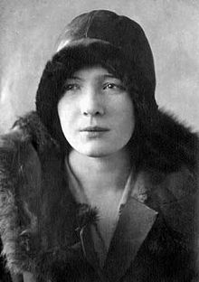
Olga Bergholz

Slide 20
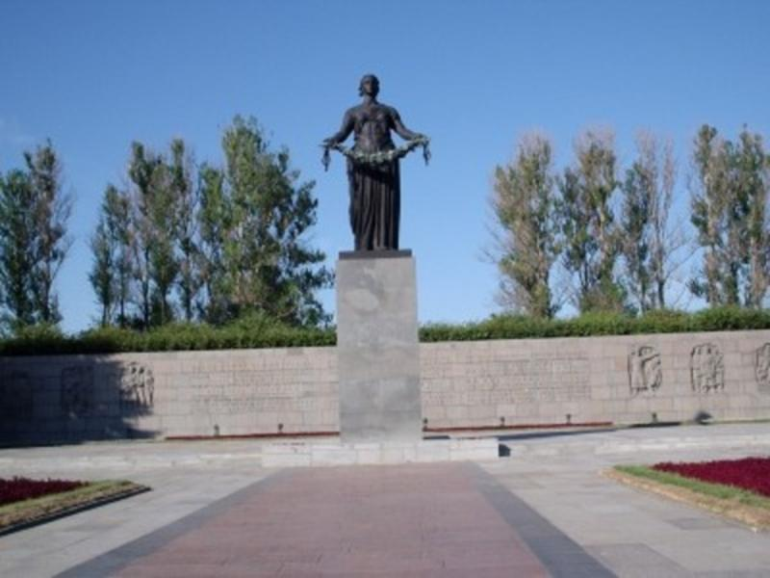
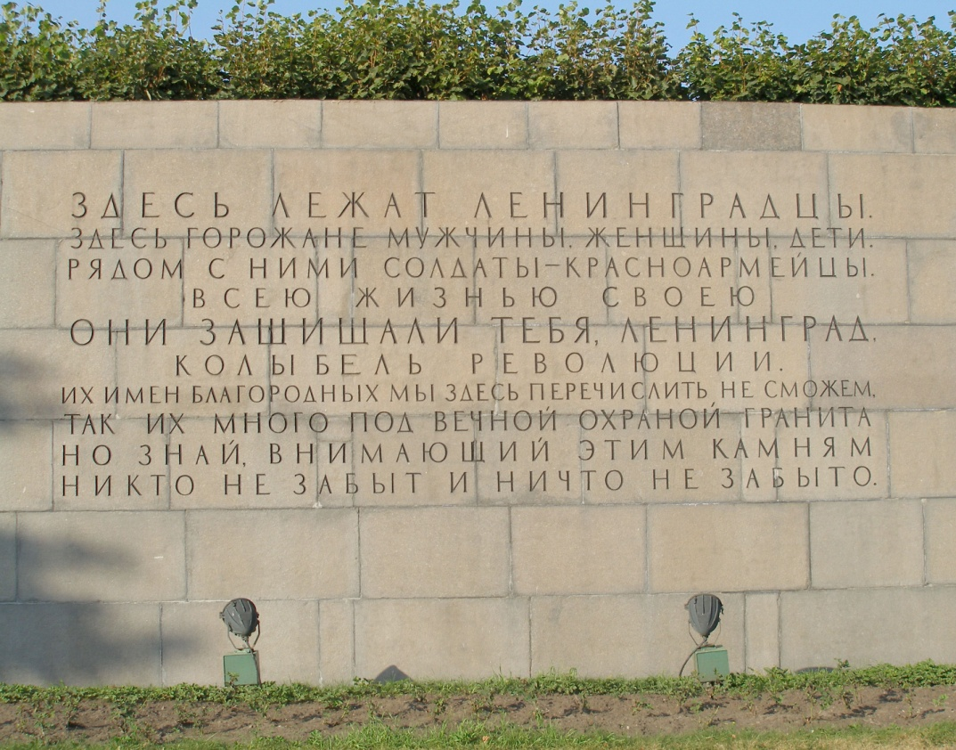
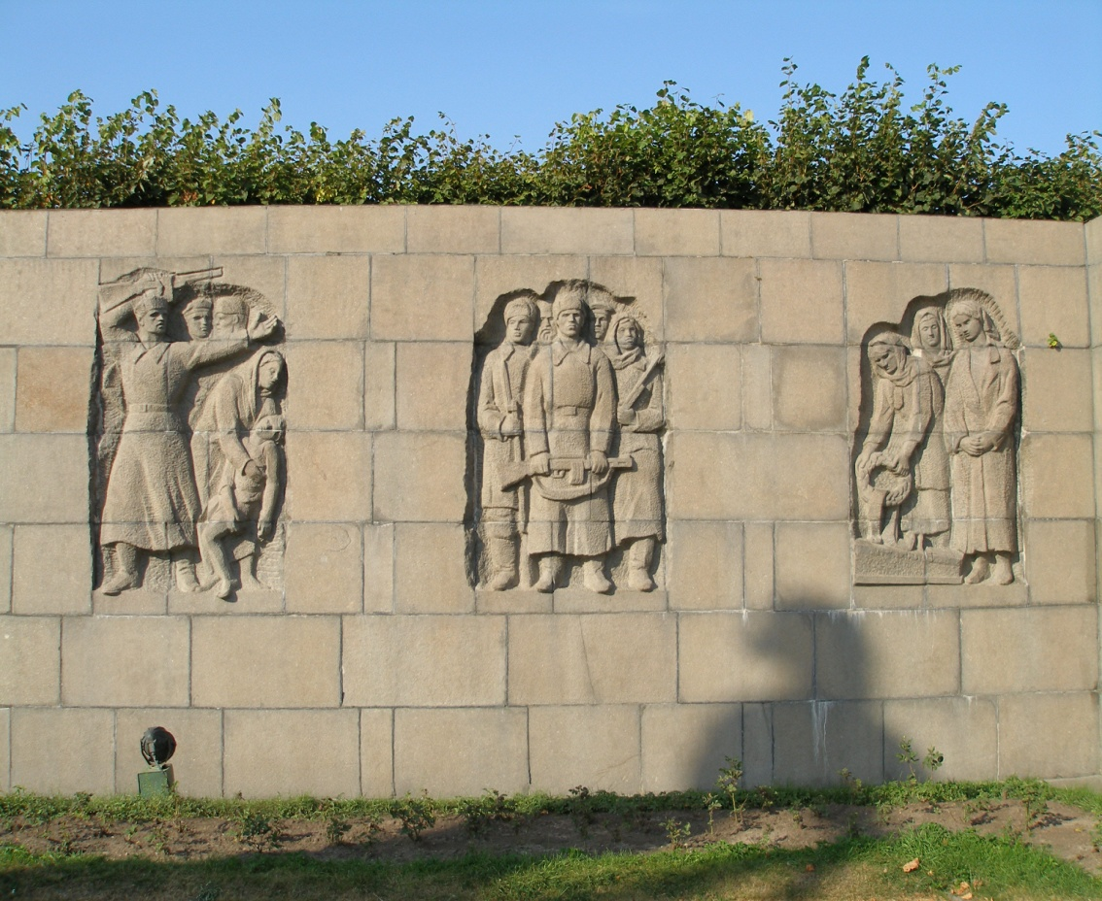
The Piskarev Memorial Cemeteryin St. Petersburg

