Slide 1
Ecological Problems

Slide 2
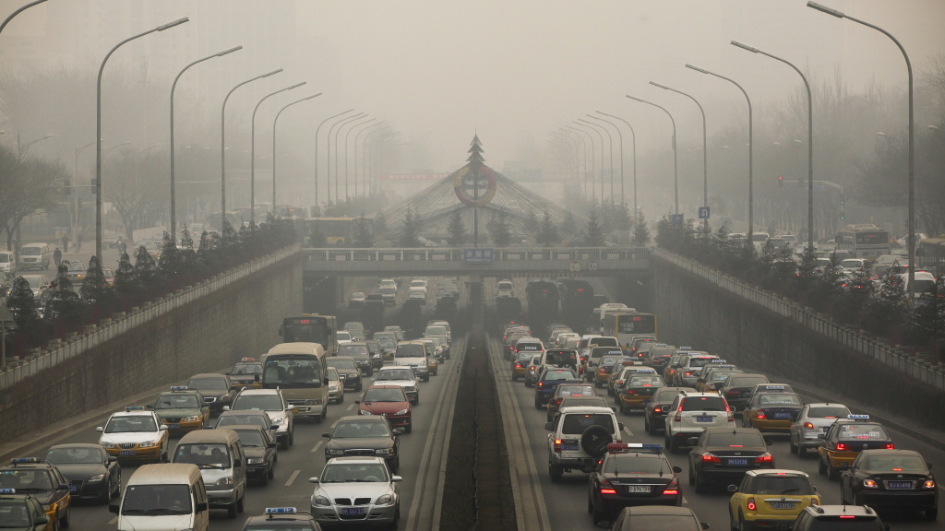
zxcbkasdbfbsdbf

Slide 3
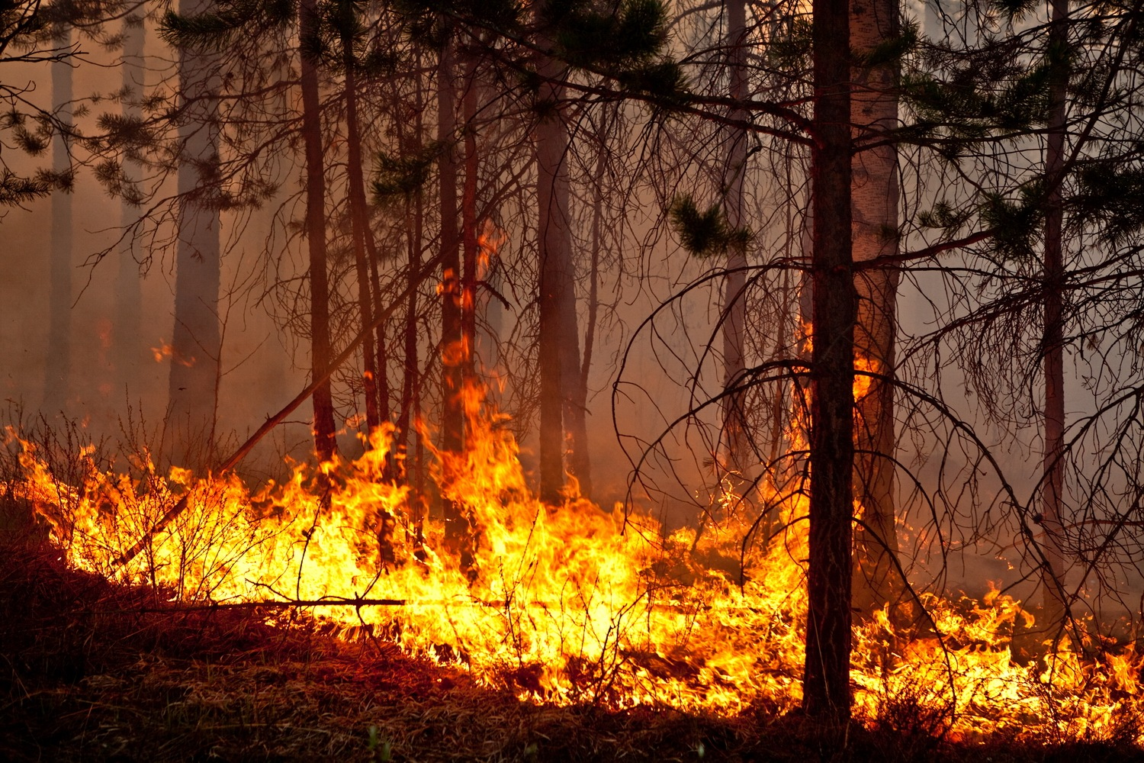

Slide 4
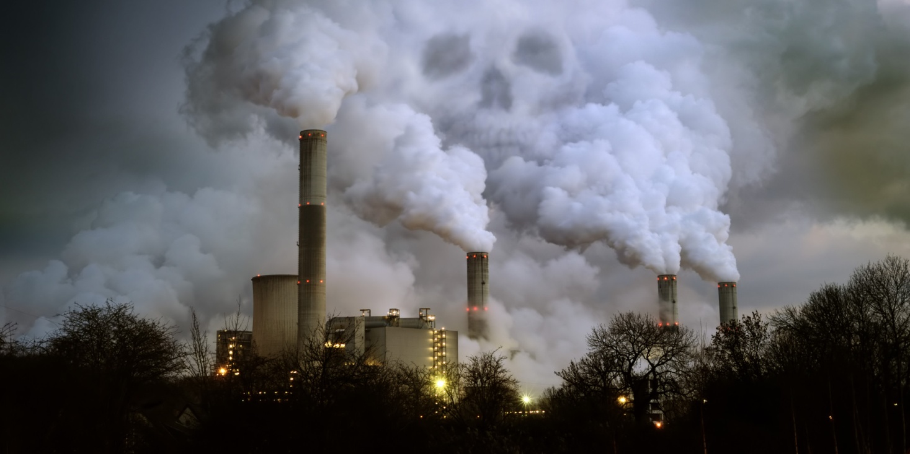

Slide 5
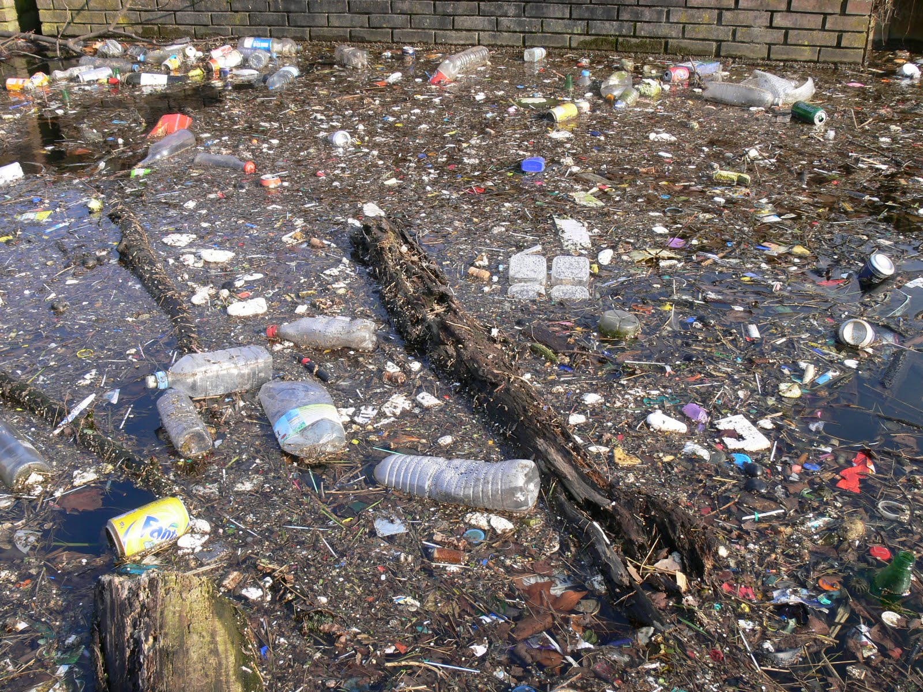

Slide 6
U.K: Conservation and the Environment
Going for a walk is the most popular leisure activity in Britain. Despite its high ------------- density, the UK has many unspoilt rural and coastal areas. Twelve National parks are free to the public and were created to conserve the ----------- beauty, wildlife and cultural heritage they contain.
Most of the land in National Parks is privately owned, but administrated by an independent National Park Authority which works to balance the expectations of ------------- with the need to conserve these open spaces for future generations.
The UK also works to improve the global environment and has taken global warming ------------------ ever since specialists discovered the hole in the ozone layer. In 1997, the UK subscribed to the Kyuto Protocol binding developed countries to reduce emissions of the six main greenhouse gases. The Protocol declares environmental -----------------.
Nowadays British ------------- are taking part in one of the largest international projects that is undertaken to protect endangered species.
SERIOUSLY, PROTECTION, NATURAL, VISITORS, SCIENTISTS, POPULATION

Slide 7


