Slide 1
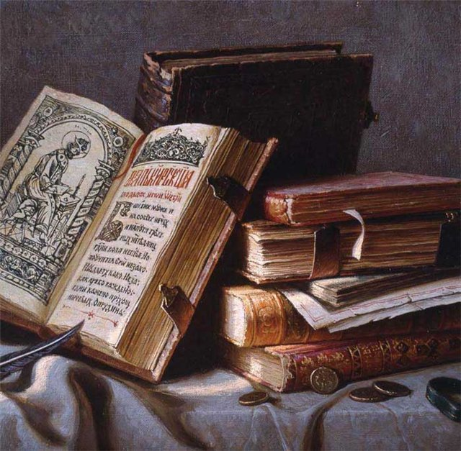
Reading in my life

Slide 2
People often speak about the books they
are reading or have read.
A novel
A historical novel
A war novel
An adventure novel
A romance
A fairy tale
A science fiction book
A biography
An autobiography
A classic
A detective story
A love story
An adventure story
A folktale
A (short) story
A humorous story
A horror story
A travel book
I like to read…
I am interested in…
I prefer reading…
My choice is…

Slide 3
Match the author to the books. Are there books in this list which you have read or heard about?Сan you say a few words about the book,the characters, the author and the plot.
1. Conan Doyle
Animal Farm
Jane Eyre
2. R.L. Stevenson
Treasure Island
I am the King of the Castle
3. Charles Dickens
The Fall of the House of Usher
4. Charlotte Bronte
5. George Orwell
Lord of the Flies
6. William Golding
The Adventures of Sherlock Holmes
The Hound of the Baskervilles
The lost World
7. Susan Hill
8. Edgar Allan Poe
9. Mark Twain
Oliver Twist
David Copperfield
Great Expеctations
The Adventures of Tom Sawyer
Life on the Mississippi

Slide 4
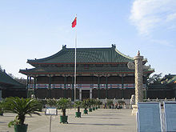
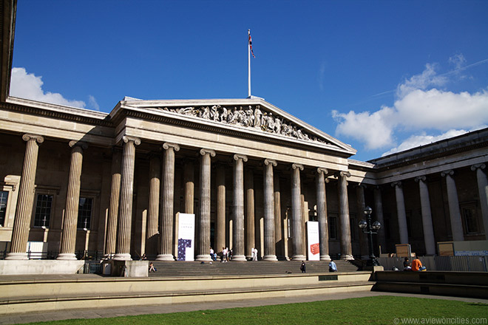
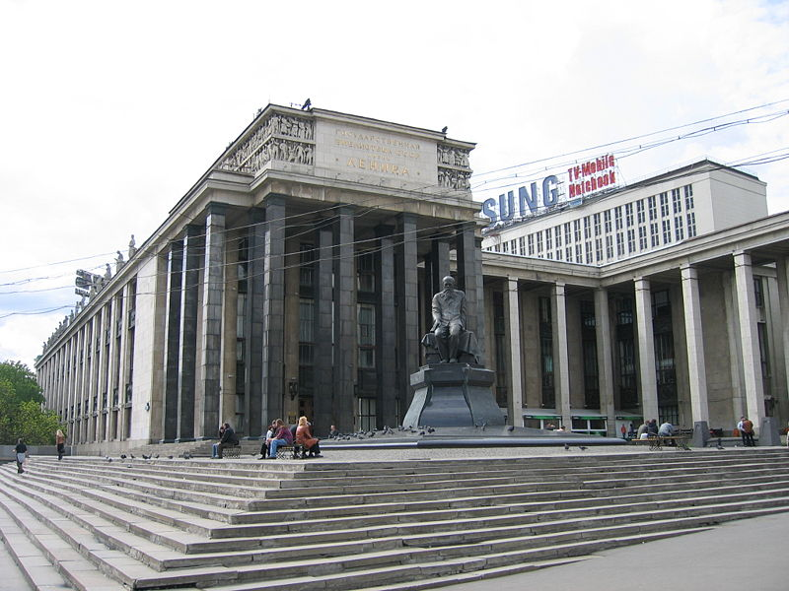
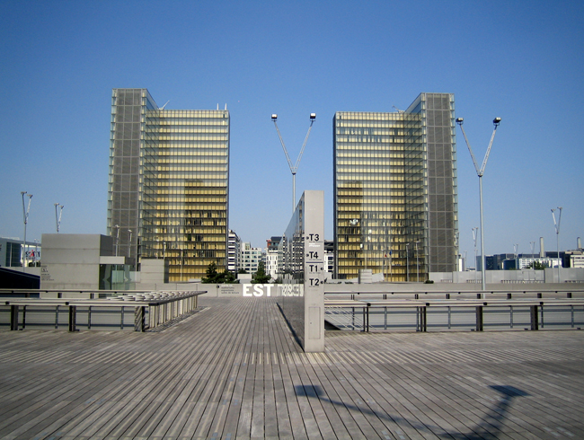
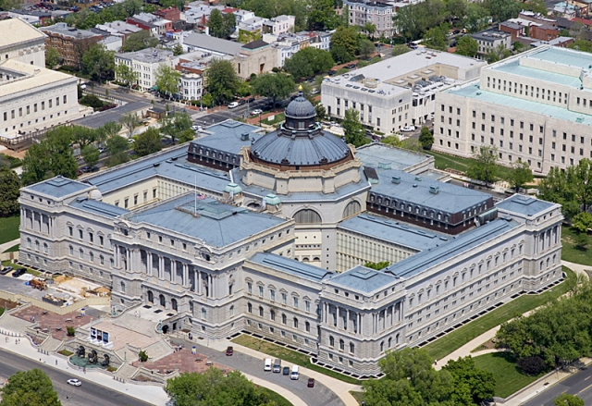

Slide 5
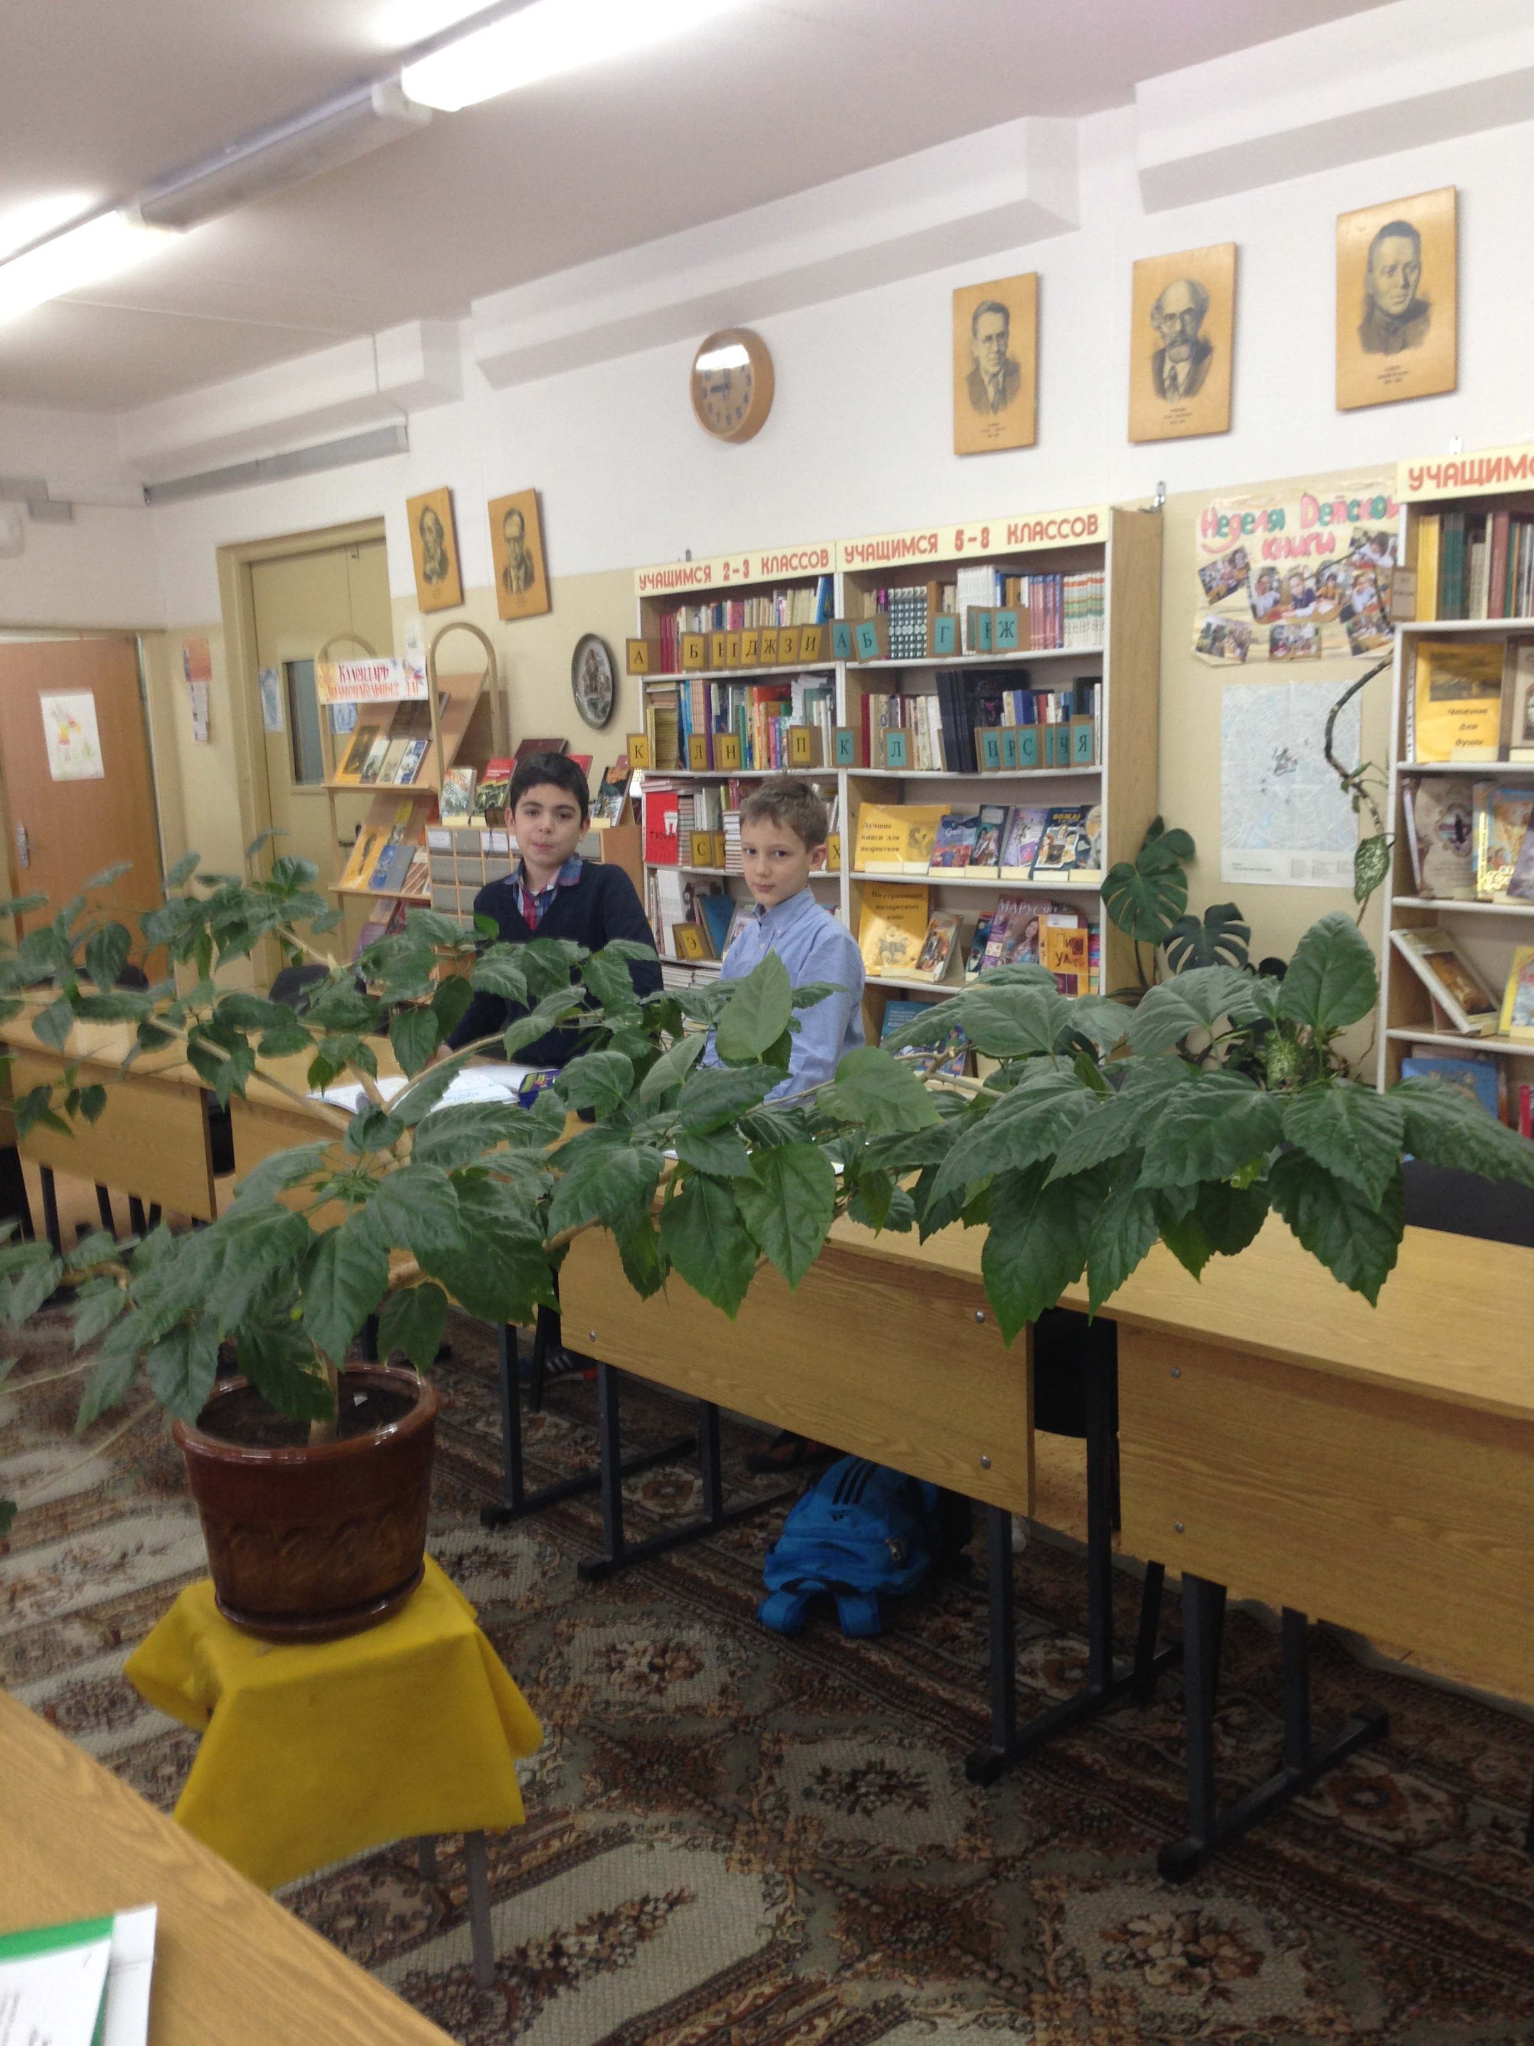
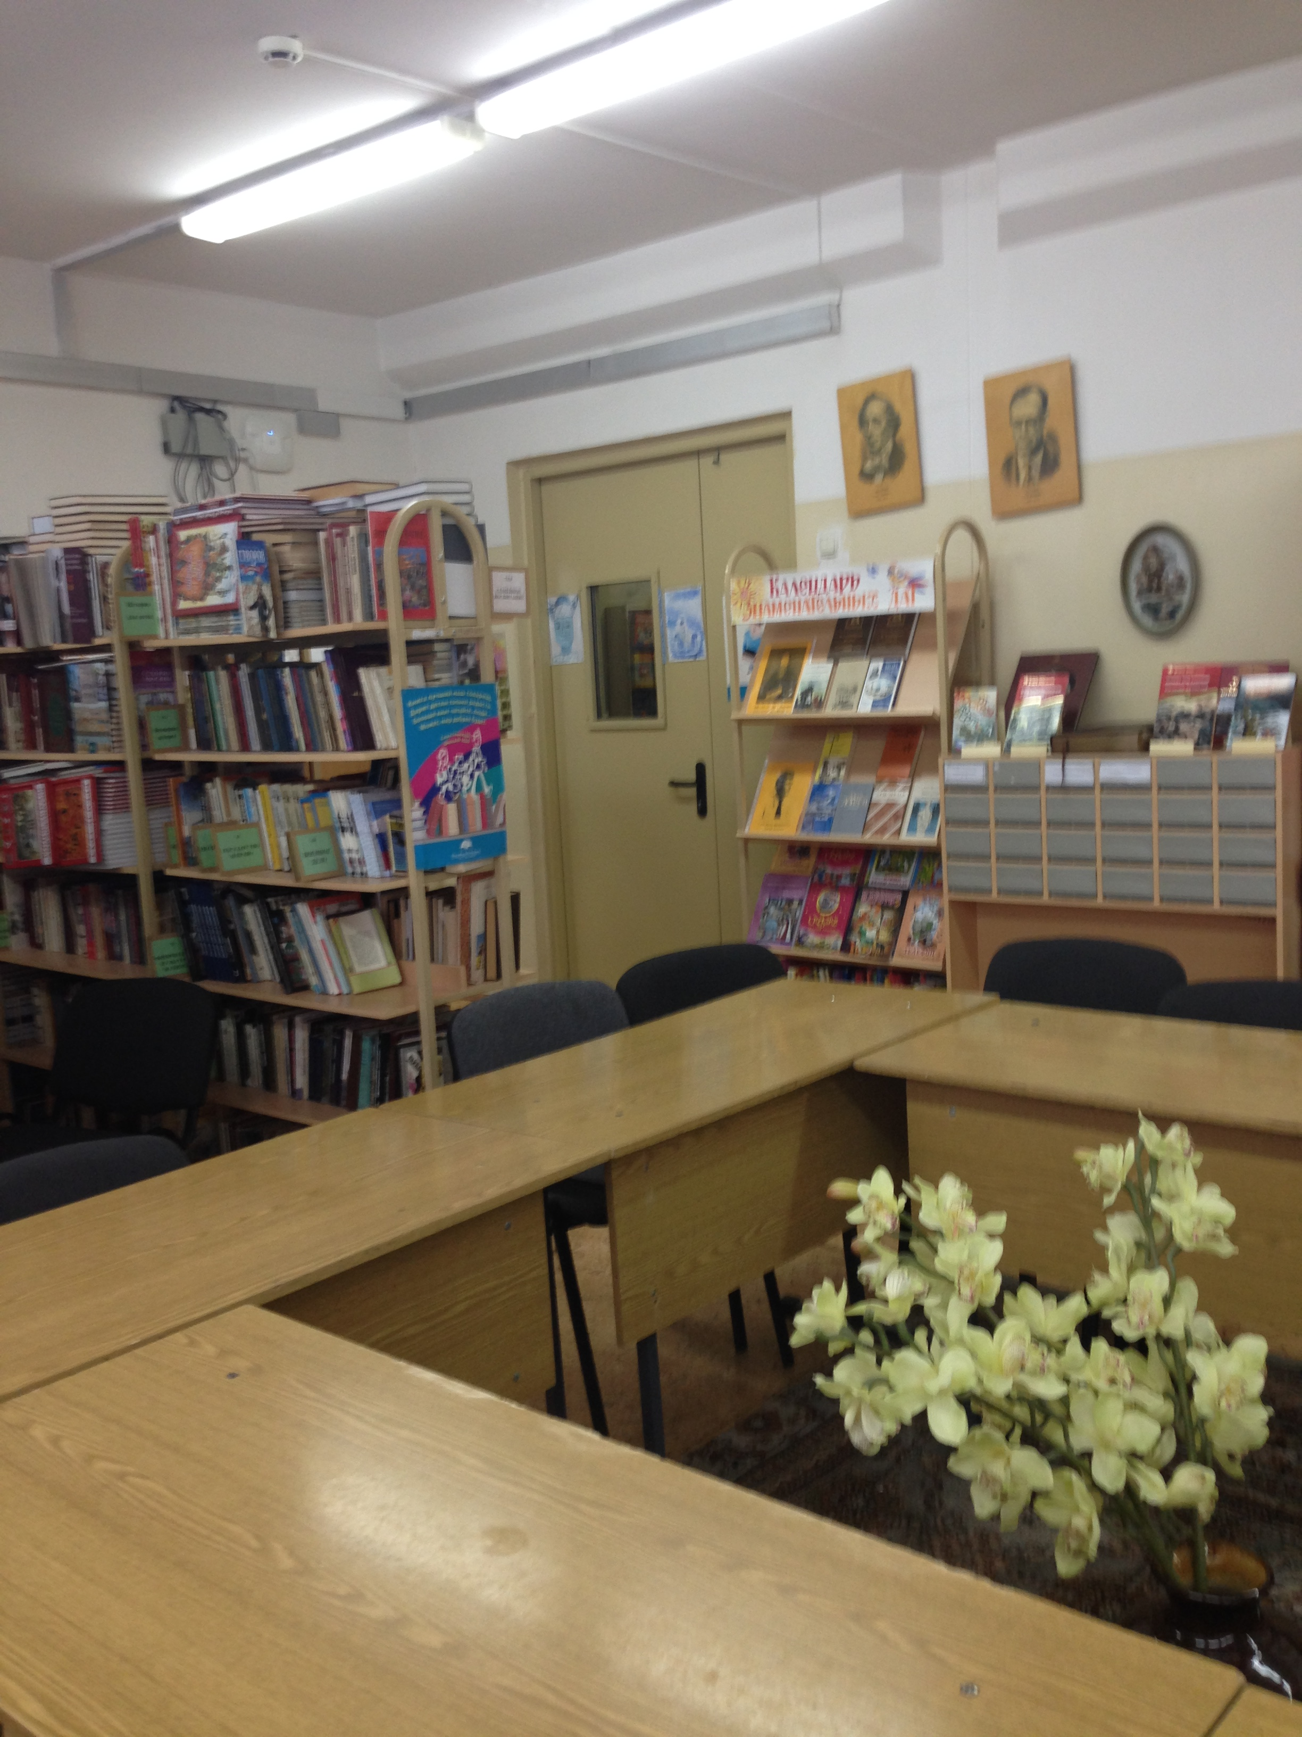
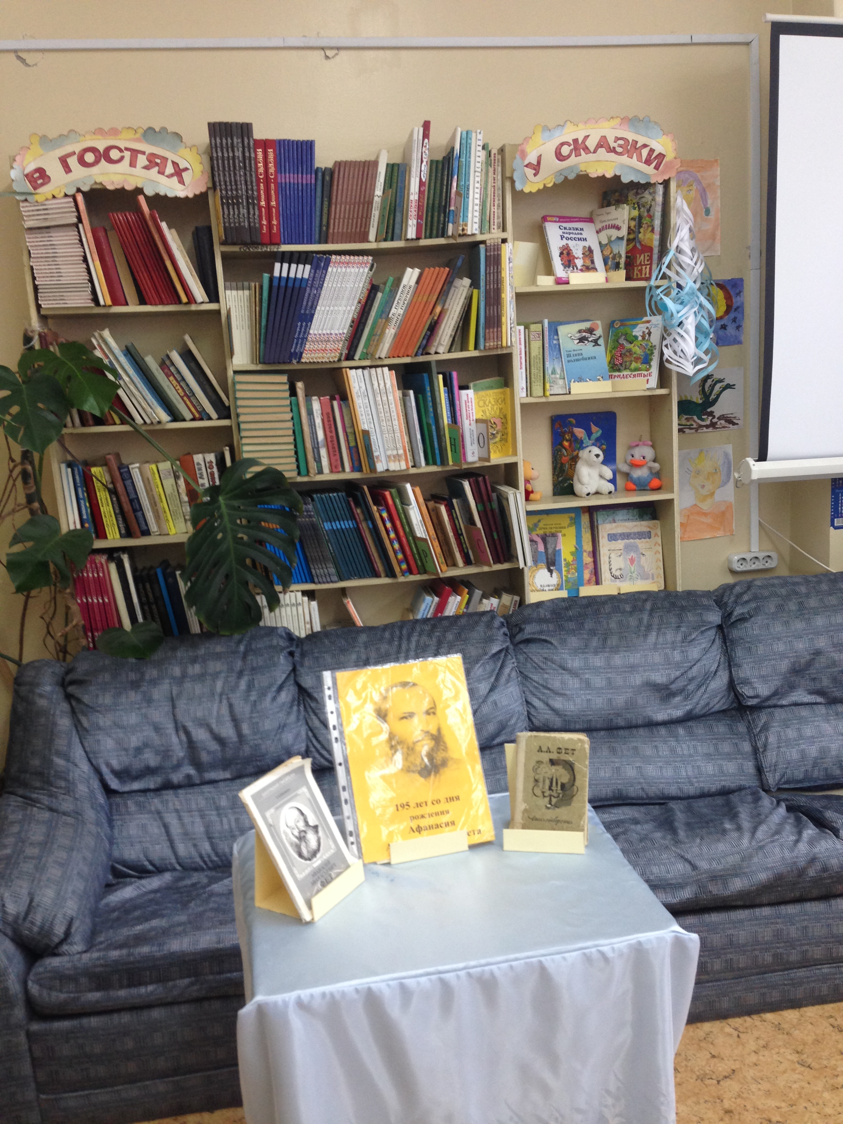
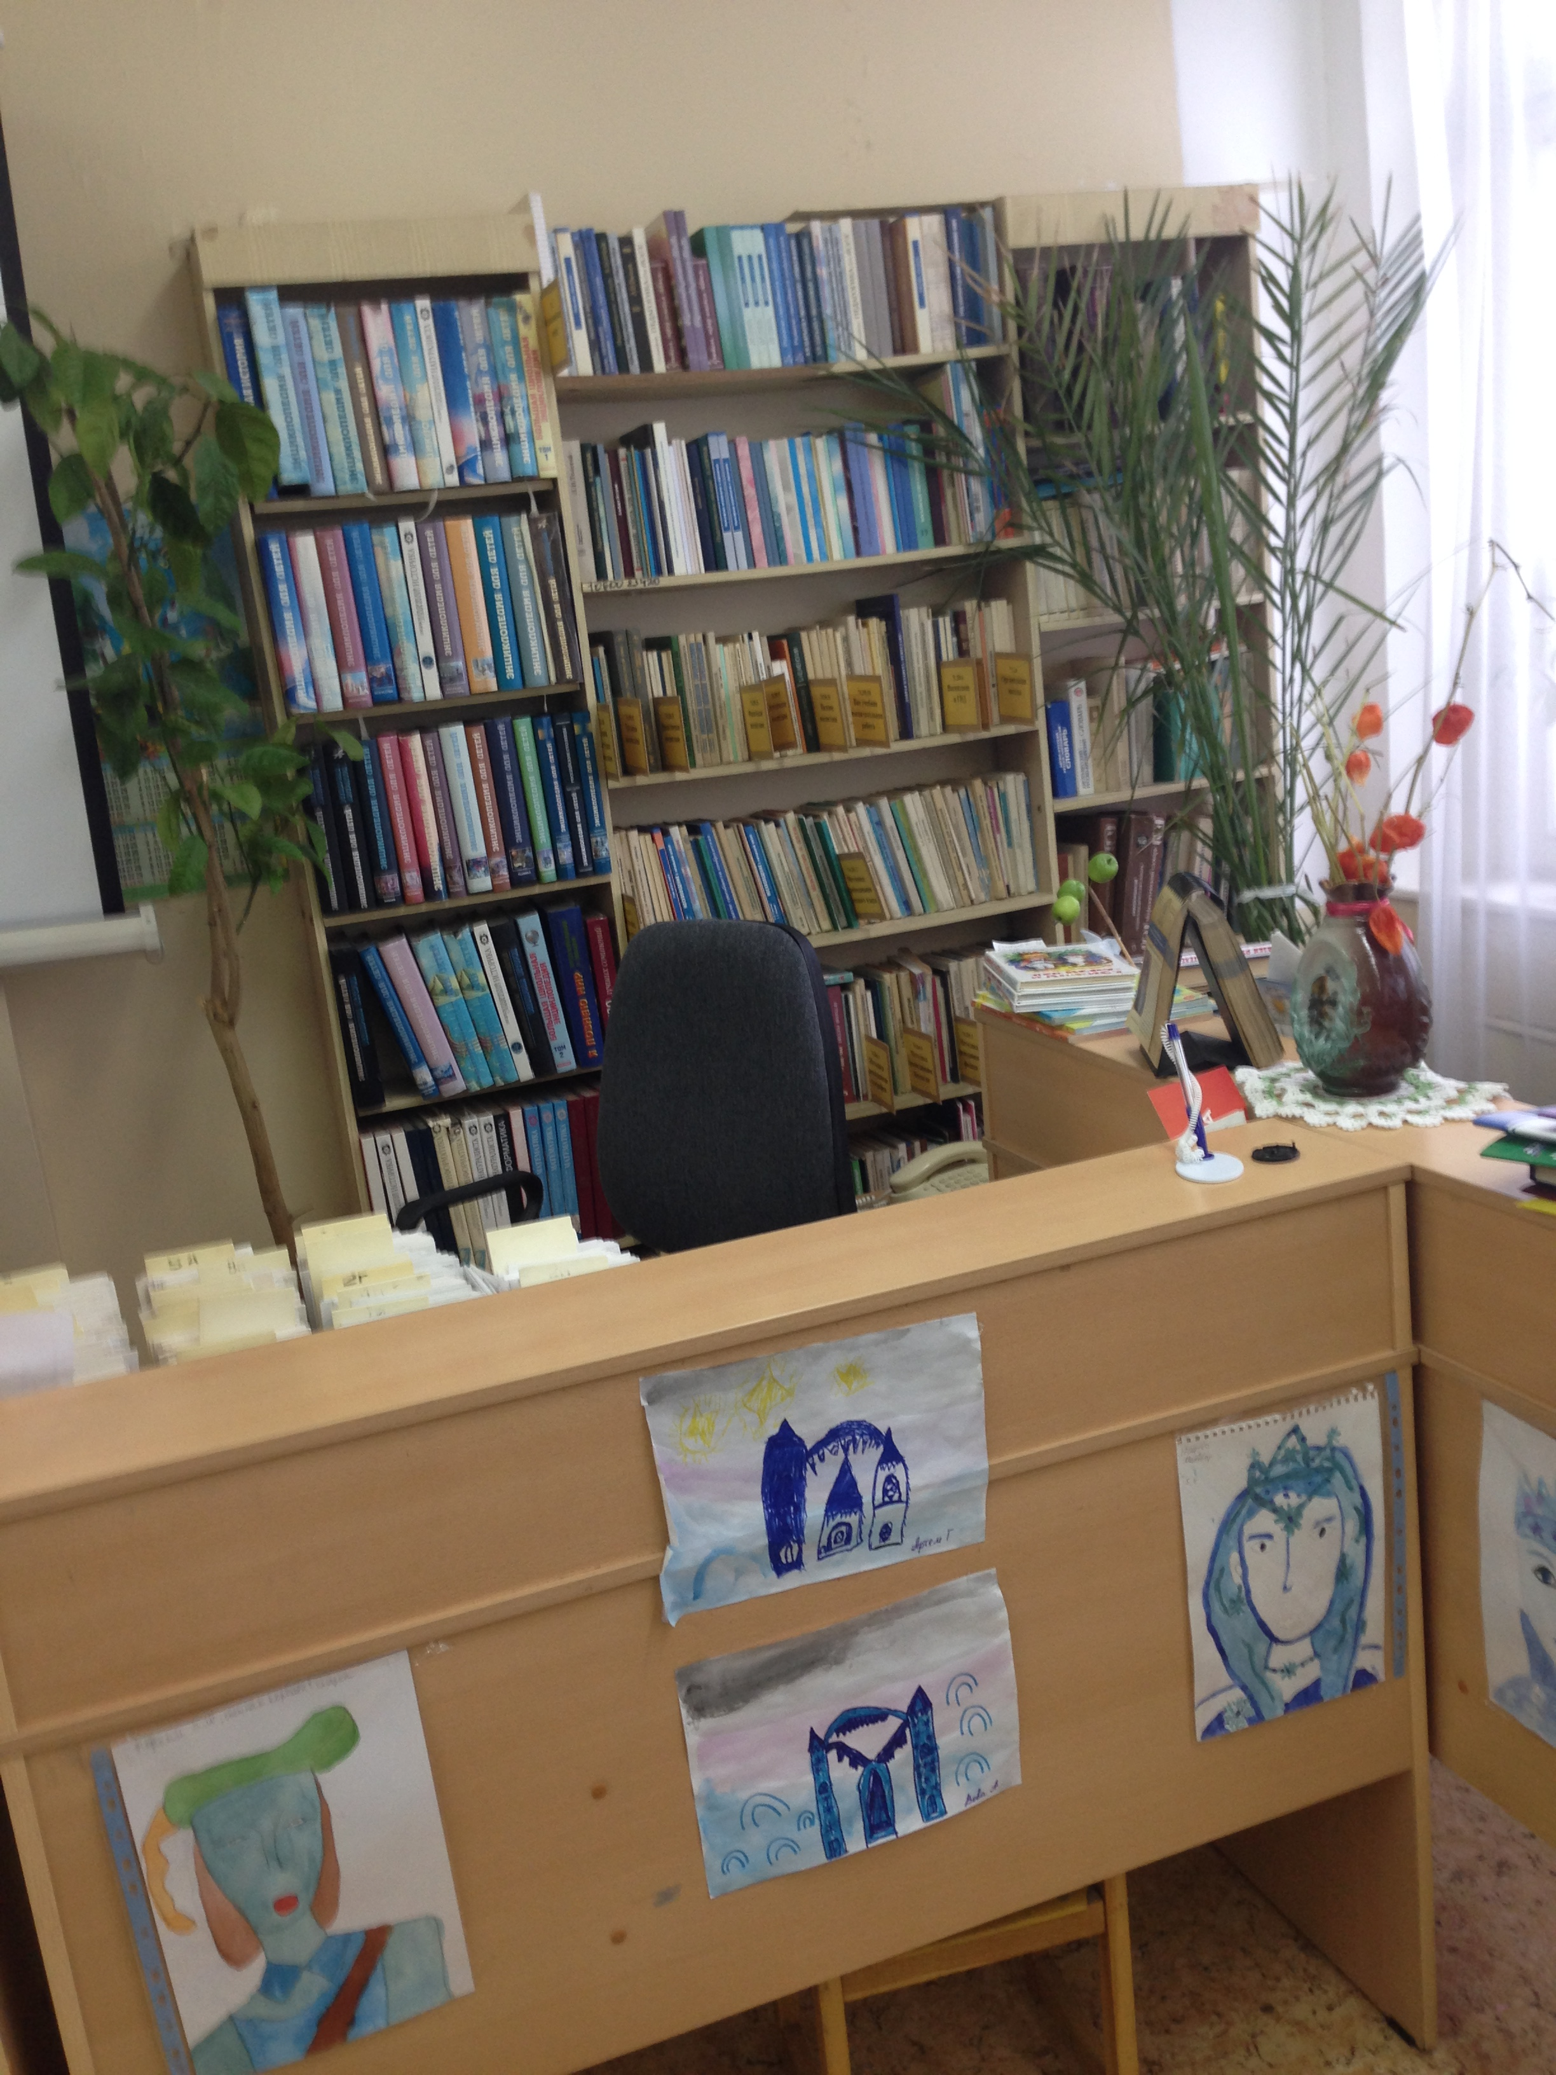

Slide 6
Give Your Opinion
Do children often visit libraries nowadays?
Why? (not)?
Use: I think…
I believe…
In my opinion…
Firstly, …
Secondly, …
Moreover, …
This way…

Slide 7

True False Not Stated
1. The Darling family lived in Scotland.
2. Mr Darling was fond of his children.
3. Mrs Darling was a very tall woman.
4. There were three kids in the family.
5. Nana was a small yellow dog.
6. The Darlings met Nana in summer.
7. Nana looked after the Darling children perfectly.
8. The Darling family lived a happy life before the arrival of Peter Pan.

Slide 8
True False Not Stated
1. The Darling family lived in Scotland.
2. Mr Darling was fond of his children.
3. Mrs Darling was a very tall woman.
4. There were three kids in the family.
5. Nana was a small yellow dog.
6. The Darlings met Nana in summer.
7. Nana looked after the Darling children perfectly.
8. The Darling family lived a happy life before the arrival of Peter Pan.

Slide 9
Make the story complete.
Use the appropriate forms of the words on the right.
There once was a little fish. He (1) one thousand and eight hundred brothers and sisters , all born at the same time. They (2) their parents and had to take care of (3). They (4) around happily in the sea. They had enough water to drink: they lived in the (5) ocean of the world.
There once was a little fish. He had one thousand and eight hundred brothers and sisters , all born at the same time. They didn’t know their parents and had to take care of themselves. They swam around happily in the sea. They had enough water to drink: they lived in the greatest ocean of the world.
1) have
2) not to know
3) they 4) swim
5) great

Slide 10
But one day...
Write your own ending of the story.

Slide 11
Do you believe in fairies?
B…
To prove that fairies exist and live everywhere around us
2. D…
There was a custom in some countries to leave something to eat and drink in the corners where
A…
Brownies in the bathroom, goblins in the kitchen and pixies in the bedroom upstairs
D…
Let’s try. The next time I’ve got a headache, I will remember to leave some milk in the corner of the bathroom.

Slide 12
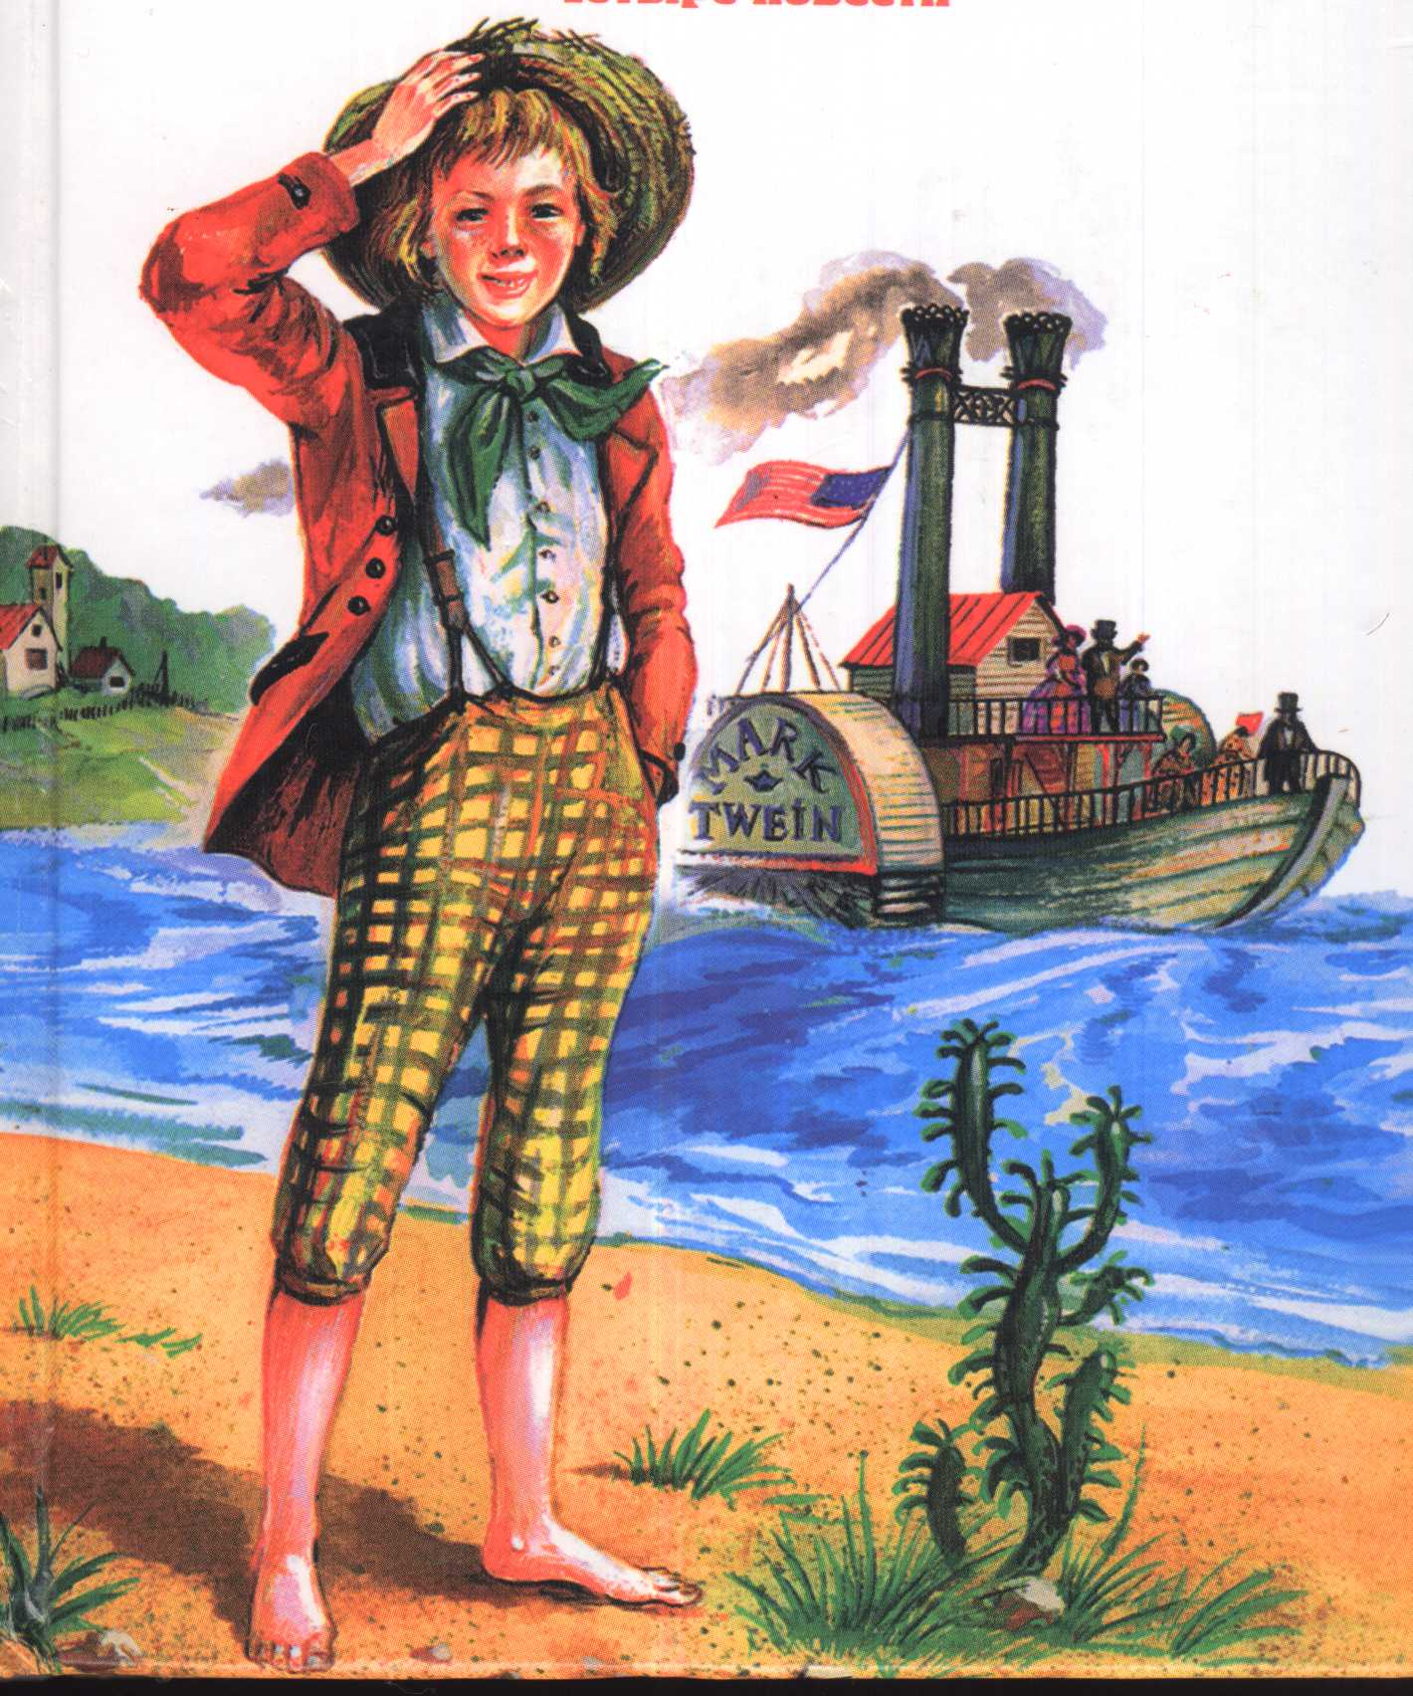
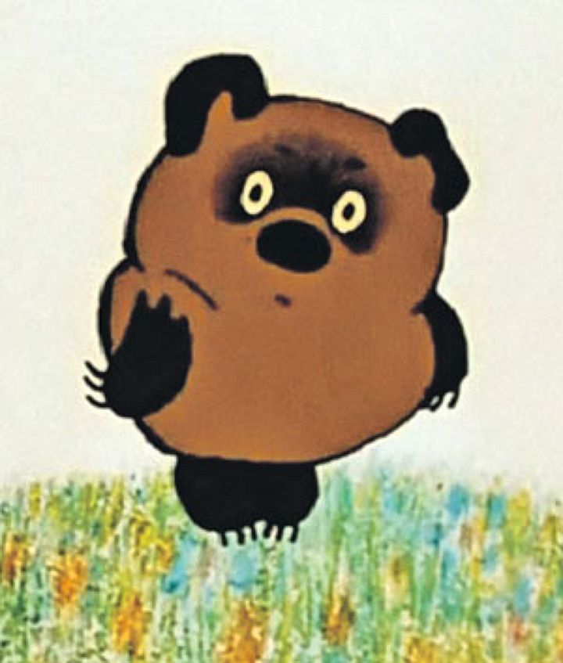
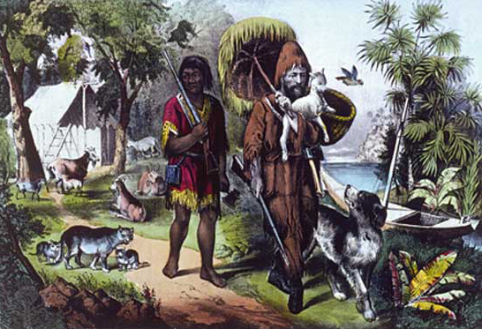

Slide 13
Continue the phrases...
Now I know ...
Now I can ...
I can’t ...
I don’t know ... but ...
I haven’t read…but..

Slide 14

WELL DONE!

