Slide 1
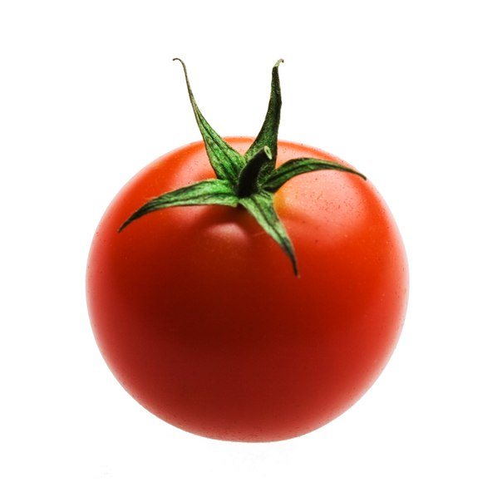

Slide 2
 |  |  |  |  |  | T | O | M | A | T | O

Slide 3
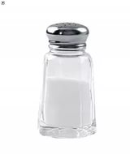

Slide 4
 |  |  |  |  |  | T | O | M | A | T | O
 |  |  |  |  | S | A | L | T

Slide 5
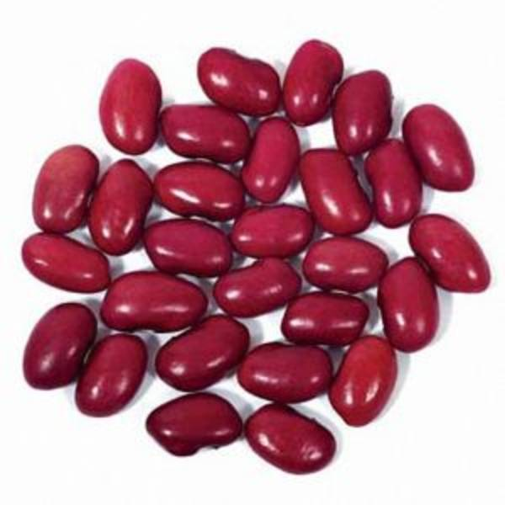

Slide 6
 |  |  |  |  |  | T | O | M | A | T | O
 |  |  |  |  | S | A | L | T
 |  | B | E | A | N | S

Slide 7
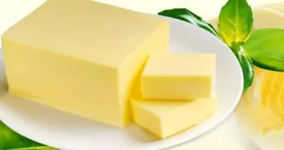

Slide 8
 |  |  |  |  |  | T | O | M | A | T | O
 |  |  |  |  | S | A | L | T
 |  | B | E | A | N | S
 |  |  |  | B | U | T | T | E | R

Slide 9
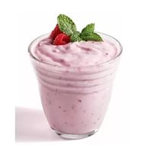

Slide 10
 |  |  |  |  |  | T | O | M | A | T | O
 |  |  |  |  | S | A | L | T
 |  | B | E | A | N | S
 |  |  |  | B | U | T | T | E | R
 |  |  |  |  |  | Y | O | G | U | R | T

Slide 11
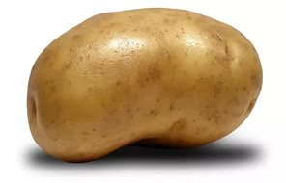

Slide 12
 |  |  |  |  |  | T | O | M | A | T | O
 |  |  |  |  | S | A | L | T
 |  | B | E | A | N | S
 |  |  |  | B | U | T | T | E | R
 |  |  |  |  |  | Y | O | G | U | R | T
 |  |  |  | P | O | T | A | T | O

Slide 13
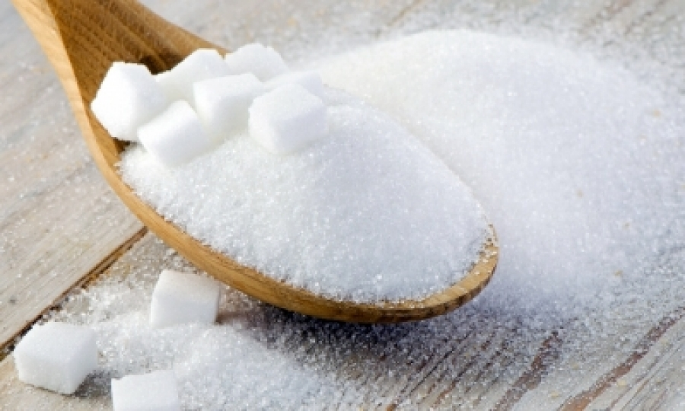

Slide 14
 |  |  |  |  |  | T | O | M | A | T | O
 |  |  |  |  | S | A | L | T
 |  | B | E | A | N | S
 |  |  |  | B | U | T | T | E | R
 |  |  |  |  |  | Y | O | G | U | R | T
 |  |  |  | P | O | T | A | T | O
 |  | S | U | G | A | R

Slide 15
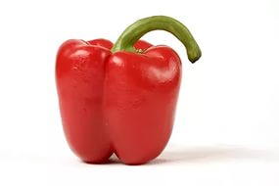

Slide 16
 |  |  |  |  |  | T | O | M | A | T | O
 |  |  |  |  | S | A | L | T
 |  | B | E | A | N | S
 |  |  |  | B | U | T | T | E | R
 |  |  |  |  |  | Y | O | G | U | R | T
 |  |  |  | P | O | T | A | T | O
 |  | S | U | G | A | R
 |  |  |  |  | P | E | P | P | E | R

Slide 17
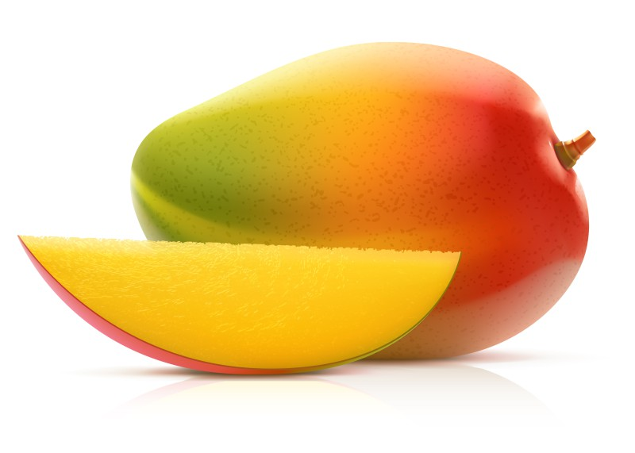

Slide 18
 |  |  |  |  |  | T | O | M | A | T | O
 |  |  |  |  | S | A | L | T
 |  | B | E | A | N | S
 |  |  |  | B | U | T | T | E | R
 |  |  |  |  |  | Y | O | G | U | R | T
 |  |  |  | P | O | T | A | T | O
 |  | S | U | G | A | R
 |  |  |  |  | P | E | P | P | E | R
 |  |  |  |  | M | A | N | G | O

Slide 19
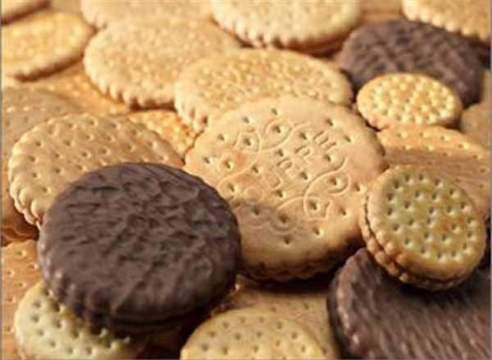

Slide 20
 |  |  |  |  |  | T | O | M | A | T | O
 |  |  |  |  | S | A | L | T
 |  | B | E | A | N | S
 |  |  |  | B | U | T | T | E | R
 |  |  |  |  |  | Y | O | G | U | R | T
 |  |  |  | P | O | T | A | T | O
 |  | S | U | G | A | R
 |  |  |  |  | P | E | P | P | E | R
 |  |  |  |  | M | A | N | G | O
B | I | S | C | U | I | T | S

Slide 21
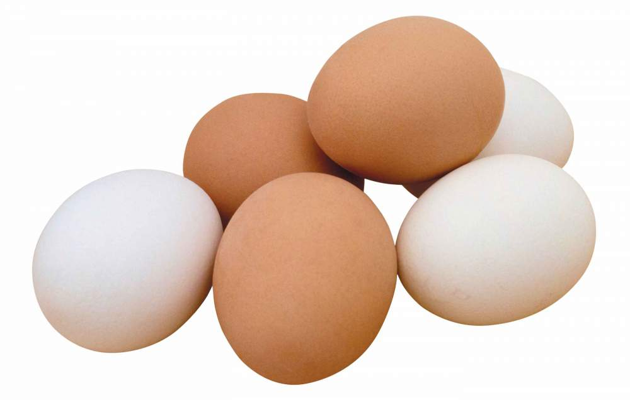

Slide 22
 |  |  |  |  |  | T | O | M | A | T | O
 |  |  |  |  | S | A | L | T
 |  | B | E | A | N | S
 |  |  |  | B | U | T | T | E | R
 |  |  |  |  |  | Y | O | G | U | R | T
 |  |  |  | P | O | T | A | T | O
 |  | S | U | G | A | R
 |  |  |  |  | P | E | P | P | E | R
 |  |  |  |  | M | A | N | G | O
B | U | S | C | U | I | T | S
 |  |  | E | G | G | S

Slide 23
“Four Red Apples on the Tree”.
Four red apples on the tree,
Two for you and two for me.
So shake that tree and
Watch them fall.
One, two, three, four - that is all.

Slide 24
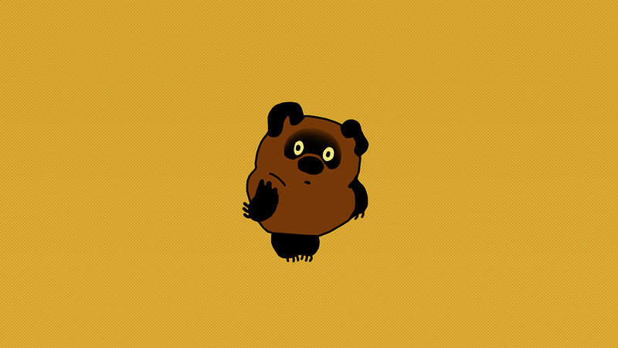
Winnie-the-Pooh

Slide 25
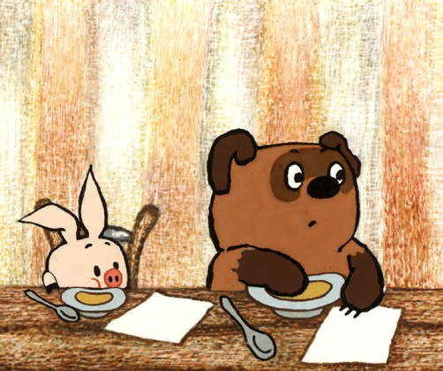
It’s fruit. It’s yellow. I drink tea with it. It’s yuck.

Slide 26
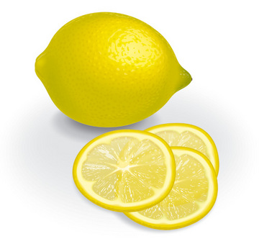
A LEMON

Slide 27
It’s white. I like to drink it. I drink it with biscuits. It’s yummy.

Slide 28
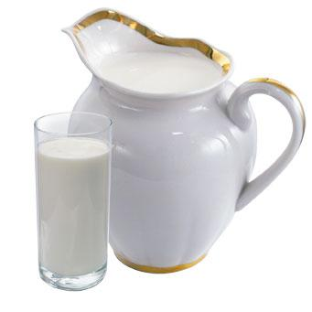
MILK

Slide 29
It’s brown, but not tea. I eat it with soup. It’s yummy.

Slide 30
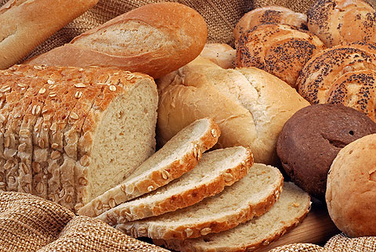
BREAD

Slide 31
It’s yellow, but not a lemon. It’s my favourite food. It’s yummy.

Slide 32
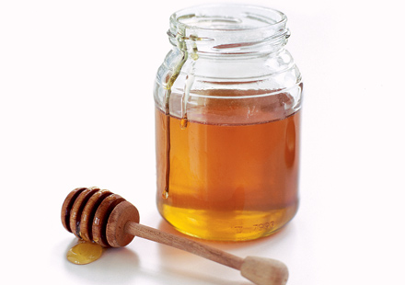
HONEY

Slide 33
What do you have for breakfast?
I have … for breakfast.

Slide 34
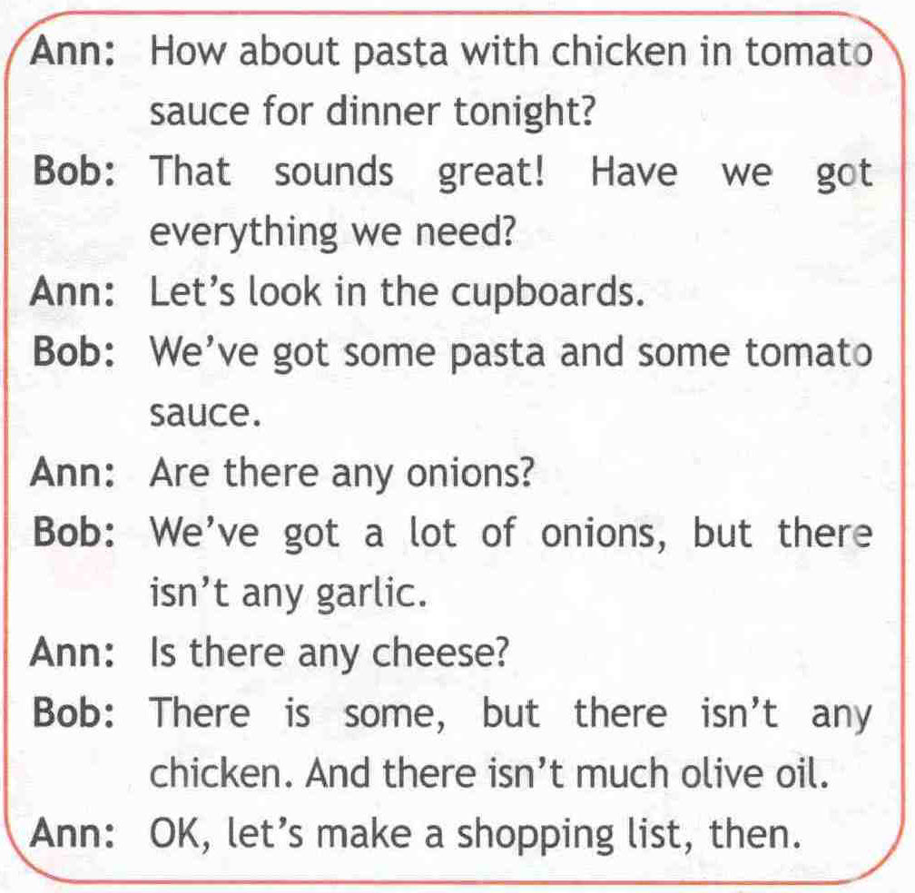

Slide 35
Affirmative sentences (+) | Negative sentences (-) | Interrogative sentences (?)
We`ve got___ pasta and ___tomato sauce. | There isn`t ___garlic. | Are there _____ onions?
 | There isn`t _____ chicken. | Is there ______ cheese?

Slide 36
We use______ in affirmative sentences.
We use______ in negative and interrogative sentences.

Slide 37
Keys
1) Any
2) Some
3) Any
4) Some
5) Any
6) Any
7) Some
0-1 mistake – “5”
2-3 mistakes – “4”
4 mistakes – “3”
5-7 mistakes – “2”

Slide 38
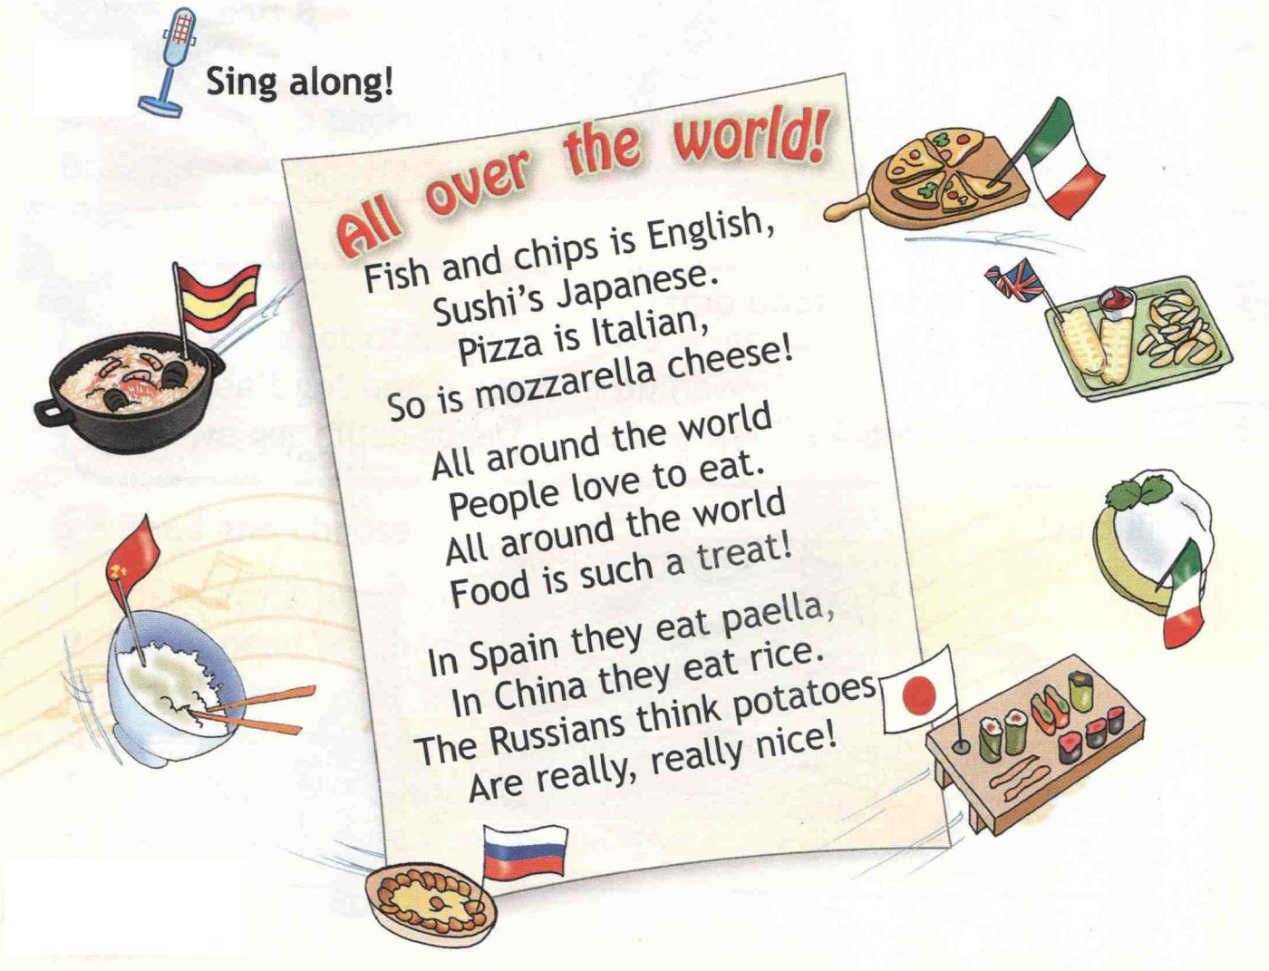

Slide 39
We take a (an)/some … for our … salad!

Slide 40
