Slide 1
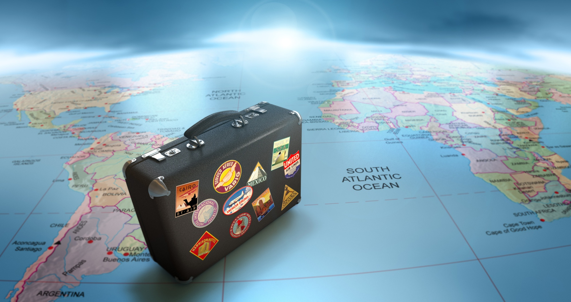
TRAVELLING AND TRANSPORT

Slide 2

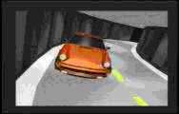
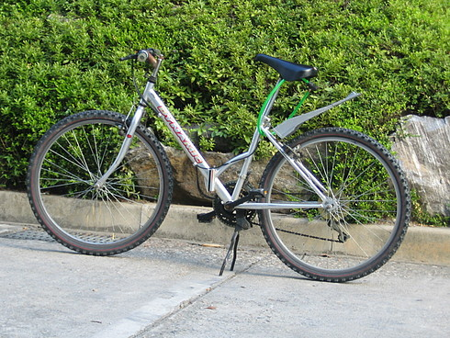
People travel by

Slide 3
During the Lesson
We are going
to speak
to listen
to discuss
to read
to answer
about the travelling

Slide 4
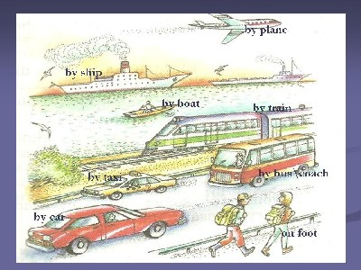
Why Do People Travel?

Slide 5
Let’s remember sound [g]!
We go by car
And we go by train.
We go by boat
And we go by plane.
We go by land,
And sea and air.
We go, go, go
From here to there.

Slide 6
Rearrange the letters to make words
1.Where is your …? (LEGUGGA)
2.My brother likes to travel by… train. (SAFT)
3.It took him 5 minutes to get to Heathrow… (PARITOR)
4.I spent last summer at the … (DESISEA)
5.How long does it take you to get to the … ? (IWAARYL ANTISOT)
6.Have you bought a … on a 6 o’clock … … ? (CIKTET, RATIN)

Slide 7
Preparing for your trip
a passport
camera
pack
maps
tickets
take
a money belt
Don’t forget to
weather report
check
clothes
a health insurance
a travel guide
a visa
buy

Slide 8
TRAVELLING
Mister Brown likes travelling. He travels on business and for pleasure. But today he can’t decide
what kind of travelling to choose. He thinks:
“travelling by air is the fastest and the most comfortable, but it is the most expensive too.
Travelling by train has its advantages. You just buy a ticket, get on train and the journey begins.
You can look at nature through the window, have a sleep, read a book. There is usually someone
interesting to talk to and when you get hungry, you can eat your food or you can buy some food
and a drink. Also modern trains have very comfortable seats.
Many people like to travel by car. It’s convenient, you can stop when and where you like, you do
not have to buy tickets or carry your suitcases.
But I have never travelled by sea. Tourist agents say that nowadays travelling by sea is very
popular. On board the ship you can enjoy your trip.
There are tennis and badminton courts, a swimming-pool, a cinema and a dancing hall there.
When you travel by ship you can feel the fresh sea, wind blowing in the face and hear the cry of
the seagulls”.
Advantages - преимущества
Seagulls -чайки

Slide 9
According to the text
What kind of travelling will Mr. Brown prefer?
Why do you think so?
How do you like to travel and why?
Answer the question using the phrases:
I’m fond of travelling ……
As for me I prefer travelling………..
For me there is nothing better than travelling

Slide 10

New words from the text:
aisle seat – место в проходе,
available – свободный,
boarding pass – посадочный талон, departure – отправление,
passengers will be allowed – пассажирам позволят

Slide 11
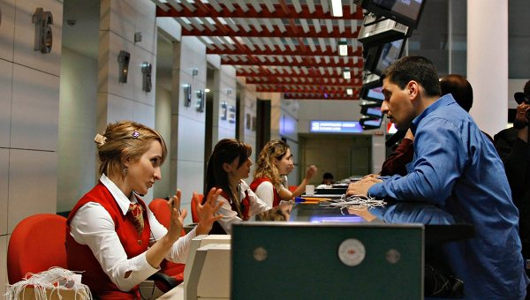
AT THE AIRPORT

Slide 12
Restore the dialogue
-Where are you flying today?
…………..
Let’s see your ticket, passport and visa, please.
…………..
Would you like a window seat or an aisle seat?
…………….
Do you prefer smoking or non-smoking?
……………..
How many pieces of luggage do you have?
………………
Here is your boarding pass, please.
………………

Slide 13
Make up your own conversation
-Upper or lower berth?
-Thank you.
-I prefer a lower one.
-Single or return?
-I want a ticket to London. Second class, please.
Could you tell me what platform the train start?
-I want a single one.
-Platform 3.
-Can I help you?
-That will be 10 pounds. Here you are.

Slide 14
-Can I help you?
-Yes ,I want a ticket to London. Second class, please.
-Single or return?
-I want a single one.
-Upper or lower berth?
-I prefer a lower one.
-That will be 10 pounds. Here you are.
-Thank you. Could you tell me what platform the train start?
-Platform 3.
-Thank you.

Slide 15
Why Do People Travel?
to see other countries
to enjoy interesting places
to study geography
to practice foreign language
to know the new customs and traditions
to discover new places and new ways of life
to try foreign food
to see sightseeing

Slide 16



The lesson was interesting
I can’t understand
I find it difficult

Slide 17

Thank you for the lesson!

