Slide 1
B
K
E
A

Slide 2
F
C
B
A
M

Slide 3
B
E
A
C
K

Slide 4
B
A
C

Slide 5
M
F
C
A
E
O

Slide 6
B
C
A
K
M

Slide 7
S= KE∙BK
S= AK∙AE

Slide 8

S= ∙ CA∙FM
S= CA∙FM

Slide 9
S= ∙ AB∙AC
S= ∙AB∙BC

Slide 10
S= ∙ EC∙AB
S= CE∙AB

Slide 11
S= ∙ MO∙AE
S= MO∙AE

Slide 12
S= MO∙AM

Slide 13
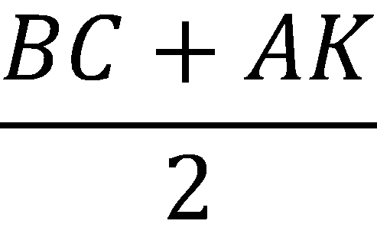
S= ∙AC
S= ∙CM

Slide 14
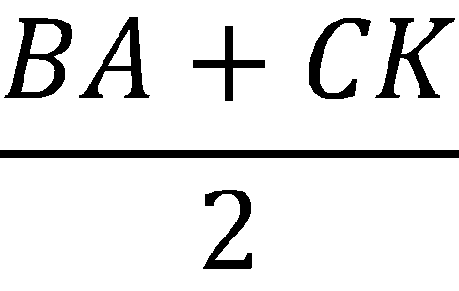
S= ∙AC

Slide 15
S= ∙ BK∙CB

