Slide 1
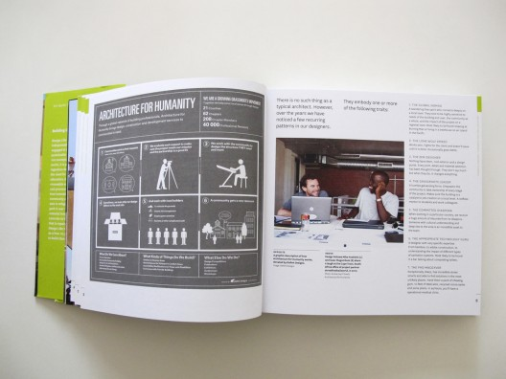


An architect
YESTERDAY TODAY TOMORROW

Slide 2

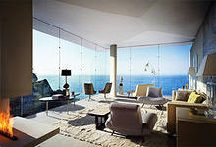
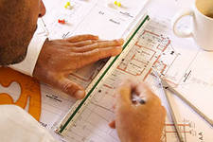

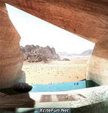

Humanity is obliged just to architects that we don’t live in the caves any more.

Slide 3
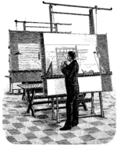
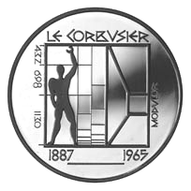
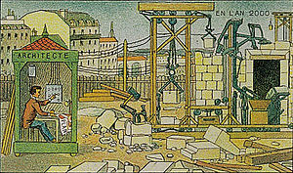
Architect derives from the Latin architectus, which derives from the Greek arkhitekton (arkhi-, chief +
tekton, builder)

Slide 4
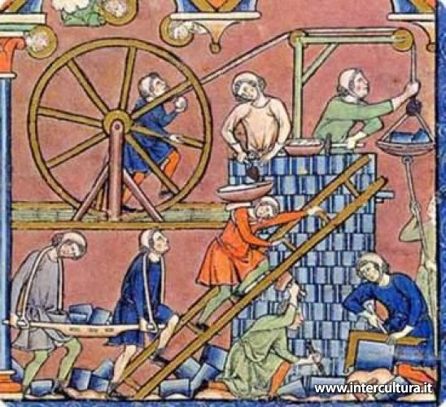
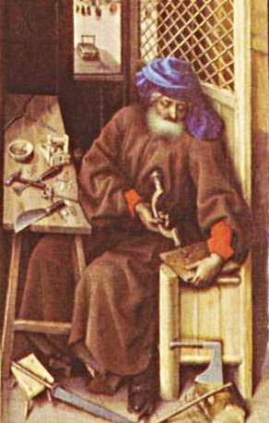
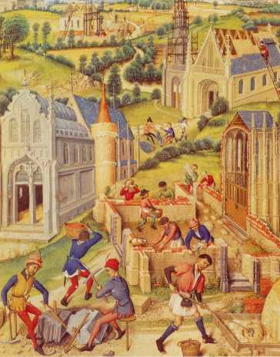

Throughout ancient and medieval history, most architectural design and construction was carried out by artisans—such as stone masons and carpenters, rising to the role of master builder.

Slide 5
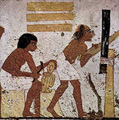
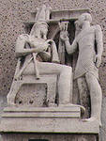

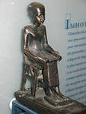
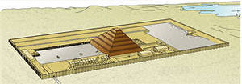
Imhotep
Only some names of the ancient architects were reached till our time.

Slide 6
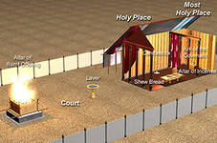
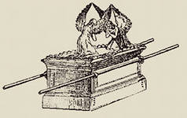
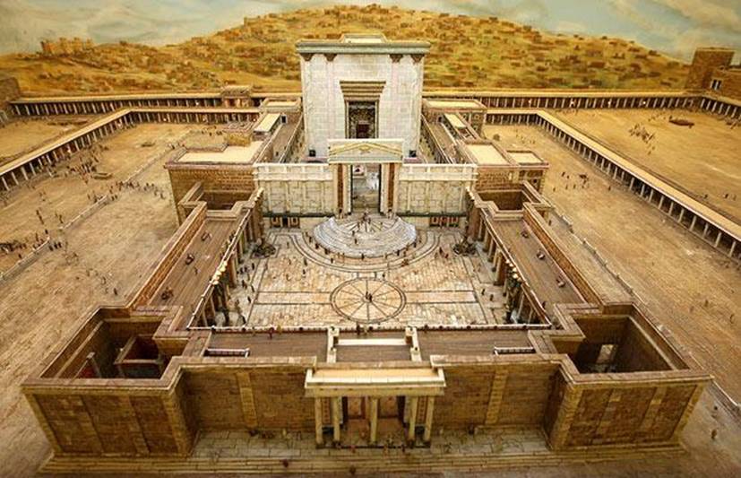
Vezaleel – the chief Builder of the Tabernacle and his assistant - Agoliav.

Slide 7
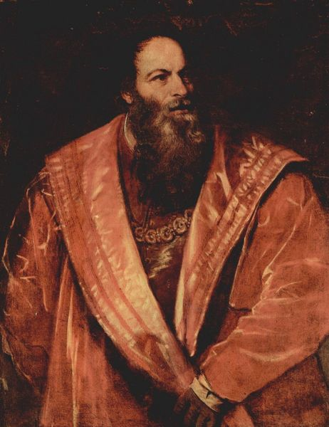



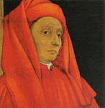
The name" an architect"has been settled down In Europe about 400 years ago. Up to the XVI century this title was not given to artists,who managed the construction of buildings

Slide 8
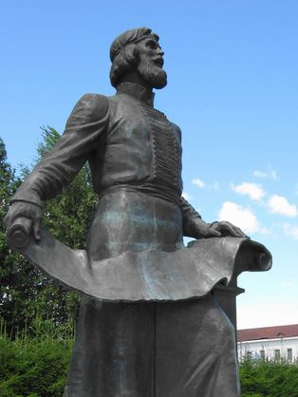
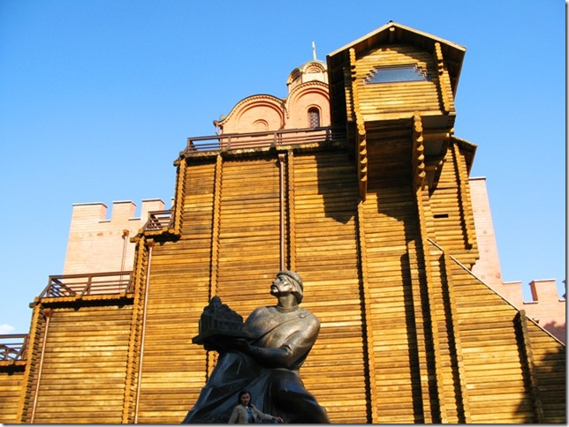
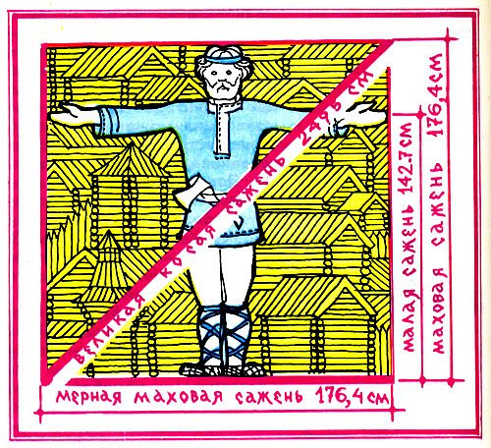

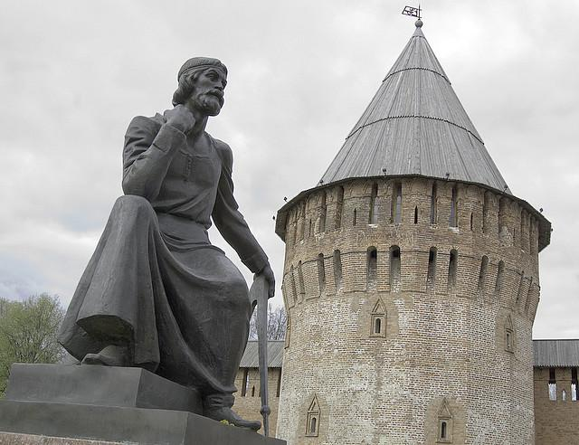
Before Peter the Great , the word "architect" was not used, and builders were called " zodchiy, carpenter, ward master,stone- craftsman and woodworker ".

Slide 9
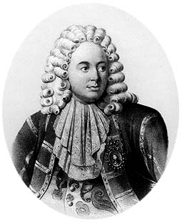
Pietro Antonio Solari
Italians: Pietro Antonio Solari, Petroc Small, Aleviz were named The first «architects» within four Russian corners of XV-XVI centuries.

Slide 10
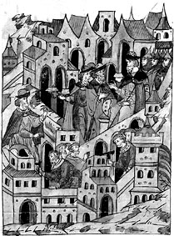

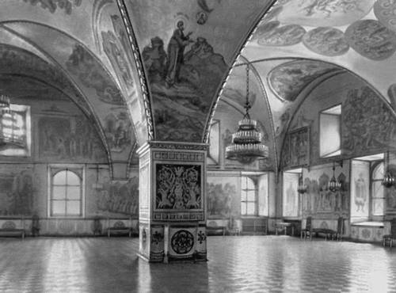

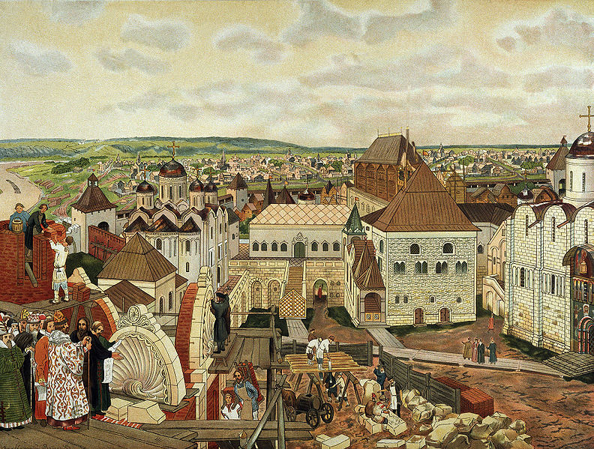
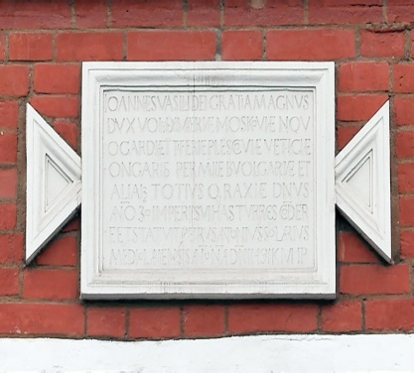
In 1487, Antonio Solari was invited to Russia by Ivan III to construct the walls and towers of the Moscow Kremlin.

Slide 11

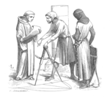
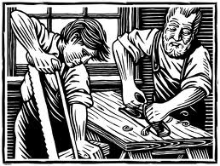
Until the 1700s buildings continued to be designed and set-out by craftsmen, with the exception of high status projects.

Slide 12



Various developments in technology and mathematics allowed the development of the professional 'gentleman' architect, separate from the hands-on craftsman.

Slide 13
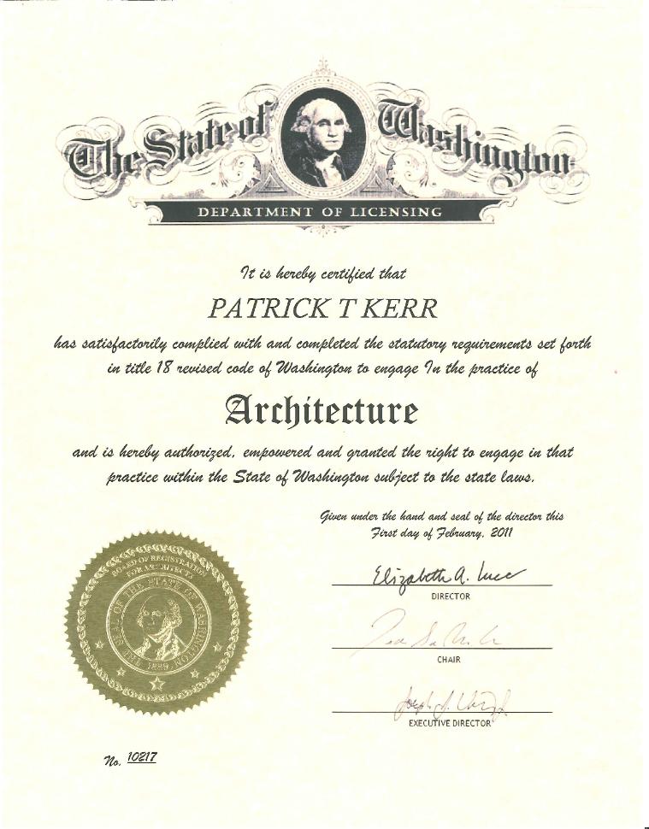
Architecture license
Only qualified persons with appropriate licensure, certification, or registration may legally practice architecture.

Slide 14
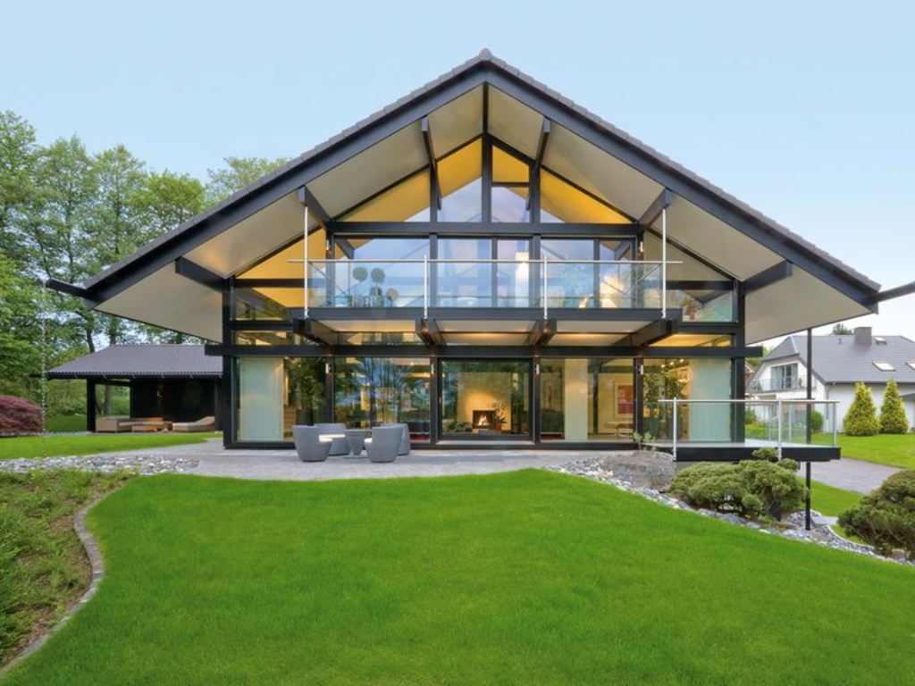


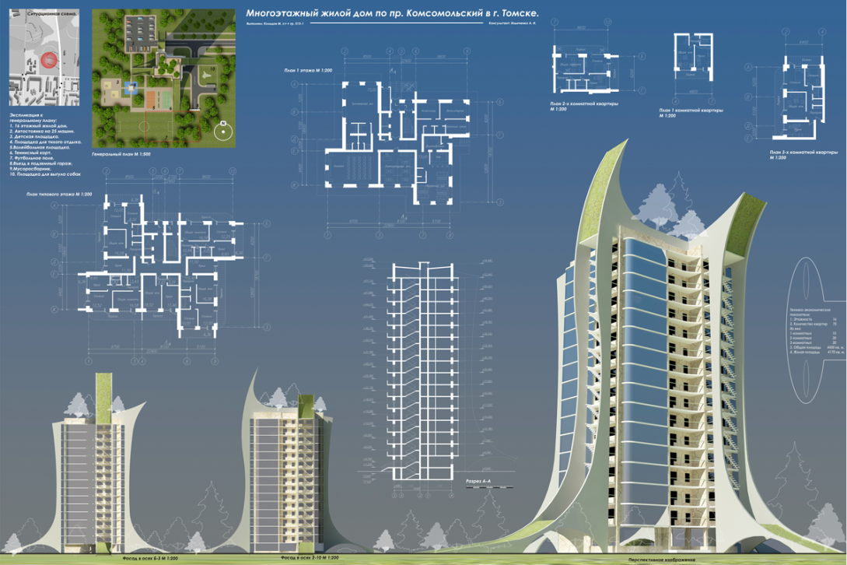
Many architects and architectural firms focus on certain project types (for example, health care, retail, public housing, event management), technological expertise or project delivery methods.

Slide 15
