Slide 1

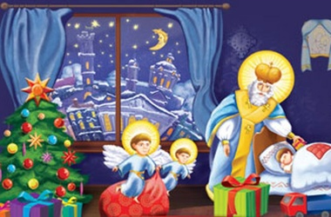
Christmas in Germany

Slide 2

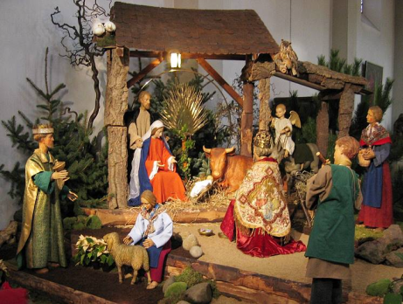
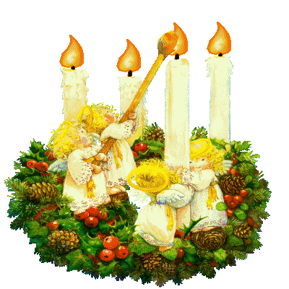
Advent
4 weeks before Christmas: the first pre-Christmas service. Children sing songs, show performances and light the first Advent candle.

Slide 3
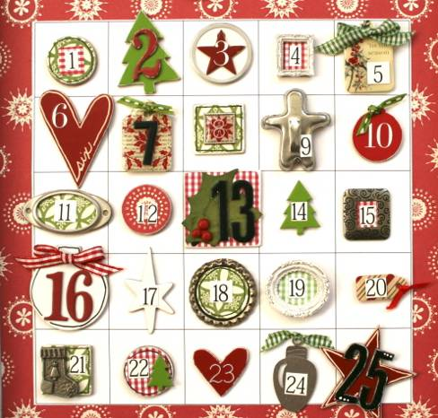
The Advent calendar (Adventskalender)
The calendars are usually made of cardboard and have 24 small windows or flaps, one of which is opened on each day leading up to Christmas. Nowadays, calendars may contain chocolate or candy behind each window, and sometimes even small toys.

Slide 4
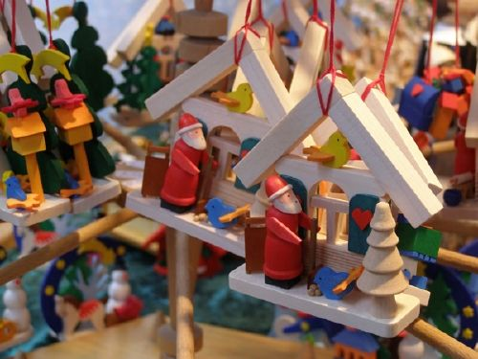
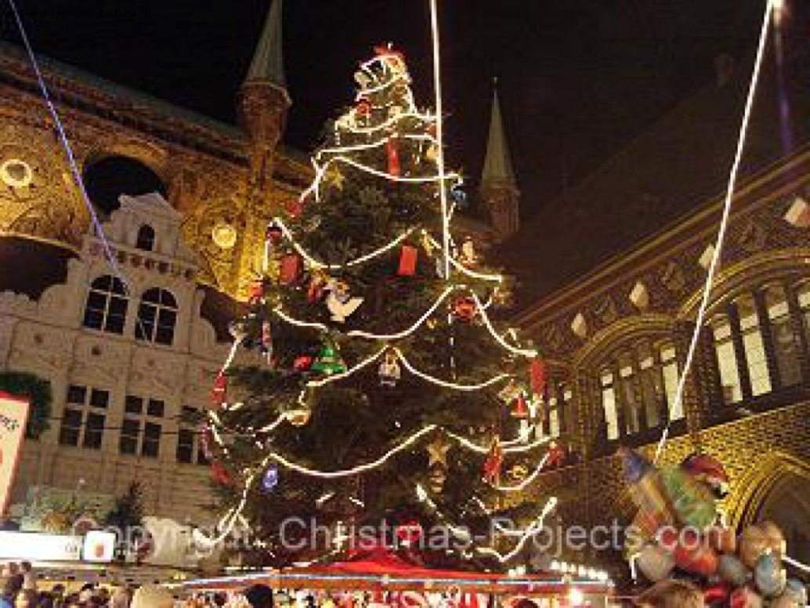
Christmas Fair -Weihnachtsmarkt
Christmas fairs take place at the central town squares. You can hear music everywhere. People can buy different sweet dishes, German sausages, souvenirs and hand-carved toys.
You can meet German Santa Claus here.

Slide 5
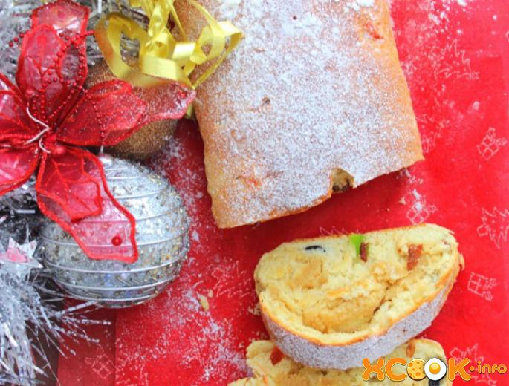
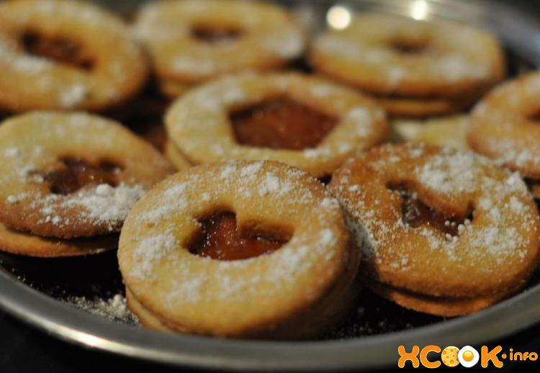
Christmas sweet dishes
Stolen -the oldest known German Christmas sweet bread
Christmas cookies (Plätzchen) are often baked during this time
Gingerbread houses are very popular

Slide 6
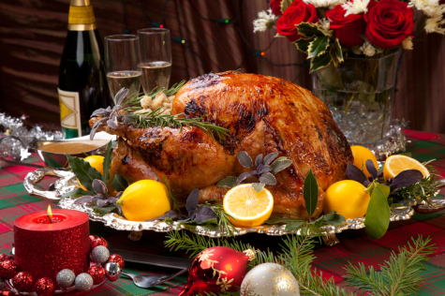
The main Christmas dish
On 25 December the whole family gathers at the table for Christmas dinner. There are different dishes to any taste. The main dish is a roast goose with vegetables – the symbol of wealth.

Slide 7
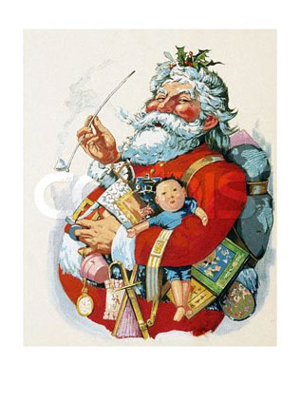
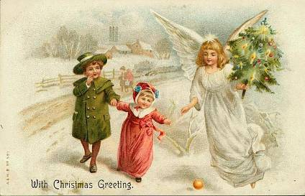
German Santa
deer Weihnachtsmann
“Christmas daddy” comes on 24 December to put presents under the Christmas Tree. Before that children write letters to Christ kind (a winged figure in white robes and a golden crown) and leave them on the windowsills.

Slide 8
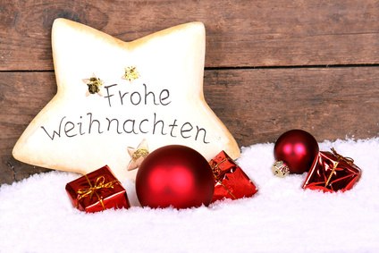

Slide 9
