Slide 1

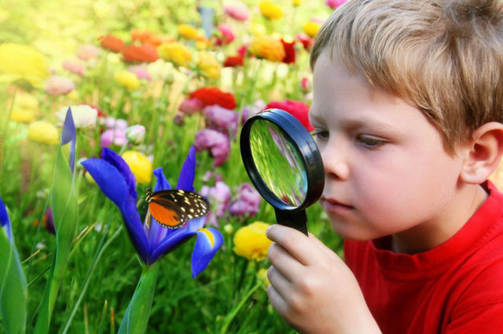

Slide 2
EARTH
DAY

Slide 3
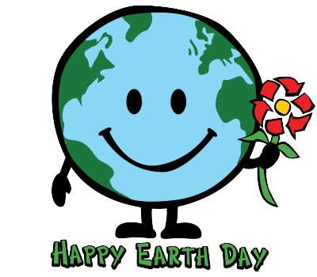
The first Earth Day was
- in 1917
- in 1970
- in 2007

Slide 4
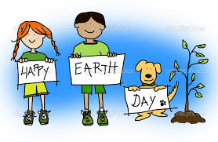
2. Earth Day was born
In Russia
- in Great Britain
In America

Slide 5

3. More than
- 100 countries
- 50 countries
- 200 countries celebrate Earth Day

Slide 6
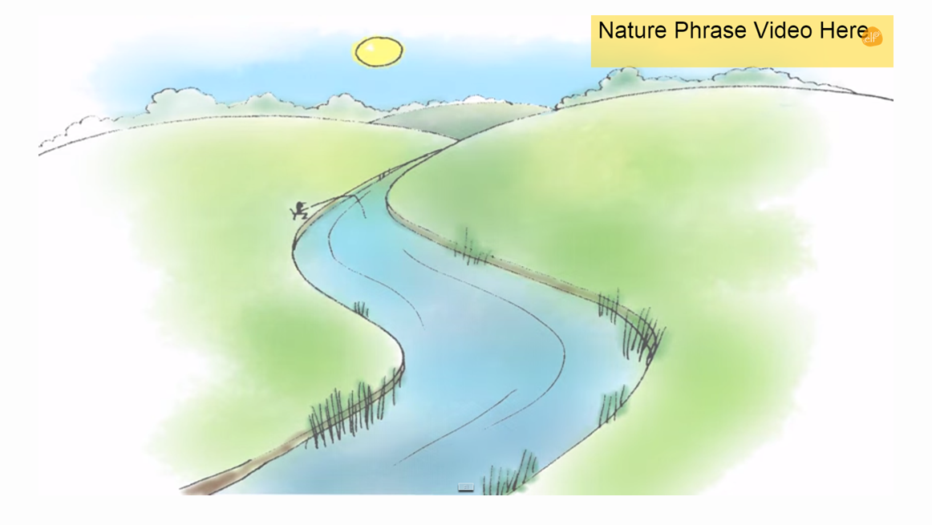
Ссылка на видео: http://www.youtube.com/watch?v=PaiNKEcaHEc

Slide 7
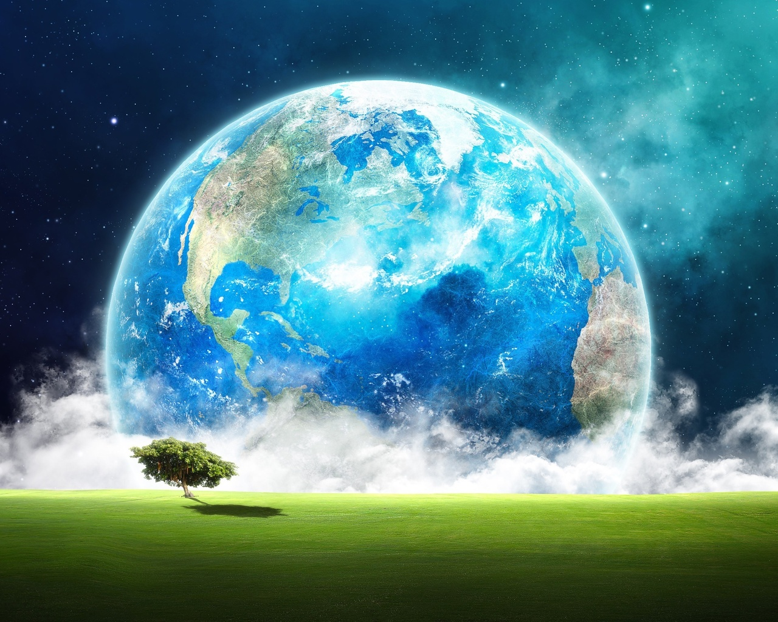


Slide 8
Land
Beach - grass
-desert - jungle
- farm - leaf
-flower - mountain
forest - tree

Slide 9
Lake
Ocean
Pond
River
WATER

Slide 10
-Cloud
-moon -star
-rain -storm
-rainbow -sun
-snow -wind
SKY

Slide 11
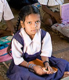
Varuni, 9
(India)

Slide 12
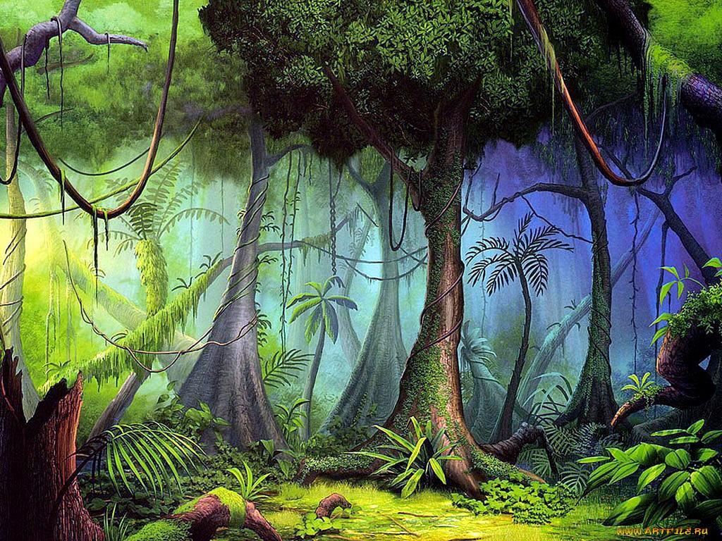

Slide 13

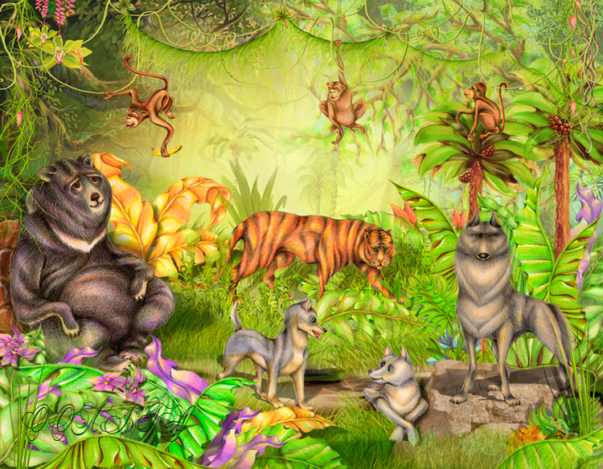


Slide 14
TRUE or FALSE?
1. TRUE
2. FALSE
3. TRUE
4. TRUE
5. FALSE

Slide 15


Ссылка на видео:
http://www.youtube.com/watch?v=GoSq-yZcJ-4

Slide 16
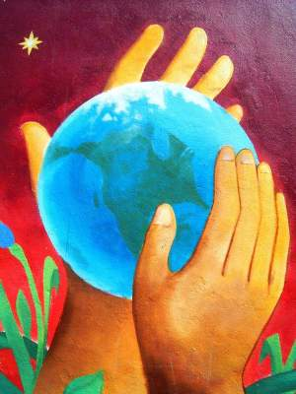
Helping the Earth

Slide 17

PUZZLE TIME

Slide 18

Ссылка на видео:
http://www.youtube.com/watch?v=um_Myo_K8_w

Slide 19


Slide 20


