Slide 1
Знаешь ли ты физику?
Презентация создана учителем физики
МАОУ «СОШ №44» г. Пермь
Шадриной Мариной Борисовной..

Slide 2
Пословицы
Кто это,
что это
Найди
ошибку
Загадки
Семь раз
отмерь
100
100
100
100
100
200
200
200
200
200
300
300
300
300
300
400
400
400
400
400
500
500
500
500
500
Notes:
2. Now, repeat Step 1 for the remaining four category placeholder names:
Slide 2-Category Selection
This slide is the main game board. You go here to begin the game, and you return here after each Question/Answer slide. This is where the “contestant” selects one of the five categories and a dollar value for the question. The higher the value, the more difficult the question. When you open this slide, the categories appear one at a time, and the dollar values appear at random with an accompanying laser beep. Here’s how it works: if the contestant selects the first category for $300, you would click on the $300 text under
To tailor this slide, follow these instructions:
Five different categories are used in the game. The category names appear at the top of the columns on this slide and on the five associated Question/ Answer slides (one for each dollar value). Rather than changing all of these separately, you will use the Replace command to change each placeholder category name only once.
1. Under Edit, choose Replace
Type the placeholder name for category 1 as shown in the pop-up at the right.
Type in your category name (e.g., Mixed Numbers) under Replace with:
The Replace pop-up should now look like the one on the right, only with your category name.
Click the Replace All button to make the changes.
You will then see this pop-up
Click the OK button. This replaces the six occurrences of the specified placeholder category name with your category name. After this, the top of the slide will look like this:
the 1st category (i.e., the 3rd dollar box in column one). As a result, the corresponding Question/Answer slide will automatically appear. Once the question, and then the answer, for that slide have been shown, you will click on the arrow in the bottom right of that slide to return to this main slide. When you return to this slide, the dollar amount for the box you selected will have changed from white to blue to show that that particular question has already been used. Below, you will see how to tailor the game for your particular categories.
Notice that in this case, “Mixed Numbers” doesn’t fit on the line. To fix this, simply click on the text right before the “N” and press Backspace followed by Enter. Now it’s on two lines:

Slide 3
Хорошему прыжку
хороший разбег нужен.
Пословицы за 100
Тело сохраняет по инерции
свою скорость.
Notes:
Slide 3-Question/Answer (Cat1, $100)
This slide is the first Question/Answer slide. It corresponds to Category 1 for $100. Once you have followed the instructions on Slide 2 to replace category name placeholders with your actual categories, the text “Cat1” on this slide will be replaced with your 1st category name.
When you click on Category 1 for $100 on the main slide, this slide opens automatically, with the Question appearing at the top. (Note: On TV Jeopardy, the contestant is actually shown an
answer and is asked to offer a related question. Since this concept is sometimes difficult to understand and implement, this PowerPoint version shows a question followed by the corresponding answer.)
One way to play the game in class is to set up three teams. For each round, have one person from each team stand up as contestants. Have one pick the category and dollar value; click on that box and then ready the question that appears. Call on the first contestant that raises his or her hand for the answer. If they are correct, their team gets corresponding points or dollars (e.g., 1 point for each $100). If the first contestant misses the question or does not answer quickly enough, his or her team loses the corresponding points. Then, offer the question to the remaining two contestants in order of their raised hands. After the question has been answered correctly, or after all three contestants miss it, or after no contestant wants to try, return to the main slide by clicking on the yellow arrow. The current contestants then sit down, and the game moves to the next round.
Note that this Jeopardy game does not have a Double Jeopardy question.
To tailor this slide, follow these instructions:
You are now ready to put in your questions and answers, but you might want to go ahead and save this file first, using Save As and giving it a new name—one that makes sense for this particular Jeopardy game (e.g., Fractions Jeopardy).
If your Question is short, simply double click on the word “Question” and type in your specific question (e.g., “50% of 150” or “Capitol of France”). If the text you enter will not fit on one line, there’s room for two lines at this font size. If you need more room, reduce the font size by triple clicking on the text and using the Font Size selector in the toolbar. In some cases, your question may need a drawn figure or graphic. You can use PowerPoint features to draw the figure you need or to insert graphics. A few examples are show below.
Double click on the word “Answer” and type in your answer in the same way.
Do the same steps to tailor the remaining Question/Answer slides, remembering to make questions of higher dollar value more difficult. Also remember to save your work.
Example Questions:

Slide 4
Брошенный вверх камень
На твою же голову упадет.
Пословицы за 200
На все тела действует сила
тяжести, направленная вниз.
Notes:
Welcome to Power Jeopardy
© Don Link, Indian Creek School, 2004
You can easily customize this template to create your own Jeopardy game. Simply follow the step-by-step instructions that appear on Slides 1-3.

Slide 5
Плуг от работы блестит.
Пословицы за 300
от трения при соприкосновении
с землей .
Notes:
Welcome to Power Jeopardy
© Don Link, Indian Creek School, 2004
You can easily customize this template to create your own Jeopardy game. Simply follow the step-by-step instructions that appear on Slides 1-3.

Slide 6
Коси коса, пока роса:
роса долой, и мы домой.
Пословицы за 400
Трение уменьшается
за счет смазки, её роль
играет вода.
Notes:
Welcome to Power Jeopardy
© Don Link, Indian Creek School, 2004
You can easily customize this template to create your own Jeopardy game. Simply follow the step-by-step instructions that appear on Slides 1-3.

Slide 7
Камень тяжел, когда лежит на
своем месте, если же его покатить,
он станет легким.
Пословицы за 500
Трение покоя много больше
трения качения.
Notes:
Welcome to Power Jeopardy
© Don Link, Indian Creek School, 2004
You can easily customize this template to create your own Jeopardy game. Simply follow the step-by-step instructions that appear on Slides 1-3.

Slide 8
Именем этого ученого названа
единица измерения одной из
основных величин в механике.
Кто это, что это за 100
Исаак Ньютон.
Notes:
Welcome to Power Jeopardy
© Don Link, Indian Creek School, 2004
You can easily customize this template to create your own Jeopardy game. Simply follow the step-by-step instructions that appear on Slides 1-3.

Slide 9
Эта сила помогает спортсменам
добиваться высоких результатов.
Кто это, что это за 200
Сила упругости.
Notes:
Welcome to Power Jeopardy
© Don Link, Indian Creek School, 2004
You can easily customize this template to create your own Jeopardy game. Simply follow the step-by-step instructions that appear on Slides 1-3.

Slide 10
Эту силу часто путают
с массой тела.
Кто это, что это за 300
Вес тела.
Notes:
Welcome to Power Jeopardy
© Don Link, Indian Creek School, 2004
You can easily customize this template to create your own Jeopardy game. Simply follow the step-by-step instructions that appear on Slides 1-3.

Slide 11
Эта сила мешает
развязать шнурок
Кто это, что это за 400
Трение покоя.
Notes:
Welcome to Power Jeopardy
© Don Link, Indian Creek School, 2004
You can easily customize this template to create your own Jeopardy game. Simply follow the step-by-step instructions that appear on Slides 1-3.

Slide 12
Это состояние испытывают
космонавты при взлете
космической ракеты.
Кто это, что это за 500
Перегрузка.
Notes:
Welcome to Power Jeopardy
© Don Link, Indian Creek School, 2004
You can easily customize this template to create your own Jeopardy game. Simply follow the step-by-step instructions that appear on Slides 1-3.

Slide 13
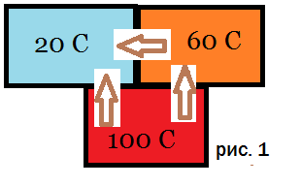
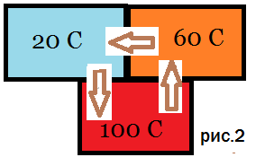
На какой картинке неверно
показано направление теплообмена?
Найди ошибку за 100
На рис. 2 теплообмен всегда
идет от более нагретого тела
Notes:
Welcome to Power Jeopardy
© Don Link, Indian Creek School, 2004
You can easily customize this template to create your own Jeopardy game. Simply follow the step-by-step instructions that appear on Slides 1-3.

Slide 14
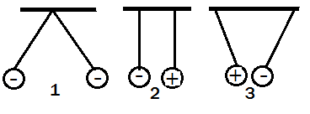
На каком рисунке неверно
показано взаимодействие зарядов?
Найди ошибку за 200
На рис.2 разноименные
заряды отталкиваются
Notes:
Welcome to Power Jeopardy
© Don Link, Indian Creek School, 2004
You can easily customize this template to create your own Jeopardy game. Simply follow the step-by-step instructions that appear on Slides 1-3.

Slide 15
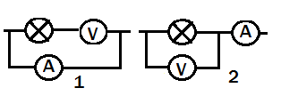
Какая схема неверна? Почему?
Найди ошибку за 300
На 1 рисунке.
Вольтметр включают параллельно,
а амперметр –последовательно.
Notes:
Welcome to Power Jeopardy
© Don Link, Indian Creek School, 2004
You can easily customize this template to create your own Jeopardy game. Simply follow the step-by-step instructions that appear on Slides 1-3.

Slide 16
Скорость испарения жидкости зависит от:
площади поверхности,
рода вещества,
температуры,
наличия ветра,
массы вещества,
Влажности воздуха.
Что указано неверно?
Найди ошибку за 400
Скорость испарения не зависит от массы
Notes:
Welcome to Power Jeopardy
© Don Link, Indian Creek School, 2004
You can easily customize this template to create your own Jeopardy game. Simply follow the step-by-step instructions that appear on Slides 1-3.

Slide 17
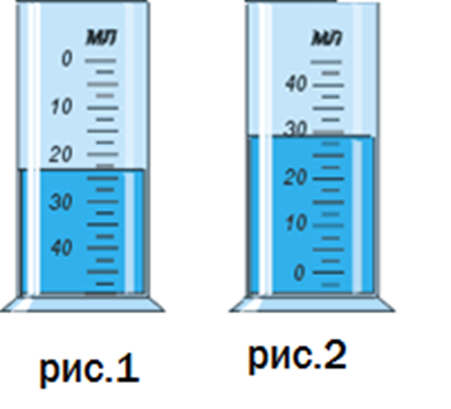
Найди ошибки на мензурках
Найди ошибку за 500
На рис.1 шкала расположена наоборот,
сверху вниз, а у рис.2 есть деления
ниже нуля.
Notes:
Welcome to Power Jeopardy
© Don Link, Indian Creek School, 2004
You can easily customize this template to create your own Jeopardy game. Simply follow the step-by-step instructions that appear on Slides 1-3.

Slide 18
На всякий зов дает ответ,
А ни души, ни тела нет.
Загадки за 100
Эхо
Notes:
Welcome to Power Jeopardy
© Don Link, Indian Creek School, 2004
You can easily customize this template to create your own Jeopardy game. Simply follow the step-by-step instructions that appear on Slides 1-3.

Slide 19
Чист и ясен как алмаз,
дорог не бывает.
Он от матери рожден,
сам её рождает.
Загадки за 200
Лед.
Notes:
Welcome to Power Jeopardy
© Don Link, Indian Creek School, 2004
You can easily customize this template to create your own Jeopardy game. Simply follow the step-by-step instructions that appear on Slides 1-3.

Slide 20
Зимой греет,
весной тлеет.
Летом умирает,
осенью оживает.
Загадки за 300
Снег
Notes:
Welcome to Power Jeopardy
© Don Link, Indian Creek School, 2004
You can easily customize this template to create your own Jeopardy game. Simply follow the step-by-step instructions that appear on Slides 1-3.

Slide 21
Меня никто не видит,
но всякий слышит.
А спутницу мою
всяк может видеть,
Но никто не слышит.
Загадки за 400
Гром и молния.
Notes:
Welcome to Power Jeopardy
© Don Link, Indian Creek School, 2004
You can easily customize this template to create your own Jeopardy game. Simply follow the step-by-step instructions that appear on Slides 1-3.

Slide 22
У тебя есть, у меня есть,
У дуба в поле, у рыбы в море?
Загадки за 500
Тень
Notes:
Welcome to Power Jeopardy
© Don Link, Indian Creek School, 2004
You can easily customize this template to create your own Jeopardy game. Simply follow the step-by-step instructions that appear on Slides 1-3.

Slide 23
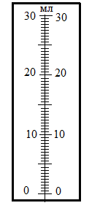
Определите цену деления
этого прибора
Семь раз отмерь за 100
0,5 мл
Notes:
Welcome to Power Jeopardy
© Don Link, Indian Creek School, 2004
You can easily customize this template to create your own Jeopardy game. Simply follow the step-by-step instructions that appear on Slides 1-3.

Slide 24
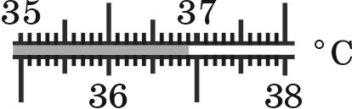
Какую температуру
показывает термометр?
Семь раз отмерь за 200
36,9
Notes:
Welcome to Power Jeopardy
© Don Link, Indian Creek School, 2004
You can easily customize this template to create your own Jeopardy game. Simply follow the step-by-step instructions that appear on Slides 1-3.

Slide 25
Единица измерения какой величины
использована в выражении:
« Мал золотник, да дорог»
Семь раз отмерь за 300
«Золотник»- единица массы,
равен 4 граммам
Notes:
Welcome to Power Jeopardy
© Don Link, Indian Creek School, 2004
You can easily customize this template to create your own Jeopardy game. Simply follow the step-by-step instructions that appear on Slides 1-3.

Slide 26
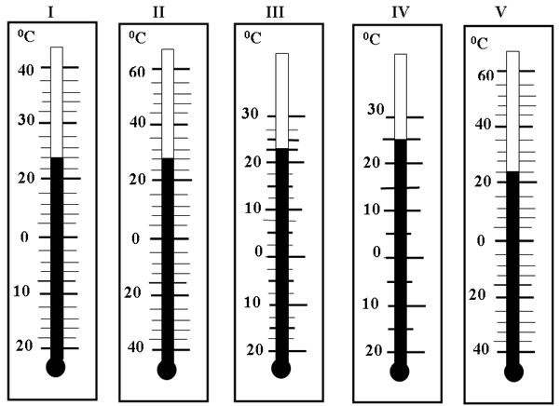
Какие термометры показывают
одинаковую температуру?
Семь раз
отмерь за 400
I и V t=24
Notes:
Welcome to Power Jeopardy
© Don Link, Indian Creek School, 2004
You can easily customize this template to create your own Jeopardy game. Simply follow the step-by-step instructions that appear on Slides 1-3.

Slide 27
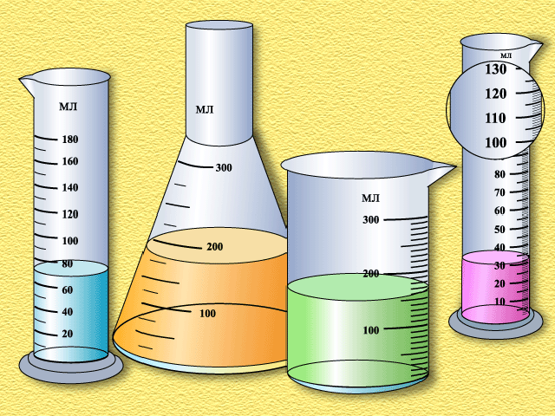
Какая из мензурок наиболее точная?
Почему?
Семь раз отмерь
за 500
Крайняя справа, у неё самая
маленькая цена деления
Notes:
Welcome to Power Jeopardy
© Don Link, Indian Creek School, 2004
You can easily customize this template to create your own Jeopardy game. Simply follow the step-by-step instructions that appear on Slides 1-3.

