Slide 1
English
Form 5
“Rules Around Us”
Teacher N.D. Golovko
101-901-023

Slide 2
Agreement (Paraphrase Rules for students)
We, the students of the 5 B form, agreed to:
Be on time and come prepared (we must..) Raise hands before speaking (we should…) 3.Do homework every day. (we must…)

Slide 3
4.Respect our classmates, teachers at school.(we must…)
5.Keep the classroom clean
(we should…)
6.Work hard (we should…)
7.Listen to our teachers (we must…)

Slide 4
Listen and sing the song “School Rules Rap”
School uniform every day!
Who looks cool in blue and grey?
You mustn’t wear jeans
And your shoes are not clean.
You must be here at 8.15.
You mustn’t wear shorts
(I don’t know why).

Slide 5
Song...
You mustn’t run in corridors
And where’s your tie?
You must tell a teacher
If you feel in danger.
You must ask first
Before you go with a stranger.

Slide 6
False Rules for Parents

Slide 7
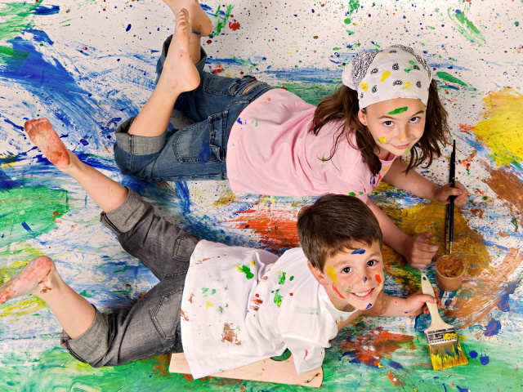
False Rules for parents
Parents should really love their child and let him play various pranks !

Slide 8
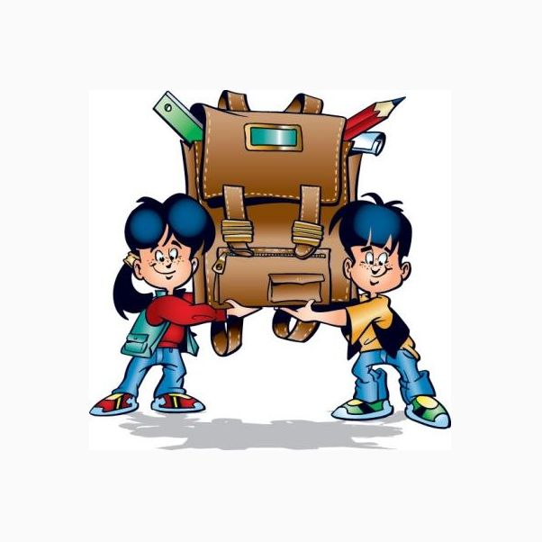
Parents should collect the books into the school bag!

Slide 9
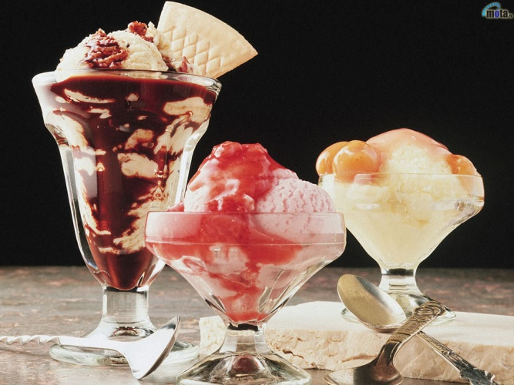
Mother should prepare cakes and chocolate and Pizza for her child’s breakfast !

Slide 10

Children do not like uniforms so parents should buy them jeans, sport shoes and colorful T-shirts!

Slide 11

Parents mustn’t wake their child early in the morning !

Slide 12

Parents must be busy with doing the homework while the child is frolicking!

Slide 13
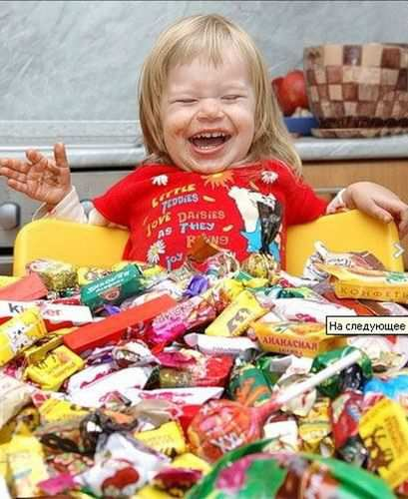
Parents should buy big chocolate bars when he does well at school

Slide 14
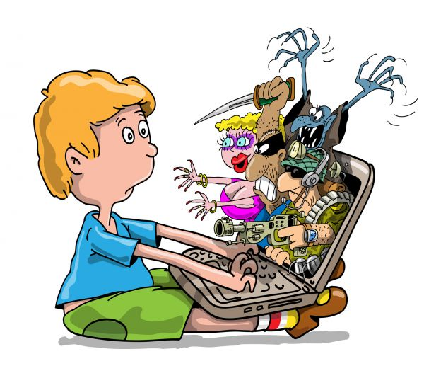
The Child may play computer games for a long time ! (as long as he likes!)

Slide 15
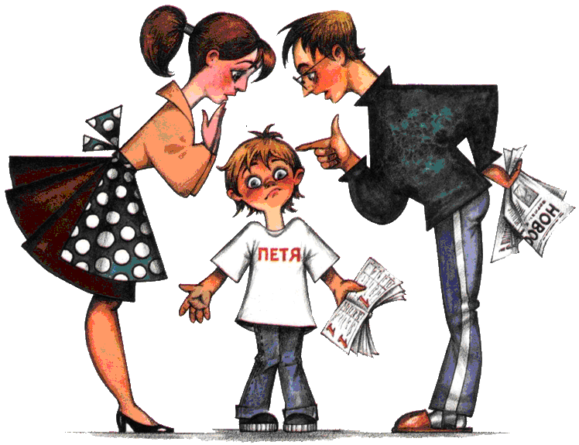
All children will be very happy if the parents follow these rules. But I know parents do not think so .

Slide 16
Rules of behaviour (manners) in Public places

Slide 17
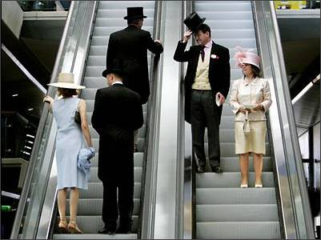
Rules of behaviour (manners) in public places.
1.You should be polite to the elders.

Slide 18
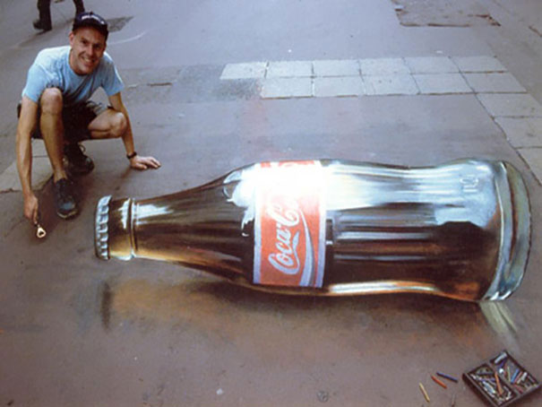
2.You mustn’t throw litter in a public place.

Slide 19

3.Children shouldn’t walk late at night without their parents.

Slide 20

4.People mustn’t smoke in a public place

Slide 21
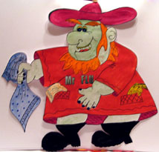
INTERESTING SENTENCES
  Pammustdrinkjuice.
  Janemustnotwalkatnight.
  Pamshouldcleanherteeth.
  Youshouldeatbananasandcarrots.
  Youmustnottellastrangeryourname
  You shouldnotusetheInternetwithout
  permission
  Youshouldwearschooluniform
C onstruct sentences and translate them

Slide 22
I Think…
The rule… is the most important
The rule… is silly
The rule… is useful

Slide 23
I Think…
The rule… is useless
The rule… is funny (humorous)

Slide 24

RIGHT ADVICE
Найдите правильные советы.
Предложения | «Yes » | «No»
1. You must wash your hands before breakfast.
2. You must not clean your teeth every morning.
3. You must not swim, skip and jump.
4. You must eat carrots, apples and cabbage.
5. You must not wash your face and body.

Slide 25
RIGHT ADVICE
Найдите правильные советы.
Предложения | «Yes » | «No»
6. You must not drink juice.
7. You must not walk at night.
8. You must be healthy.
9. You must drink milk.
10. You must not eat nuts.

Slide 26
SONG … Clap, clap, clap your hands, clap your hands together! Stamp, stamp, stamp your feet, stamp your feet together! Nod, nod, nod your heads, nod your heads together! Dance, dance, dance a dance, dance a dance together!

Slide 27
SAFETY TRAFFIC RULES
YOU MUST…
YOU MUSTN’T…
YOU SHOULD…
YOU SHOULDN’T…

Slide 28

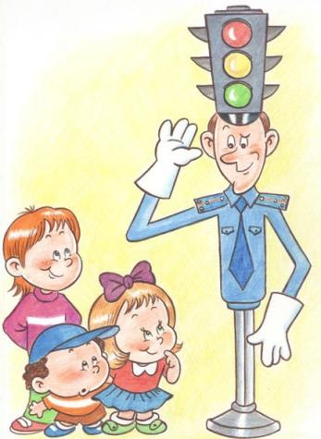
Children should follow traffic rules!

Slide 29

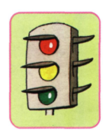
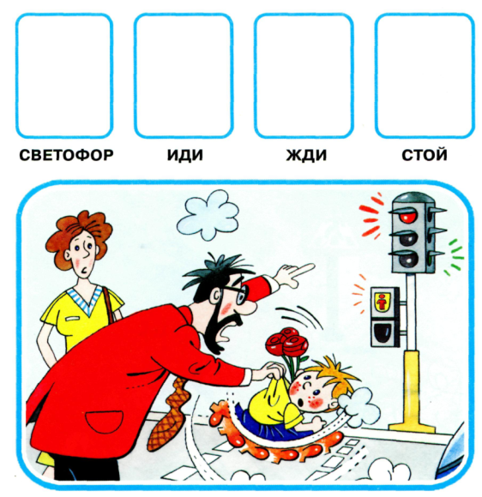
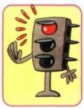
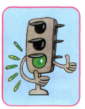
Put the signs into the right window!

Slide 30


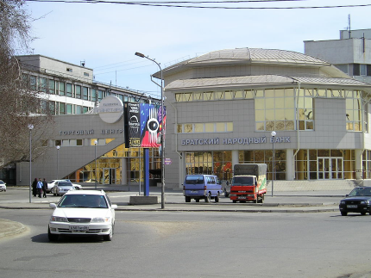
You should stop when
the light is red

Slide 31
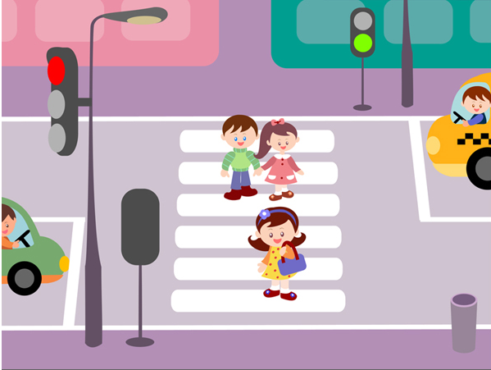
You should cross the street when the light is green

Slide 32
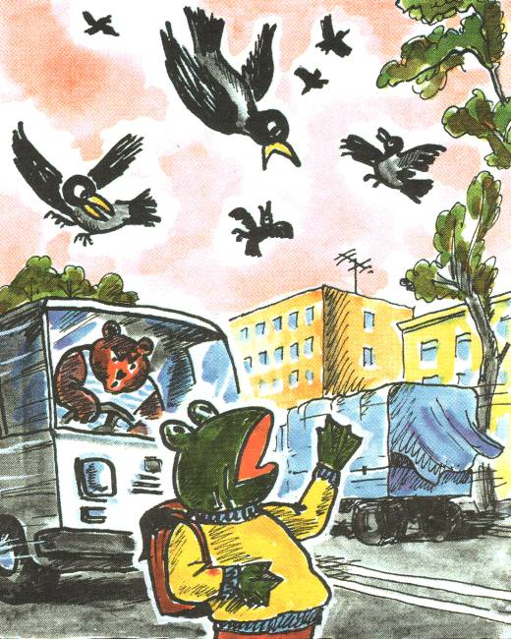
You shouldn’t gape (count crows) while crossing the street

Slide 33
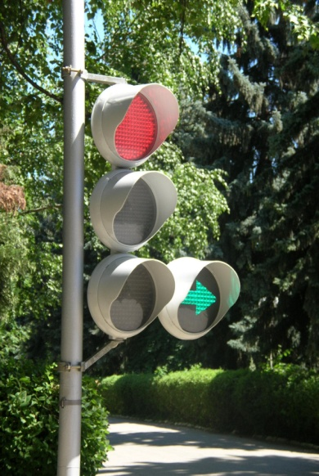

Song “ROAD RULES” Stop! Look! Listen! Think!
Everyone repeat!
Stop! Look! Listen! Think!
When you cross the street!
Look to the left, look to the right
Look to the left again
Keep on looking right and left
Thinking all the way

Slide 34
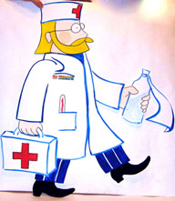
Homework:
- Can you give advice?
- Your home task is to make five sentences with the verbs must and should. Give your advice how to be healthy.

Slide 35
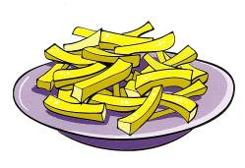

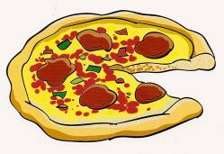

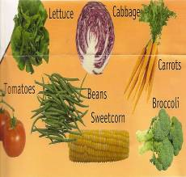
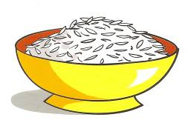
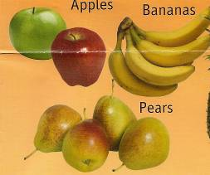
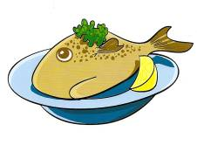
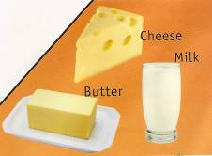
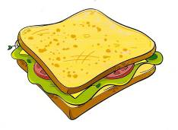
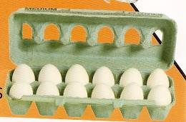
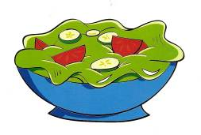
We should (must) eat ...
We shouldn`t (mustn’t) eat …

Slide 36
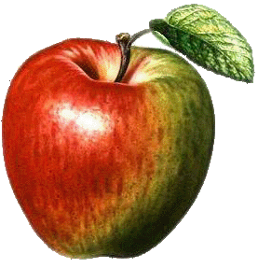
THE LESSON IS OVER…
THANK YOU !
GOOD BYE!

Slide 37
СОСТАВЬТЕ ПОСЛОВИЦУ
away
keeps
the doctor
an apple
a day

Slide 38
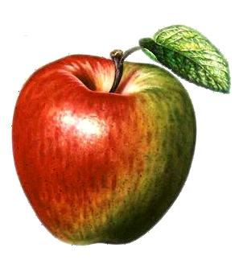
WELL DONE!!!
"AN APPLE A DAY
KEEPS
THE DOCTOR AWAY"

