Slide 1

Self-regulation Day
at our school

Slide 2
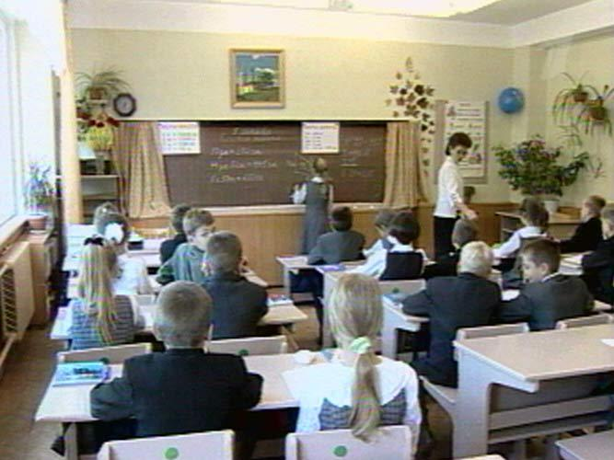

Slide 3
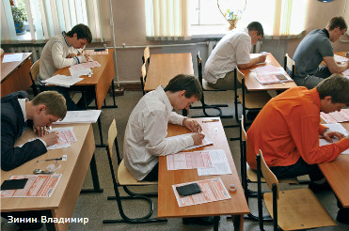
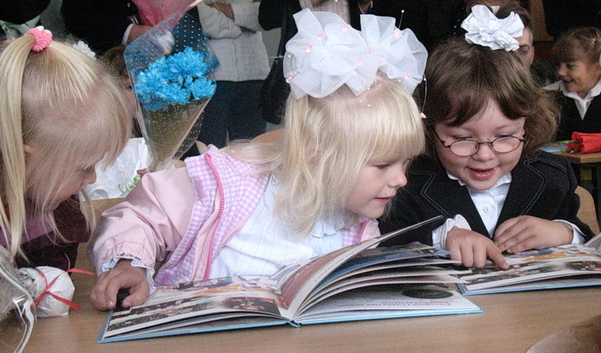

Slide 4


Slide 5
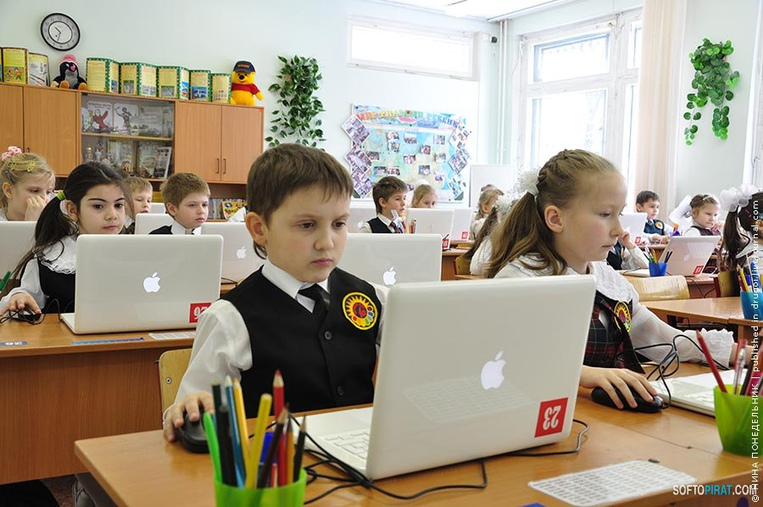

Slide 6
Put in the verbs in the Past Tense:
1. We … (not have) 6 lessons that day.
2. I … (work) hard at the Maths lesson.
3. We …(ask) a lot of questions.
4. Students …(not get) bad marks.
5. Our teachers …(give) only good marks.

Slide 7
Compare your sentences with the example:
1. We didn’t have 6 lessons that day.
2. I worked hard at the Maths lesson.
3. We asked a lot of questions.
4. Students didn’t get bad marks.
5. Our teachers gave only good marks.

Slide 8
Your home task is:
- to write a story about your Self-regulation Day
or
- to read the story about the Self-regulation Day

