Slide 1
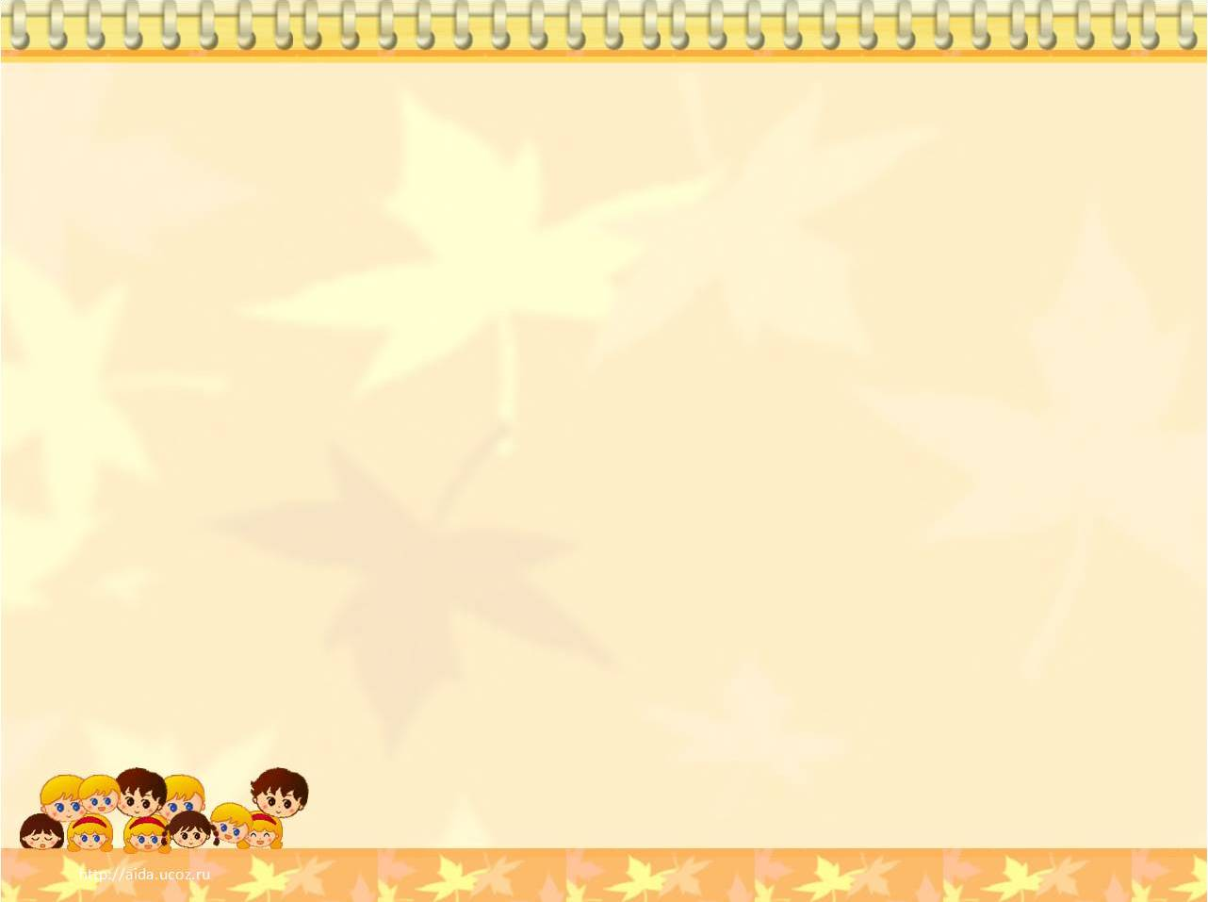
МБОУ «Илькинская средняя общеобразовательная школа»
ПЛАН
урока по английскому языку
6 класс
Тема “English famous sandwiches”
Подготовила и провела: учитель иностранных языков Назарова Е.В.

Slide 2
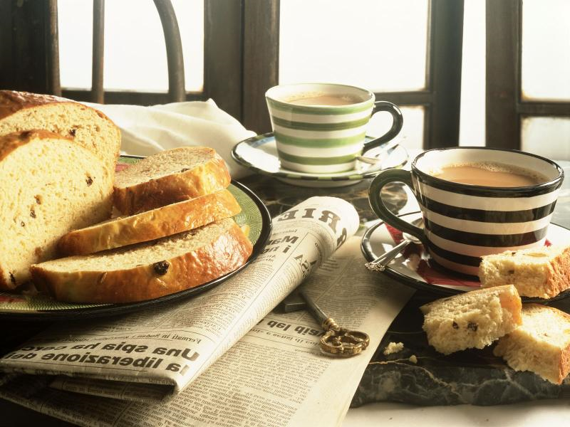
Topic
“English Meals”

Slide 3

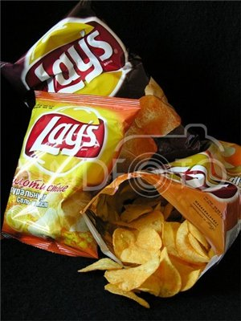
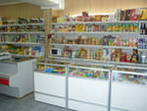
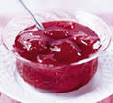




Do a crossword.
People buy food in this place.
It is made from fruit or berries.
A meal between breakfast and dinner.
Christmas food.
The British have a …tooth.
The British like this drink with tea.
This drink is made from fruit.
Children like them very much. They are made from potatoes.
 |  |  | 1
 |  | 2
 | 3
4
 |  | 5
 |  | 6
7
 |  | 8

Slide 4
Exchange your crosswords and check them up.
 |  |  | 1 | S | H | O | P
 |  | 2 | J | A | M
 | 3 | L | U | N | C | H
4 | P | U | D | D | I | N | G
 |  | 5 | S | W | E | E | T
 |  | 6 | M | I | L | K
7 | J | U | I | C | E
 |  | 8 | C | H | I | P | S
8 words – “5”
7 words – “4”
5-6 words – “3”
4 words and less – “2”
Your mark is ____

Slide 5
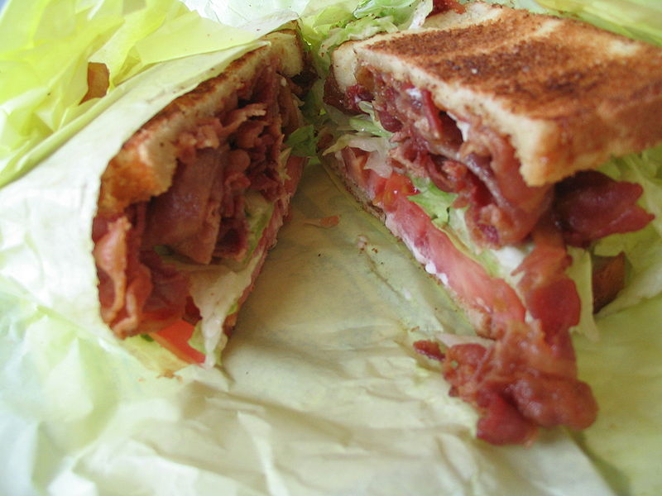
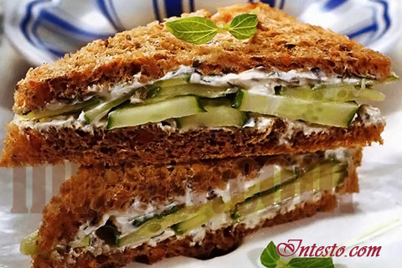
The theme of our lesson is
“Famous English sandwiches”.

Slide 6
Get ready to answer my questions and be attentive.
When do the British people usually eat sandwiches?
There are few sandwiches shops in the capital of England, aren’t there?
What kinds of sandwiches can you name?
How many slices of bread does each sandwich have?
Do foreigners like English sandwiches?
How do we call a kind of sandwich the foreigners like?
Do the English drink much tea?
Why do not foreigners like English tea?

Slide 7
Who invented the sandwich and why?
The Earl (граф) of Sandwich – he wanted food which he could eat with one hand while gambling (игра в карты).
2. Lord Sandwich – he wanted food which he could take for a picnic in the countryside.
3. Queen Elizabeth I – she wanted food which could be prepared quickly for guests.

Slide 8
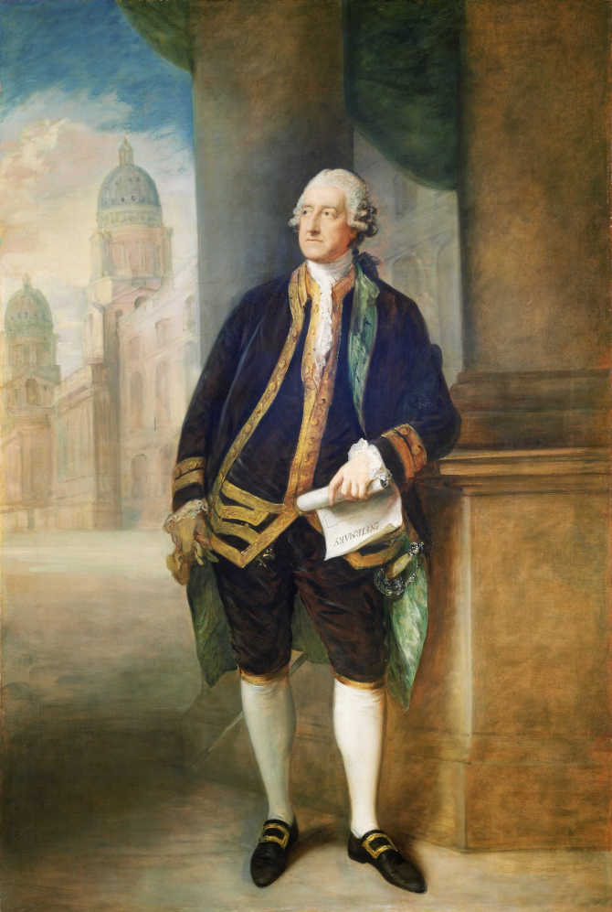
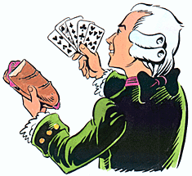
Earl of Sandwich

Slide 9
Прочитайте текст и выполните задания 1 – 4, обведя букву A, B, C или D, соответствующую варианту ответа, который вы считаете наиболее правильным.
What kind of meal did the Earl’s of Sandwich servant invent?
A quick and convenient
B very delicious
C very good for health
D junk food
What was one of the great traditions in Victorian England?
A make cucumbers sandwiches
B cut the crusts off the bread
C have 5 o’ clock tea
D eat lots of sandwiches
What kind of sandwiches do people have today?
A very elegant
B very big
C with many slices of bread
D much bigger than they used to be
          Why do people like to have sandwiches for their meal?
A Because sandwiches are a typical ‘snack’ meal.
B Because people can do sandwiches themselves.
C Because sandwiches are easy and quick to cook.
D Because people can buy sandwiches almost everywhere.

Slide 10


satisfaction
Positive
emotions
Negative
feelings
What emotions do you feel?
joy
success
unsatisfaction
irritation
boredom
happiness
I feel
proud
admiration
sadness
surprise
anxiety
Why?
fear
Because I…
…was (not) bored;
…worked hard;
…didn’t relax;
…answered properly;
…was active, emotional;
…fulfilled the task;
…received reward (a good mark).

Slide 11
Homework
Read what the famous cook says about making sandwiches (p. 133, ex. 35.) and make an “Egg and Spring Onion sandwich (p. 134, ex. 37).
Find interesting facts about the typical Russian food.
стр. 133, упр. 35 (чтение, перевод)
стр. 134, упр. 37 (чтение, перевод)
Найдите интересные факты
о традиционной русской кухне.

