Slide 1

новый

Slide 2


Slide 3
Fabulous Ideas for the First Day of Class

Slide 4

Break the Back-to-School Ice!
Fun Icebreakers for the Beginning of the Year

Slide 5
Welcome back to school everyone!

Slide 6


Slide 7
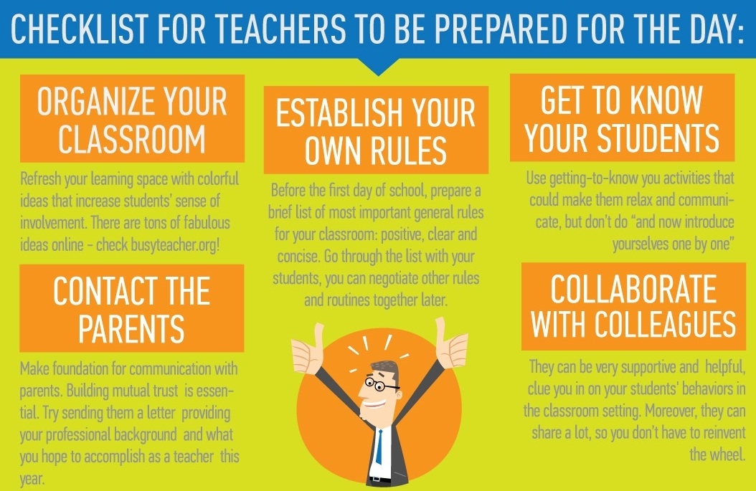

Slide 8
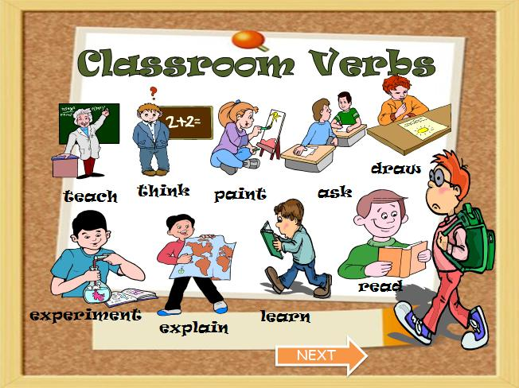

Slide 9
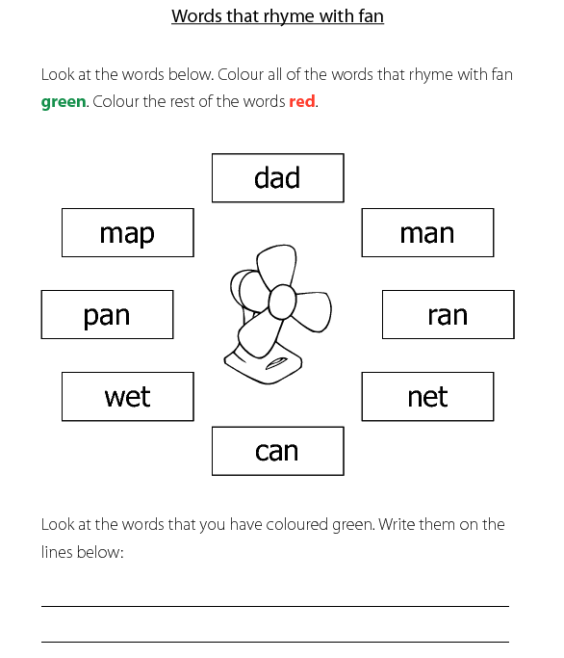

Slide 10
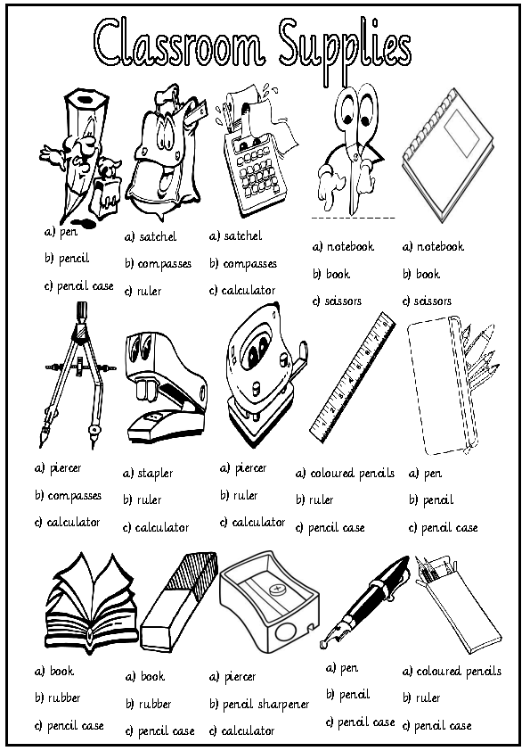

Slide 11
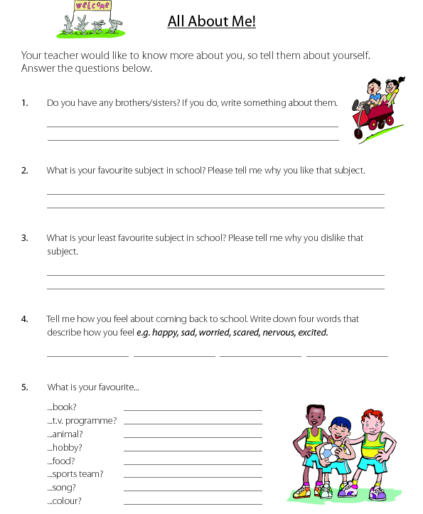

Slide 12
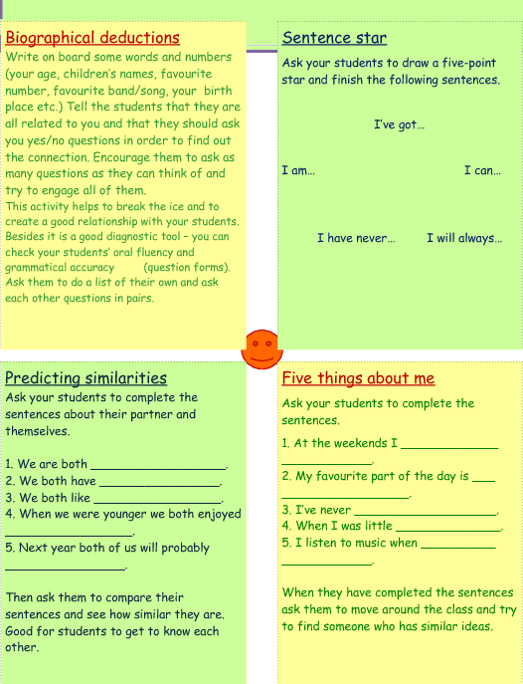

Slide 13
http://busyteacher.org/
teaching_ideas_and_
techniques/warmers-worksheets/

Slide 14
See what’s happening in your area……
Creativity in the Language Classroom
28th - 29th August 2013
Webinar
Join Charles Hadfield as he explores ways to encourage students to overcome their nerves and fears through creative activities.
Warmers, fillers and other quick activities
12 September 2013
Webinar
Join John Hird, author and teacher trainer for a practical session on warmers and fillers, and take away a few tricks that you can always keep up your mind.

Slide 15
What are your
favourite first day
activities?

Slide 16
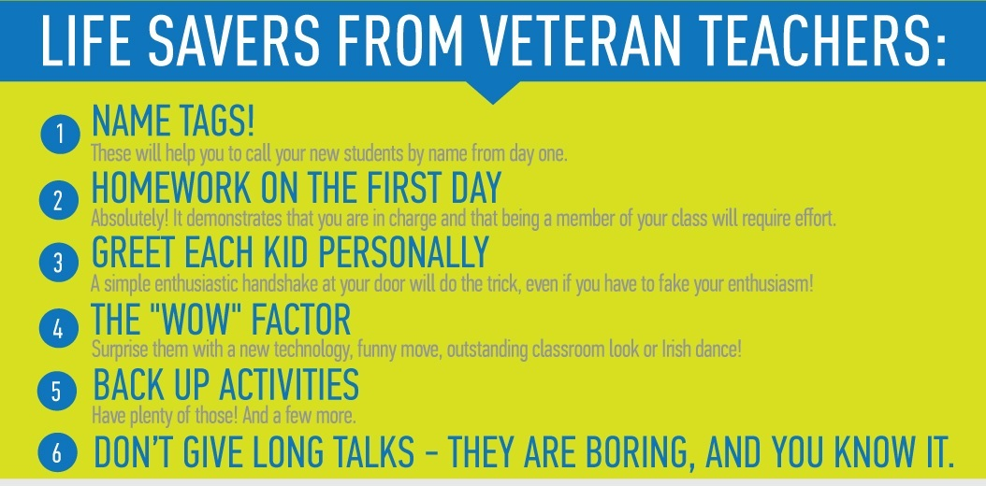

Slide 17


Slide 18
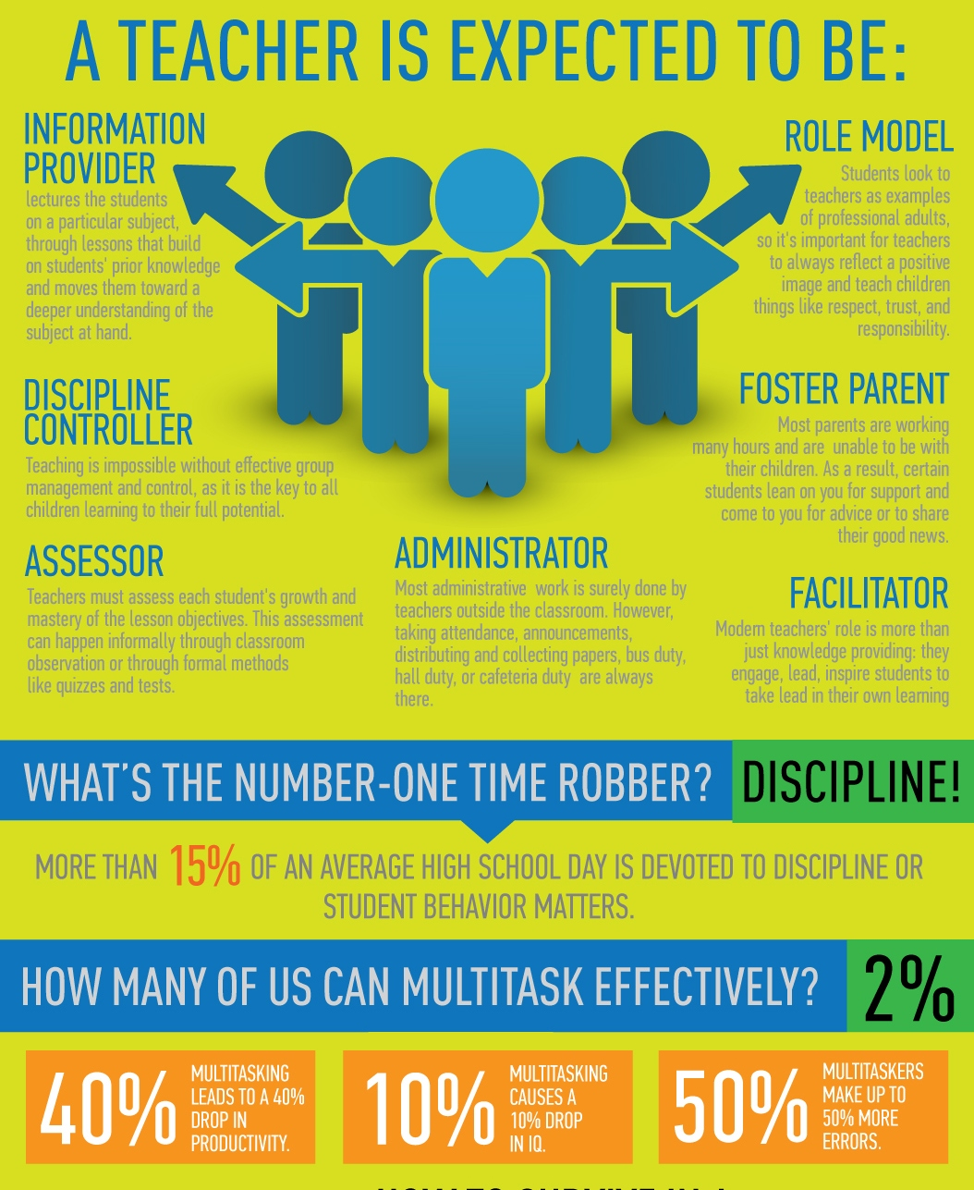

Slide 19
