Slide 1
The Discovery Of America

Slide 2
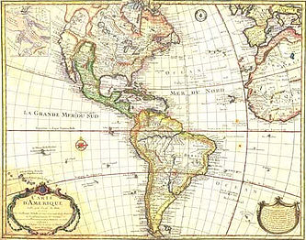
Who discovered America?

Slide 3
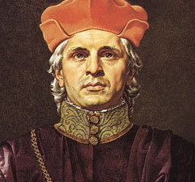
Christopher Columbus
discovered America in 1492.
This seaman was born in Italy, but he lived in Spain for a long time. He was sure, our land is round.

Slide 4
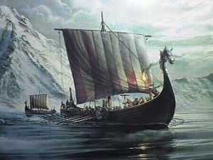
The first Columbus’ voyage to the west was made on purpose to find a short way to get to India.

Slide 5
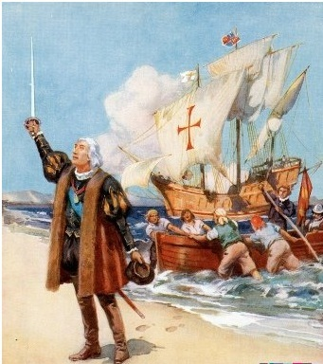
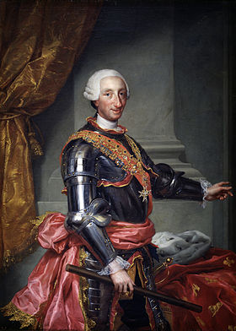
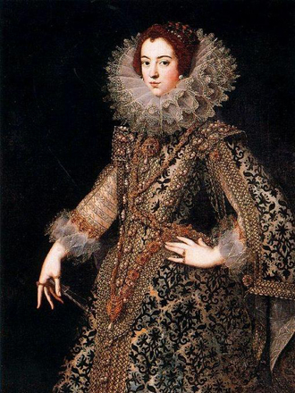
The King and the Queen of Spain gave him money to go there, so after sailing 6400 km he reached some land, but it wasn’t India.

Slide 6
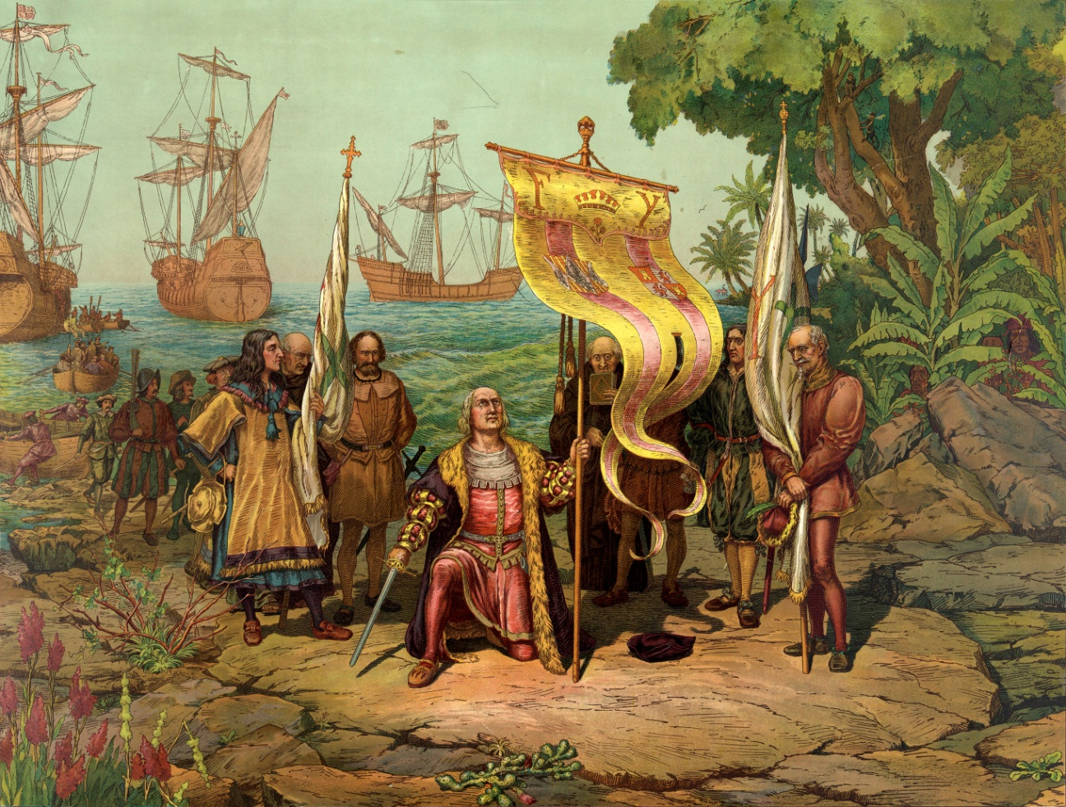
Columbus discovered a new land,
a new continent. It’s called America.
In fact, Columbus reached Central America, and people began to call the land
“The New World”

Slide 7
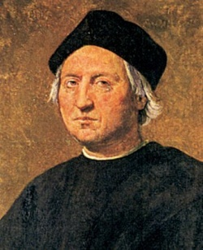
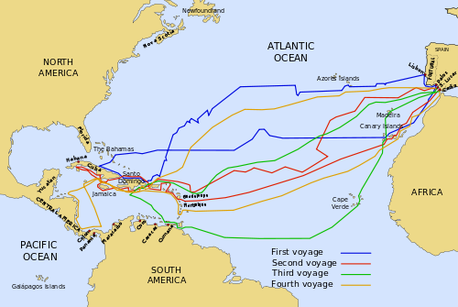
Christopher Columbus also discovered some more islands and reached Cuba.

Slide 8
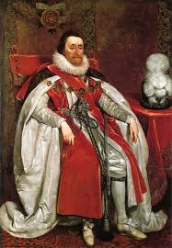
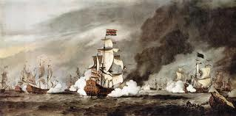
English expedition
After the first Columbus’ voyage to America England became interested in the new continent too.

Slide 9
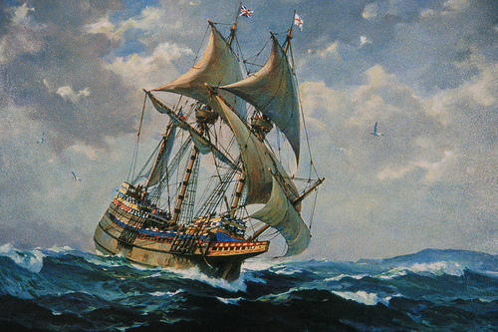
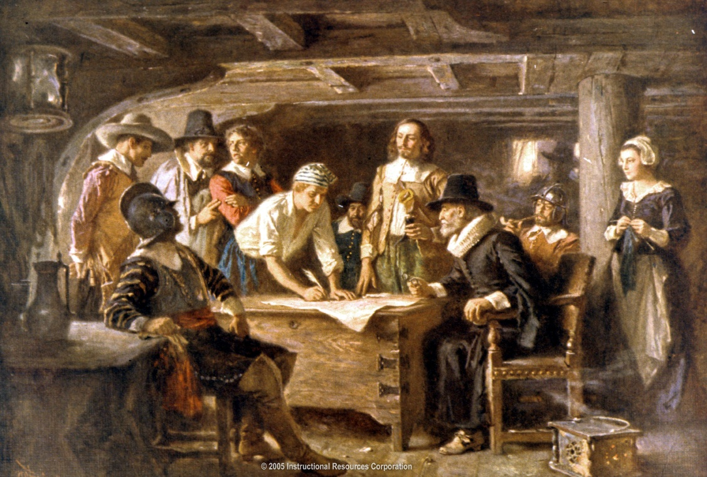
“Mayflower”
On the 6th of September 1620 74 men and 28 women left England on the board of “Mayflower”. They wanted to start a new life in America.

Slide 10
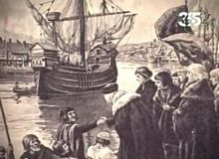
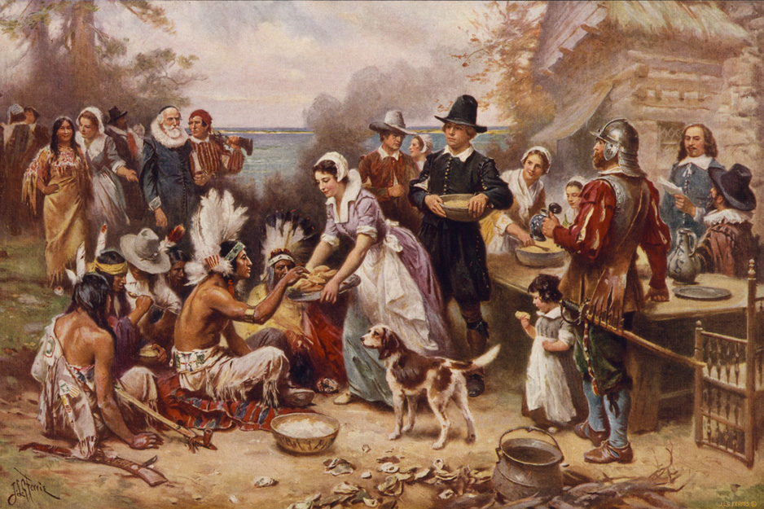
It took the colonists 3 months to get to North America.
They set up a new colony and called that part of the country “New England”.
They also met Native Americans, who were very friendly and helped these people to start the new life though the New World was full of danger.

Slide 11
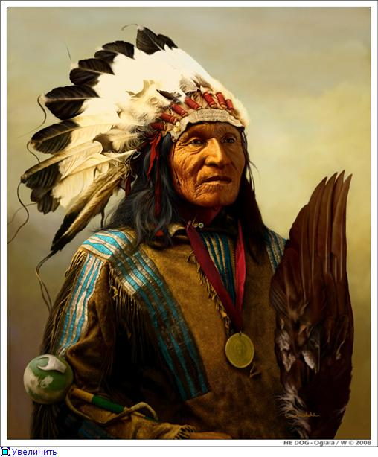
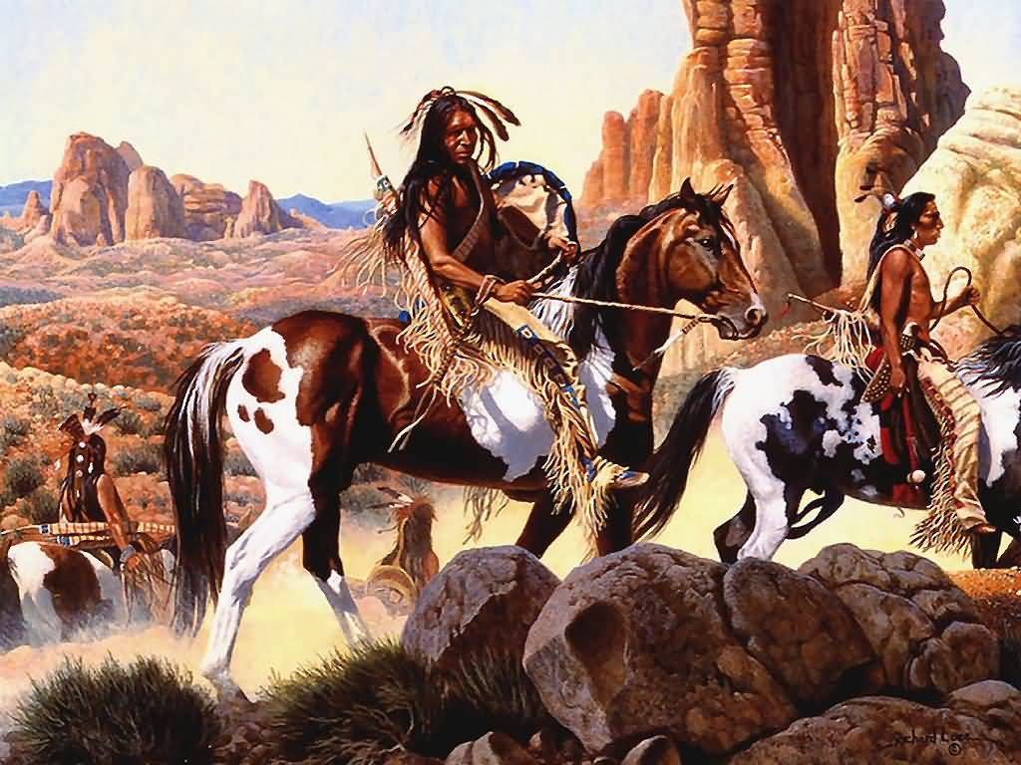
Native Americans
came from Asia over 20000 years ago.
They lived in small earth houses
and grew their own food.
They also believed in many gods.

Slide 12
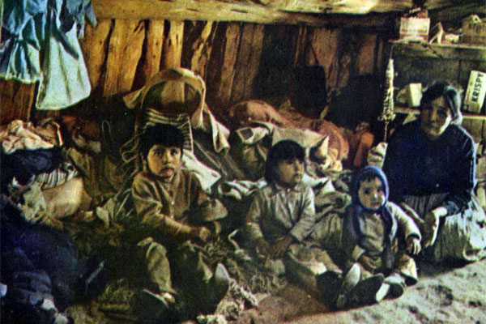
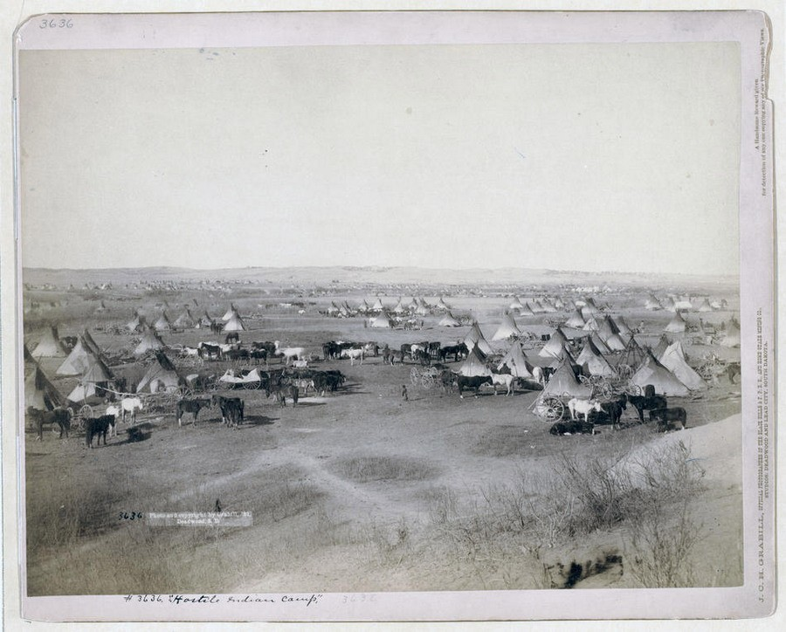
But after the British colonists came, they lost their territories and nowadays Native Americans live in poor lands to the west of Mississippi
on “reservations”.

Slide 13
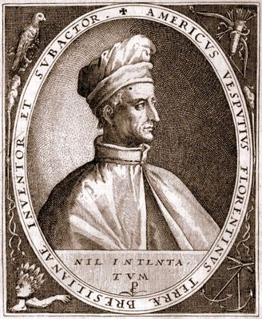
Where does the name “America” come from?
In 1499 Amerigo Vespucci did his
the first voyage to America,
composed of the Spain
expedition. Soon, in 1501 he did
the second voyage along the east
seaside of South America and
wrote a detailed description of
those places (“The letters of Amerigo
Vespucci”). The discovered land was
named “America” in honor of
Vespucci, whose name sounds life
“Americus”.

