Slide 1
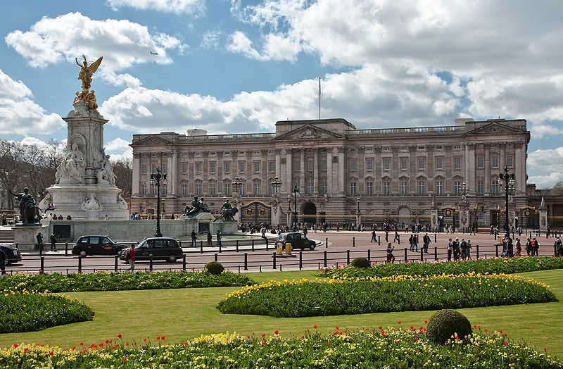
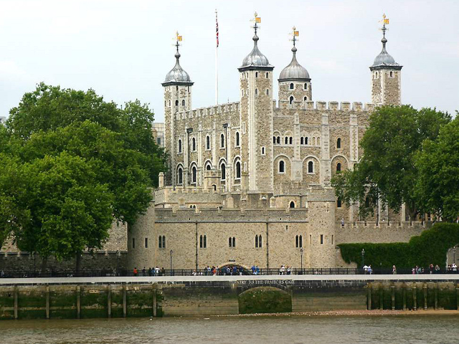
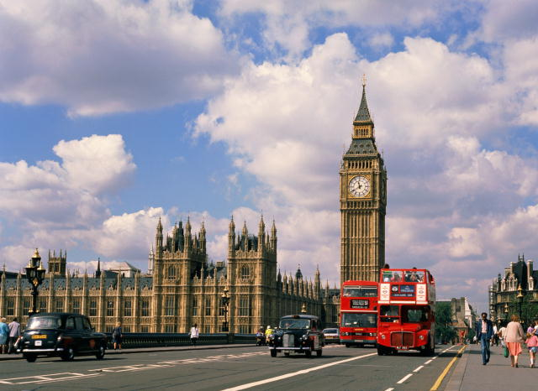
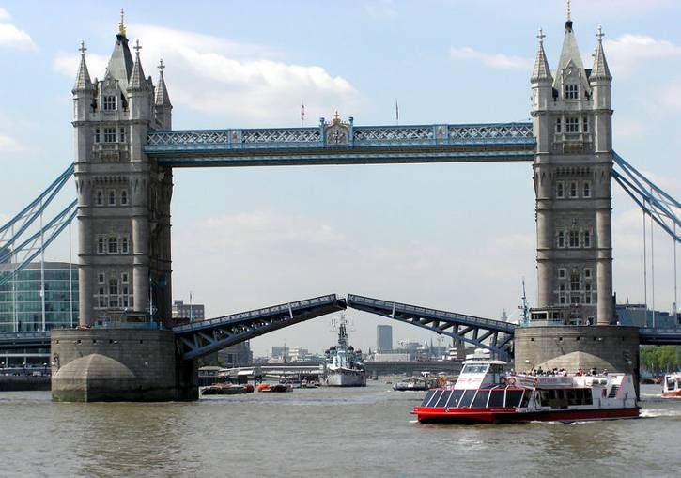




Travelling to

Slide 2
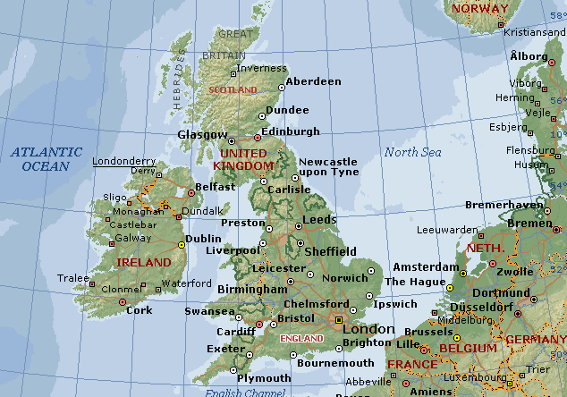
Great Britain
?
?
Wales
?
?

Slide 3
What is the capital of … ?
Scotland
Edinburgh
Northern Ireland
Belfast
Wales
Cardiff
England
London

Slide 4
Read and match
Big
Trafalgar
Bloody
White
Buckingham
Westminster
The Houses of
The Tower of
Palace
Tower
London
Abbey
Ben
Square
Tower
Parliament

Slide 5
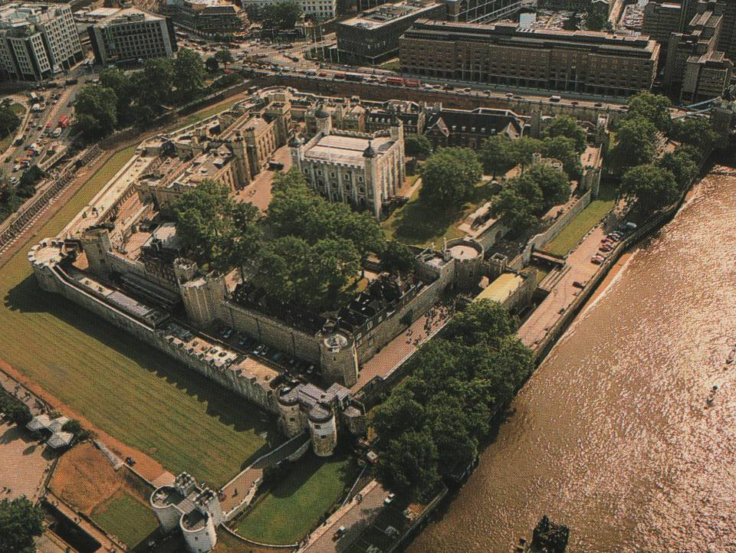
The Tower of London
The Tower has been part of the capital’s history for the past 900 years. The fortress first built by William the Conqueror as a citadel, royal palace, seat of the government. The Tower now protects the Crown Jewels.

Slide 6
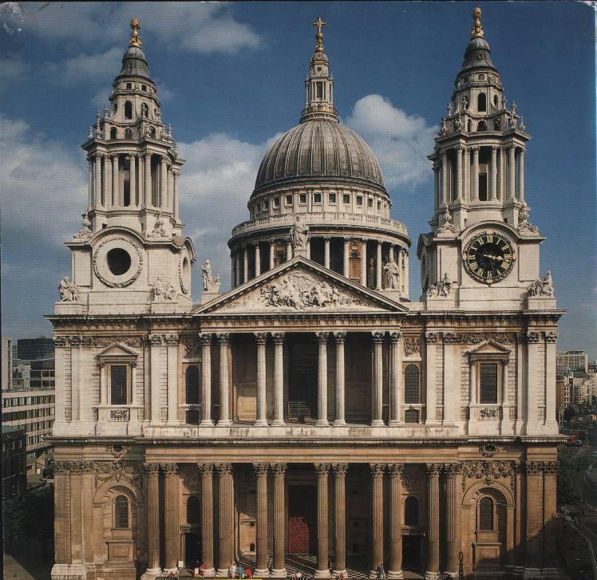
St Paul’s Cathedral
St Paul’s Cathedral is the spiritual centre of the City. Old Saint Paul’s was destroyed by the Great Fire of London in 1666. The fire was so hot, it melted the cathedral bells. After the fire, Sir Christopher Wren designed a new Saint Paul’s.

Slide 7
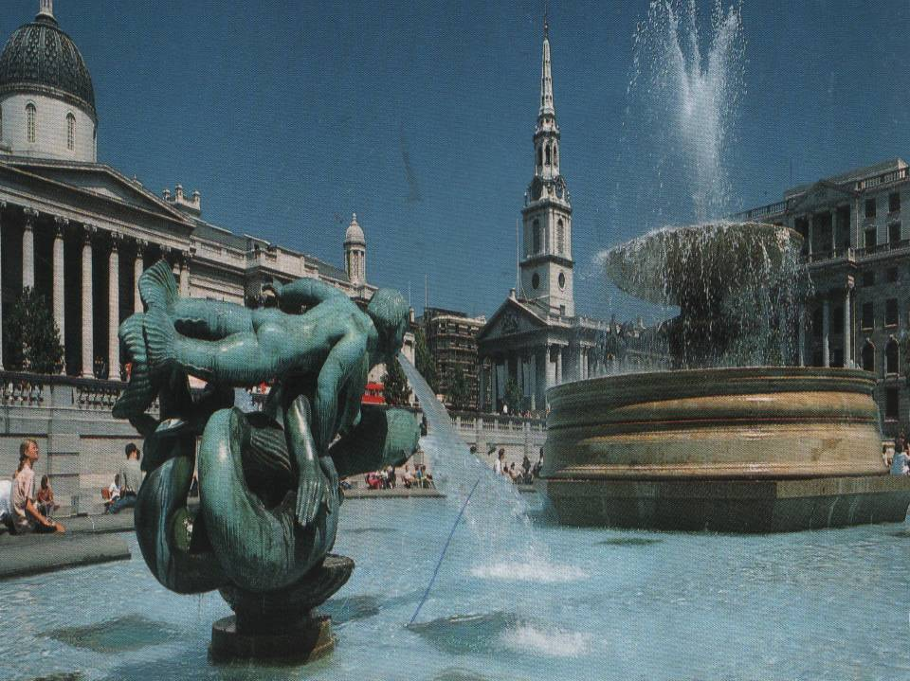
Trafalgar Square
Trafalgar Square is in the centre of the West End of London. On the column in the centre there is a stature of Admiral Nelson who defeated the French at the Battle of Trafalgar in 1805. Trafalgar Square is the place where the meetings and demonstrations take place.

Slide 8
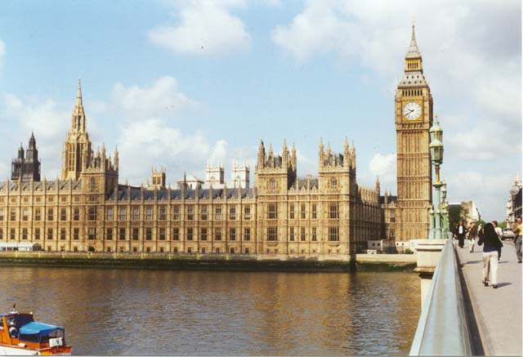
Houses of Parliament
Houses of Parliament stands on the River Thames at Westminster. It begun in 1840 after a Great Fire of London. It is a place where the British Government sits. It consists of three parts: the Royal Apartments, the House of Lords and the House of Commons It is officially known as the Palace of Westminster. The complex includes the 320 foot high Clock Tower. It contains the world famous sight Big Ben.

Slide 9
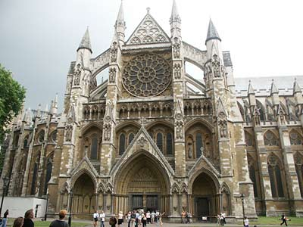
Westminster Abbey
Westminster Abbey has been closely connected with the Crown over 900 years. The Abbey was rebuilt in the 11th century by a king Edward the Confessor. The Abbey contains monuments to monarchs. It is the meeting place for Parliament from the 14th to the 16th centuries.

Slide 10
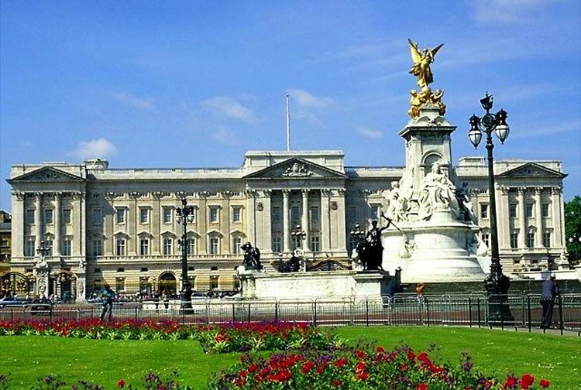
Buckingham Palace
It’s the London home of the Queen. When the flag is flying on the top she is at home. Buckingham Palace was built for John, first Duke of Buckingham, in1703.
Changing the guards takes place there. The palace is open to public.

Slide 11
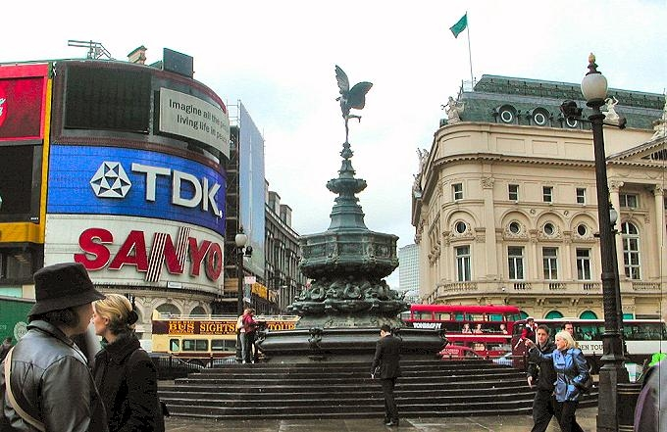
Piccadilly
Piccadilly is the centre of entertainment. It is the meeting point of six streets. Here you can find the most expensive shops, restaurants and entertainment places. This centre was created in 1980s.

Slide 12
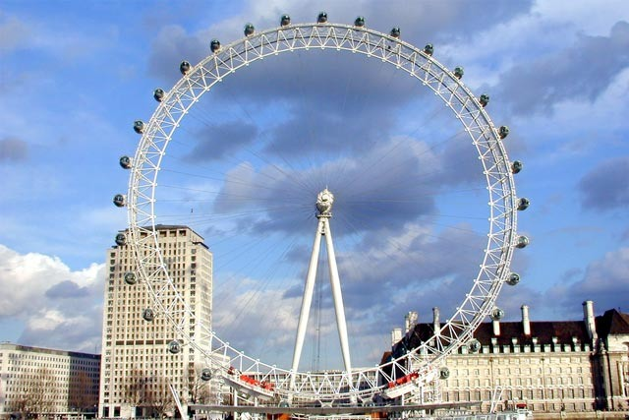
The London Eye
The London Eye is a giant Ferris wheel situated on the banks of the River Thames in London, England. The entire structure is 135 metres tall and the wheel has a diameter of 120 metres.
The London Eye was opened on New Year’s Eve 1999 to celebrate the Millenium.

Slide 13

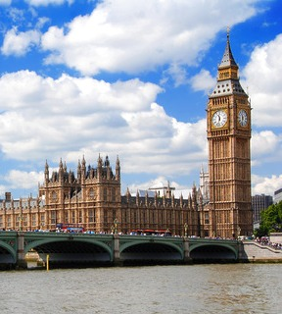


Westminster Abbey
London Bridge
Big Ben

Slide 14
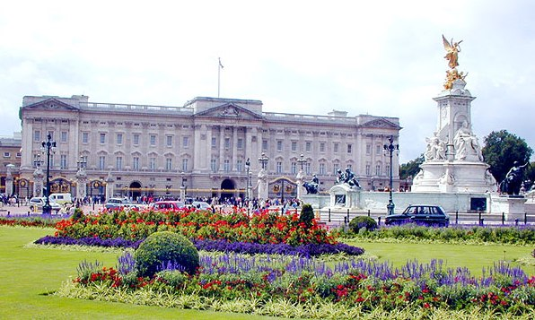
The Houses of Parliament
Buckingham Palace
Westminster Abbey

Slide 15
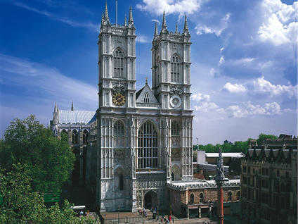
Tower Bridge
London Eye
Westminster Abbey

Slide 16
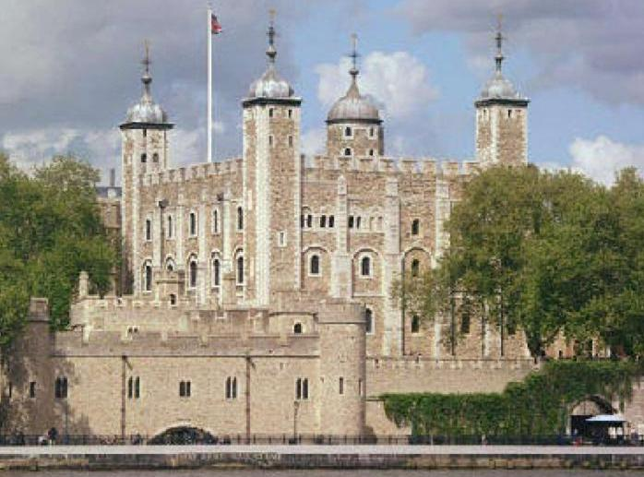
The Tower of London
St. Paul’s
Trafalgar Square

Slide 17
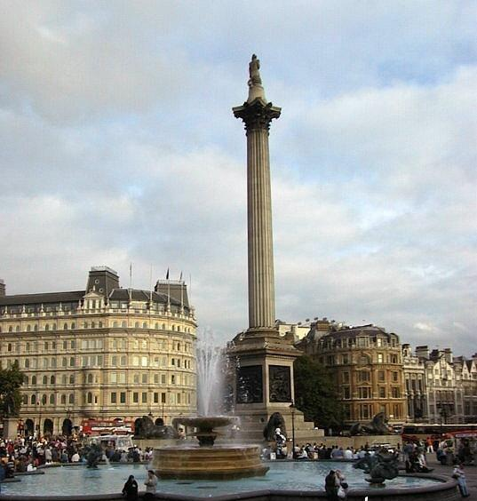
Tate Gallery
London Bridge
Trafalgar Square

Slide 18
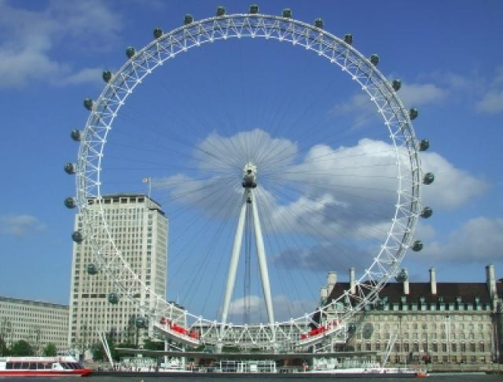
London Zoo
London Eye
London Bridge

Slide 19
Fill in the sentences with the words in the table
London
Queen
cities
The Houses of Parliament
Trafalgar Square
Piccadilly Circus
centre
is the capital of Great Britain.
London is the one of the largest in the world.
There is a Nelson’s Column in the centre of .
is the meeting point of six streets.
is the seat of the British government.
Covent Garden is a fashionable trading .
Buckingham Palace is the London home of the .

Slide 20
