Slide 1
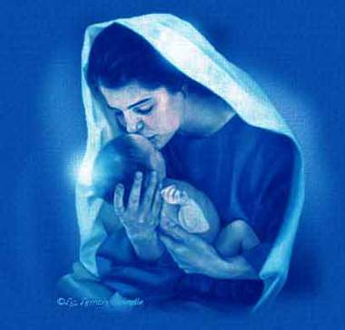

Это доброе слово -
МАМА

Slide 2

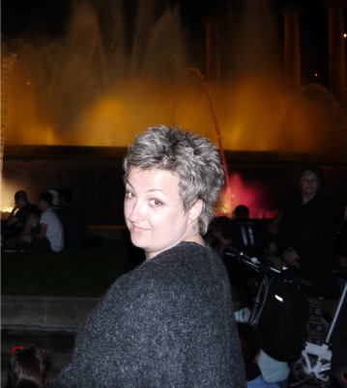

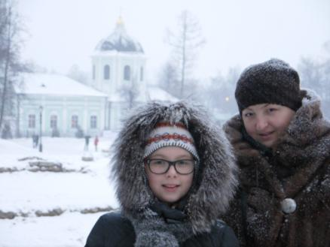
My mother is very kind. She always can help me. She always understands my problems. She is the best! My dear mother, I love you very much!

Slide 3
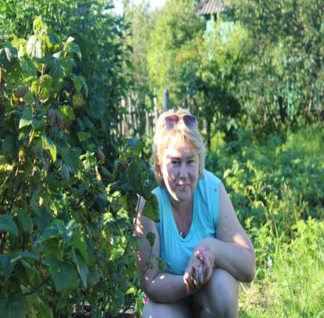


Her name is Svenlana. She is kind ,beautiful and good . She always help me. I love my mum very much.

Slide 4

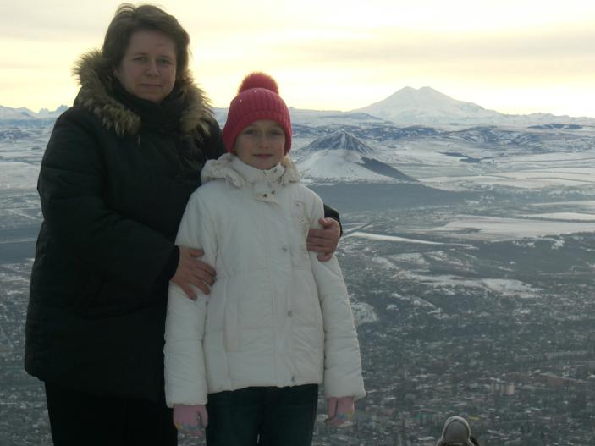

Slide 5

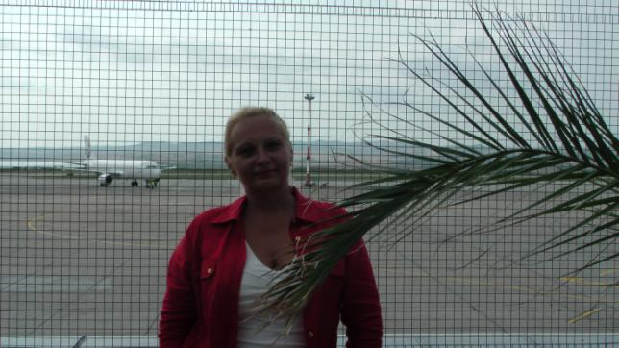
My mom is the best and most gracious

Slide 6
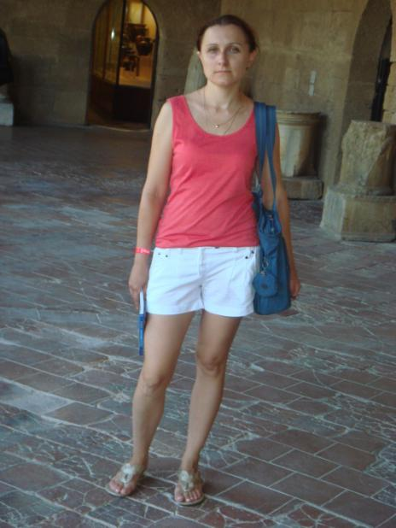

Slide 7
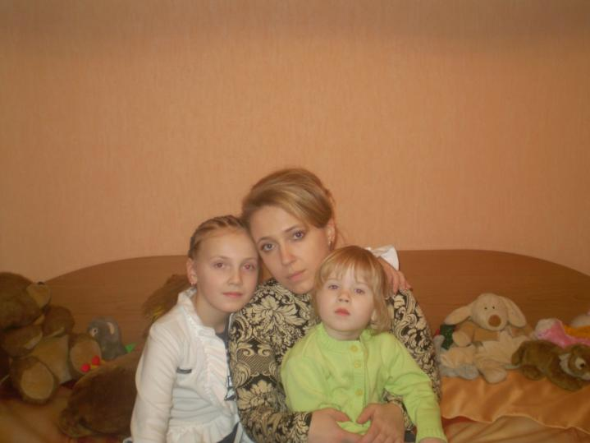

Slide 8
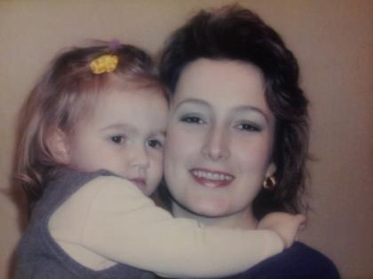
My mother is:
charming
cheerful
beautiful
careful
fine
surprising
happy
THE BEST!
darling
unforgettable

Slide 9

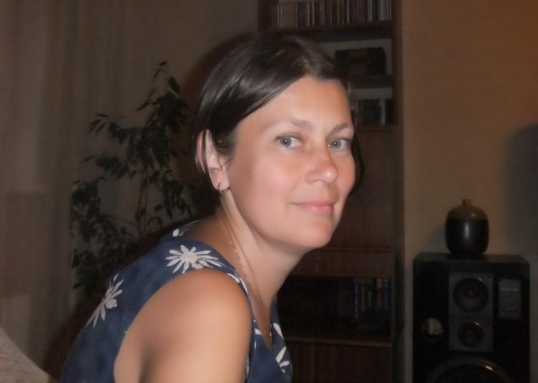

Slide 10
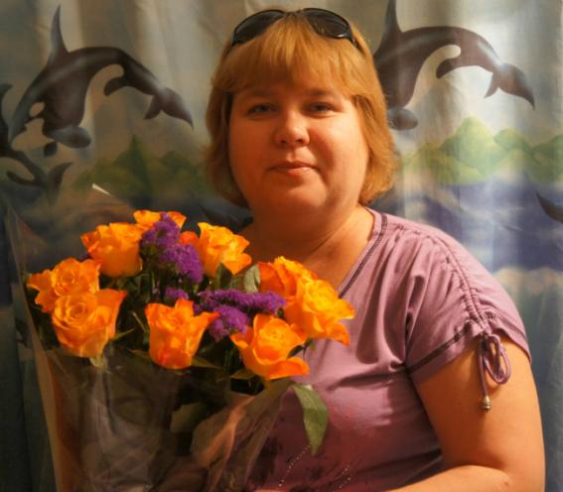
Novikova Svetlana Vladimirovna

Slide 11
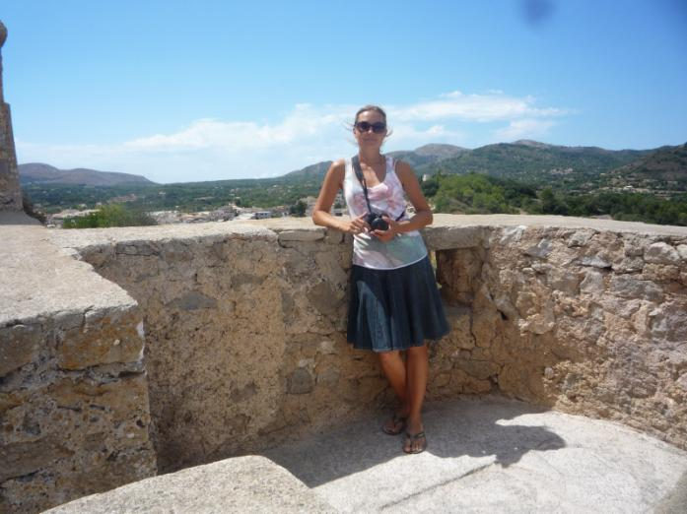

Slide 12
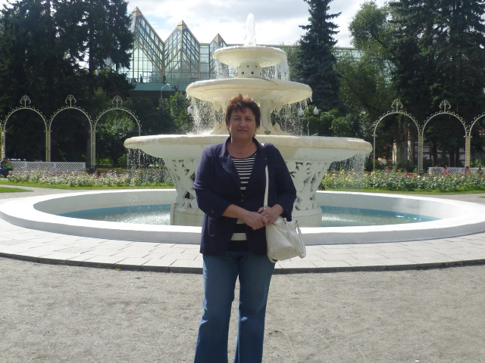

Slide 13

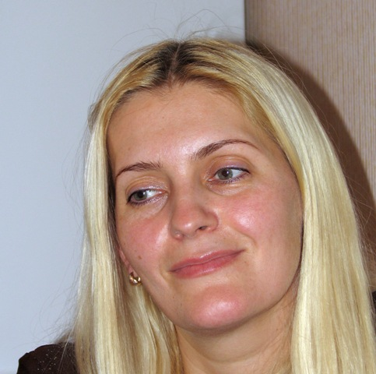
We congratulate dear mothers with a happy holiday!

Slide 14
