Slide 1
Урок английского языка с использованием интерактивной доски
Автор: Рыжкова Ирина Павловна,
учитель английского языка
МБОУ CОШ №85
г. Воронежа

Slide 2
Цель: Ознакомление учащихся с новой лексикой по теме «Аэропорт» и организация тренировки по оперированию данной лексикой на уровне предложения.
Задачи:
Введение новой лексикой по теме «Аэропорт»;
Совершенствование языковых компетенций (умений и навыков диалогической и монологической речи).

Slide 3
Let’s check your homework.
WB Unit 5, Lesson 1-2, Ex. 3
Контроль лексических конструкций.
Вид деятельности: перевод.
Режим работы: У-уч1,уч2,…

Slide 4
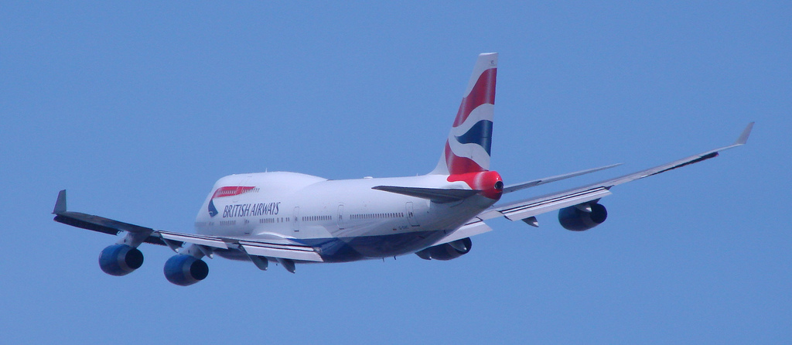
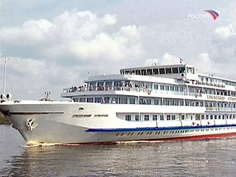
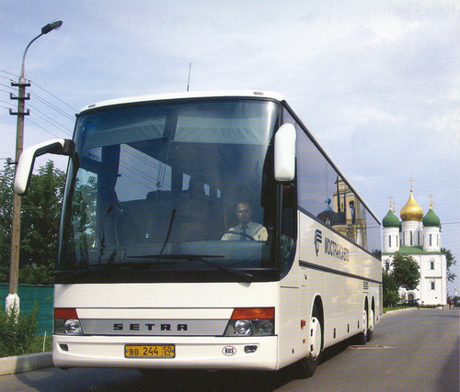
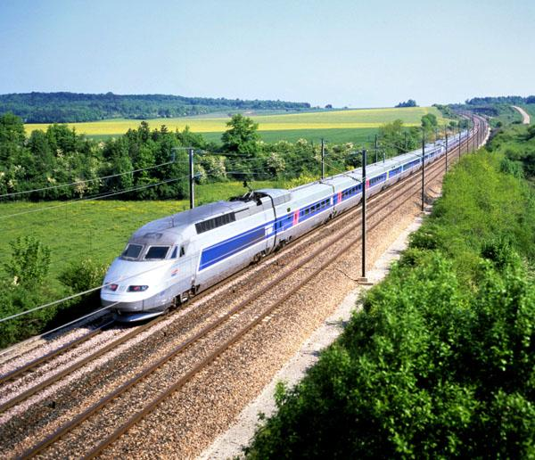
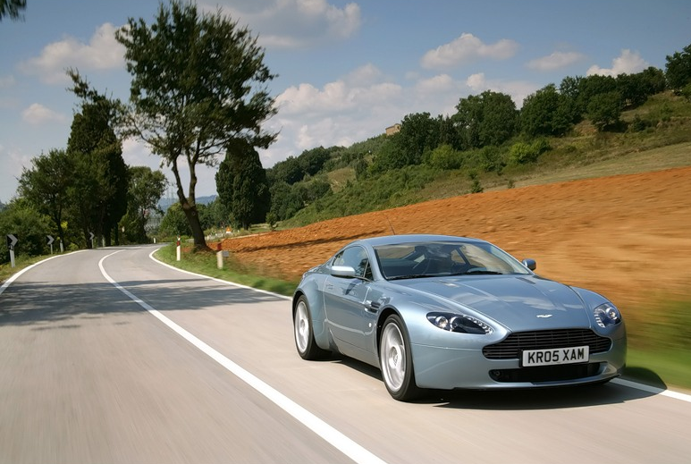
ЭПИГРАФ

Slide 5
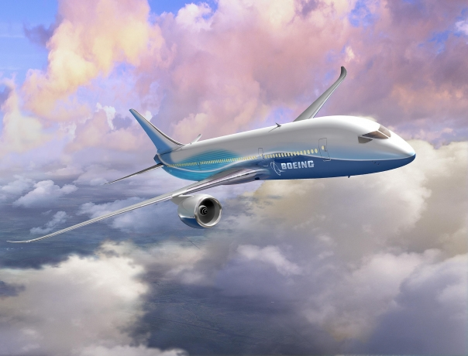
Air travel

Slide 6

check

Slide 7
baggage

Slide 8
property

Slide 9
boarding

Slide 10
passport

Slide 11
lounge

Slide 12
luggage

Slide 13
terminal

Slide 14
reclaim

Slide 15
customs

Slide 16
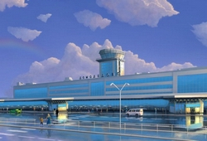
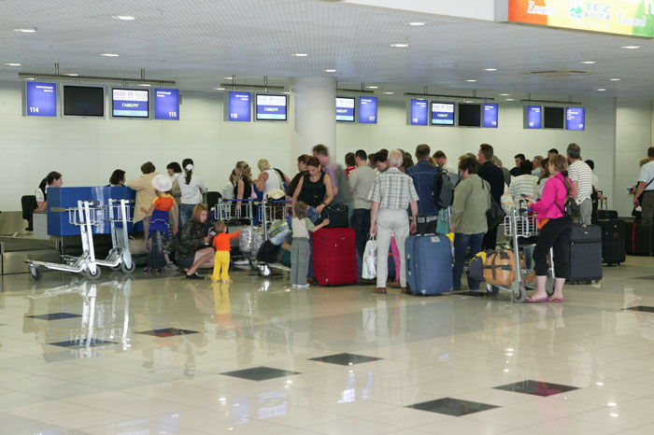
When we get to the airport, first we go to the check-in desk where they weigh our luggage.

Slide 17
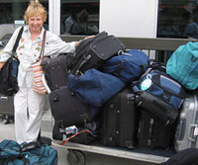
Usually we are permitted 20 kilos, but if our bags weigh more, we have to pay excess baggage.

Slide 18
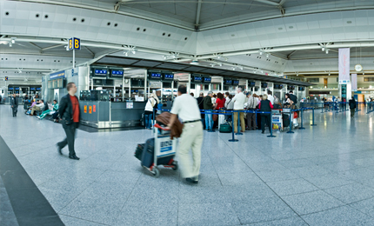
When we lose our bags, we have to go to the lost property office.

Slide 19
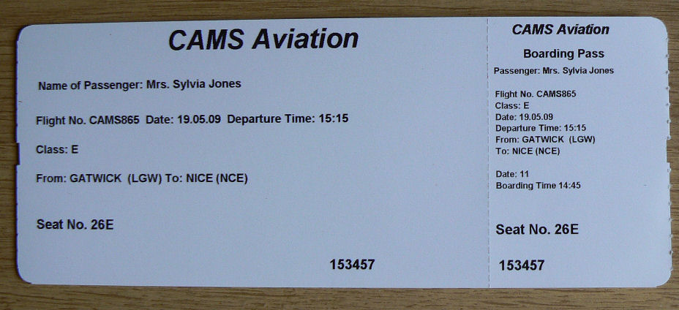
The airline representative checks our tickets and gives us boarding cards for the plane with our ticket numbers on it.

Slide 20
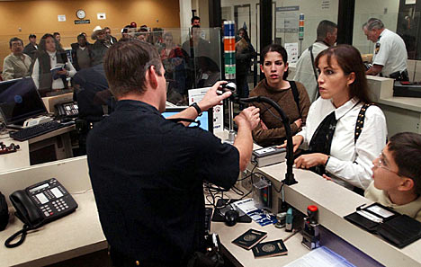
Then we go through passport control where a customs officer checks our passports.

Slide 21
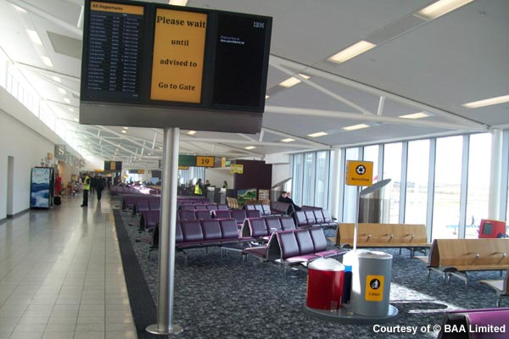
After customs we go into the departure lounge. Here we can have a rest and read newspapers/books.

Slide 22
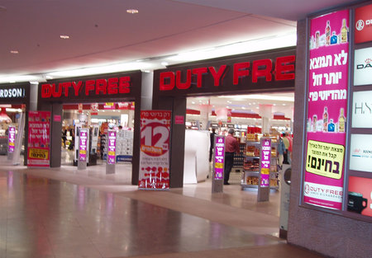
At the departure lounge, we can also buy things in the duty-free, e.g. perfume and souvenirs.

Slide 23
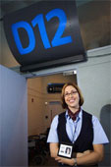
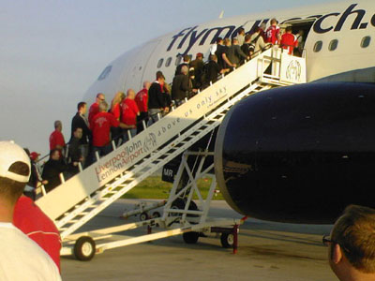
About half an hour or forty minutes before take-off, we are told to go to a gate number, e.g. gate D12, where we wait before we get on the plane. When we get on the plane, we find our seats.

Slide 24
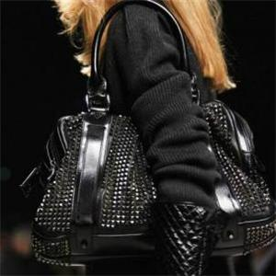
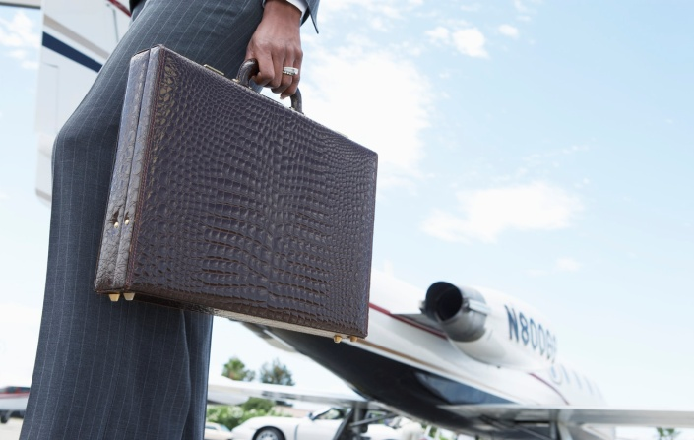
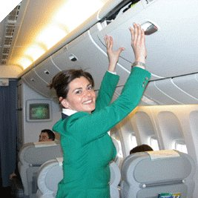
If we have hand luggage, we can put it under our seats or in the overhead locker above our seats.

Slide 25
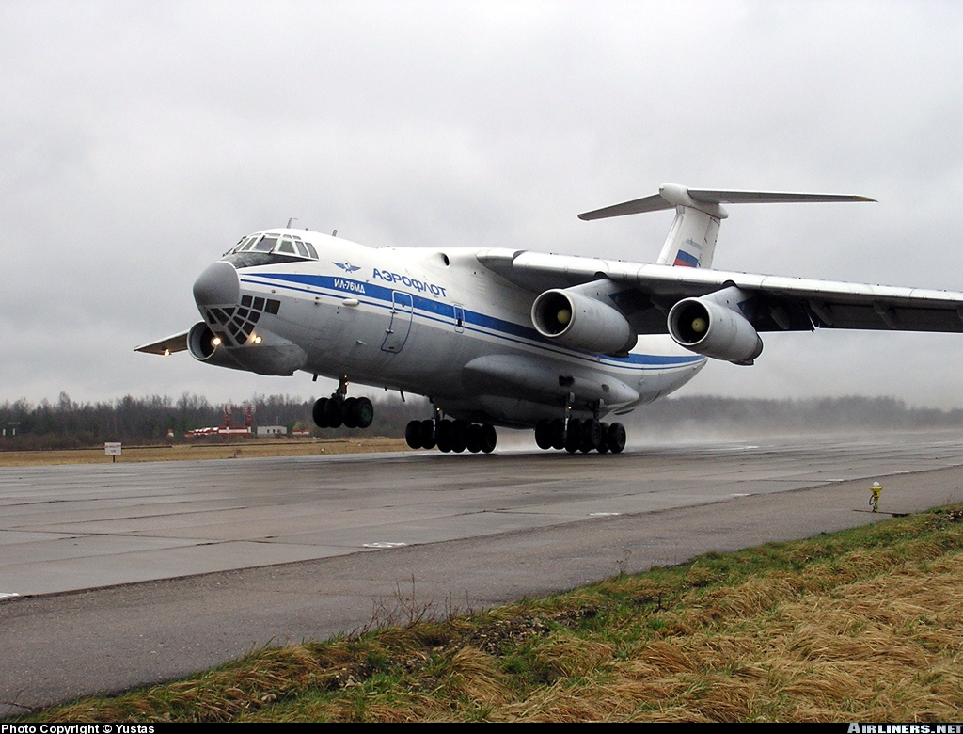
The plane arrives on the ground, we have to wait for it to stop. Then the doors are open, we get off the plane.

Slide 26
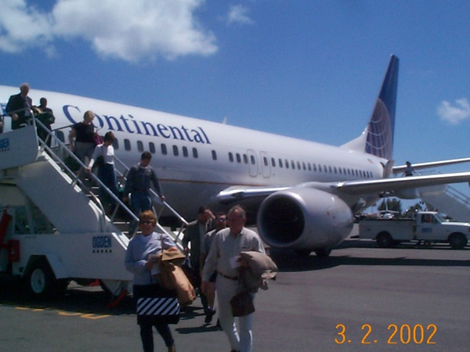
When we get off the plane, we go to the terminal building.

Slide 27
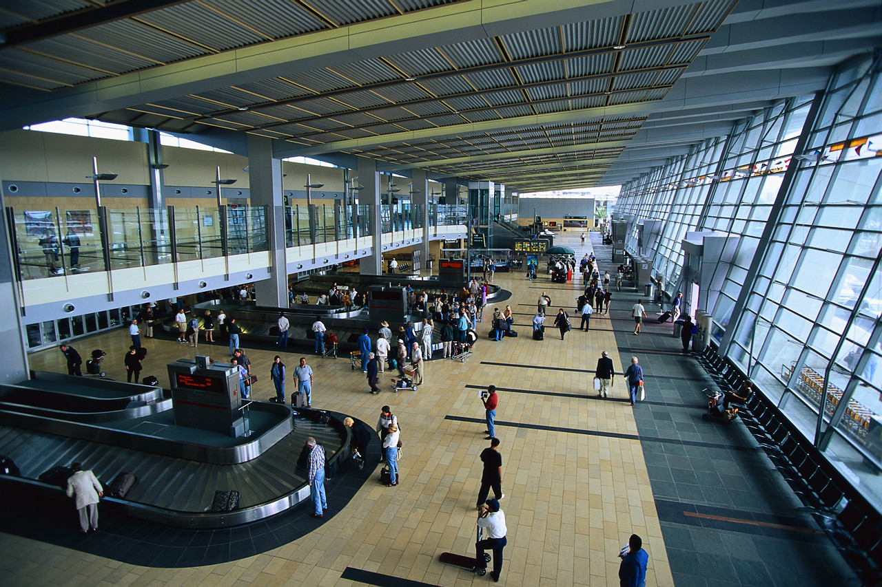
At the baggage reclaim we collect our luggage.

Slide 28
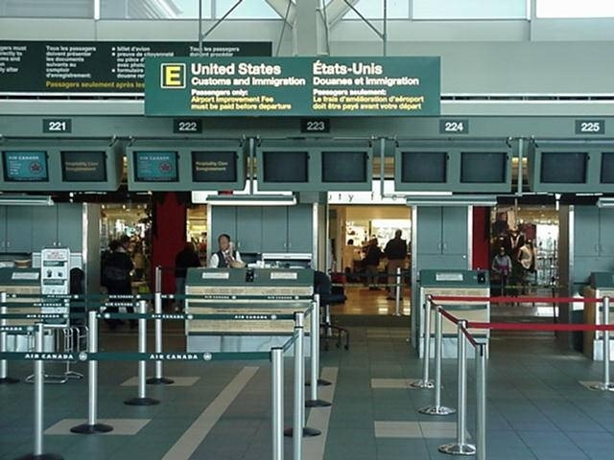
Then we pass through customs, here we can declare our goods.

Slide 29
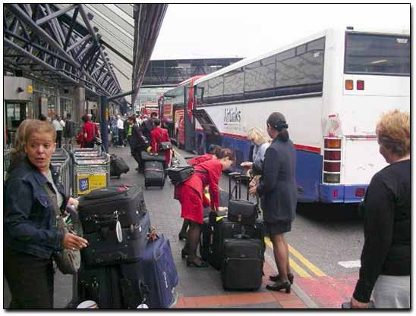
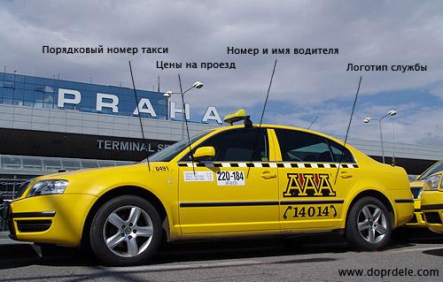
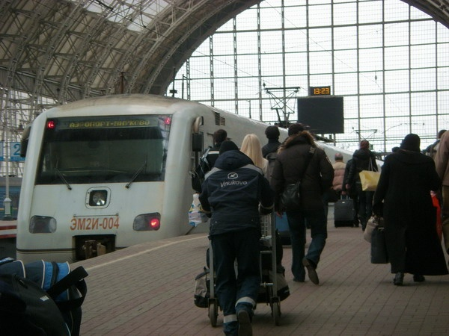
If we are lucky, we can get a bus, taxi or train to the center of a town without waiting too long.

Slide 30
Check up yourselves:
check-in desk
excess baggage
lost property office
boarding card
passport control
departure lounge
duty-free
gate
hand luggage
overhead locker
to get off the plane
terminal building
baggage reclaim
customs
to get a bus/taxi
стойки регистрации
превышение нормы багажа
бюро находок
посадочный талон
паспортный контроль
зал ожидания
магазин (где товары не облагаются налогом)
выход
ручная кладь
верхний запирающийся шкафчик
сходить с самолёта
конечная станция
место выдачи багажа
таможня
добраться на автобусе/такси

Slide 31
Complete the words or phrases below using words from the box.
Boarding ……….
Baggage ……….
Excess ……….
Passport ……….
Hand ……….
Duty …………
Overhead ……….
Take-……….
Departure ……….
Check-……….
off control free card baggage in lounge luggage reclaim locker

Slide 32
What do we call:
The place where you go when you arrive at the airport with your luggage.
check-in desk
The card they give you with the seat number on it.
boarding card
The money you have to pay if your luggage is very heavy.
excess baggage
The place where you sit and have a drink when you are waiting for your flight to be called.
departure lounge
The bags you carry onto the plane with you.
hand luggage
The place above your head where you can put your hand luggage.
overhead locker
The part of the airport you walk through when you arrive or depart.
terminal building
The place where you collect your luggage after you land.
baggage reclaim

Slide 33
Fill in the gaps with the appropriate words in the box.
Information desk flight lost property office baggage check-in desk excess gate boarding cards customs departures duty free shop/store terminal
We arrived at the airport in plenty of time. We put our (1)_______ onto trolleys and headed into the (2)_______ . At the (3)_______ we asked where the (4)_______ area was and first went to the (5)_______ . They looked at my ticket and weighed my baggage. It was 25 kilos. I was only allowed 23 kilos so I paid for my (6)_______ baggage. We got our (7)_______ and went to (8)_______ and passport control. An officer asked me if I had any guns or drugs with me. I tried to say no in Chinese but the officers were quite competent in English and we continued in English.
We decided to go to the (9)_______ and I bought some souvenirs.
We went to one of the airport bars when my wife noticed she didn’t have her handbag with her. She was very upset. We looked around but without any success. After fifteen minutes we decided to go to the (10)_______ . We didn’t really think it would do any good so we were really surprised when they had my wife’s handbag! This made her so happy that she forgot about her fear of flying. At that moment they called our (11)_______ . We found our (12)_______ , showed our boarding cards and passports again and got on the plane .

Slide 34
Fill in the gaps with the appropriate words in the box.
Information desk flight lost property office baggage check-in desk excess gate boarding cards customs departures duty free shop/store terminal
We arrived at the airport in plenty of time. We put our (1)_______ onto trolleys and headed into the (2)_______ . At the (3)_______ we asked where the (4)_______ area was and first went to the (5)_______ . They looked at my ticket and weighed my baggage. It was 25 kilos. I was only allowed 23 kilos so I paid for my (6)_______ baggage. We got our (7)_______ and went to (8)_______ and passport control. An officer asked me if I had any guns or drugs with me. I tried to say no in Chinese but the officers were quite competent in English and we continued in English.
We decided to go to the (9)_______ and I bought some souvenirs.
We went to one of the airport bars when my wife noticed she didn’t have her handbag with her. She was very upset. We looked around but without any success. After fifteen minutes we decided to go to the (10)_______ . We didn’t really think it would do any good so we were really surprised when they had my wife’s handbag! This made her so happy that she forgot about her fear of flying. At that moment they called our (11)_______ . We found our (12)_______ , showed our boarding cards and passports again and got on the plane .

Slide 35
Imagine the situation and answer the questions:
You are at the airport. Where do you go?
You are at the check-in desk. What do you get?
Your bags weight more then it’s permitted. What have you to pay?
You need to go through passport control. Where do you go?
You are at the departure lounge. Where can you buy souvenirs?
You are told to go to a gate number. What do you wait?
You have your hand luggage. Where can you put it in the plane?
The plane arrives on the ground. The doors are open. What have you to do?
You get off the plane. Where do you go?
You’ve taken your luggage. What transport can you get to go to a town?

Slide 36
Домашнее задание.
Think about the whole experience of flying (from check-in desk to the time you leave the airport ) and make an essay about «My air travel to London».

