Slide 1
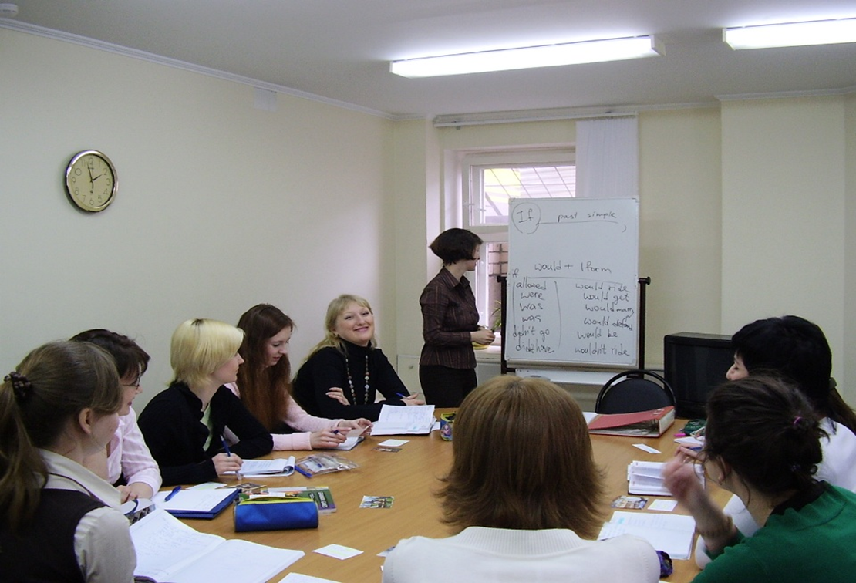

Slide 2




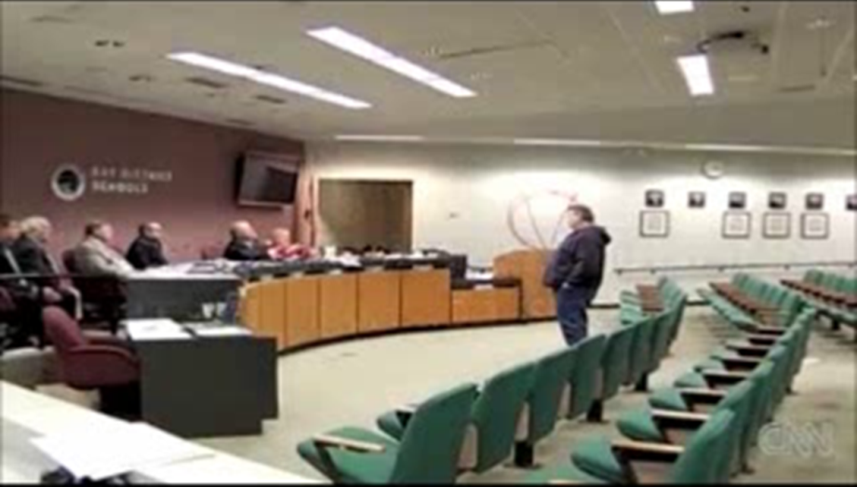
6 Form – Christmas
7 Form – In the World of Books
8 Form – Sport and the Olympics
9 Form – Healthy Food vs. Unhealthy Food
10 Form – Crime, Security and Safety

Slide 3
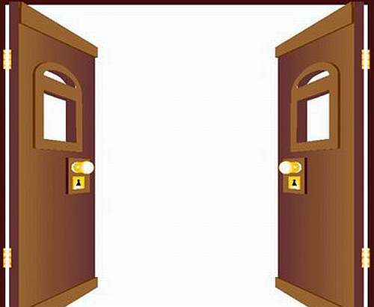
?
11 Form

Slide 4
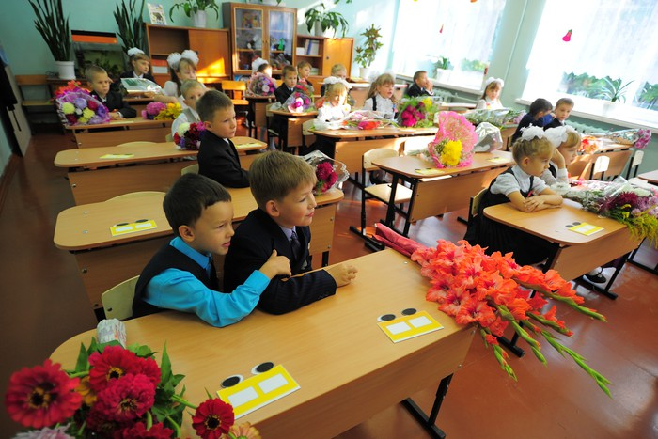
Video of a 2nd form student
FORM: 2B

Slide 5
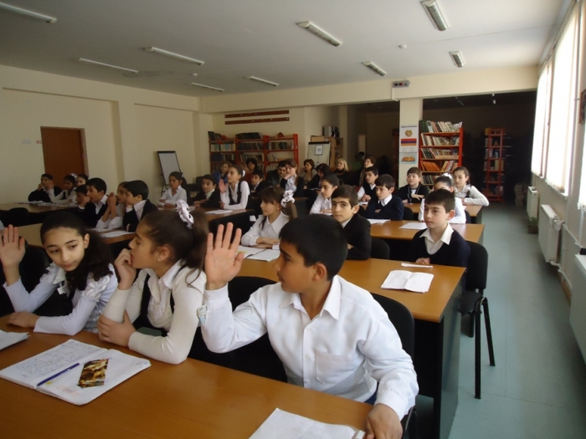
Video of a 6th form student
FORM: 6B

Slide 6

Work and Future Career

Slide 7

2nd Form
FORM: 2B

Slide 8
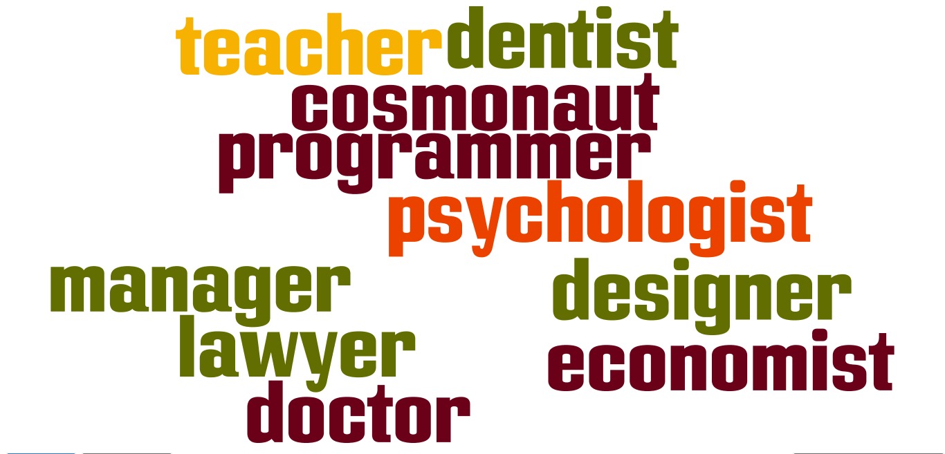
6th Form
FORM: 6B

Slide 9
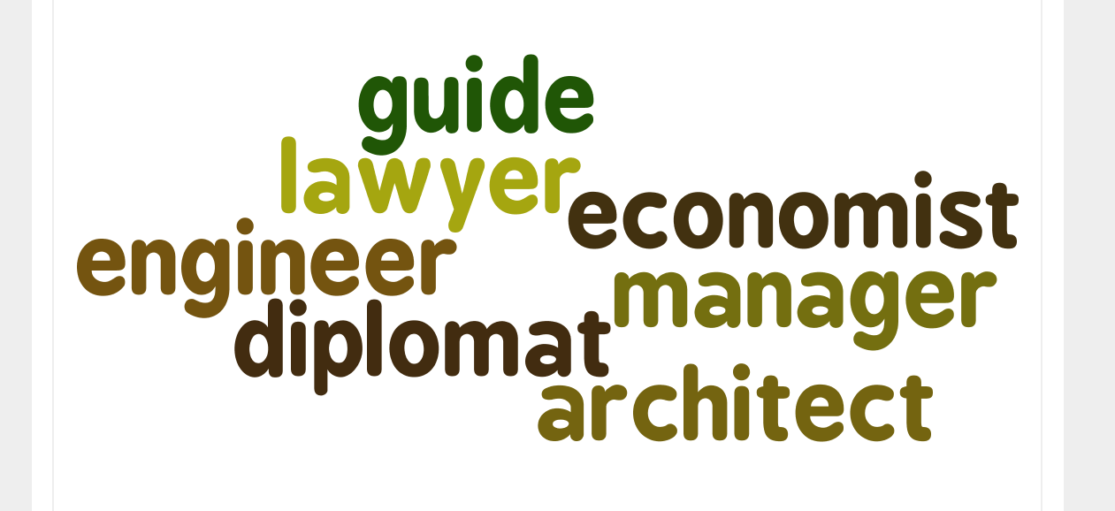
11th Form
FORM: 11B

Slide 10
“The Future of Work”- http://www.youtube.com/
watch?v=p6Dee5woT3A

Slide 11
C2 Comment on the following statement.
Many people think that the best way to work is from home.
What is your opinion? Do you agree with this statement?
Write 200-250 words.
Use the following plan:
Make an introduction (state the problem)
Express your personal opinion and give 2-3 reasons for your opinion
Express an opposing opinion and give 1-2 reasons for this opposing opinion
Explain why you don’t agree with the opposing opinion
Make a conclusion restating your position

Slide 12


Slide 13
B11 – UNCERTAIN
B12 – FLUCTUATIONS
B13 – EMPLOYMENT
B14 – BUSINESS
B15 – OWNER
B16 - DIFFERENT
KEYS

Slide 14


Slide 15
Keys
A | B | C | D | E | F | G
1 | 3 | 6 | 4 | 2 | 5 | 8

Slide 16

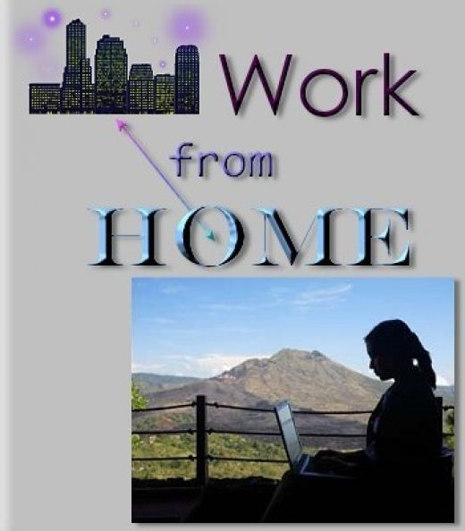
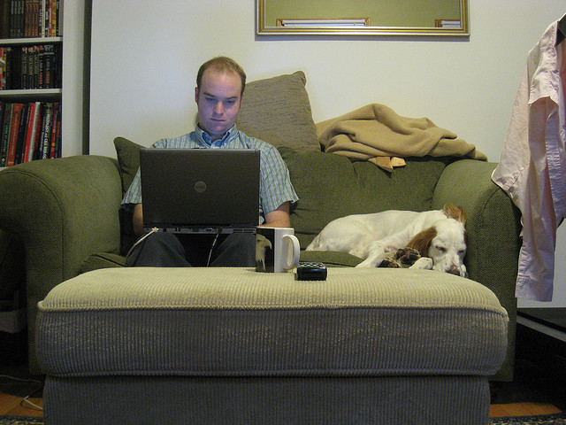

Slide 17
“Benefits of teleworking” (http://www.youtube.com/watch?v=G7onb_1jXMM)

Slide 18
“Disadvantages
of work from home”
(http://www.youtube.com/watch?v=gdbcrDwc3sE)

Slide 19

Essay

Slide 20

Thank You for Your Work !

