Slide 1
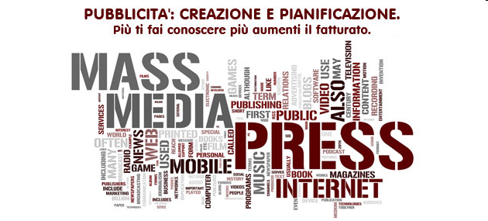
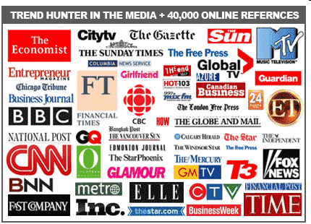
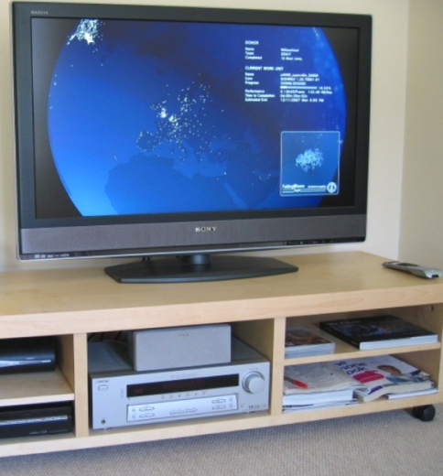
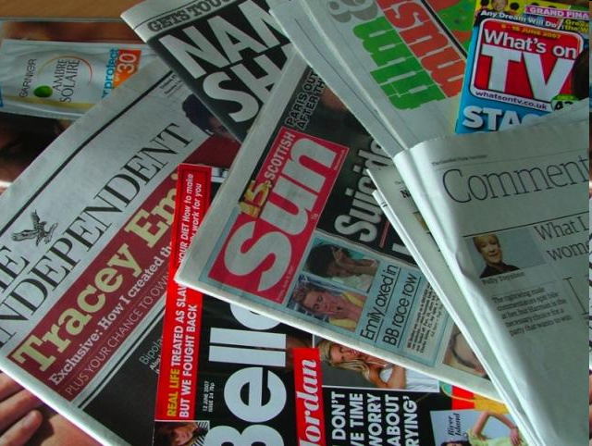

Slide 2
Mass Media
Mass media is a broad concept. It includes
radio, television, newspapers, magazines,
Internet and else.
It informs us about current affairs in the world. It
educates us, gives a possibility to learn
something new.
Millions of people watch TV every day, listen to
the radio in cars, read newspaper and
magazines.

Slide 3
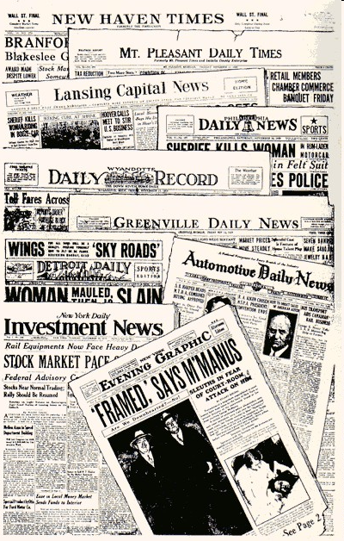
Newspapers
A newspaper is a
publication containing
news and information and
advertising, usually
printed on low-cost paper
called newsprint. It may
be general or special
interest, most often
published daily or
weekly.

Slide 4
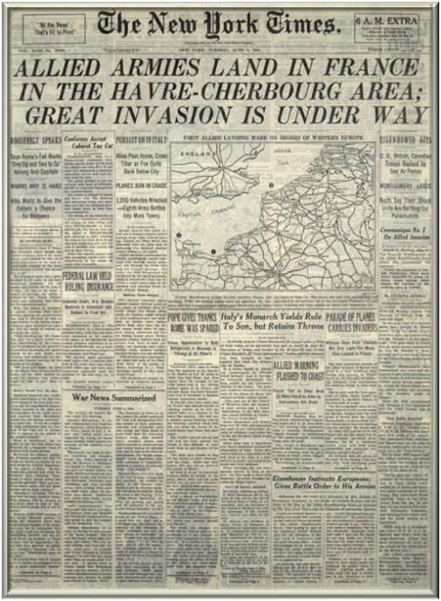
The first newspaper
The first printed newspaper was
published in 1605, and the form has thrived even in the face of competition from technologies such
as radio and television.

Slide 5

Television
Television (TV) is a
telecommunication medium
for transmitting and
receiving moving images
that can be monochrome
(black-and-white) or
colored, with or without
accompanying sounds

Slide 6
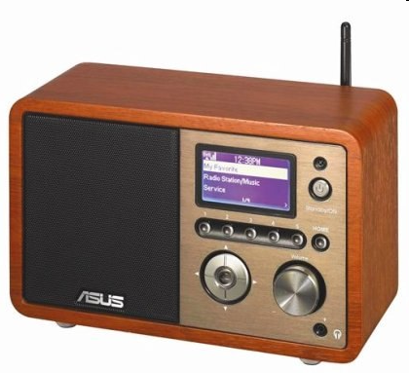
RADIO
Radio - much more
than the TV without
seeing. It is not clear,
but true.

Slide 7
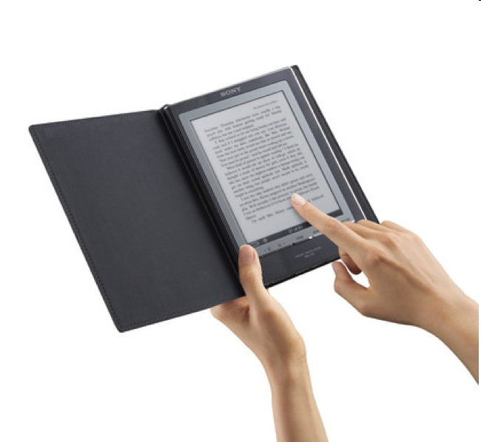

Book
A book is a collection of sheets
of paper, parchment or other
material with a piece of text
written on them, bound together
along one edge within covers. A
book is also a literary
work or a main division of such
a work. A book produced in
electronic format is known as
an e-book.

Slide 8

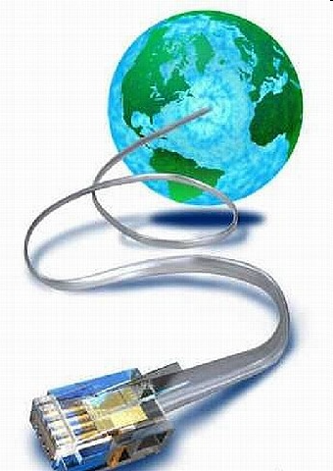
Internet
The Internet is a
more interactive medium of mass media,
and can be briefly described as "a
network of networks". Specifically, it is
the worldwide, publicly accessible
network of interconnected computer
networks that transmit data by packet
switching using the standard Internet
Protocol (IP). It consists of millions of
smaller domestic, academic, business,
and governmental networks, which
together carry various information and
services, such as email, online chat, file
transfer, and the interlinked web pages
and other documents of the World Wide
Web.

Slide 9
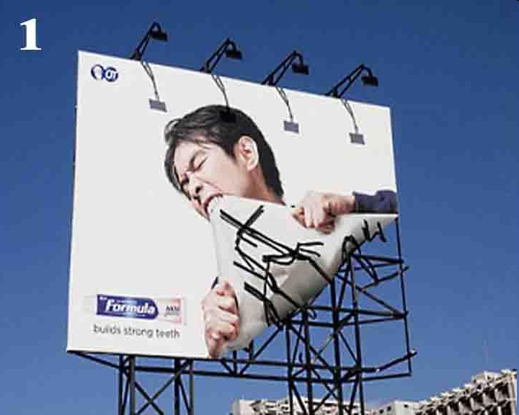
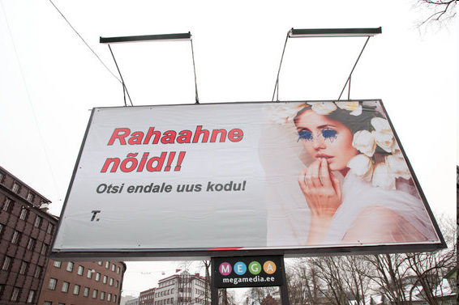
Outdoor media
Outdoor media is a form of
mass mediawhich comprises
billboards, signs, placards placed
inside and outside of commercial
buildings/objects like
shops/buses, flying billboards
(signs in tow of airplanes),
blimps, and skywriting.
Many commercial advertisers use
this form of mass media when
advertising in sports stadiums.

