Slide 1
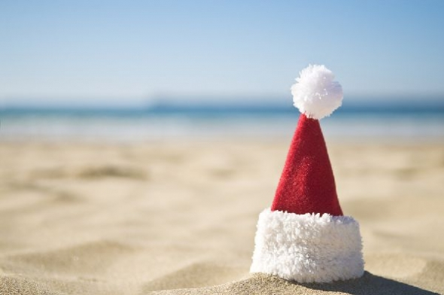
Christmas in Australia

Slide 2
Christmas Day falls in the middle of the summer school holidays and both December 25 and 26 are public holidays. Many people celebrate the event away from home, in holiday parks, in camp sites or at relatives' homes. Christmas Day falls on December 25 and it is a reason for Christians to celebrate the birth of Jesus. Many people, even if they are not Christians, give each other gifts, prepare special meals and decorate their homes at this time of year.

Slide 3
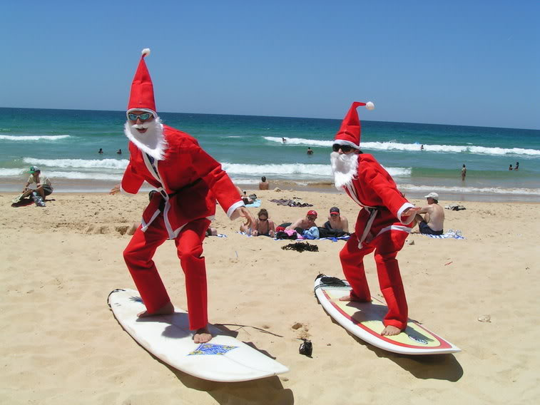

Slide 4
What do people do?

Slide 5
In the weeks before Christmas Day, many people decorate their homes with Christmas decorations such as a Christmas tree, candles or small electric lights, glass baubles, tinsel, snowmen, fake snow and figures of Santa Claus in his red furry outfit. Typically Australian decorations are also used. These are glass baubles or wooden ornaments decorated with images of Australian wildlife, such as koalas, king parrots, Waratah flowers, or Australian sights. Small statues of native animals dressed in 'Santa' hats and sleighs pulled by groups of six white kangaroos are also popular as figures of Santa Claus in beach clothing.

Slide 6
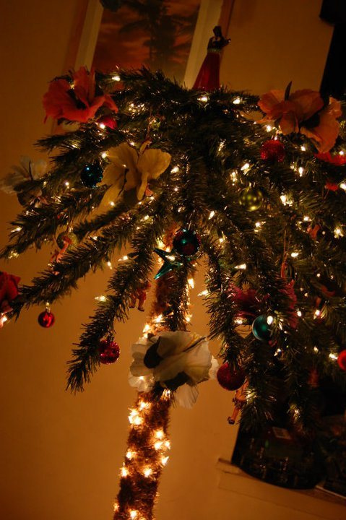
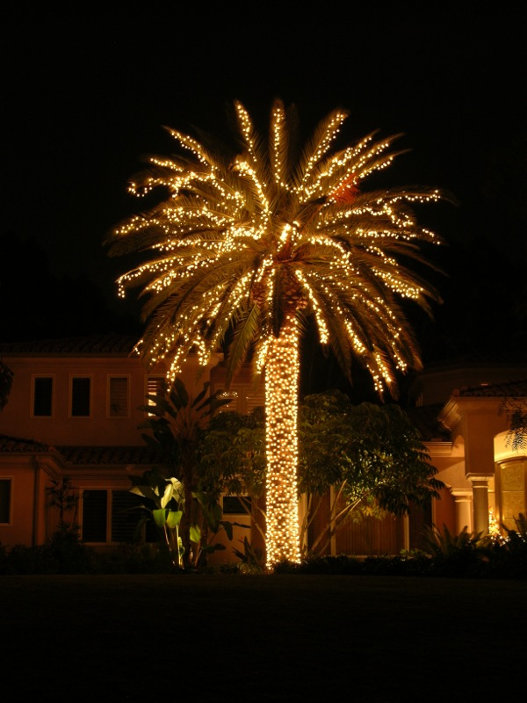

Slide 7
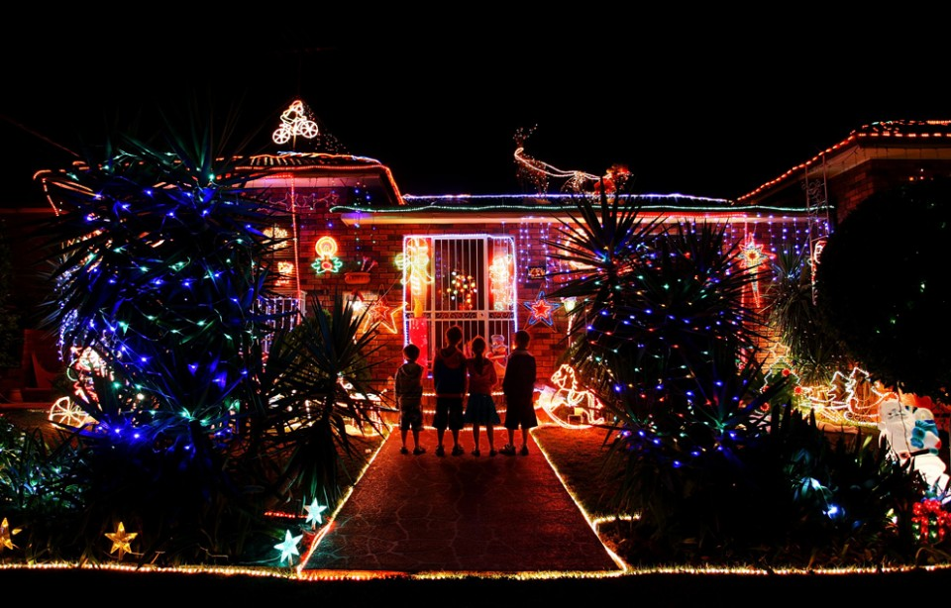

Slide 8
On Christmas Day, children hope to receive gifts in stockings or under the Christmas tree from the mythical figure Santa Claus. In the weeks before Christmas, they write letters to him so that he knows what they want. In some stories, Santa Claus wears a thick red, fur-trimmed suit and travels in a sleigh pulled by reindeer. In others he wears shorts and a loose, brightly coloured shirt and his sleigh is pulled by six white kangaroos. In some families, individual members also exchange gifts.

Slide 9
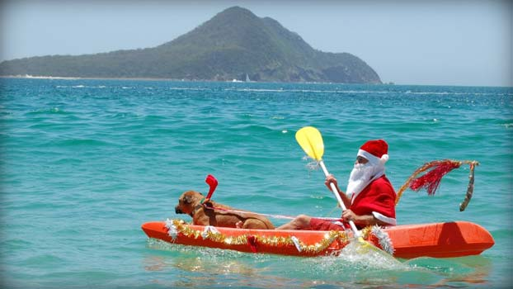

Slide 10
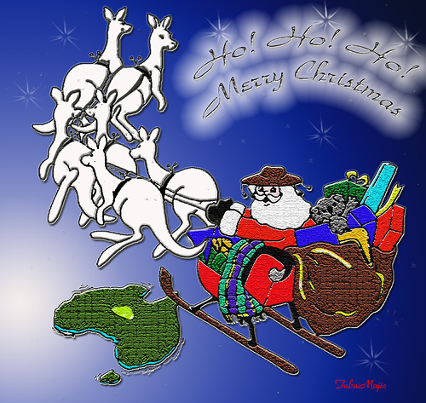
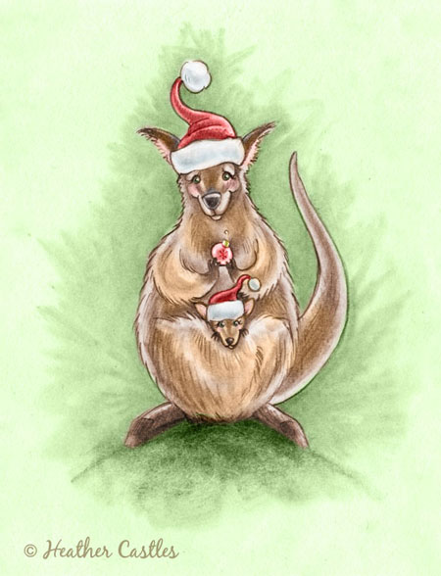

Slide 11
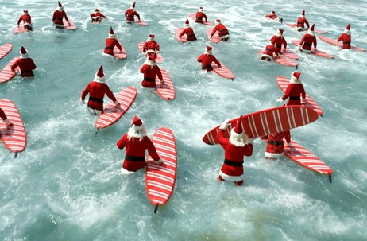

Slide 12
Many people eat special food on Christmas Day. Traditionally, the main meal was similar to the Christmas meals served in Europe. They consist of roast meat and vegetables and heavy fruit cakes and steamed puddings. A small coin was often baked inside a steamed pudding, which was doused with burning alcohol before being served. Whoever found the coin in his or her portion, would have a lucky year. However, nowadays many people choose to have a barbecue on the beach or a picnic in a park or prepare tasty cold meat and seafood, a soft meringue cake topped with whipped cream and fresh fruit.

Slide 13
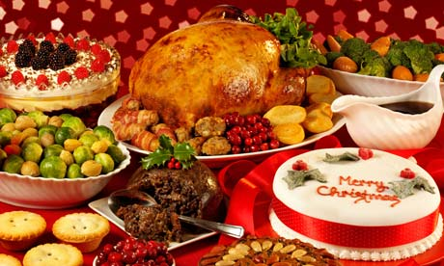
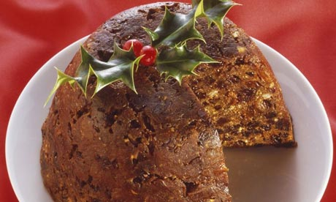

Slide 14
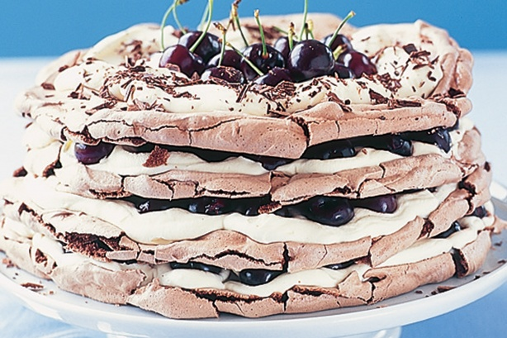

Slide 15
Public life

Slide 16
Christmas Day falls in the summer school holiday. All schools and other educational establishments, many businesses and many stores are closed on Christmas Day. Some public transport systems close down and others offer only a limited service. If you wish to travel by public transport, it is a good idea to check the services before you make your plans.

Slide 17
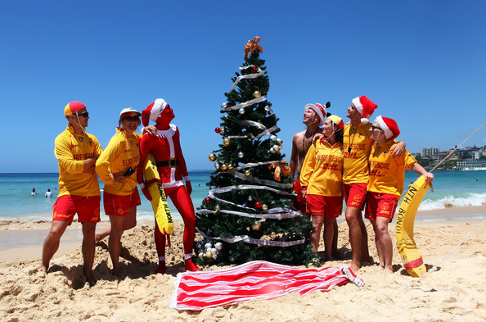

Slide 18
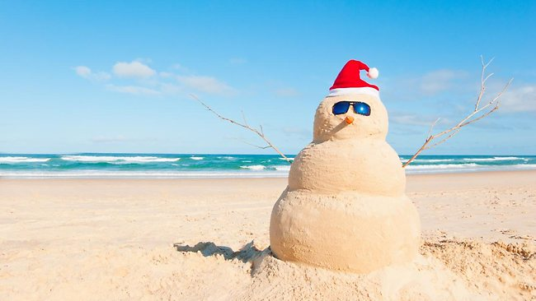

Slide 19
Background and symbols

Slide 20
On Christmas Day, Christians celebrate the birth of Jesus. Different denominations have a range of traditions and types of Church service around Christmas Day. Catholics often attend midnight mass, which starts at midnight as Christmas Eve leads to Christmas Day. Other denominations attend special church services during the day on December 25.

Slide 21
There is a number of native Australian plants that include “Christmas” in their popular names. Usually it is because of they are in blossom during the Christmas period. For example, Christmas bells, Christmas Bush, the Christmas tree and the Christmas orchid.

Slide 22
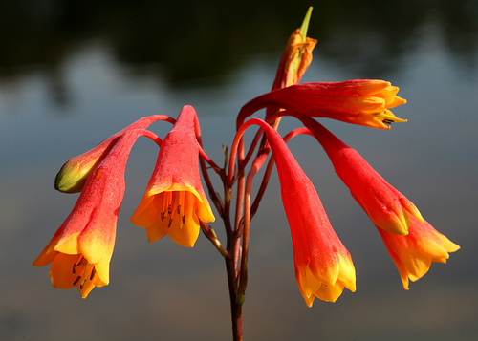
Christmas Bells

Slide 23
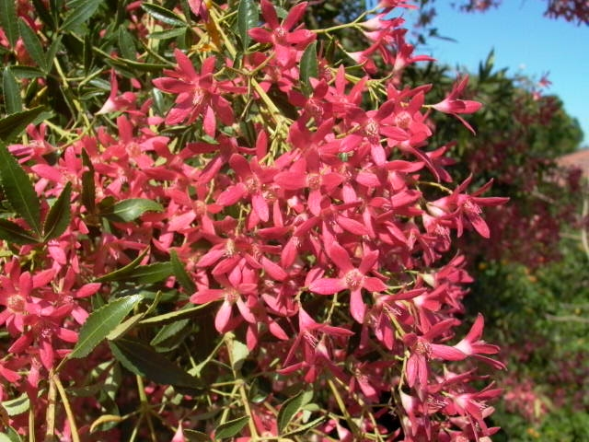
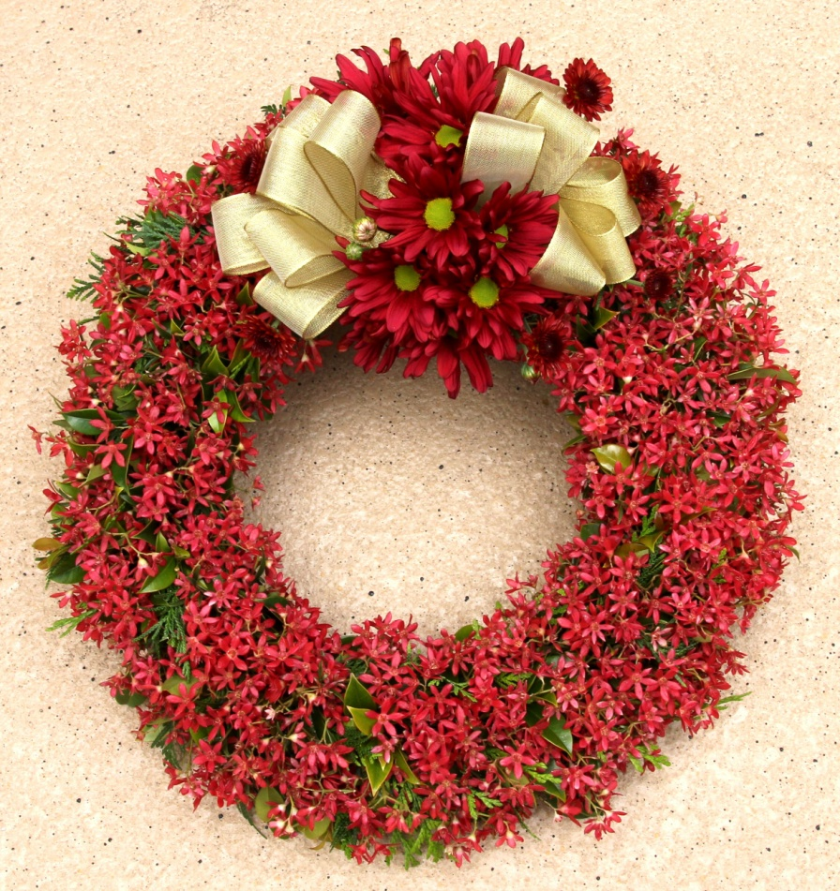
Christmas Bush

Slide 24
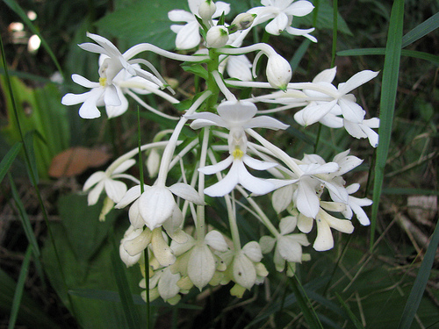
Christmas orchid

Slide 25
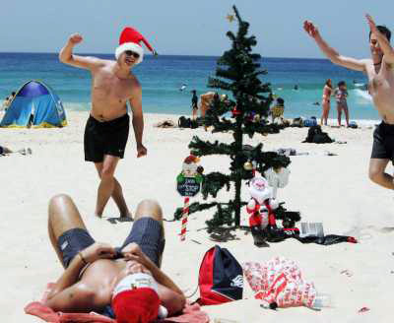
And the Christmas Tree!

Slide 26
Merry Christmas, Australians!
;)

Slide 27
