Slide 1





Teenagers' competition
“We live on the same planet”

Slide 2
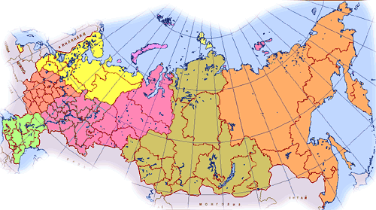



THE RUSSIAN FEDERATION

Slide 3
Different nationalities
Different culture
Phonetic differences
Grammar differences
One language

Slide 4
Reason Language must be easy to learn
Reason
People need
One language
Esperanto-an artificial language
People need one international language
In 1887 Esperanto
was invented.
2)It was a mixture of
other European
languages
The language
was not
popular

Slide 5
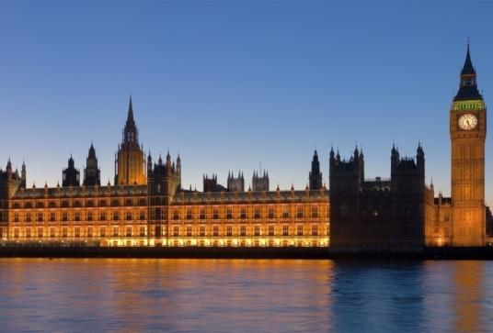
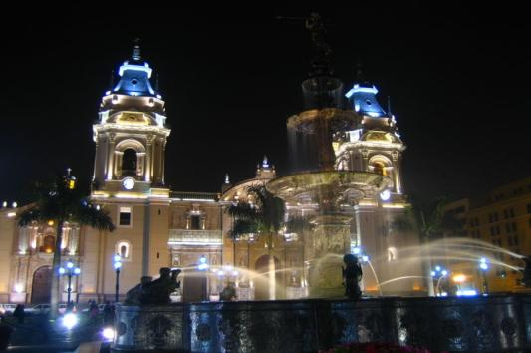
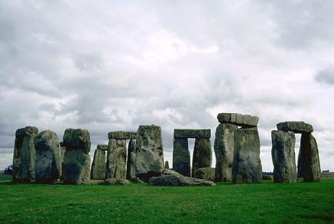
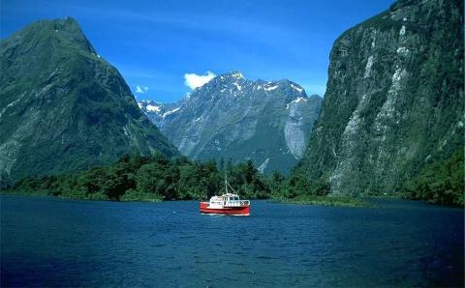
What a wonderful world !
Dear travelers !
Promise you will spend the time entertaining and fun.
Invite you to visit countries such as: Great Britain, Canada, New Zealand,
Australia. All these countries are
Beautiful and interesting for visiting.

Slide 6


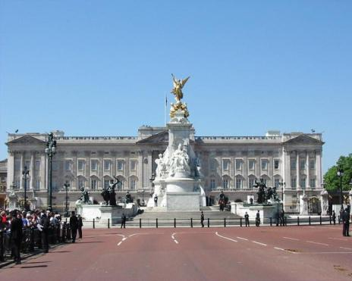
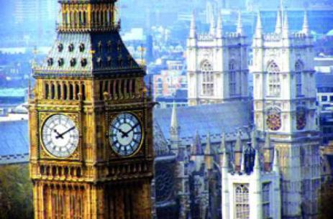
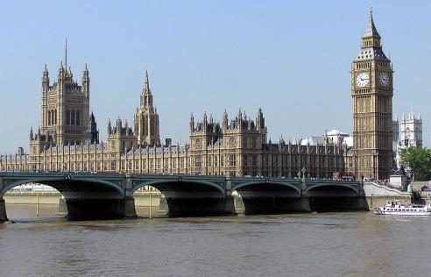
Great Britain
The total area: 244,000 sq. kms.
The population: 57 min people
The capital: London
The places of interest of country:
Trafalgar Square, Westminster Abbey,
Tower of London, Buckingham Palace,
Big Ben, Liverpool, Manchester, etc.

Slide 7


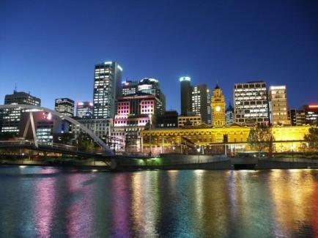

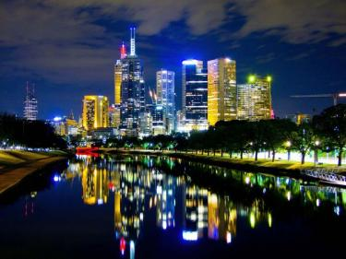
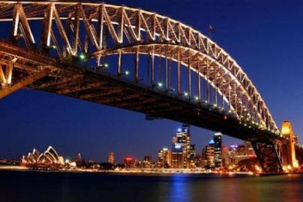
Australia
The total area: 7687 sq. kms.
The population: 16 min people
The capital: Canberra
The places of interest of country:
The kangaroo, the dingo, the emu,
The koala, the echidna, Tasmania Island,
The Central Lowlands, etc.

Slide 8


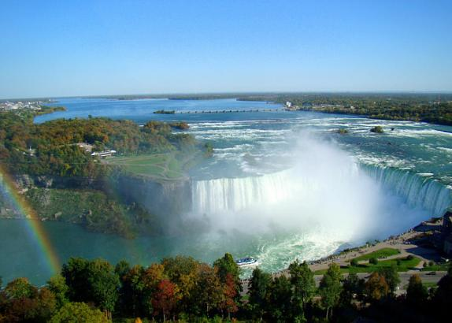
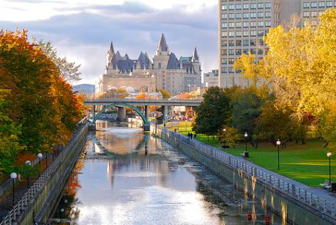
Canada
The population: 26 min people
The total area: 9976 sq.kms
The capital: Ottawa
The places of interest of country:
The Great Lakes, the Niagara Falls,
Toronto, Vancouver, the Rockies,
Baffin land, etc.

Slide 9


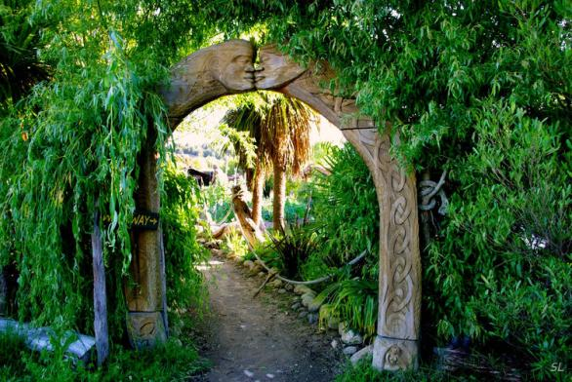
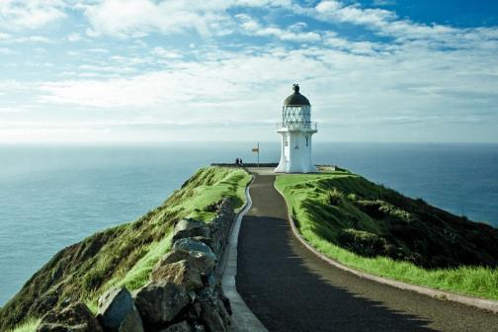
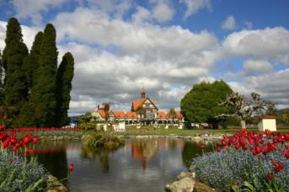
New Zealand
The total area: 269 sq. kms.
The population: 3,3 min people
The capital: Wellington
The places of interest of country:
The kiwi, the aborigines Maori, North
Island ,South Island, Stewart Island, etc.

Slide 10


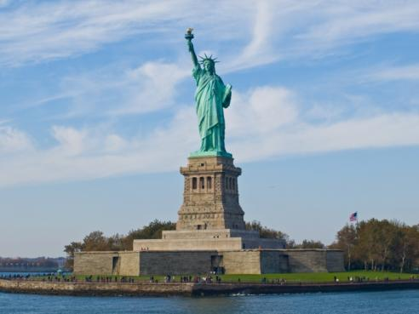

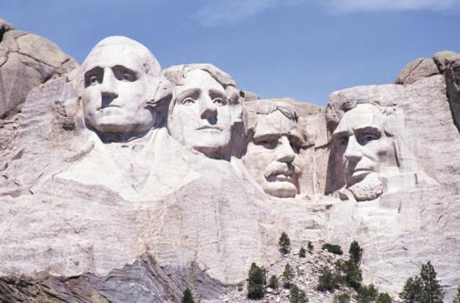
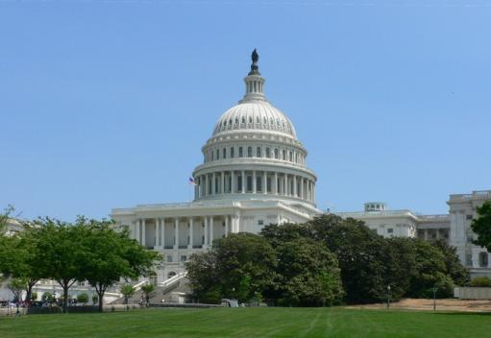
The USA
The total area: 9,39 sq. kms.
The population: 309 min people
The capital: Washington
The places of interest of country:
Times Square, Las Vegas Strip, National
Mall, Disney World`s Magic Kingdom,
Disneyland Park, Memorial Parks, etc.

Slide 11
Why do people study English?
I study English because I need it for my future.
I want to travel to other countries.
I want to be able to work in the Internet.
I want to live and work abroad.
I want to speak with people from different continents.
I want to be able to order meals in a restaurant when I’m abroad.
I want to read English books in the original.

