Slide 1
Let’s Help Our Nature!
(Ecological Problems)

Slide 2
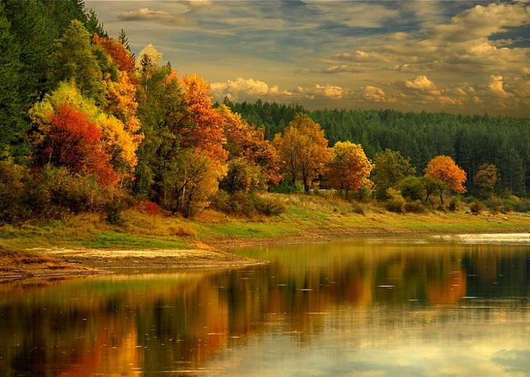
Autumn

Slide 3
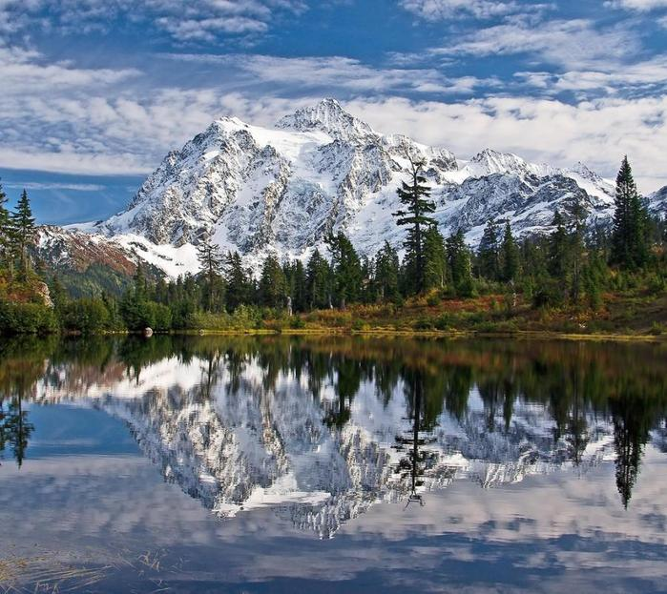
Mountains

Slide 4
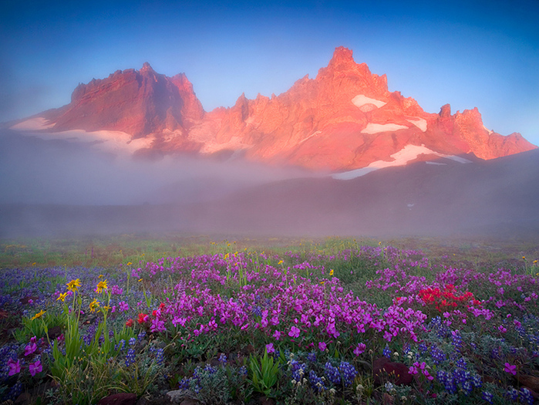
Meadows

Slide 5
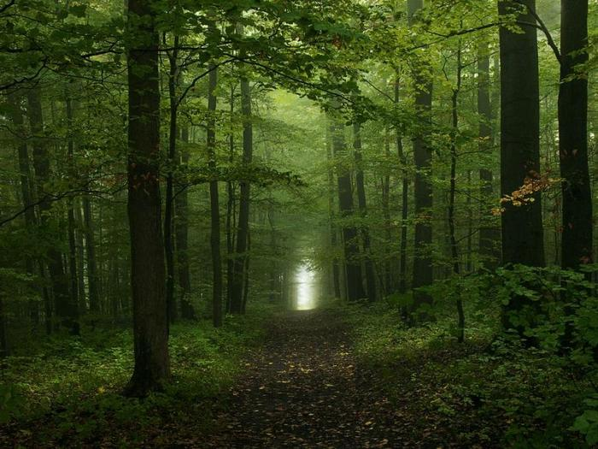
Forests

Slide 6
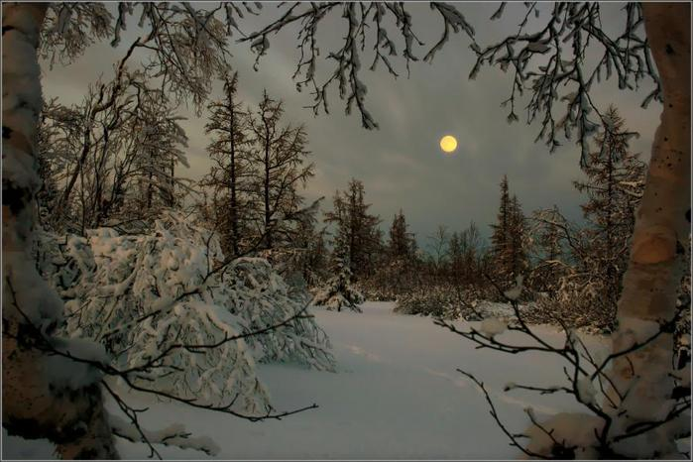
Winter

Slide 7
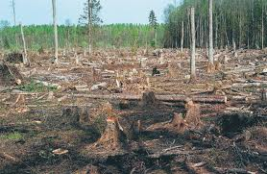
Cutting down trees

Slide 8
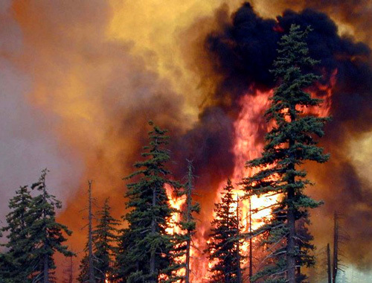
Forest Fires

Slide 9
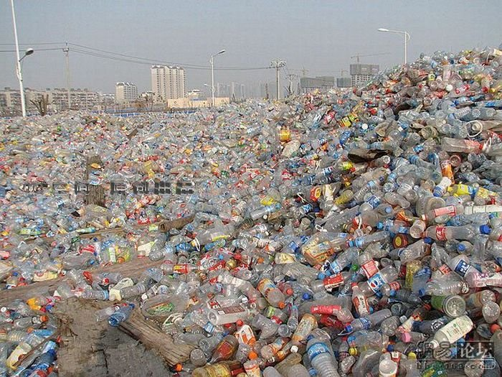
Rubbish in Cities

