Slide 1
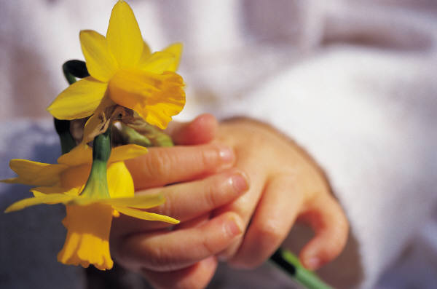
Урок английского языка в 9 «а» классе по теме «Conflict resolution»
Муниципальное казенное общеобразовательное учреждение средняя общеобразовательная школа № 1

Slide 2
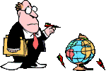
The aims of the lesson are…
to repeat the lexical material
to act the conflicts.
to listen to the dialogue
to try to find the resolution of some actual conflicts

Slide 3

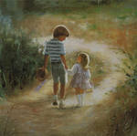

“PLANT KINDNESS AND LOVE WILL GROW”
Thomas Jefferson

Slide 4

Translate the words
предотвращать конфликт | несправедливый | спорить | поддерживать
уважать ценности | мирное решение | человеческие права | быть толерантным
непонимание | плохие отношения | частная жизнь | дружить

Slide 5
What is a conflict?
What is a conflict? –It’s a harmful thing.
That makes us rude and cruel.
It breaks relationship and peace
And starts the fights and quarrels.
What should we do?
Who has to help us live without conflicts?
Don’t do to people harm!
And learn TO LIVE IN FRIENDSHIP!
What are negative features of the conflict?

Slide 6


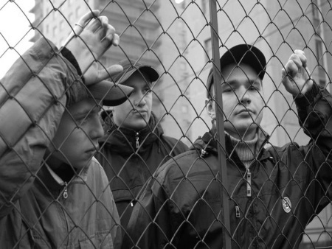

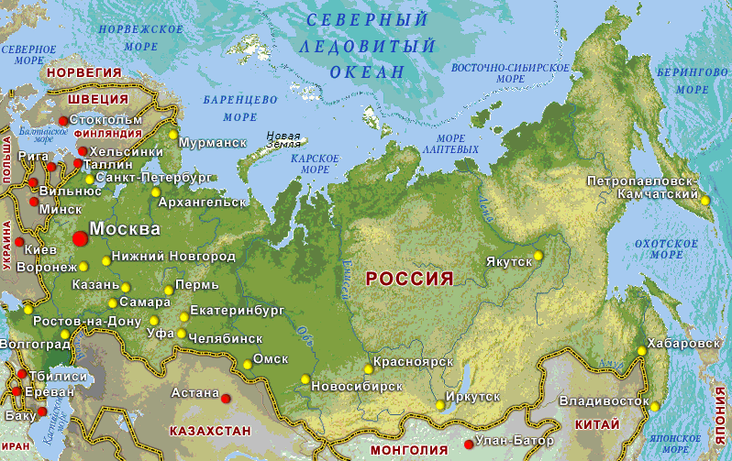

The types of conflicts
BETWEEN

Slide 7

Listen to the dialogue

Slide 8
Fill the table “Conflict Resolution”
 | Questions | Answers
step 1 | What is the problem? | The daughter refuses to do housework
step 2 | How can we solve the problem? | 1. 2.
step 3 | What will happen? | 1. 2.
step 4 | What is the best idea?
step 5 | How can we put the idea into action?

Slide 9

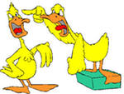

Role-playing

Slide 10
Be tolerant!
And you’ll prevent
All conflicts in the world!
We should learn to live in peace
With classmates, parents, friends

Slide 11

All is well that ends well!
Your homework:
to write the conflict resolution;
to make a symbol of peace (additional homework)

Slide 12

Well done!
Thank you for the lesson!
Good luck!!!

