Slide 1
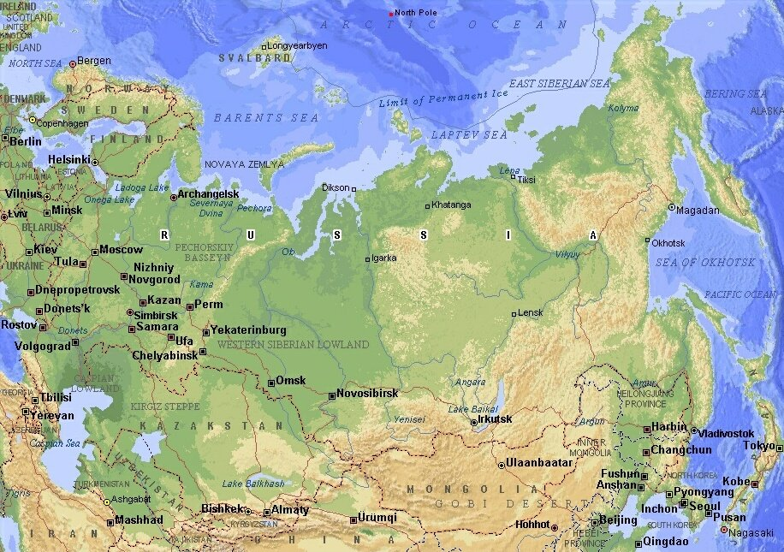
Presentation on topic:
«RUSSIA - MY MOTHERLAND»

Slide 2
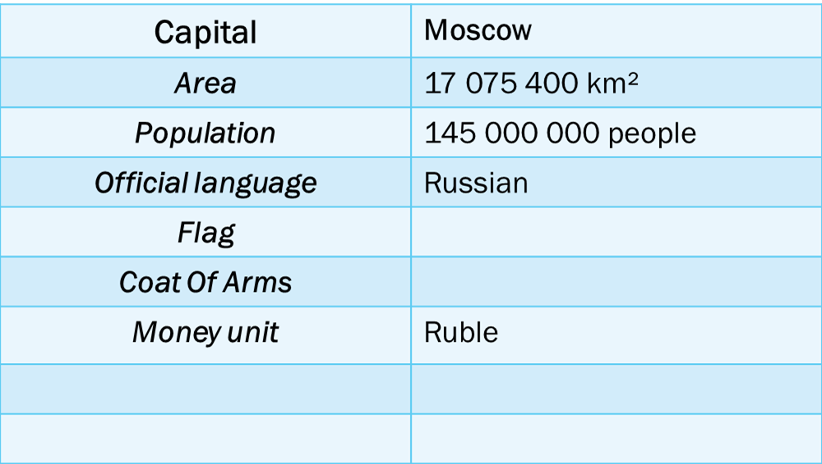
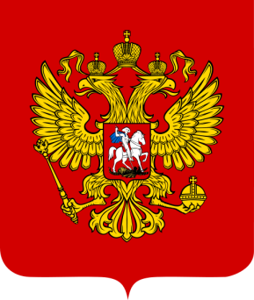
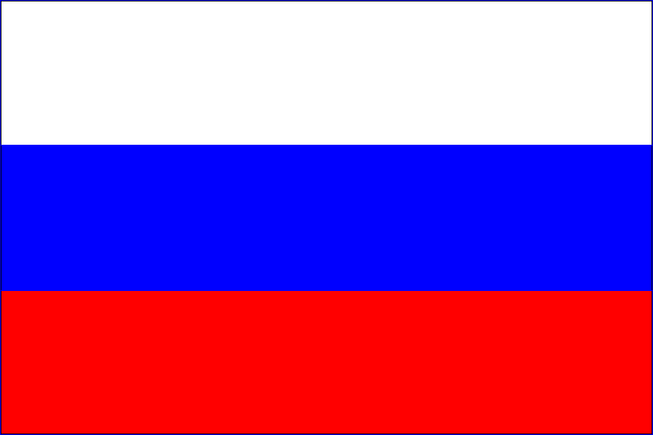
Official name
Republic of the Russian Federation

Slide 3
Russia, our sacred nation,
Russia, our beloved country.
A powerful will, and great glory,
Your possession for all time!
Hail our free fatherland,
Of brotherly of peoples, centuries united
Given the people’s wisdom by our ancestors!
Hail country!
You make us proud! From the Southern seas to the open frontiers
Stretch our forests and plains.
You are one in the light!
You, Our one Native land, protected by God!
The wide space to dream, to live,
The future years are open to us.
Our fidelity gives might to the fatherland.
As it was, is, and always will be!
The Anthem of the Russian Federation

Slide 4
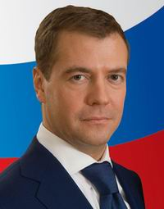
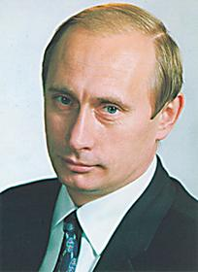

President and Prime Minister.
The President is the head of the country. At the moment the Russian President is Vladimir Putin. The Prime Minister is Dmitry Medvedev.
V. Putin
Prime Minister

Slide 5
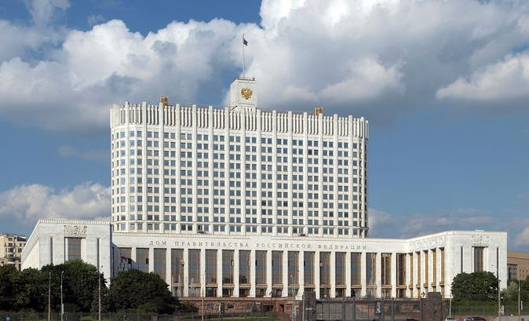
The Russian National Government
The President and his aides (helpers)
The Federal Assembly
The Council of Ministers with the Prime Minister
(the Parliament)
The Federal Council
(the upper House)
The State Duma (the lower House)
The National Government of Russia consists of the President, the Council of Ministers and the Federal Assembly. There are two Houses in the Federal Assembly. The lower House of the Federal Assembly is the State Duma. The upper House of the Federal Assembly is the Federal Council.

Slide 6
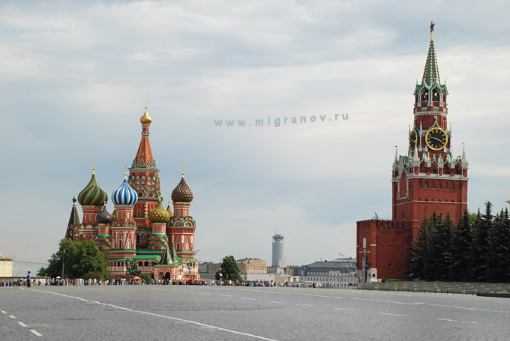
Moscow
Moscow, the capital of Russia is one of the world’s great cities. Moscow stands on the Moskva River in the center of European Russia. The climate in this part of the country is continental. Winters are long and snowy. Spring is rather short, and the temperature rises quickly during late April.
Summers are warm and July is the warmest month. Rainy days are quite common, but the summer rainfall often comes in heavy showers and thunderstorms.
One of the most famous places in Moscow is Red Square with the Kremlin.

Slide 7
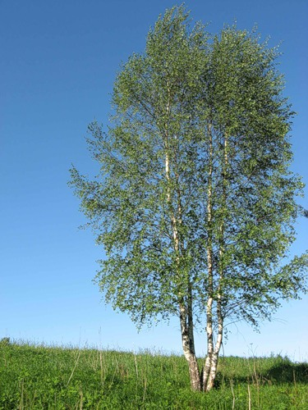
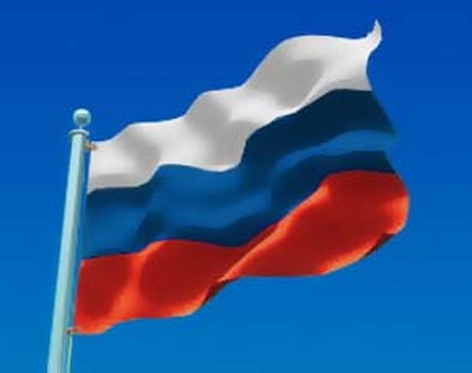
Symbols of Russia
One Russian symbol is the Russian national flag. The flag has 3 wide stripes on it. The stripes are white, blue and red. The upper stripe is white, the middle stripe is blue and the red stripe is at the bottom. These colours have always been symbolic in Russia – white – noble, blue – honest and devoted. The red colour has always meant love and bravery.
The other symbol of Russia which all Russian people know and love is the birch tree. You can find these trees everywhere. People sing songs with poetic words and plant them near their houses.

Slide 8
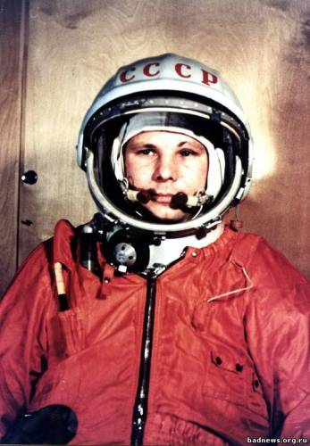
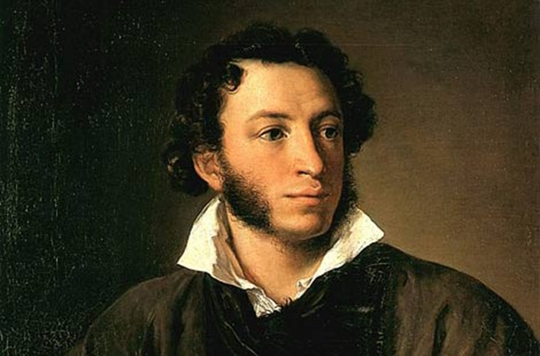
Famous people of Russia
Gagarin
Pushkin
The first Russian cosmonaut Yuri Gagarin was in space on 12 April 1961.
Our national pride Alexander Pushkin is the greatest poet and writer. He wrote many poems and stories. The most famous of them are "Ruslan and Lyudmila“, "Eugene Onegin" and the story "Dubrovsky".

Slide 9
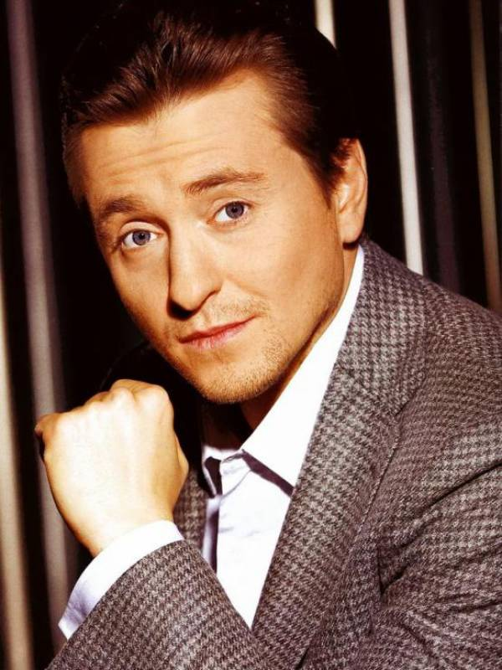
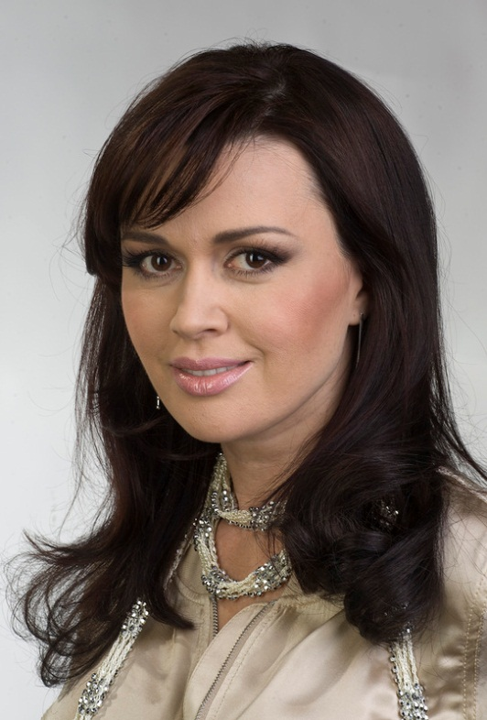
Famous ACTORS
Sergey Bezrukov - Russian theater and film actor . He was born in Moscow on October 18, 1973. The most famous films with his participation: "Holidays Security Vacation", "Vysotsky. Thanks for living" and "Brigade"
Anastasia Zavorotnyuk - Russian actress and TV presenter. She was born on April 3, 1972 in the city of Astrakhan. Anastasia starred in many films but the most famous is "My beautiful nurse ".

Slide 10
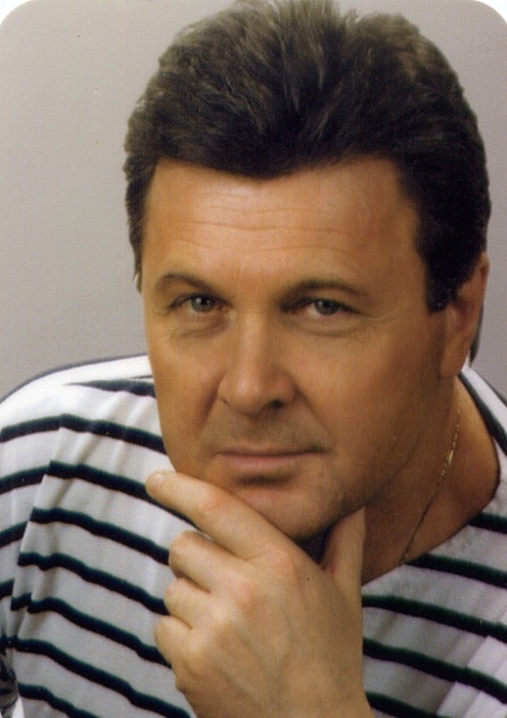
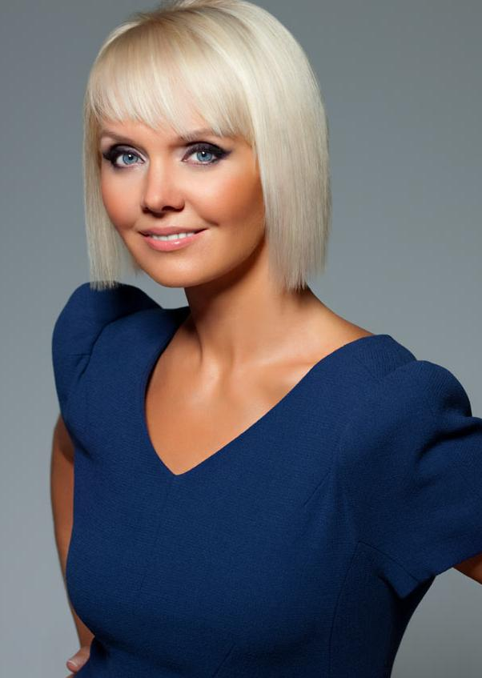
Lev Leshchenko
Lev Leshchenko - Russian singer. He was born on February 1, 1942 in Moscow. His famous songs are :”The Day of Victory”,"Parental home", "I love you, the capital."
Valeria
Valeria – Russian singer. She was born on 17 April in Atkarsk, Saratov region. One of her most famous songs is "I'm flying."

Slide 11
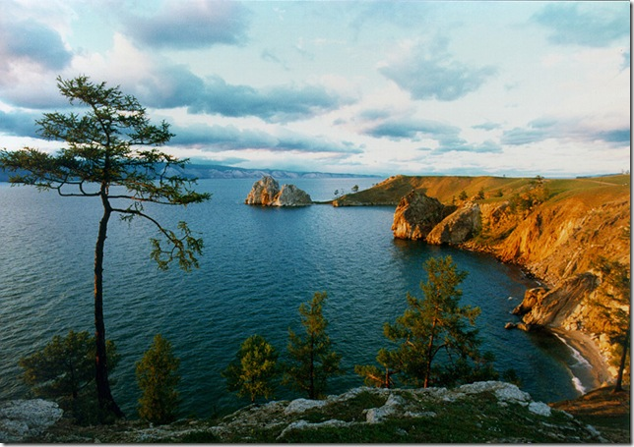
Seas. Rivers. Lakes.
Baikal - lake is in the southern part of Eastern Siberia, the deepest lake on the planet, the largest natural reservoir of fresh water. Lake and coastal areas offer a unique variety of flora and fauna. .
The Volga – river is in the European part of Russia. One of the largest rivers in the world and the largest in Europe. Long - 3530 km . On the Volga there are four millionaire -cities: Nizhniy Novgorod, Kazan, Samara, Volgograd.
Many people love to rest in Russia, the Black Sea is the most popular place. It washes the shores of Russia, Ukraine, Romania, Bulgaria, Turkey.

Slide 12
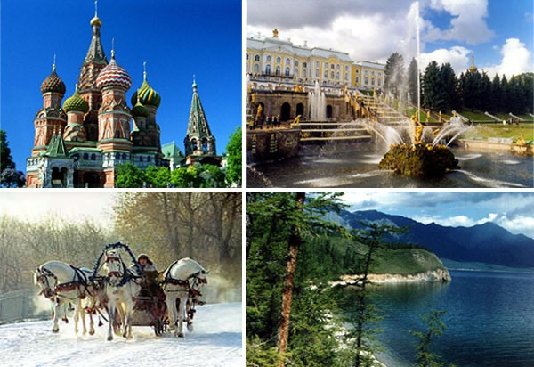
The End
The presentation is made by:
Nakaryakova Marina,
Shestova Kristina
and
Kudinova Aleksandra.
pupils of the 7th form ,
Gymnasium.
Используемые источники:
Student’s Book.Учебник английского языка для 7 класса (углубленное изучение) авторов О.В,Афанасьевой, И.В.Михеевой. Москва. Просвещение. 2011 год.
2. Изображения представлены в свободном доступе поисковой системы «Яндекс».

