Slide 1
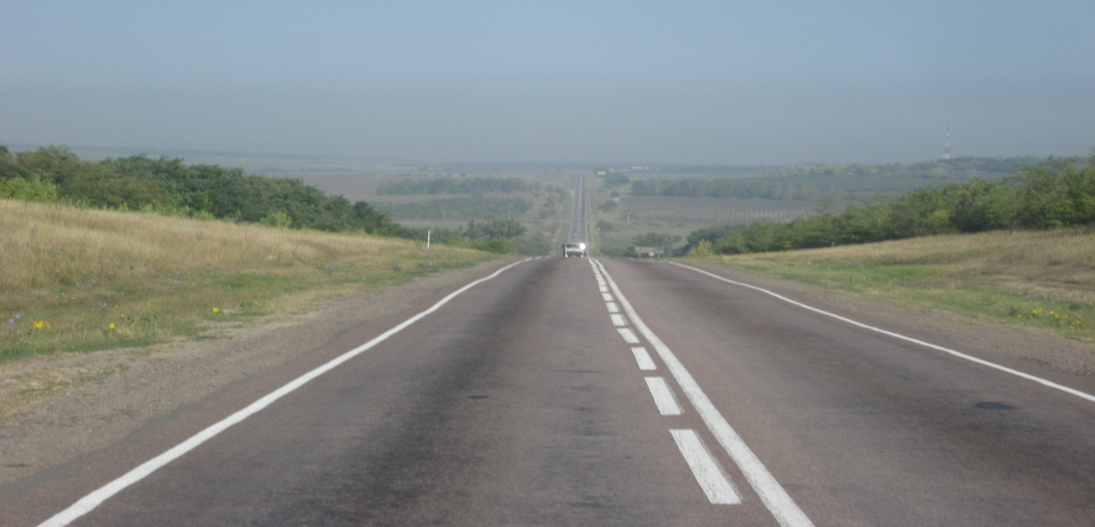
TRAVELLING…
WHAT FOR?

Slide 2
Ways of travelling…

Slide 3
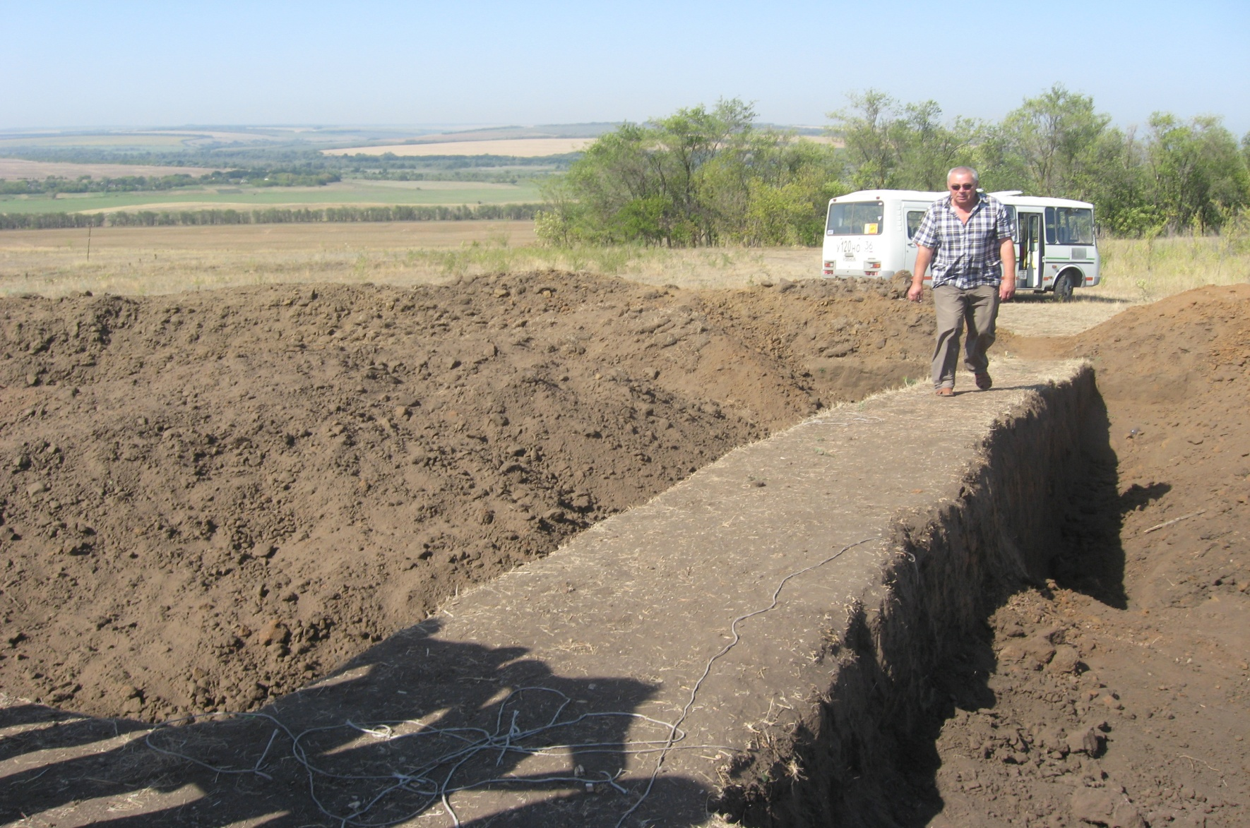
TRAVELLING ON FOOT

Slide 4
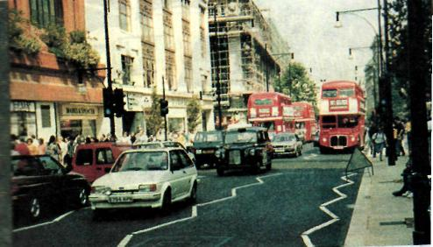
TRAVELLING BY CAR

Slide 5
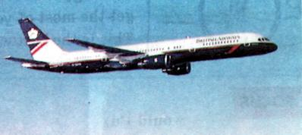
TRAVELLING BY PLANE

Slide 6
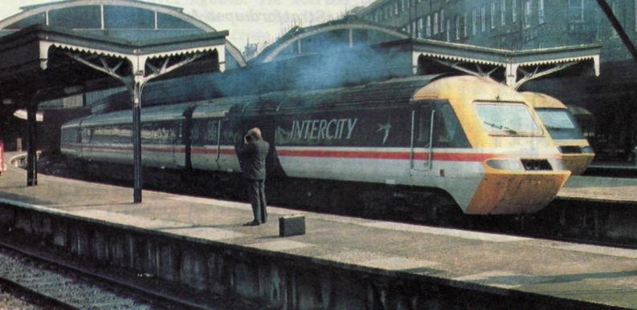
TRAVELLING BY TRAIN

Slide 7
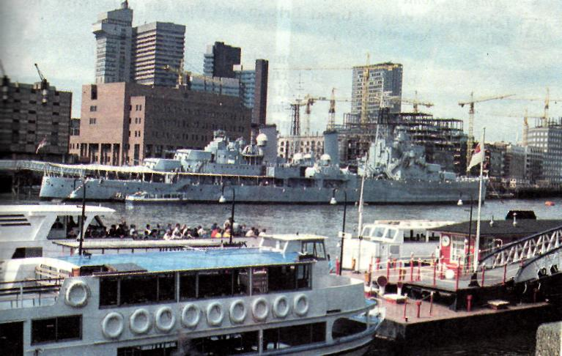
TRAVELLING BY SEA

Slide 8
THE TOPICS OF YOUR PROJECTS:
TRAVELLING FROM VLADIVOSTOK TO MOSCOW;
TRAVELLING FROM MOSCOW TO ST.PETERSBURG;
TRAVELLING FROM MURMANSK TO PETROZAVODSK.

Slide 9
WHY DO PEOPLE TRAVEL?
they travel to discover new places;
they travel to get education;
they travel to practice foreign languages;
they travel to meet different people;
they travel to go sightseeing.

Slide 10
DO YOU LIKE TRAVELLING?
WHAT IS YOUR FAVOURITE WAY OF TRAVELLING?
WHY DO YOU TRAVEL?
WHERE ARE YOU GOING FOR YOUR NEXT HOLIDAYS?
WHO ARE YOU GOING WITH?

Slide 11
PHRASES FOR HELP
IN MY OPINION…
PERSONALLY, I THINK…
IT SEEMS TO ME…
IF YOU ASK ME, I THINK…
AS I SEE IT…
I’D LIKE TO SAY THIS.
THE POINT IT…

Slide 12
HOME TASK
WRITE A COMPOSITION “TRAVELLING TO EGIPT”

