Slide 1

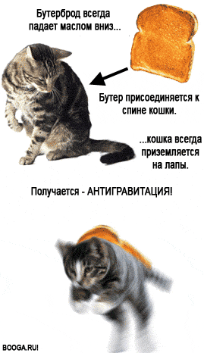
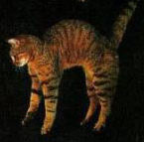
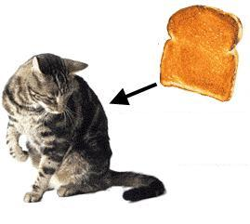
The sandwich falls butter side down…
Приложение 6
Получается
Well… we observe the law of antigravity.
The cat always lands on the paws…
…
Let’s fix the sandwich to the cat’s back.

