Slide 1
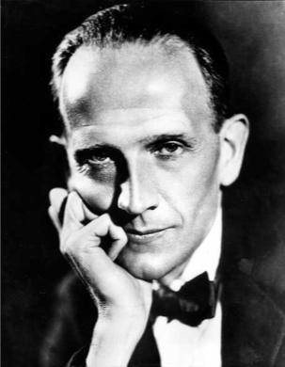
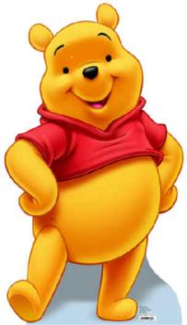
Winnie – the – pooh
& others
December, 17th

Slide 2
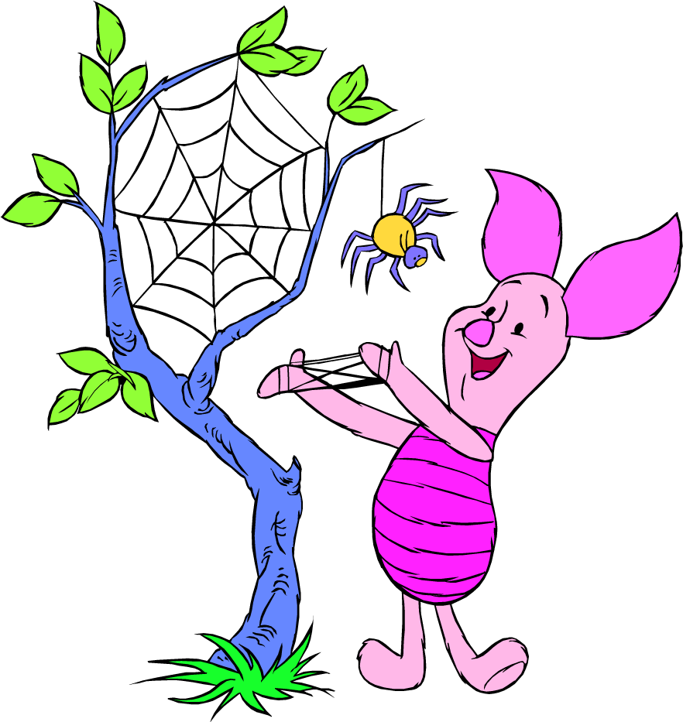
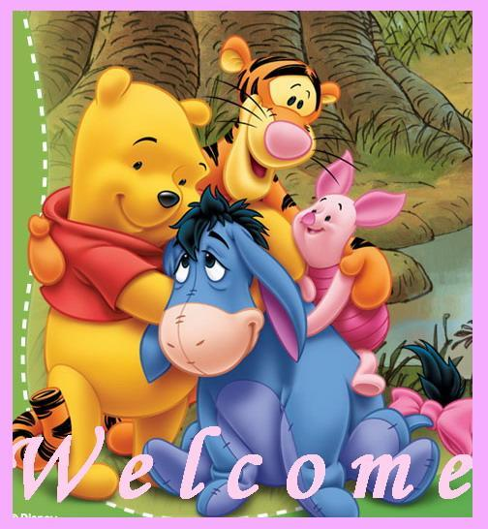
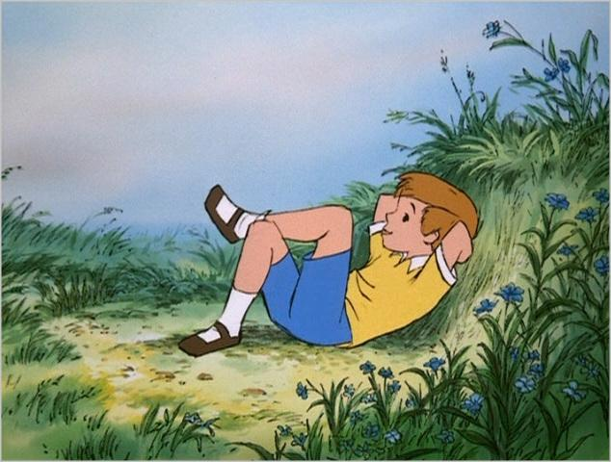
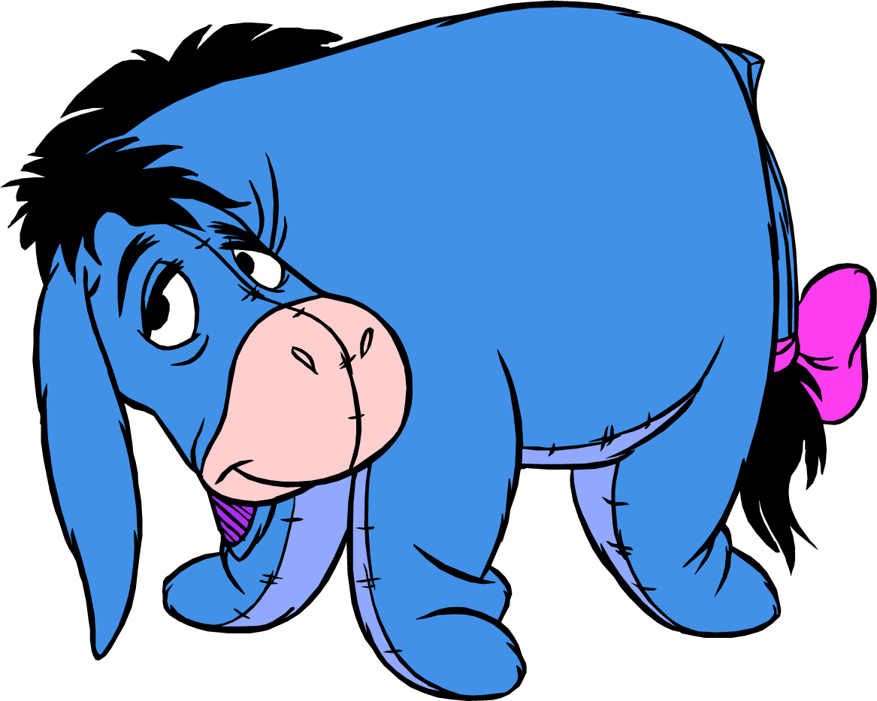
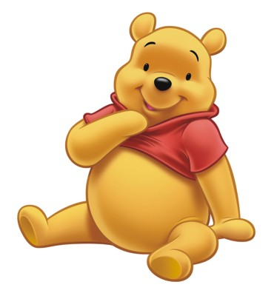
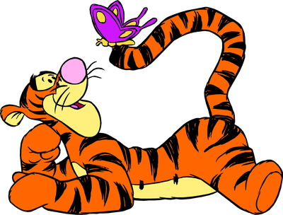
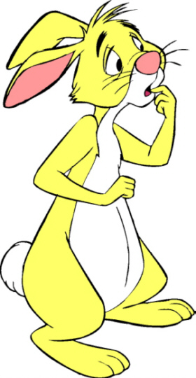
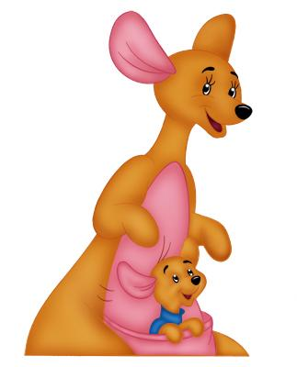
Winnie – the – pooh & others

Slide 3
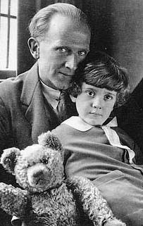
Alan Alexander Milne
(1882—1956)

Slide 4
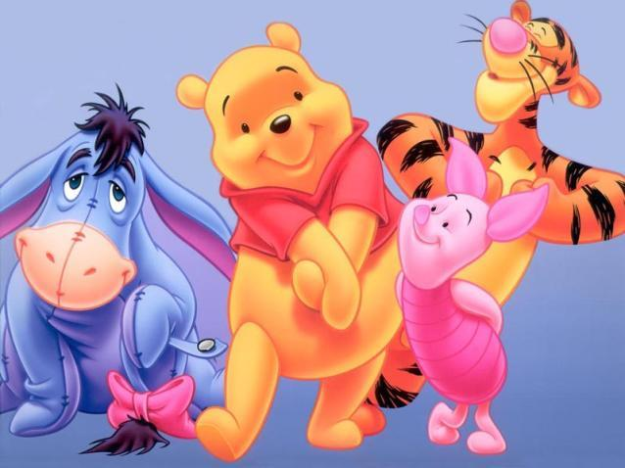
THE WISHING BEAR

Slide 5
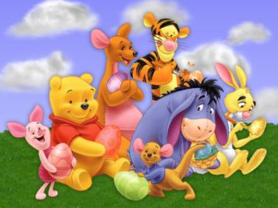
1. Who are the main characters of the cartoon?

Slide 6
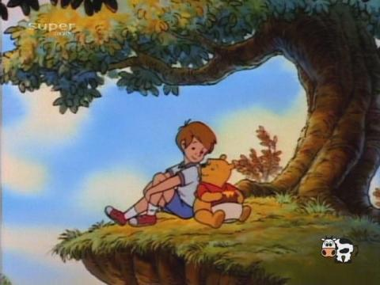
2. Who showed Winnie the wishing star?

Slide 7
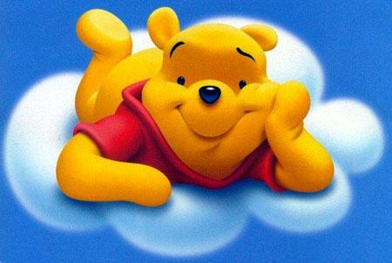
3. What was Winnie’s wish?

Slide 8
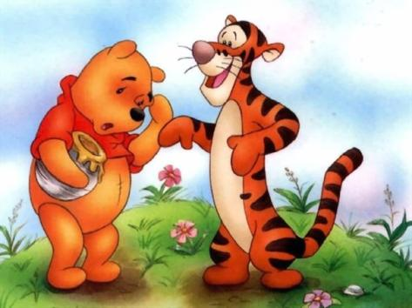
4. What happened in the morning?

Slide 9
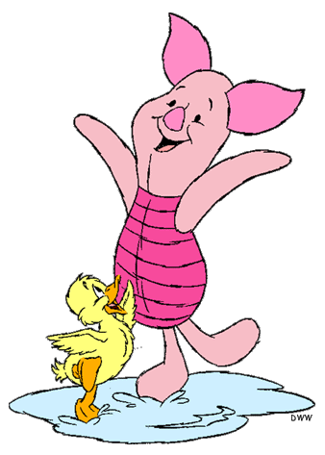
5. What did Piglet want to have of his own?

Slide 10
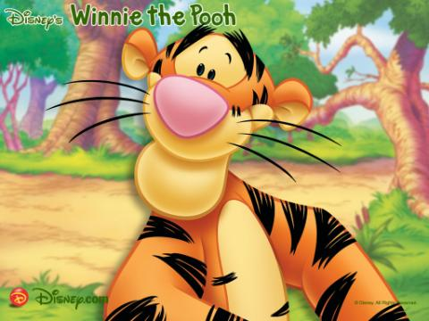
6. What did Tigger want to wish?

Slide 11
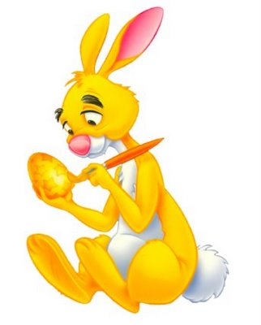
7.What did
Rabbit cook?

Slide 12
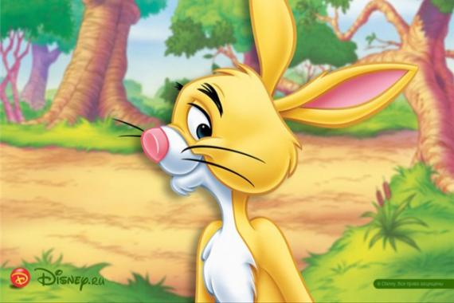
8. What was Rabbit’s wish?

Slide 13
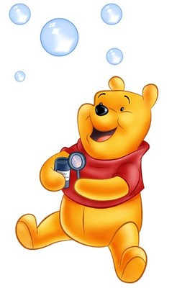
9. Who helped Winnie to remember the rhyme?

Slide 14
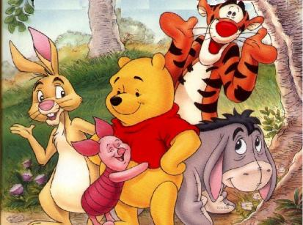
10. Did Piglet, Tigger and Rabbit make their wishes?

Slide 15
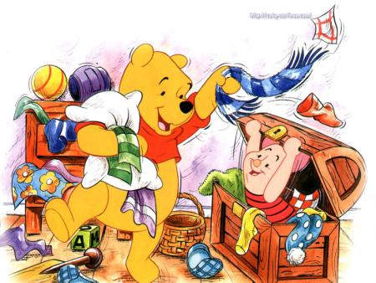
11. Recite
“ the wishing rhyme”.

Slide 16
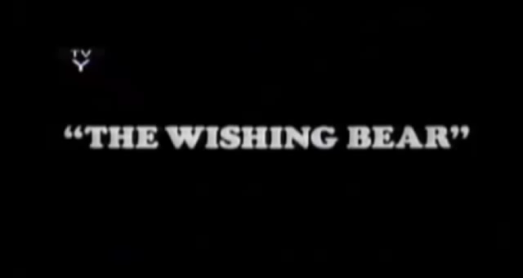
THE WISHING BEAR

Slide 17

Answer the questions:
1. Who are the main characters of the cartoon?
2. Who showed Winnie the wishing star?
3. What was Winnie’s wish?
4. What happened in the morning?
5. What did Piglet want to have of his own?
6. What did Tigger want to wish?
7. What did Rabbit cook?
8. What was Rabbit’s wish?
9. Who helped Winnie to remember the rhyme?
10. Did Piglet, Tigger and Rabbit make their wishes?
11. Recite “the wishing rhyme”.

Slide 18



Slide 19
COUNT THE STARS

Slide 20
You have a letter

Slide 21

Do this exercise for eyes:

Slide 26


Slide 27
Home task:
Ex. 72, 74, 80,83
p. 142 – 146

