Slide 1

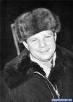
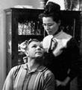
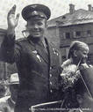

Victorina: “The First man in space”
This presentation is devoted
to the 50th anniversary of first man’s flight to cosmos.
1961-2011
Teacher of English PECHCKUROVA H.

Slide 2
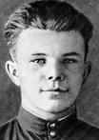
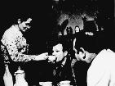
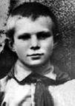
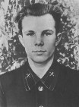


TASK 1.
CHOOSE THE RIGHT VARIANT:
1.Yuri Gagarin was born on the 9th of March in … .. …village, Smolensk area.
1934 in Clushino 2. 1935 in Clushino. 3. 1934 in Glushino.
2.He was a native … … … family. 1. from rich country 2. from simple country 3. from simple town
3. Later he finished … School in Moscow, … … Technikum School. 1.Saratov, then Lubertsy 2. Lubertsy, then Novgorod 3. Lubertsy then Saratov
4.By the way, in Saratov he studied in the … … . 1. bus club. 2. aero club. 3. car club.

Slide 3
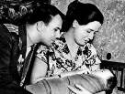
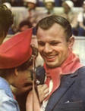

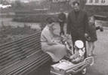


TASK 2.
COMPLETE THESE SENTENCES BY USING THE CORRECT WORD FROM THE BOX.
He (1) … Valentina Goriacheva. Soon he (2) … two wonderful (3) …, Lena and Galia. So what kind of (4) … was Gagarin? It’s really (5) … to find the answer to this question.
a). Hard b).daughters c). married d).had e). person

Slide 4
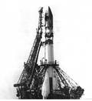
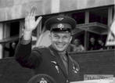
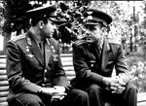



TASK 3.
Finish the sentences.
a). No doubt that the main event in the life of Yuri Gagarin became his flight into space (cosmos) which .. … .. … … … .
b). This flight lasted … … .
c). The rocket flew around the Earth and … … … .. … … .
then came back to the orbit.
he made on the craft “East”.
108 minutes

Slide 5
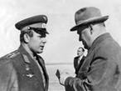
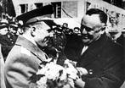



TASK 4
TRANSLATE THIS SENTENCE FROM ENGLISH INTO RUSSIAN.
During the times of the Soviet Union, space exploration was one of the main priorities. And a rocket undertaking the first flight into space departed from the USSR. That happened on the 12th of April, 1961. This day became an important part of history. The cosmonaut on board was pilot Yuri Alekseevich Gagarin. Before the flight Yuri Gagarin was given an envelope where the secret cipher was – the figure “25”, as it was found out later.

Slide 6
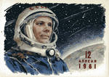
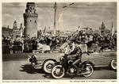
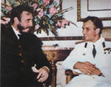


TASK 5.
Complete these sentences by finding the right beginning of each ones.
1. … …became the first person in space.
2. … … … … … was driven to the meeting with Nikita Khrushchev.
3. … … … … … … … … in front of the Red Square with the most high-ranking capital inhabitants.
A). Right after landing the cosmonaut …
B). And the next day Yuri Gagarin was standing …
C). Yury Gagarin …

Slide 7

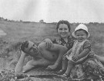
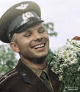
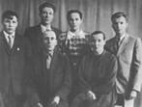


TASK 6.
Read the abstract below. Use the words given at the end of lines to form words that fit in the spaces in the lines.
After the flight into space, Yuri Gagarin 1)______ become
a person (2)_______ represent
the USSR. He (3)__________ give
the rank of Soviet Union (4)_______________ heroism.

Slide 8




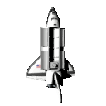
TASK 7.
Read the text below and decide which answer (A, B, C) best fits each space.
108 minutes now (1)… not a long time spent in (2)… . But just think what that meant for a person who (3) … that he was the (4) … one to do it. No doubt the flight … … with tremendous risk. And Yuri Gagarin understood that … .
1. | A. seem | B. seems | C. seemed
2. | A. space | B. water | C. country
3. | A. know | B. is known | C. knew
4. | A. first | B. second | C. third
5. | A. connected | B. is connected | C. was connected
6. | A. clear | B. clearly | C. unclearly

Slide 9

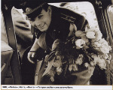
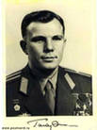
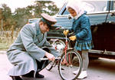

TASK 8.
Answer the questions after the text.
Everyone dreamed to shake his hand, to speak with a hero. His smile had become one of the symbols of Soviet Union. He wasn’t allowed to go on space flights anymore.
Who dreamed to shake his hand?
What had become one of the symbols of Soviet Union?
What wasn’t allowed to do anymore?

Slide 10
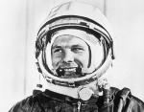
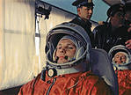

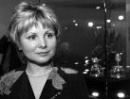
TASK 9.
CHOOSE THE RIGHT VARIANT.
1. Unfortunately in …. Yuri Gagarin tragically perished during a training mission.
a). 1967 b). 1969 c). 1968
2.An … with the engine took place.
a). accident b). crime c). tragedy
3. Though lots circumstances of the accident … quiet mysterious.
a). was looked b). look c). see

Slide 11
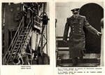
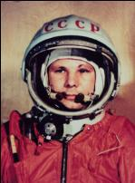
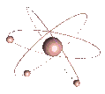
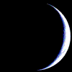
TASK 10.
TRANSLATE THIS TEXT FROM ENGLISH INTO RUSSIAN.
Yuri Gagarin was buried near the Kremlin wall on the Red Square.
Today the Gjatsk city where the first cosmonaut spent many years has been renamed to Gagarin.

Slide 12
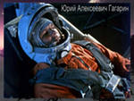


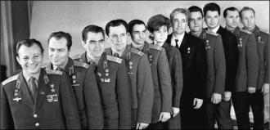
Thank you for your attention. See you soon!

