Slide 1

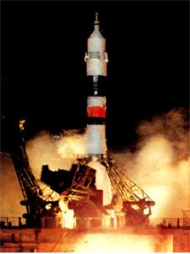
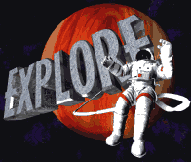

Victorina “cosmos” (5-6 forms).
This presentation is devoted
to the 50th anniversary of first man’s flight to cosmos.
1961-2011
Teacher of English PECHCKUROVA H.

Slide 2
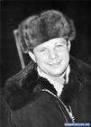



Task 1 Choose the right variant (Выбери правильный вариант):
1.The first cosmonaut was… .
a. G. Titov b. V. Tereshkova
c. Y. Gagarin
2.The second cosmonaut was … .
a. Y. Gagarin b. G. Titov c. V. Komarov
3.The first woman cosmonaut was … .
a. V. Tereshkova b. S. Savitskaya
c. S. Ivanova

Slide 3
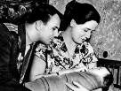

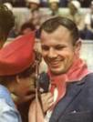
Task 2. Choose the right variant (Выбери правильный вариант):
1. The Soviet people were …. to fly into outer space.
a). the second b). the ninth c). the first
2. The first Sputnik was sent into outer space in … …, … .
a).October 4, 1957 b).September 4, 1958
c). October 6, 1956.

Slide 4

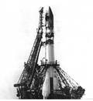

Task 3. Do you Know? Guess. (Знаешь ли ты? Отгадай.)
1. The round object in the sky at night:
a. The Moon b. The Sun c. Star
2. Red planet:
a. Mercury b. Mars c. Neptune
3. The planet that we live on:
a. The Sun b. The Earth c. The Moon
4.All space, including all the stars and planets :
a. The Earth b. The Moon c. The Universe

Slide 5
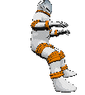

TASK 4. CHOOSE THE RIGHT VARIANT (Выберите правильный вариант).
1. Unfortunately in …. Yuri Gagarin tragically perished during a training mission.
a). 1967 b). 1969 c). 1968
2.An … with the engine took place.
a). accident b). crime c). tragedy
3. Though lots circumstances of the accident … quiet mysterious.
a). was looked b). look c). see

Slide 6

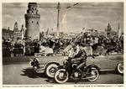
TASK 5. CHOOSE THE RIGHT VARIANT (выберите правильный вариант):
1.Yuri Gagarin was born on the 9th of March in … .. …village, Smolensk area. a. 1934 in Clushino b. 1935 in Clushino. c. 1934 in Glushino.
2.He was a native … … … family.
a. from rich country
b. from simple country
c. from simple town

Slide 7
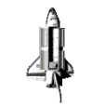

TASK 6. Finish the sentences (Закончи предложения):
a). No doubt that the main event in the life of Yuri Gagarin became his flight into space (cosmos) which .. … .. … … … . b). This flight lasted … … . c). The rocket flew around the Earth and … … … .. … … . 1.then came back to the orbit. 2. he made on the craft “EAST”. 3. 108 minutes

Slide 8
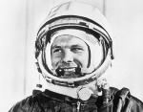
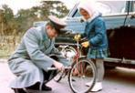

Task 7. Guess the words (отгадай слова):
S - - - e Космос
С - - - t Комета
O - - - t Орбита
M - - n Луна
S - n Солнце
E - - - h Земля
S - - - s Звёзды
P - - - - t Планета
M – - s Марс
N - - - t Ночь

Slide 9



TASK 8. Read the text below and decide which answer (A, B, C) best fits each space (Прочитай текст и реши, какой из вариантов (А, В, С) лучше всего подходит).
108 minutes now (1)… not a long time spent in (2)… .
But just think what that meant for a person who (3) … that he was the (4) … one to do it.
1. A. seem B. seems C. seemed 2. A. space B. water C. country 3. A. know B. is known C. knew 4. A. first B. second C. third

Slide 10

TASK 9. Answer the questions after the text. (Ответьте на вопросы после текста):
Everyone dreamed to shake his hand, to speak with a hero.
His smile had become one of the symbols of Soviet Union.
He wasn’t allowed to go on space flights anymore.
Who dreamed to shake his hand?
What had become one of the symbols of Soviet Union?
What wasn’t allowed to him to do anymore?

Slide 11
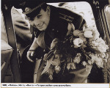
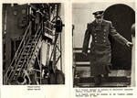

TASK 10. TRANSLATE THIS TEXT FROM ENGLISH INTO RUSSIAN (переведите текст на русский язык).
Yuri Gagarin was buried near the Kremlin wall on the Red Square.
Today the Gjatsk city where the first cosmonaut spent many years has been renamed to Gagarin.

Slide 12
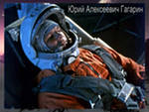

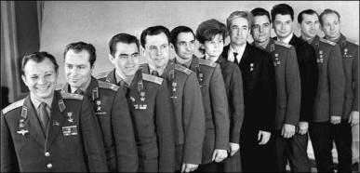
Thank you for your attention. See you soon!

