Slide 1
Profile

Slide 2
Description
People that are friendly and enjoy talking to each other. S_ _ _ _ _ _ _
People that want to know more about things.
C _ _ _ _ _ _
People that want to do things that might be dangerous. D _ _ _ _ _
People that stay calm and don’t get annoyed when something takes a long time. P _ _ _ _ _ _
People that can think of or create new and exciting things. I _ _ _ _ _ _ _ _ _ _
sociable
curious
daring
patient
imaginative

Slide 3
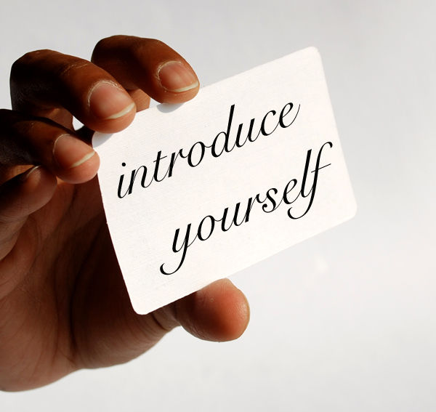
Profile.
is a short description
of a person’s appearance and\or character.

Slide 4
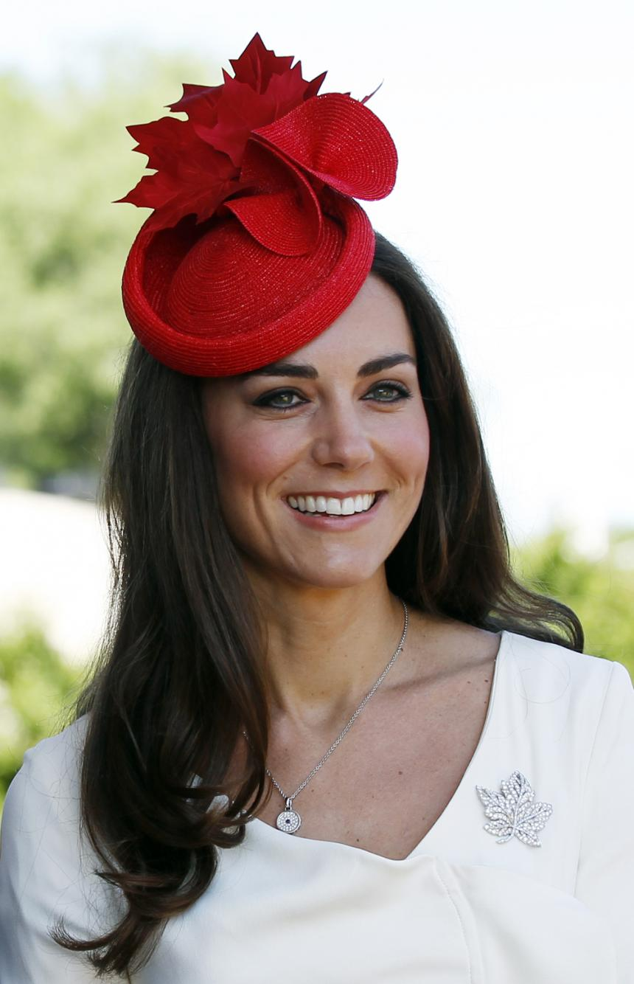
Let’s read a profile of a famous person
Full name: Catherine Elizabeth Middelton
Nickname: waity katie
Date of birth: January 9th, 1982
Relatives: one brother James and two sisters Philippa and Pippa
Hometown: Reading, the UK
University: studied art history in Scotland
Career: as a web designer for her parent’s company
Marriage: Prince Williams, April 29th, 2011
Engagement ring: belonged to William's mother, Lady Diana
Children: Prince George (22nd June, 2013) and Princess Charlotte (2nd May, 2015)

Slide 5
Fill in the gaps using the fact file
Kate’s full name is … . Her nickname is … . She was born on …, … in … . But she isn’t the only child in the family. She has got … .
She studied … in … where she met William in 2001. She finished her studies and achieved career success as … .
She got married to … on … , … . Moreover, Prince Williams gave Catherine Middleton an engagement … that belonged to his … .
Nowadays she is a mother of two children. On … , … she gave a birth to a boy … and on … , … a daughter … was born.

Slide 6

Pronunciation /e/ /æ/
Reading rules:
e /e/ get
a /æ/ glad
 | /e/ | /æ/ |  | /e/ | /æ/
set |  |  | kettle
sat |  |  | cattle
bed |  |  | pet
bad |  |  | pat
●
●
●
●
●
●
●
●

Slide 7
Choose the most/the least popular hobby for a teenager nowadays and discuss.
I (don’t) think … is a typical/popular hobby for a teenager nowadays.
- I think … is popular with teenagers nowadays as it is exciting and interesting.
- I agree\disagree. Teenagers (don’t) … nowadays.
Sewing – to sew
Knitting – to knit
Collecting stamps – to collect stamps
Ice-skating – to skate, to go ice-skating
Boxing – to box
Skateboarding – to skateboard, to go skateboarding
Playing football – to play football
Painting – to paint
Dancing – to dance
Taking photos – to take photos
Making sculpture – to make sculpture
Travelling – to travel
Designing – to desing
Photography – to take photos
I think … isn’t popular with teenagers nowadays. But my grandma used to … when she was my age.
As for me, I like … as it is rewarding.
I think … is a rewarding activity as I do something important and useful for me.
As for me, … is a great and rewarding hobby as it helps me to feel creative.

Slide 8
What qualities do you need to do these hobbies?
I need to be | qualities | to | hobbies
 | artistic |  | write songs
 | creative |  | box
 | daring |  | skateboard
 | fit |  | paint
 | patient |  | travel and learn languages
 | athletic |  | play football
 | sociable |  | write stories
 | curious |  | play chess
 | determined |  | design clothes
 | imaginative |  | collect stamps
 | ingenious |  | make sculpture

Slide 9
Listen to Sally describing her friends? What are they like?
People | Qualities
1. Debbie | a. artistic
2. Peter | b. patient
3. Lisa | c. sociable
4. Stephanie | d. daring
5. Alistair | f. fit
 | g. practical
 | h. determined
a
f
d
g
h

Slide 10
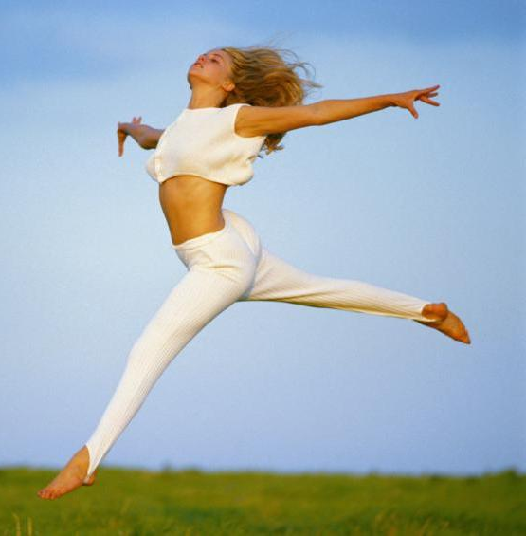
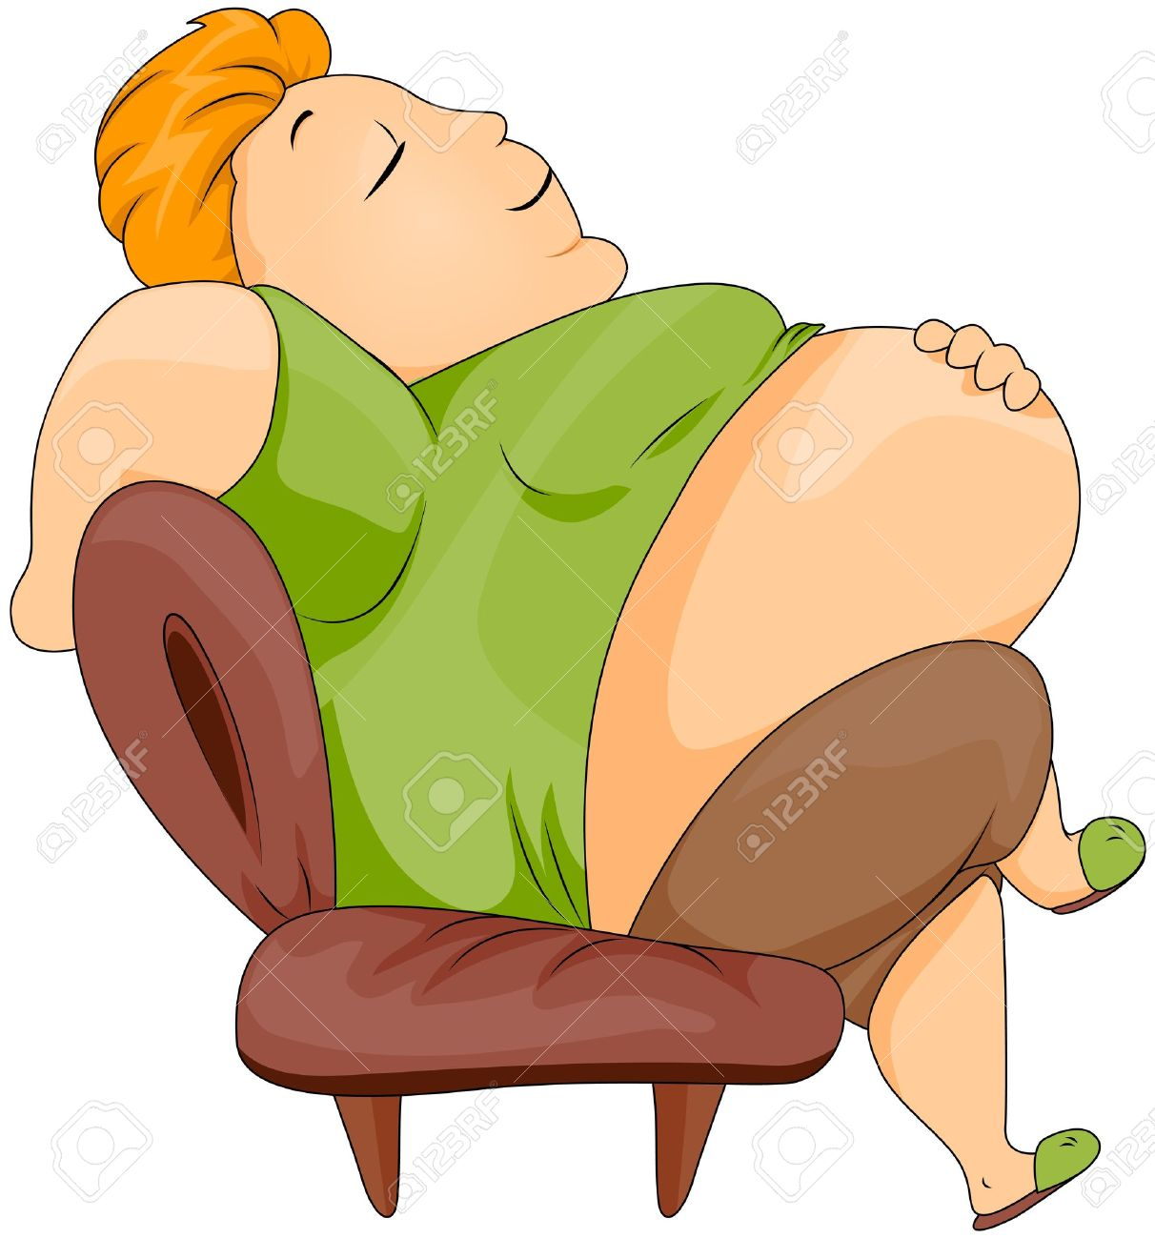
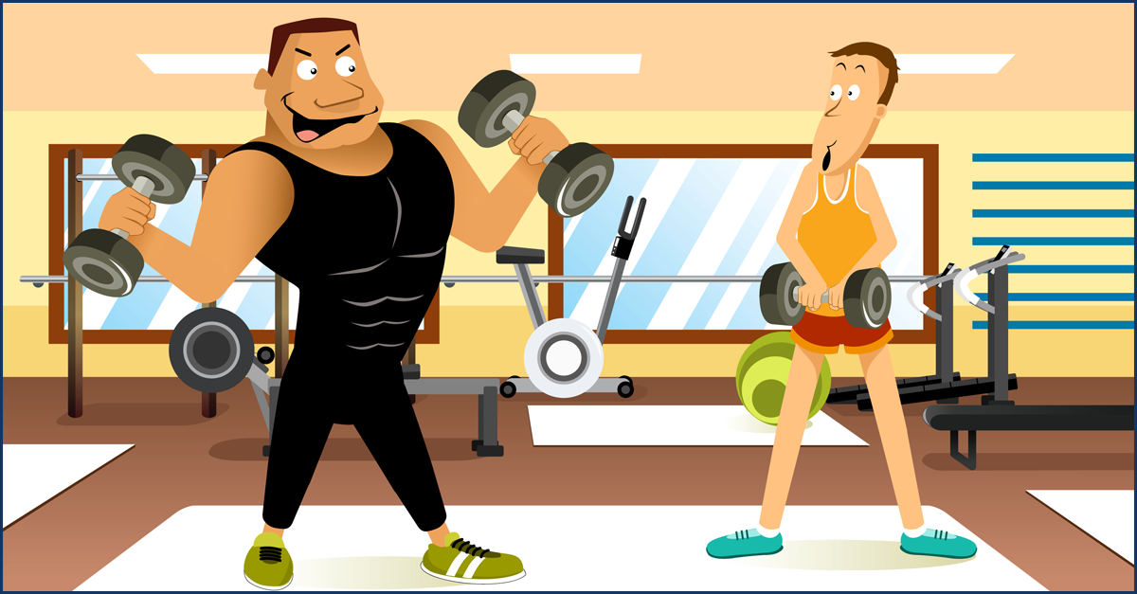
What do they look like?
slim
plump/fat
2) Is she fat?
well-built
thin
1) Is he skinny?
3) Is he plump?
4) Is he fat?

Slide 11
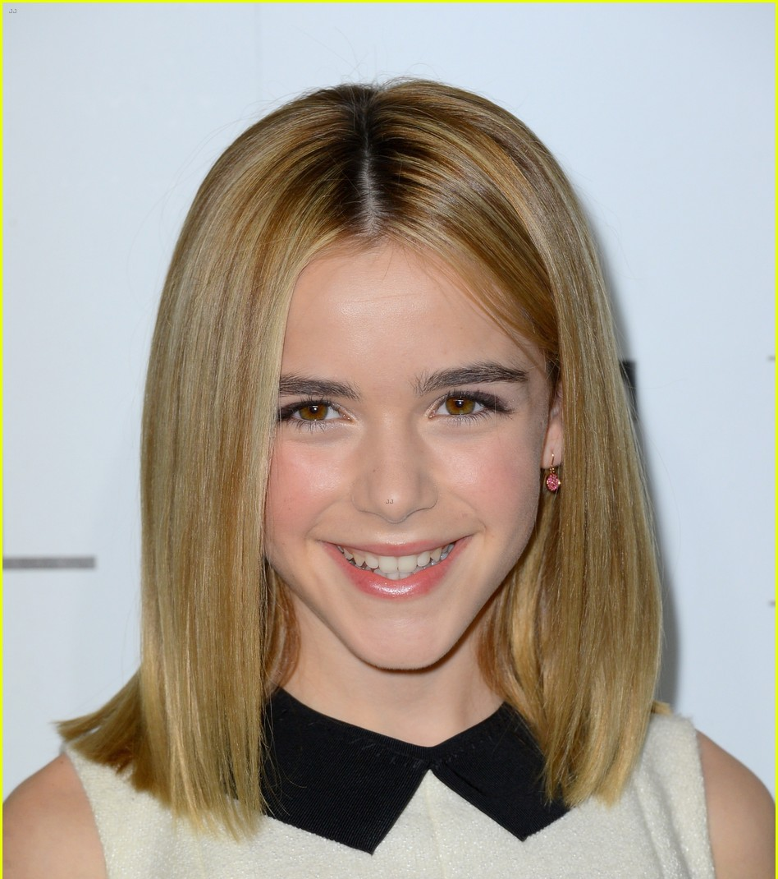
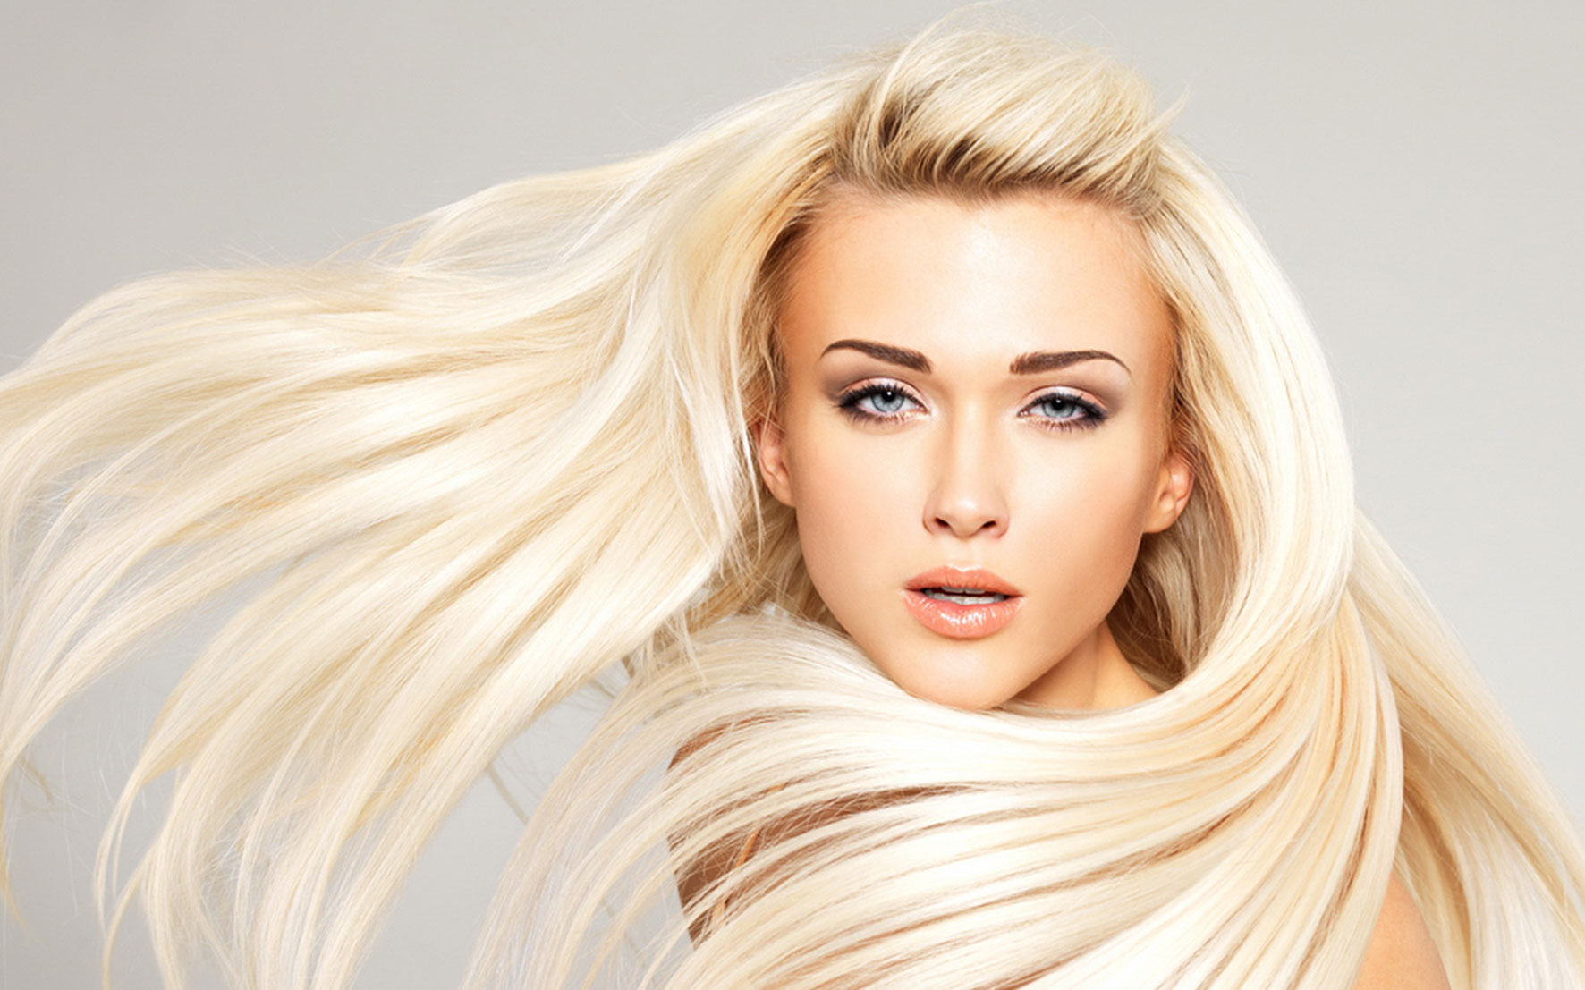
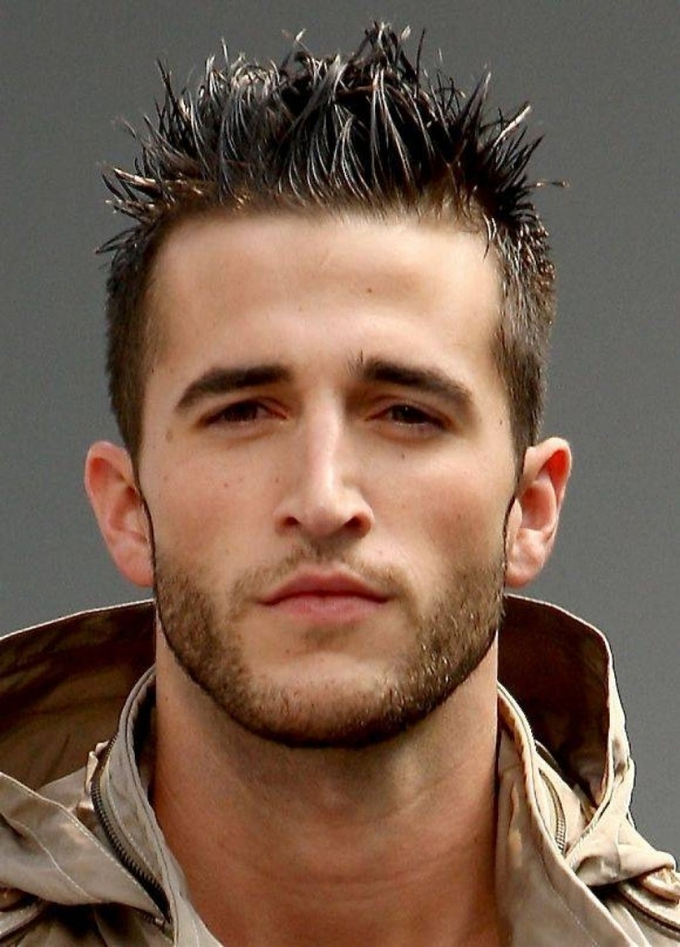
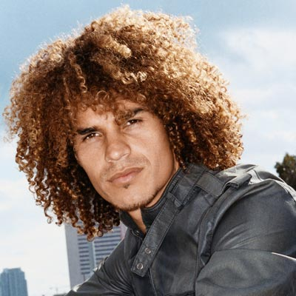
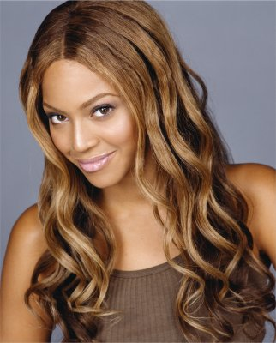
What do they look like?
She has got straight
shoulder-length hair.
She has got long
fair hair.
She has got long
wavy hair.
He has got short
spiky hair, beard and moustache.
He has got short
curly hair.

Slide 12
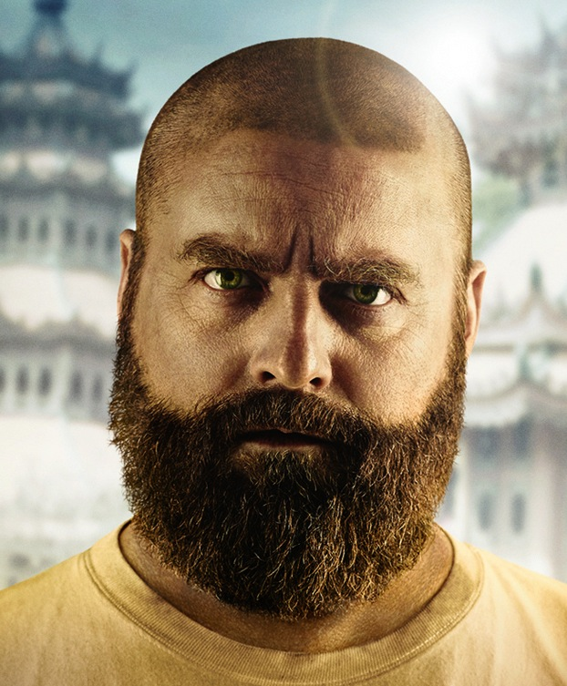
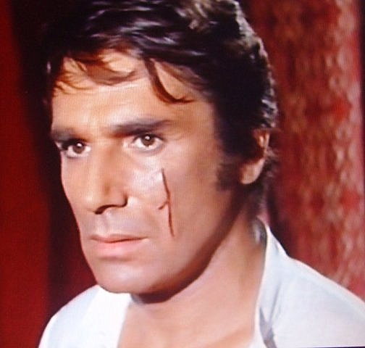
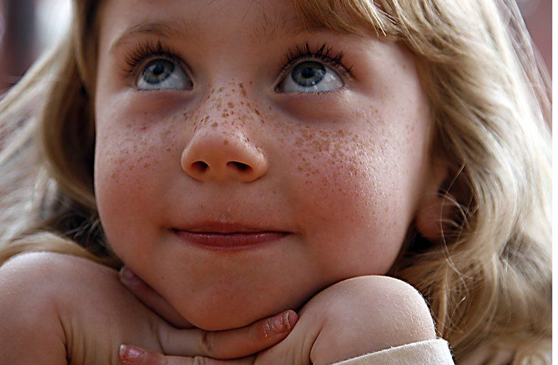
What do they look like?
He is
bald.
He has got a
scar.
She has got
freckles.

Slide 13
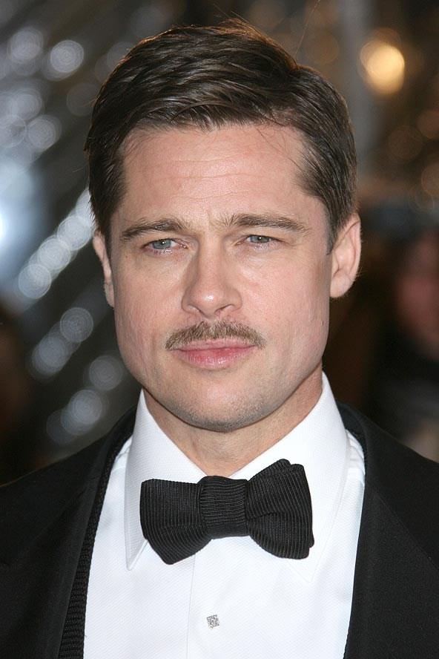
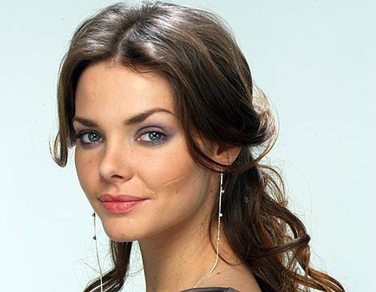
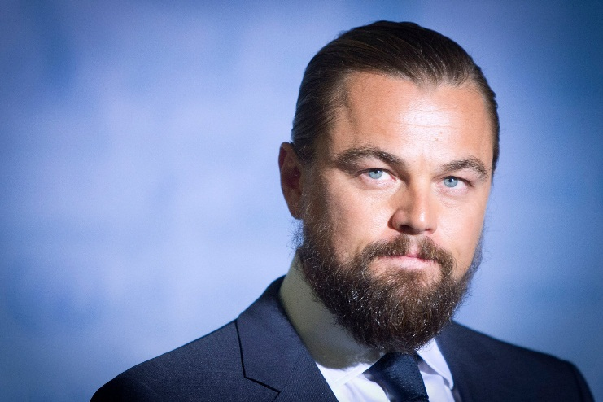
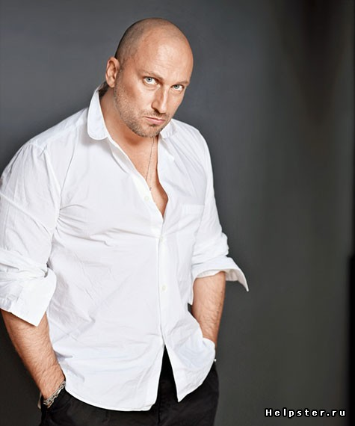
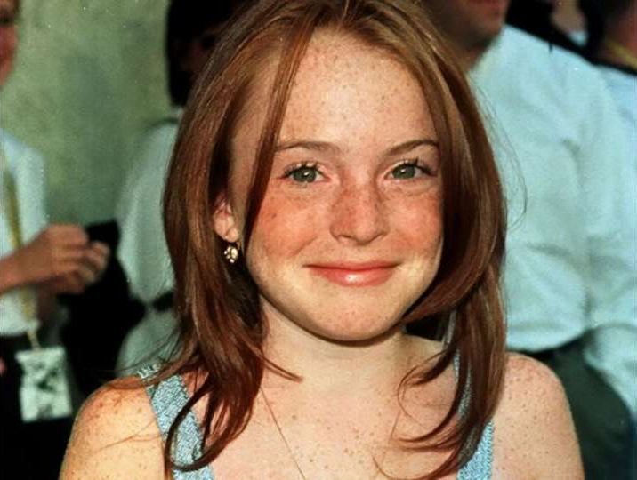
Describing a celebrity
Liza Boyarskaya
Brad Pitt
Leonardo Di Caprio
Dmitriy Nagiev
Lindsay Lohan
Is it a man or a woman? - It’s a … .
Is he tall? - Yes, he is.
Has he got dark hair? – Yes, he has/No, he hasn’t.
Has he got red hair? - Yes.

Slide 14
Let’s relax!

Slide 15
The person I admire
Plan:
1) Introduction (name, date, place of birth, profession)
2) Main body (early years)
3) Main body (later years)
4) Conclusion (the reason you admire him\her)
Some years later, she worked hard to develop her career because she wanted to achieve success. Moreover, in 2014 she carried the Olympic flag during the Winter Games in Sochi.
The reason I admire her is because she is one of the most talented actresses and she never gives up on life. When I think of her, I know that it is possible to achieve everything when you work hard.
The person I admire the most is an actress Chulpan Khamatova. Her name means the Morning Star in Tatar language. She was born on 1st October, 1975, in Kazan. She is tall and slim with dark brown hair and brown eyes. She is famous for awarding the State Prize by the Russian president Vladimir Putin for her achievements in acting and her work in the charity organization “Gift of Life”.
She studied at business school of Kazan University, but became bored and decided to change her career and entered the Kazan School of Theatre. Despite all the troubles, she finished her studies, got married. Then she started her career achievements at acting and starring as a successful and creative actress.

Slide 16
Answer the following questions and describe your friend, family member or celebrity you admire most
What’s he/she like? – He/She is determined, imaginative, creative, sociable, daring, artistic, patient, daring, brave, ingenious.
What does he/she look like? - He/She is … . He/She has got … .
What is his/her favourite hobby? – His\Her favourite hobby is travelling. His\Her favourite hobbies are dancing, playing board games, singing, writing stories and songs, painting and photography.
Is it rewarding? Why? – Yes, it is rewarding because … .
What does he\she do for a living? – He\She is an actor, an actress, a designer, a singer, a writer, a composer, a photographer, a musician.
What is he\she famous for? – He\She is famous for … .

Slide 17
Personal profile
Name: ___________________
Date of birth:______________
Hometown:________________
Relatives:_________________
Appearance:_______________
Qualities:_________________
Interests: _________________

Slide 18
Well done!
I am sure your work deserves an excellent mark!
Thank you!

