Slide 1



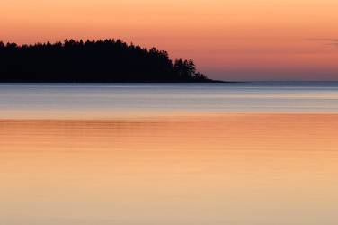
Environmental Issues of CANADA

Slide 2
Environmental Issues
Acid Rain
Pollution of Great Lakes
Extraction and use of Natural resources on Canadian Shield
Timber Industry

Slide 3
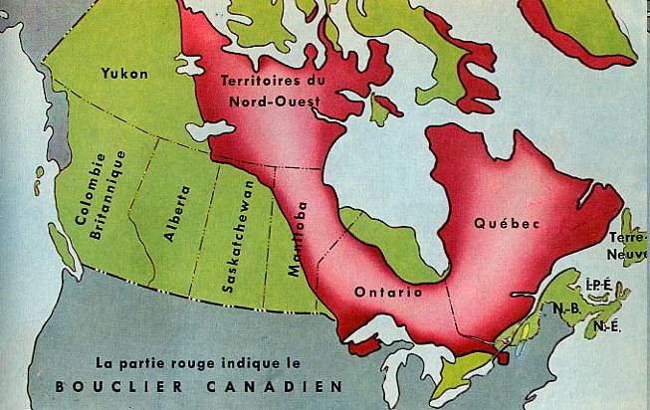
The Canadian Shield

Slide 4
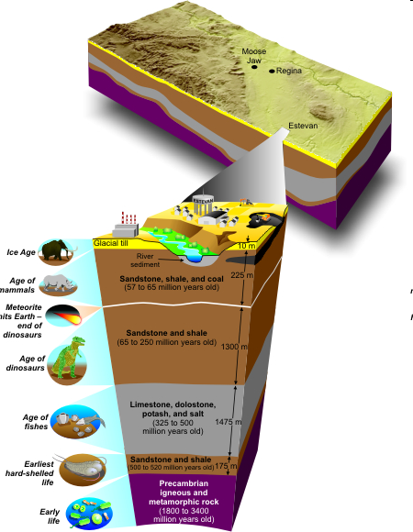
Canadian Shield
Large area of thin rocky soil around the Hudson Bay.
Very Important to Canadaian economy
1.5 million people make their living in the mining industry.

Slide 5

The Canadian Shield
The Canadian Shield contains much of Canadian mineral wealth, including diamonds.
Mining is the biggest industry in this area.
About 85 percent of the nation’s iron ore comes from mines near the Quebec- Newfoundland border.
The Canadian Shield has large deposits of gold, silver, zinc, copper, and uranium as well as forest.

Slide 6
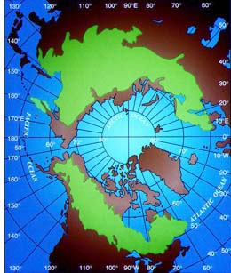
Boreal Forests
The circumpolar range of the boreal forest. About two-thirds of the area is in Eurasia. The sector in Eastern Canada lies farthest from the North Pole

Slide 7
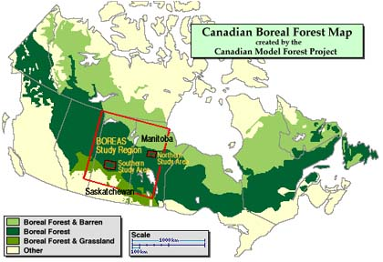

Slide 8

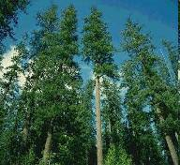
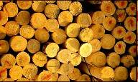
Canadian Timber Resources
With almost half its land covered in forests, Canada is a leading producer of timber products.
These products include lumber, paper, plywood, and wood pulp.
The major timber – producing provinces include British Columbia, Quebec, and Ontario.

Slide 9
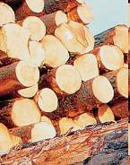
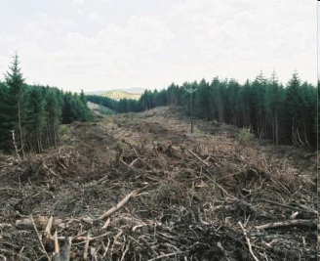
Timber Solution
Government and Industry are working together to manage use of the forest
When too many of these raw materials are removed or extracted from the environment, it hurts the environment permanently.
Historical and current over-extraction of minerals and timber has threatened the future of available resources.

Slide 10
Solution to Extraction of Resources
Canadian government has made new rules:
Reduce amount of mining allowed in the shield
Reduce exports of raw materials, but focus on manufactured goods like cars.

