Slide 1


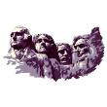






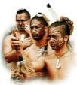





The USA
Quiz
Canada
Great Britain
New Zealand
Australia
100-288-905
Дикая Наталья Александровна , учитель английского языка,
ГБОУСОШ № 347 с углубленным изучением английского языка
Невского района Санкт-Петербурга

Slide 2
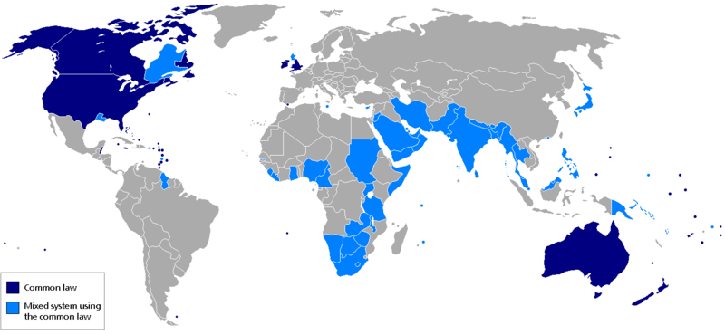
English-speaking countries

Slide 3


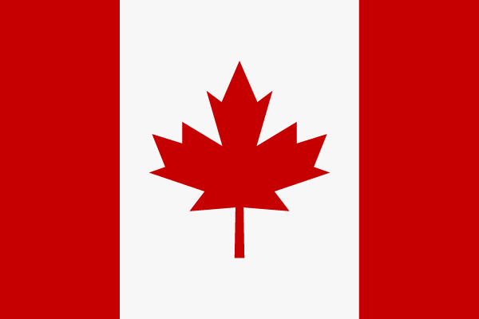
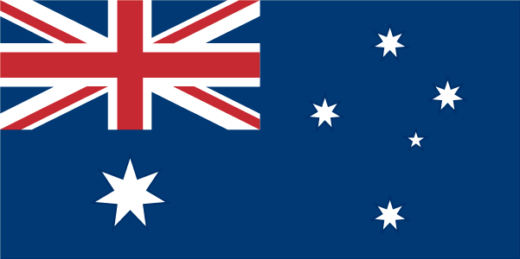

English-speaking countries
1
2
3
4
5
6
7
8
9
10
11
12
13
14
15
16
17
18
19
20
21
22
23
24
25
26
27
28
29
30
31
32
33
34
35
36
37
38
39
40
41
42
43
44
45
46
47
48
49
50

Slide 4
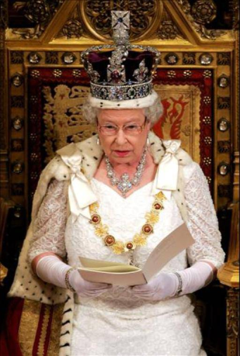


1.In Britain the Queen is the formal head of state, but it is the prime minister and the cabinet who ....
a) govern
b) choose
c) advise
d) elect

Slide 5
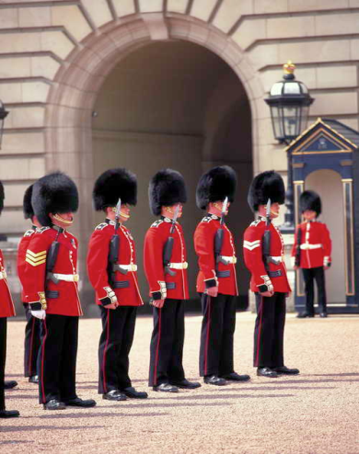
2.The Church of England is a ... church and official state religion of England.
a) Orthodox
b) Moslem
c) Protestant
d) Catholic

Slide 6
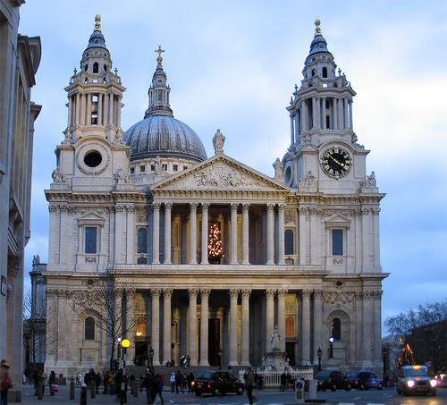
3.Old St. Paul’s was ... by the Great Fire of London in 1666.
a) broken
b) destroyed
c) disappeared
d) hidden

Slide 7
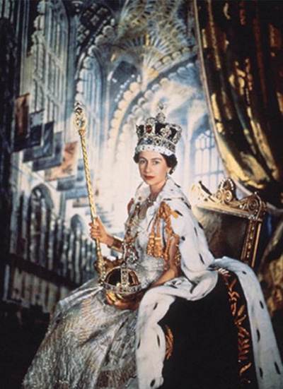
4.Elizabeth II has been the Queen of Great Britain since ....
a) 1932
b) 1992
c) 1982
d) 1952

Slide 8
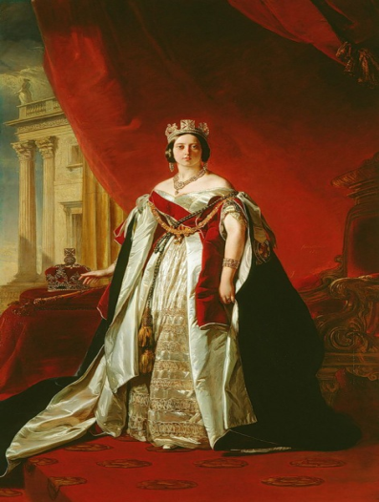
5.In British history the period from 1837 to 1901 is known as the Victorian ....
a) century
b) decade
c) era
d) local time

Slide 9
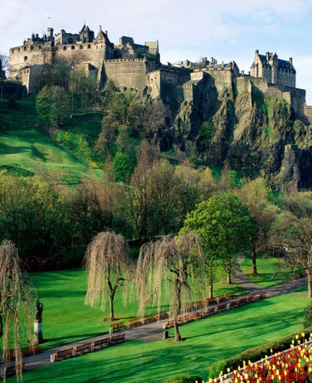
6.Scotland is the land of tartans and malt whisky, of romantic castles and the haunting melodies of....
a) violins
b) guitars
c) organs
d) bagpipes

Slide 10
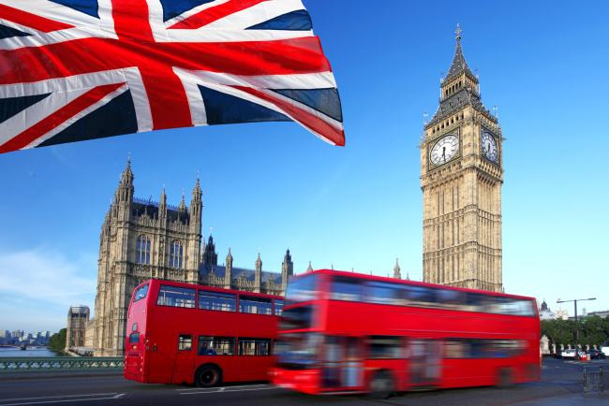
7.The flag of the United Kingdom, known as the Union Jack, is made up of ... crosses.
a) two
b) three
c) four
d) five

Slide 11
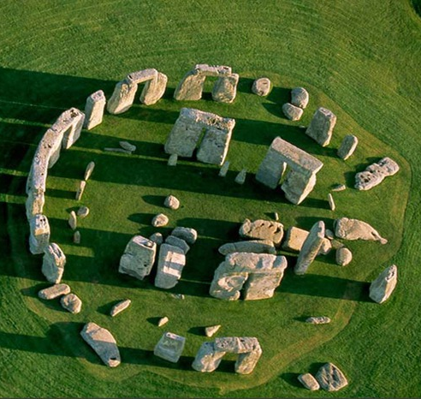
8.Stonehenge is about ... years old.
a) 40
b) 400
c) 4 000
d) 40 000

Slide 12
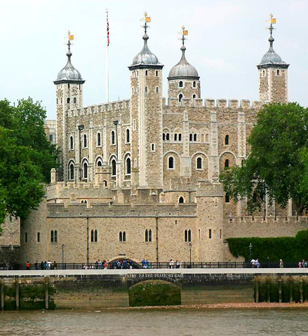
9.The Tower of London was started by ... .
a. Julius Caesar
b. William the Conqueror
c. Henry VIII
d. Sir Christopher Wren

Slide 13
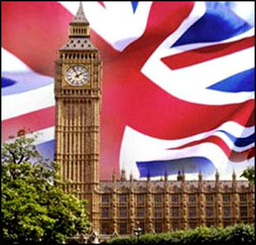
10.Big Ben is ... .
a) the clock tower of the Houses of Parliament
b) the clock
c) the largest bell at the top of the tower
d) the pendulum

Slide 14
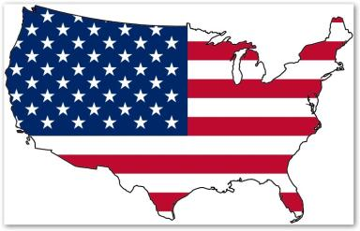

11.... was the name of the first village of Europeans in America.
a) New Plymouth
b) New Amsterdam
c) New York
d) Mayflower

Slide 15
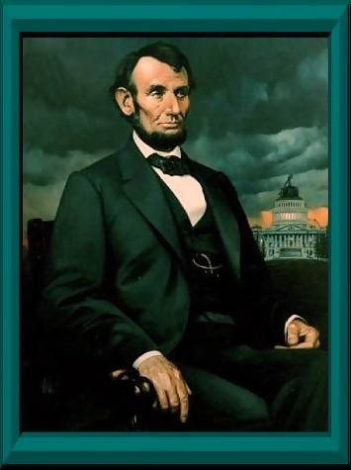
12. Abraham Lincoln is the ... president of the USA.
a) sixteenth
b) first
c) last
d) eighth

Slide 16
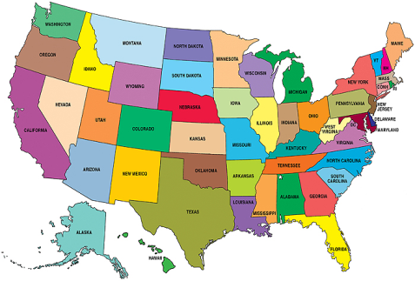
13. The USA is a ... .
a) republic
b) federal republic
c) monarchy
d) parliamentary monarchy

Slide 17
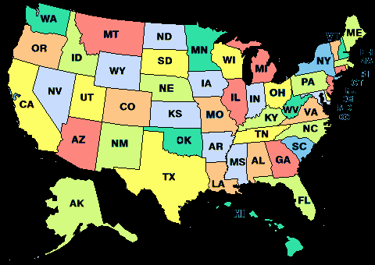
14. There are ... states in America.
a) 51
b) 50
c) 52
d) 13

Slide 18

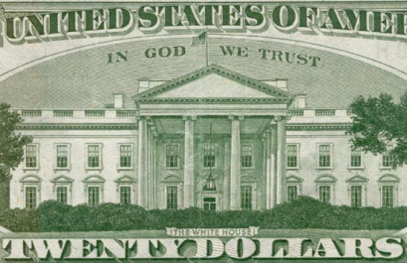
15.The United States’ national motto is ... .
a) Uncle Sam
b) In God We Trust
c) Epluribus unum
d) Stars and Stripes

Slide 19
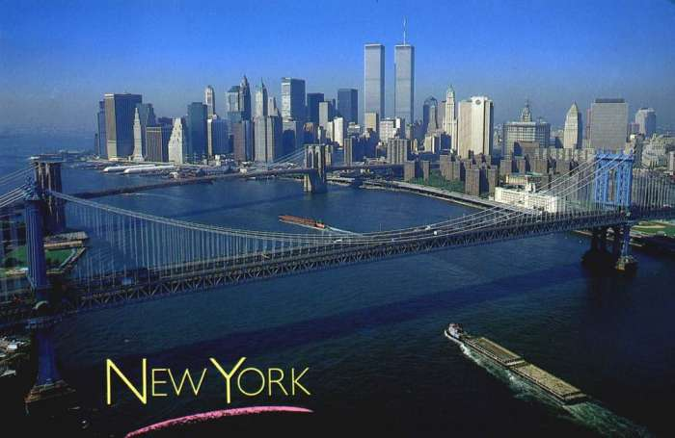
16.The heart of the city of New York is ... .
a) the Bronx
b) Manhattan
c) Brooklyn
d) Queens

Slide 20
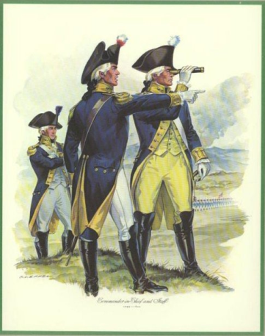
17. By the time of the American Revolution (1776), the culture of American colonists had been thoroughly ....
a) British
b) French
c) Indian
d) Dutch

Slide 21

18. Education in the USA comprises ... basic levels.
a) two
b) three
c) four
d) five

Slide 22
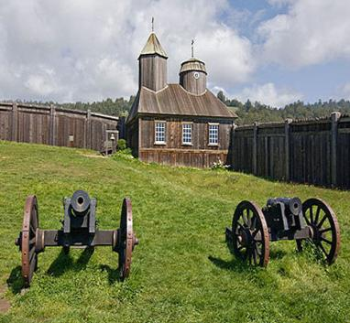
19.In 1812 the first Russian settlement appeared on the American continent. The name of it is ... .
a) the White House
b) Fort Ross
c) Moscow
d) The Grand Canyon

Slide 23
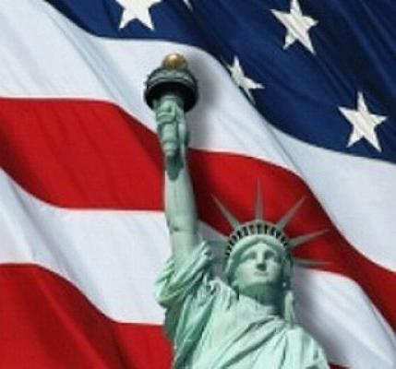
20. The Statue of Liberty was presented to the USA by the freedom-loving people of ... .
a) Britain
b) Spain
c) France
d) Italy

Slide 24
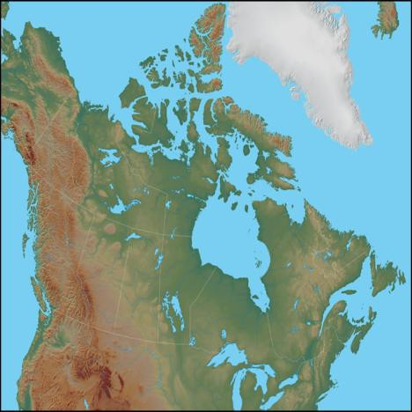
21. Canada is the ... country in the world.
a) largest
b) fifth largest
c) second largest
d) third largest

Slide 25
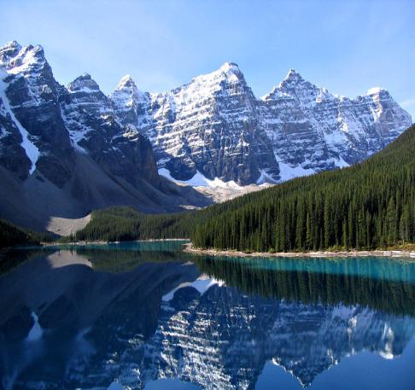
22.... poetically called Canada “Our Lady of the Snows”.
a) M. Twain
b) O. Henry
c) M. Lawrence
d) R. Kipling

Slide 26
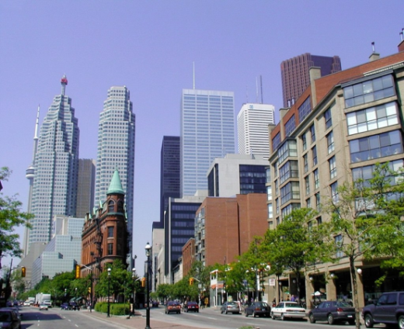
23. The city with the largest population in Canada is ....
a) Montreal
b) Toronto
c) Ottawa
d) Vancouver

Slide 27
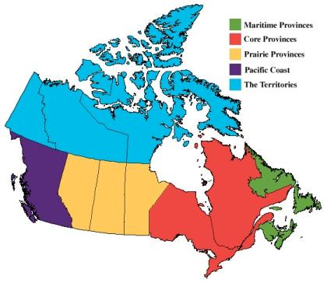
24. There are ... provinces and three territories in Canada.
a) 50
b) 12
c) 10
d) 8

Slide 28
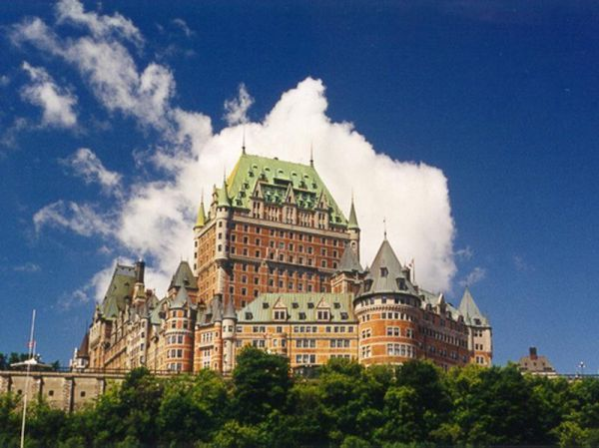
25. The largest Canadian province is ... .
a) Ontario
b) Manitoba
c) Alberta
d) Quebec

Slide 29
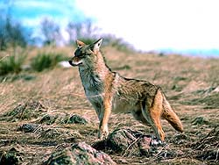
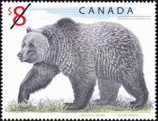
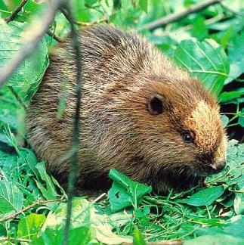
26. Canadian animal symbol is a ... .
a) bear
b) beaver
c) fox
d) wolf

Slide 30
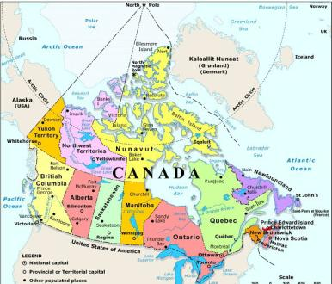
27. Canada is ... .
a) a federal republic
b) a parliamentary republic
c) a monarchy
d) an independent constitutional monarchy

Slide 31
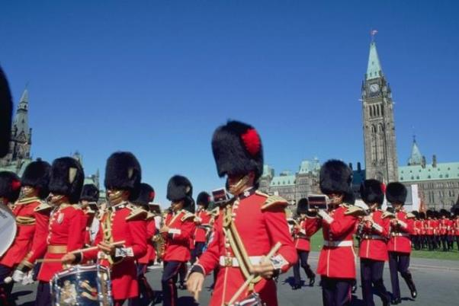
28. Canada became independent from Britain in ... .
a)1759
b)1867
c)1776
d)1931

Slide 32
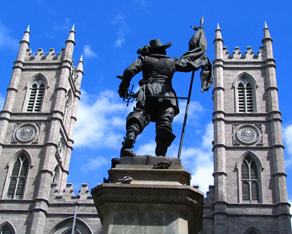
29. In 1603 ... began the settlement which was named Quebec.
a) Samuel de Champlain
b) Jacques Cartier
c) James Cook
d) Abel Tasman

Slide 33
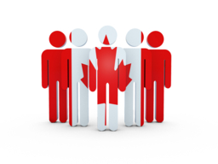
30. The ... is the national emblem of Canada.
a) birch
b) maple leaf
c) rose
d) daffodil

Slide 34
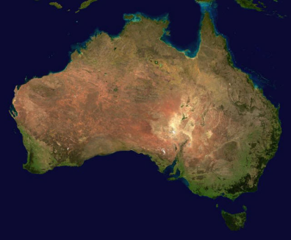
31. Australia is the ... of all continents.
a) smallest and flattest
b) biggest and flattest
c) biggest and driest
d) smallest and wettest

Slide 35
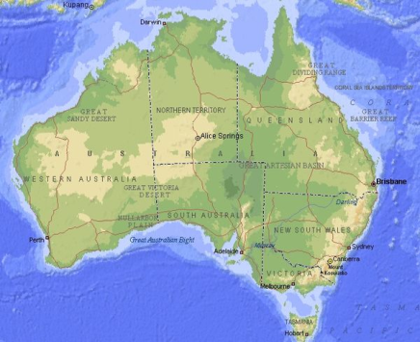
32. Australia is the ... country in the world.
a) smallest
b) largest
c) sixth largest
d) fourth largest

Slide 36
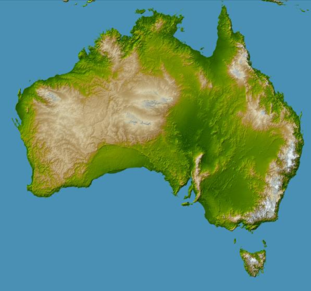
33. There are ... states and two territories in the Commonwealth of Australia.
a) 50
b) 13
c) 6
d) 5

Slide 37
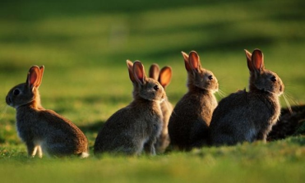
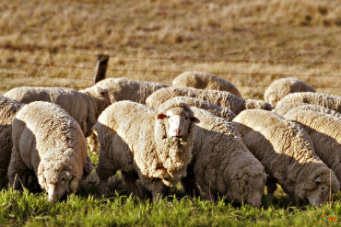
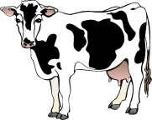
34. A domestic animal which outnumbers people in Australia is a ... .
a) rabbit
b) cow
c) cat
d) sheep

Slide 38
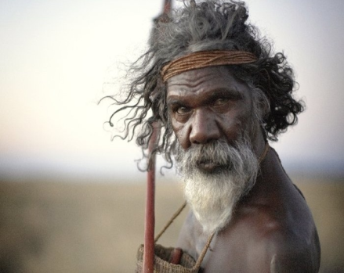
35. Aborigines constitute ... of Australia’s population.
a) nearly half
b) one per cent
c) twenty per cent
d) five per cent

Slide 39
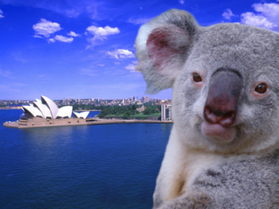
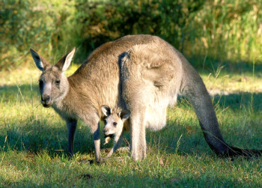
36. The name of this animal is an Aboriginal one for “no water”.
a) echidna
b) kangaroo
c) kookaburra
d) koala

Slide 40
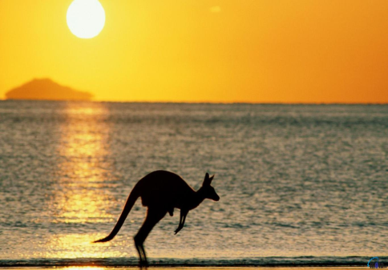
37. The first Europeans reached Australia in ... .
a) 1606
b) 1770
c) 1788
d) 1492

Slide 41
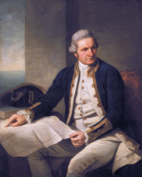
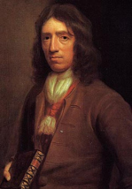
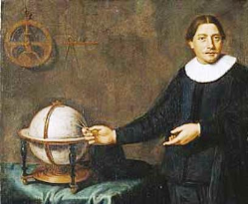
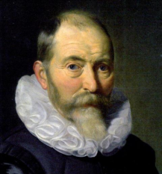
38....claimed New South Wales for Britain.
a) James Cook
b) Abel Tasman
c) William Dampier
d) Dirk Hartog

Slide 42


39.... could be called “the Australian Volga” or “the Australian Mississippi”.
a) The Murray
b) The Darling
c) The Lachlan
d) The Murrumbidgee

Slide 43


40. The centre of the continent Australia is taken by the ...
a) mountains
b) lakes
c) forests
d) deserts

Slide 44


41. New Zealand is dominated by Nature, with magnificent beaches, lakes and ....
a) deserts
b) prairies
c) mountains
d) lowlands

Slide 45

42. New Zealand has ... climate.
a) an oceanic
b) a continental
c) an arctic
d) a cold

Slide 46

43. New Zealand was first settled by ... .
a) Europeans
b) Indians
c) Chinese
d) Polynesians

Slide 47

44. Full independence from Britain was conferred by the Statute of Westminster in ... .
a) 1931
b) 1907
c) 1841
d) 1852

Slide 48

45. There are two official languages in New Zealand - ... .
a) English and French
b) English and Maori
c) German and Maori
d) French and Maori

Slide 49



46. Many birds in New Zealand are ... .
a) abundant
b) meat-eating
c) flightless
d) long-tailed

Slide 50

47.... is New Zealand’s largest city.
a) Wellington
b) Auckland
c) Dunedin
d) Christchurch

Slide 51

48. Maori constitute ... of New Zealand’s population.
a) nearly half
b) one per cent
c) twelve per cent
d) eighty per cent

Slide 52

49. New Zealand is ... .
a) a small country
b) the largest country in the world
c) the sixth largest country in the world
d) the tenth largest country in the world

Slide 53



50. New Zealand is the largest exporter of ... in the world.
a) fur
b) wheat
c) dairy products
d) oil

Slide 54


Yes, it’s right!!!

Slide 55

No, it’s wrong!!!

