Slide 1
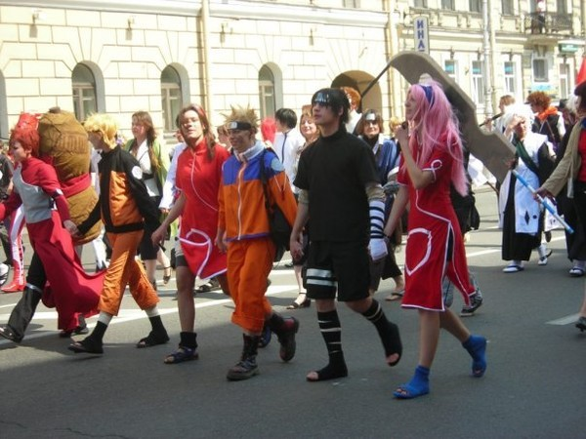
Youth subcultures

Slide 2

Plan:
Discussion
What is a subculture?
Vocabulary
Differences between subcultures
Video film “A Gothic festival”
Presentations

