Slide 1
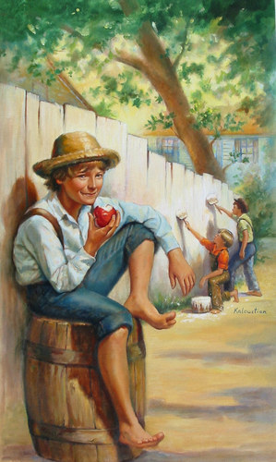

The adventures of tom sawyer
Khaninyova Diana 7 «B»
Teacher: Baeva Marina Leonidovna

Slide 2
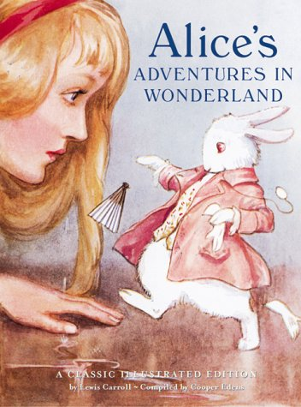
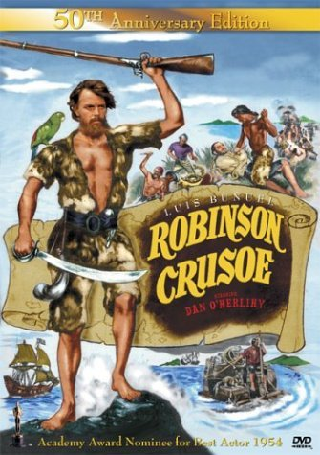
BOOK’S WORLD
A BOOK IS ONE OF THE GREATEST WONDERS OF THE WORLD.
WHY ARE SO MANY PEOPLE FOND OF READING?
A GOOD BOOK IS A FAITHFUL FRIEND .
WHO HASN’T READ «ALICE IN THE WONDERLAND», «MOWGLI»?
WHO HASN’T TRAVELLED WITH MARRY POPPINS TO HER IMAGINARY WORLD?
WHO HASN’T IMAGINED HIMSELF TO BE ROBINSON CRUSOE ON THE DESERTED ISLAND?

Slide 3
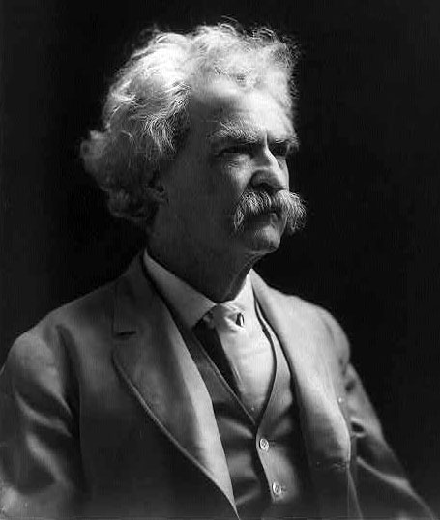
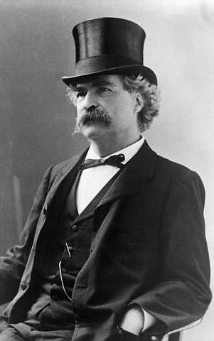
Mark Twain
So now I’d like to tell you about the author Mark Twain.
Samuel Clemens was born in Florida, on November 30, 1835, known by his pen name Mark Twain. He was an American author and humorist. He wrote novels “Adventures of Huckleberry Finn” (1885) and “The Adventures of Tom Sawyer “(1876).
After his death he was called as the "greatest American humorist of his age“ and "the father of American literature".

Slide 4
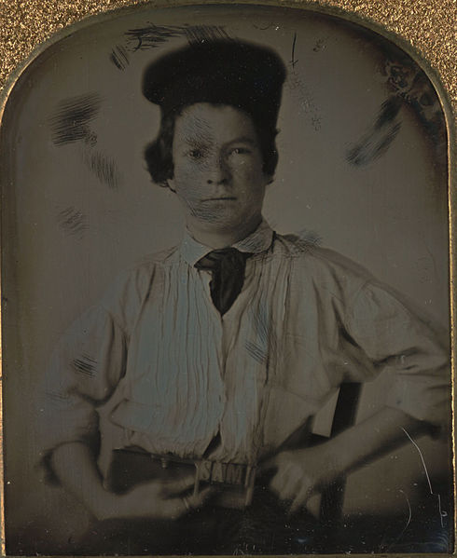
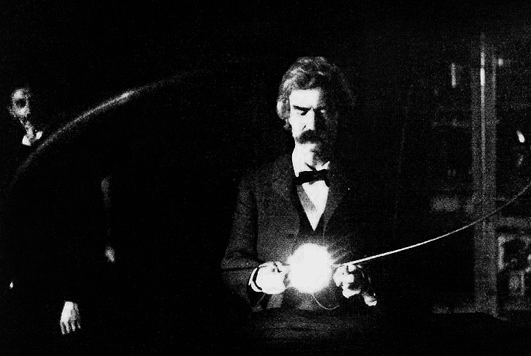
Samuel Clemens, age 15
Twain in the lab of Nikola Tesla, early 1894

Slide 5
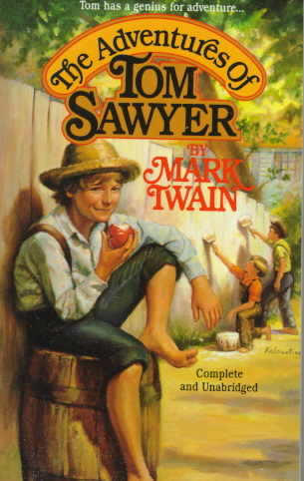
And now I’d like to tell you about my favourite book of M. Twain. This a well-known book is popular with children all over the world. The main character of the book is Tom Sawyer, who lived in a small town on the Mississippi River. He was a boy with a wild imagination. He and his friends often dreamed of different adventures. Tom was naughty, kind and brave, noble.
I like this boy because he teaches us to be true friends.
If you are not fond of reading, take a book to your taste or borrow it in a library and read it. Books are worth reading. Really, they are our good friends.

Slide 6
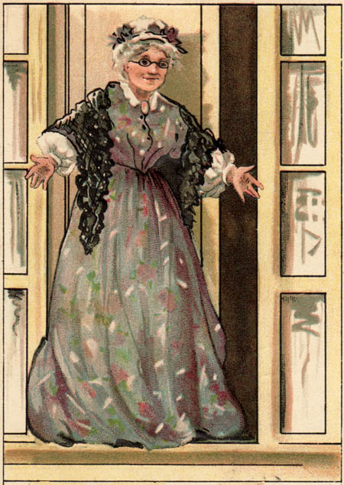
Tom was always getting into trouble . Aunt Polly found Tom in the closet eating jam. Aunt Polly was mad! He was so good at it.

Slide 7
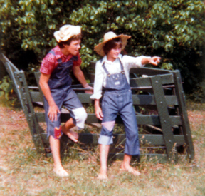
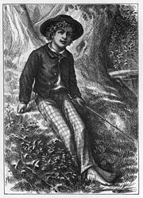
That weekend, Aunt Polly made Tom paint the fence. Tom could not believe he had to work on a beautiful Saturday. There was no school and it was a beautiful day! Would you want to work on a Saturday painting fence? Tom didn’t!

Slide 8
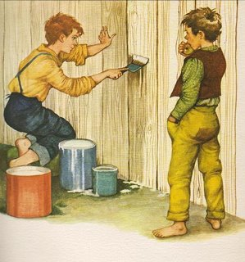
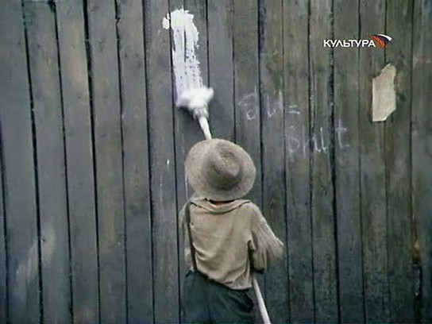
Tom’s friend Ben was walking down the street. He was going swimming. Ben watched as Tom painted the fence. He tried to ask Tom why he was working on such a beautiful Saturday. Tom looked at Ben and said he was having fun painting the fence and it wasn’t work at all! But Ben wasn’t so sure.

Slide 9
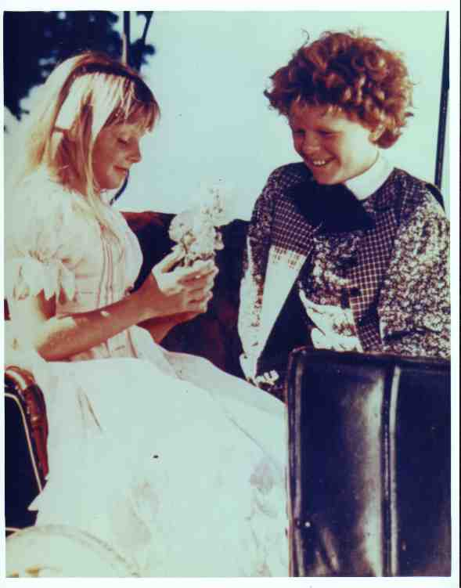
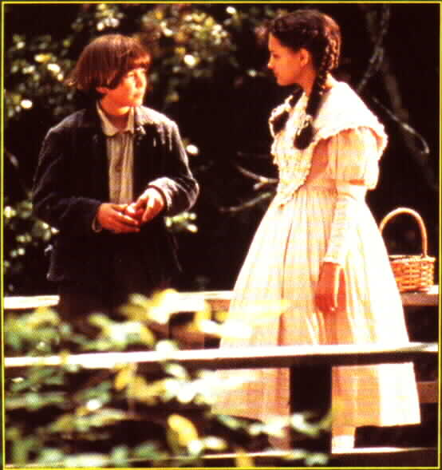
At school, Tom was late.. He sat beside the girl of his dreams, Becky! he offered her a peach, and she took it. Pupils didn't hear the teacher. Tom smiled and wrote “I love you, Becky!”

Slide 10
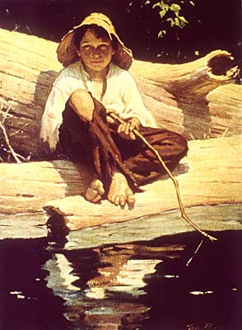
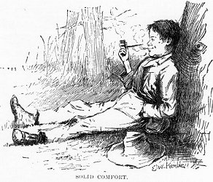
Everyone wanted to be Huck Finn because He didn’t have to go to school. and he could always go fishing! He was the best tom’s friend.

Slide 11
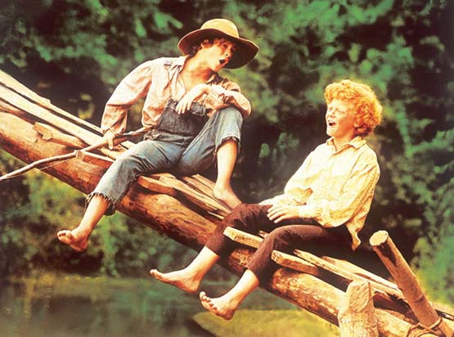
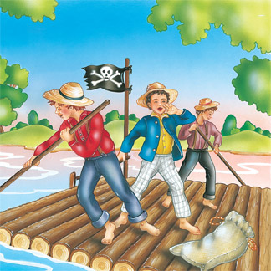
Tom and the other boys were enjoying being pirates. They had a lot of adventures.

Slide 12
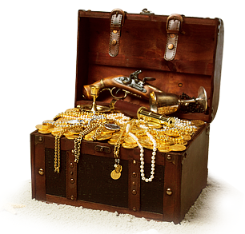
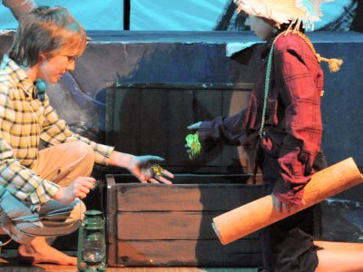
Tom and Huck wanted to look for treasure !
They were nervous. Two men entered the house. One of the men was Injun Joe.
Tom and Huck went to the cave and found Injun Joe’s secret. The boys found several bags of gold. The boys were so happy.
Would you be happy if you found that much gold? They found 12,000 dollars! That was a lot of money!

Slide 13
Now that is our story about Tom Sawyer. If you want to read more about Tom and Huck, you’ll have to read “Huckleberry Finn” !

