Slide 1


DESCRIBING PEOPLE

Slide 2
Appearance | 200 | 400 | 600 | 800
Who are they? | 200 | 400 | 600 | 800
Idioms | 200 | 400 | 600 | 800
Bad and good qualities | 200 | 400 | 600 | 800
Famous characters | 200 | 400 | 600 | 800
История | Философия | Экономика | Психология | Иностранный язык
200 | 200 | 200 | 200 | 200
400 | 400 | 400 | 400 | 400
600 | 600 | 600 | 600 | 600
800 | 800 | 800 | 800 | 800

Slide 3

What is it being said about:
It can be delicate, slim, slender, stout, plump, skinny. It makes us look different and alike.
Узнать ответ

Slide 4
Build/ Stature/ figure
Вернуться к выбору тем→

Slide 5
To give an idea of someone’s appearance
we should describe the next features. Choose the correct option:
Height;
Behavior;
Hair;
Eyes;
Relations with next-door neighbors;
The place he/she was born;
Person’s hobby;
A shape of a face;
Person’s clothes;
A Stature/a build;
A chin;
Teeth;
If a person has read Shakespeare
Узнать ответ

Slide 6
Height;
Hair;
Eyes;
A shape of a face;
Person’s clothes;
A Stature/a build;
A chin;
Teeth;
Вернуться к выбору тем→

Slide 7
Replace adjectives with words with the opposite meaning:
Stout, of solid build-
Close-cropped-
Old-fashioned-
Curly-haired-
Dark-haired-
Tall-
Different-
Узнать ответ

Slide 8
Stout, of solid build- slender, delicate, graceful, slim Close-cropped- long-haired Old-fashioned- smartly-dressed, fashionably-dressed Curly-haired- straight-haired Dark-haired- fair/light-haired tall-short different-alike
Вернуться к выбору тем→

Slide 9
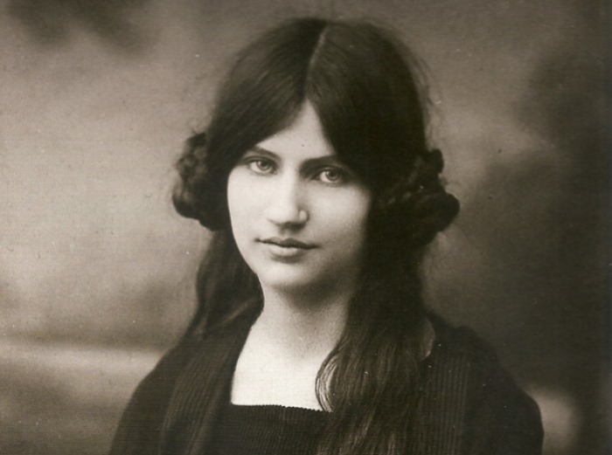
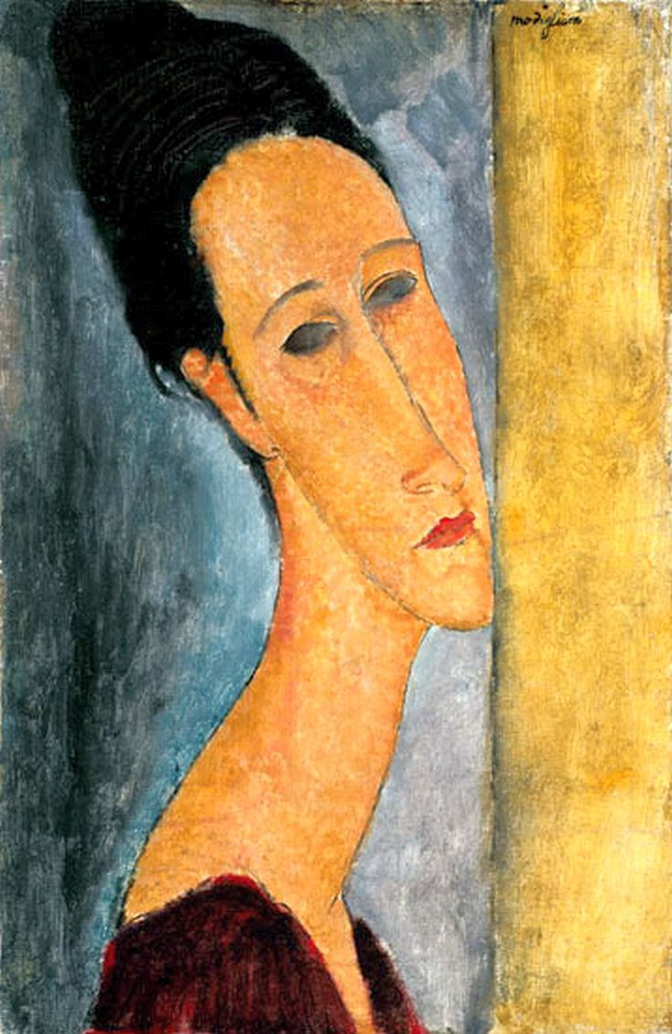
This is Modigliani’s painting and nearby it is the photo of his beloved Jeanne. Compare and say what ‘s wrong with the painting. Why does the painted woman not look like her original?
Узнать ответ

Slide 10
The woman in the portrait has no pupils, her eyes are blurred. She has extremely long neck. The woman in the photo has long straight hair and a pair of plaits rolled up into a ball.
Вернуться к выбору тем→

Slide 11
I am something people love or hate. I change people’s appearances and thoughts. If a person takes care of themself I will go up even higher. To some people I will fool them. To others I am a mystery.
Some people might want to try and hide me but I will show. No matter how hard people try I will Never go down. What am I?
Узнать ответ

Slide 12
I am Age.
Вернуться к выбору тем→

Slide 13
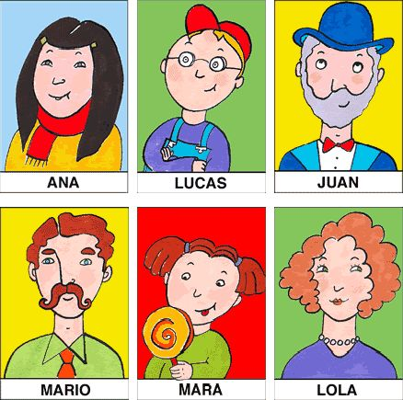
Who am I?
I am a person
with curly red hair,
bushy eyebrows.
I wear a moustache.
I am dressed formal.
Узнать ответ
Категория 2 / Вопрос за 400

Slide 14
I am Mario Категория 2 / Вопрос за 400
Вернуться к выбору тем→

Slide 15
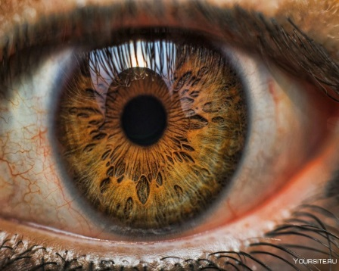
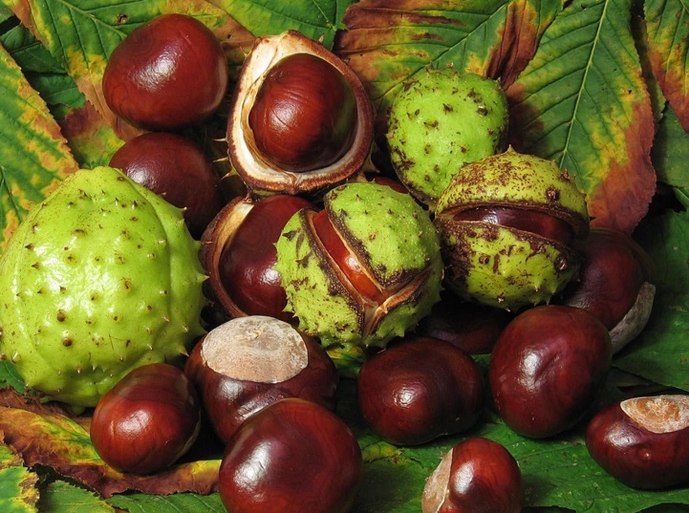

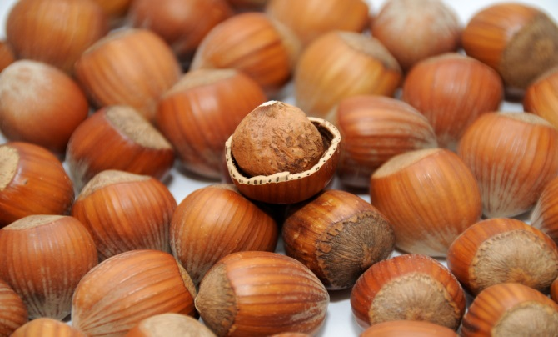
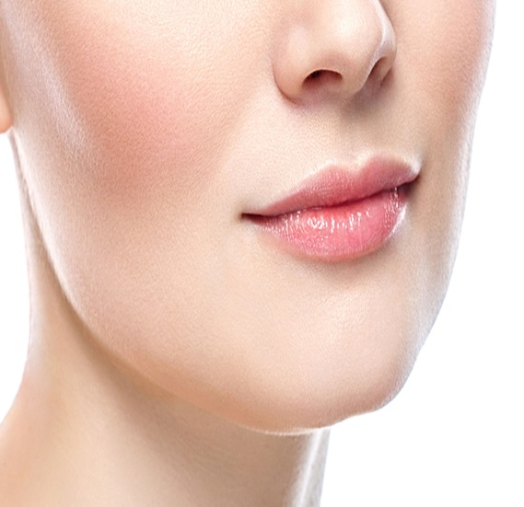
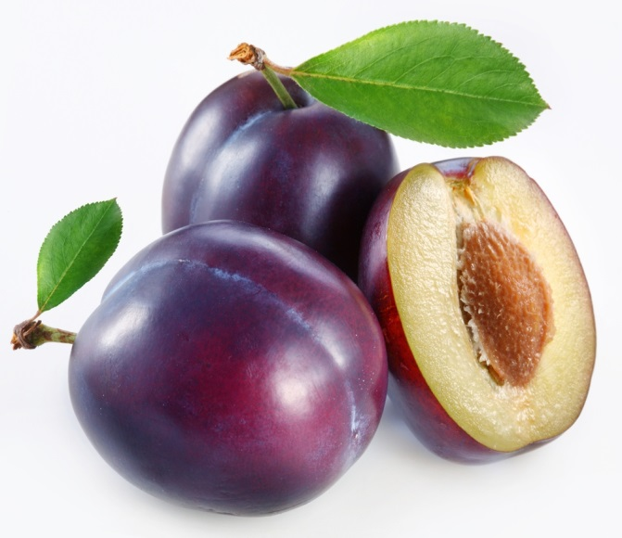
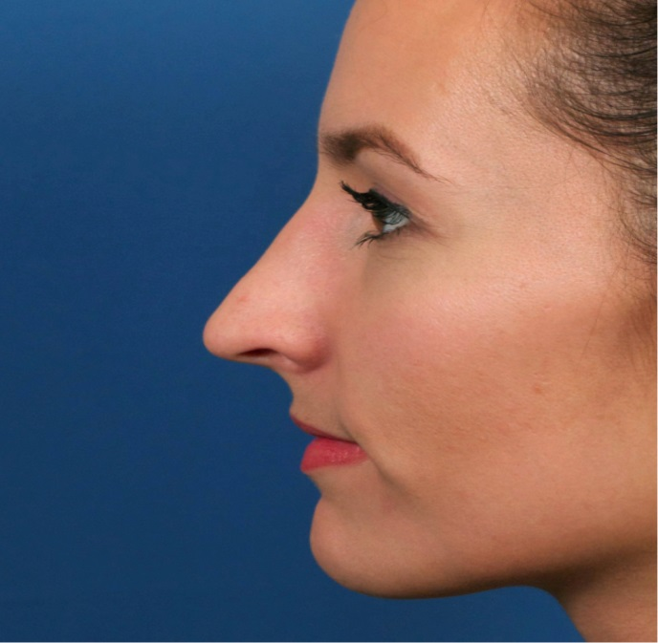
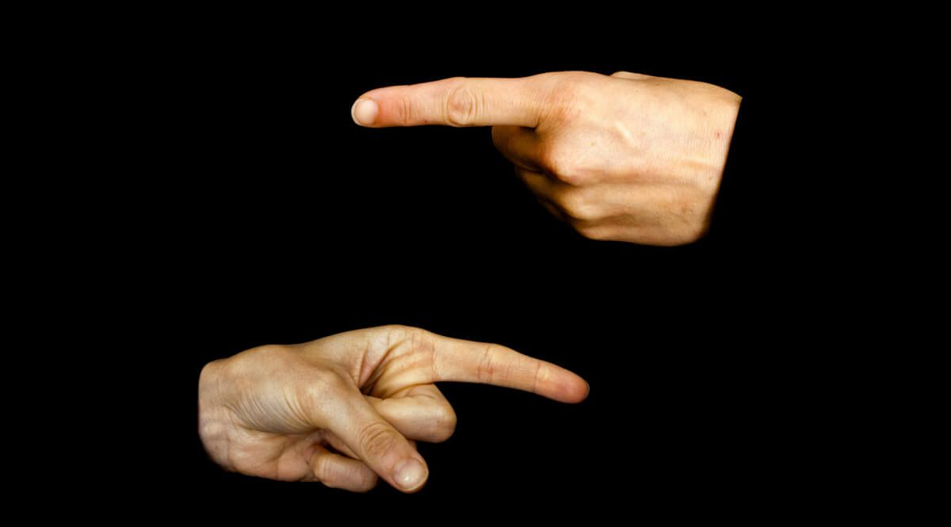
Describe the person whose features of appearance are encrypted here. These features are encrypted in pictures.
Категория 2 / Вопрос за 600
1..
2.
3.
P
4.
Узнать ответ

Slide 16
Hazel eyes, chestnut hair, plump cheeks, a pointed nose Категория 2 / Вопрос за 600
Вернуться к выбору тем→

Slide 17
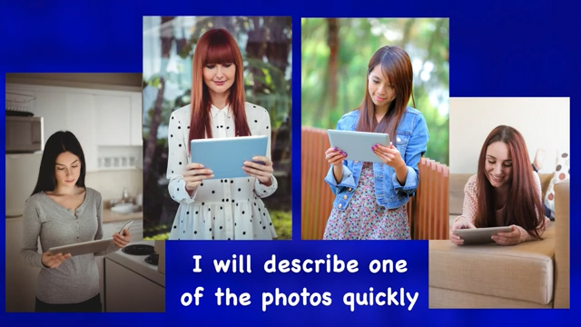
Категория 2 / Вопрос за 800
Узнать ответ

Slide 18
Picture # 2 Категория 2 / Вопрос за 800
Вернуться к выбору тем→

Slide 19
Match the idioms with the appropriate words
and translate them:
To have a sweet | nose
To be head over… | thumbs
Running… | shoulder
To put foot in …. | a finger
to be all…. | tooth
to give somebody the cold… | eye
to have …. in every pie | heels
to catch someone’s … | mouth
Категория 3 / Вопрос за 200
Узнать ответ

Slide 20
Категория 3 / Вопрос за 200
To have a sweet | nose
To be head over heels | thumbs
Running nose | shoulder
To put foot in mouth | a finger
to be all thumbs | tooth
to give somebody the cold shoulder | eye
to have a finger in every pie | heels
to catch someone’s eye | mouth
Вернуться к выбору тем→

Slide 21
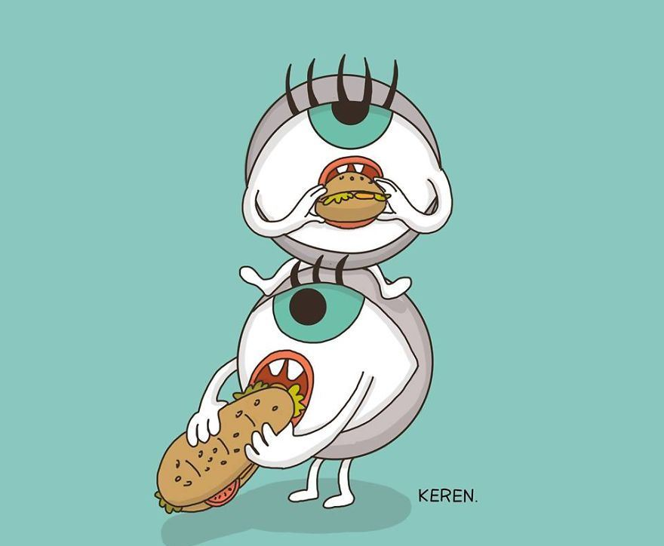
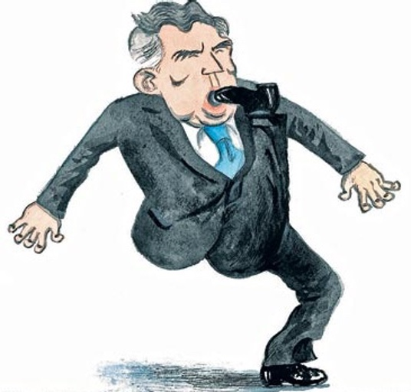
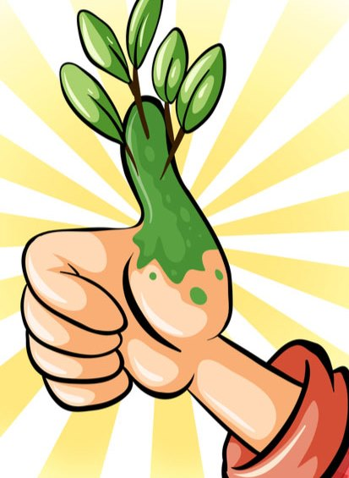
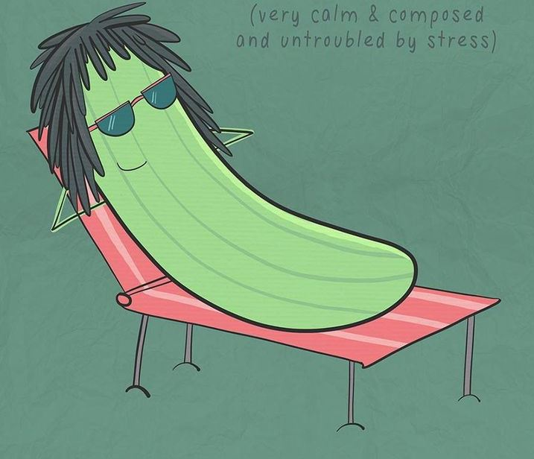
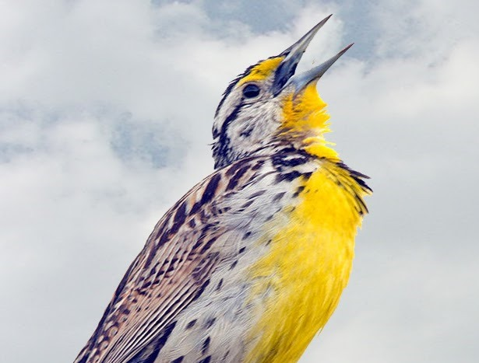
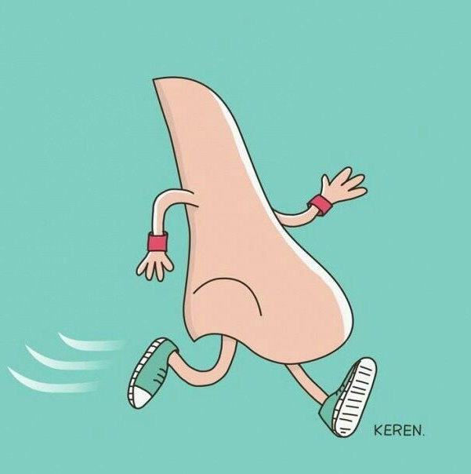
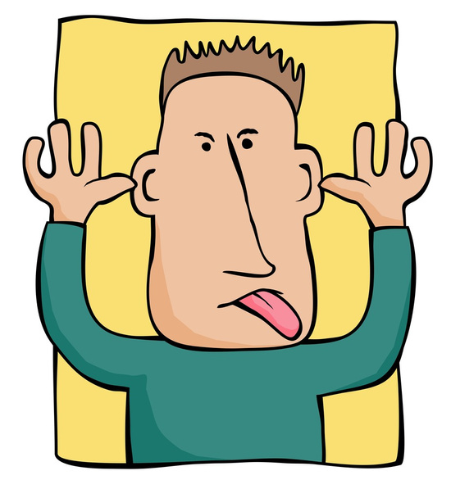
Узнать ответ

Slide 22
Hungry eyes
To put foot in mouth
As cool as cucumber
To have a green thumb
As happy as a lark
Running nose
To pull the face
Вернуться к выбору тем→

Slide 23
Whom does the description belong to? Guess Milne’s characters:
a) He often feels blue but he is more like a shrinking violet. He is very generous.
b) He is a bad apple, some kind of a troublemaker. He was acting as if he had itchy feet.
Узнать ответ
Категория 3 / Вопрос за 600

Slide 24
Eeyore, Tigger Категория 3 / Вопрос за 600
Вернуться к выбору тем→

Slide 25

A CAT IN THE SACK
Категория 3 / Вопрос за 800

Slide 26
A CAT IN THE SACK
Guess the idiom
To be caught committing the crime;
Very rarely;
An expensive and useless thing;
Not brave, coward;
To be sad;
To be skilled at gardening;
To joke or tease someone;
Very calm and untroubled by stress;
Узнать ответ
Категория 3 / Вопрос за 800

Slide 27
To be caught red-handed once in a blue moon a white elephant to feel blue to have a green thumb to pull someone’s leg as cool as cucumber
Категория 3 / Вопрос за 800
Вернуться к выбору тем→

Slide 28
Find the antonyms to the following qualities:
Reliable –
Gloomy –
Well-read –
Obedient –
Fair –
Generous –
Tough-
Tactful-
Узнать ответ

Slide 29
Answers:
Reliable - unreliable
Gloomy – cheerful
Well-read – ill-read
Obedient – disobedient
Fair – unfair
Generous - greedy
Tough- easy-going
Tactful - tactless
Вернуться к выбору тем→

Slide 30
Form nouns from the following adjectives:
Selfish =>
Greedy=>
Angry=>
Disgusting=>
Sad=>
disappointed=>
Reliable=>
Solemn=>
Obedient=>
Flexible=>
Generous=>
Узнать ответ

Slide 31
Answers:
Selfish => selfishness
Greedy=>greediness
Angry=> anger
Disgusting=> disgust
Sad=> sadness
disappointed=> disappointment
Reliable=> reliability
Solemn=> solemnity
Obedient=> obedience
Flexible=> flexibility
Generous=> generosity
Вернуться к выбору тем→

Slide 32
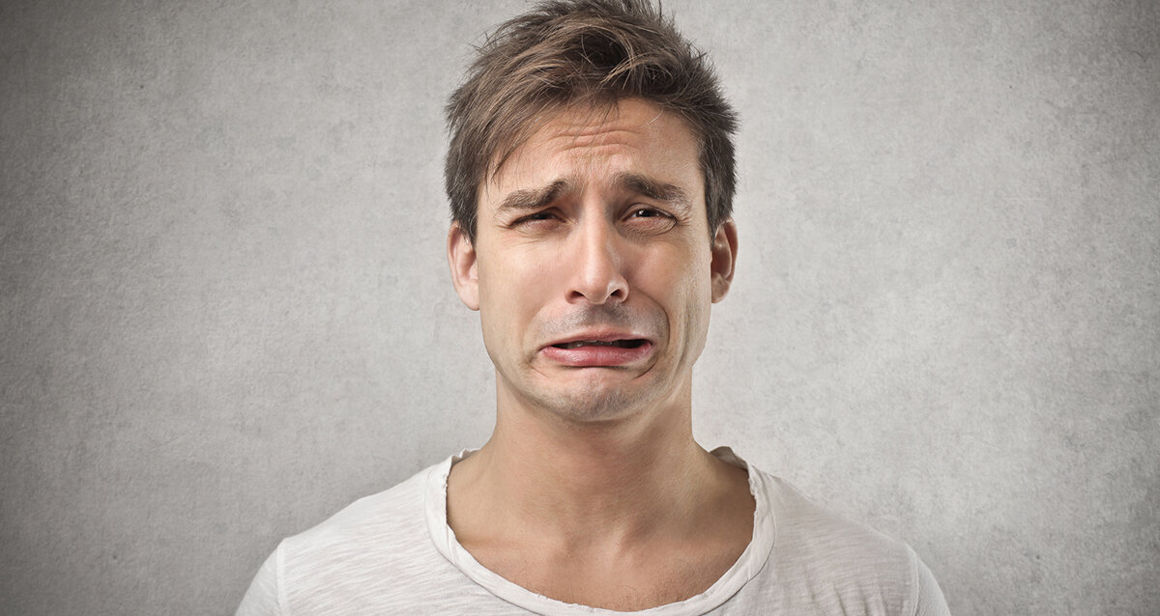
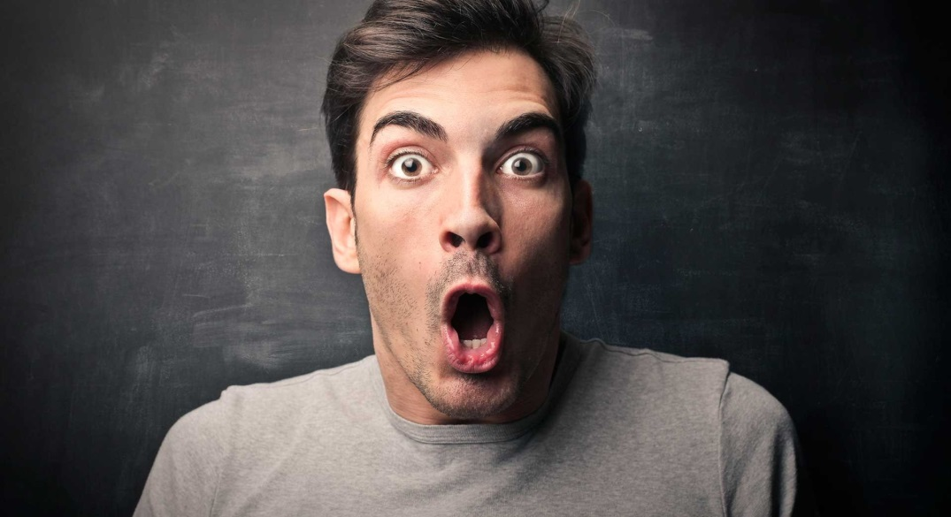
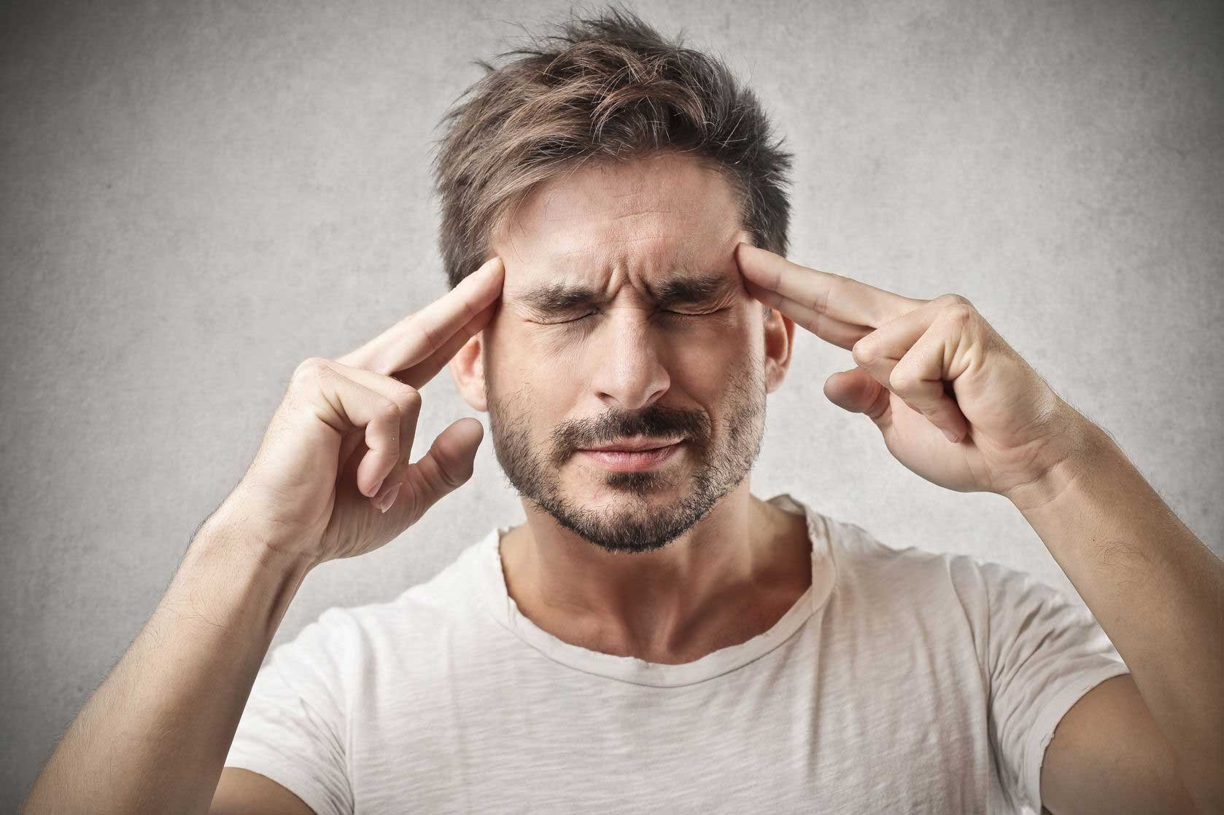
He looks as if he feels…
1.
3.
2.
Категория 4 / Вопрос за 600
Узнать ответ

Slide 33
Правильный ответ Категория 4 / Вопрос за 600 1. He feels unhappy, disappointed; 2.He feels embarrassed; 3. He feels surprised, may be unpleasantly surprised.
Вернуться к выбору тем→

Slide 34
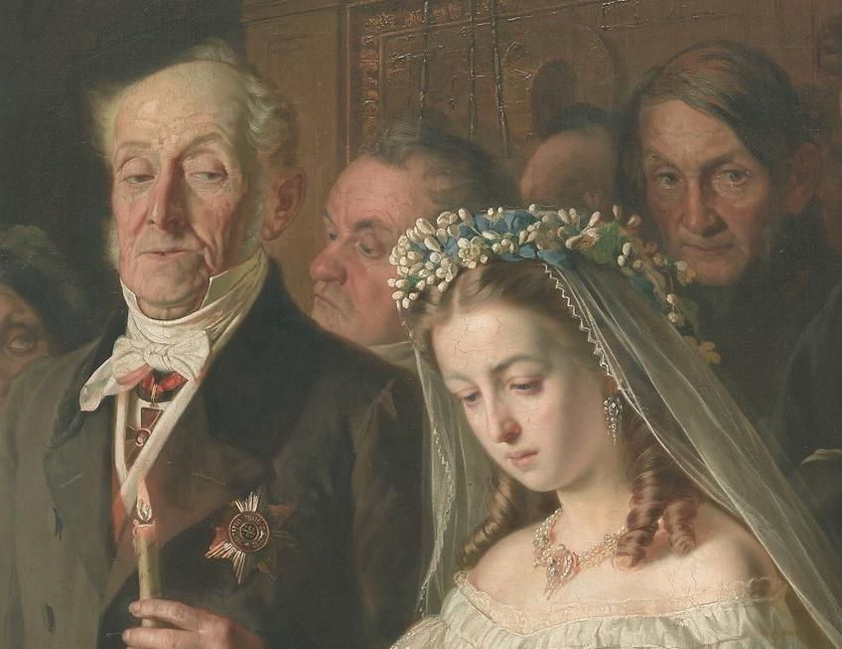
This is a fragment of the painting
“Unequal marriage”.
Guess who is hidden
in the right corner of the picture. Try to describe
the person’s emotions.
Категория 4 / Вопрос за 800
Узнать ответ

Slide 35
Правильный ответ Категория 4 / Вопрос за 800
There is depicted the young bride during the wedding with the old man who is 40 years older than her.
Obviously, she looks as if she feels unhappy and desperate, but at the same time she is obedient and patient.
Вернуться к выбору тем→

Slide 36
Whom does the description belong to? Guess Milne’s characters:
a) He often has his head in the clouds, he is has a sweet tooth and you might name him a top banana of the story.
b) He has a green thumb, he is always busy as a bee. His relatives are usually yellow and have their heart in their mouth but not him. He is a tough cookie.
Категория 5 / Вопрос за 200
Узнать ответ

Slide 37
Winnie-the-Pooh, Rabbit Категория 5 / Вопрос за 200
Вернуться к выбору тем→

Slide 38
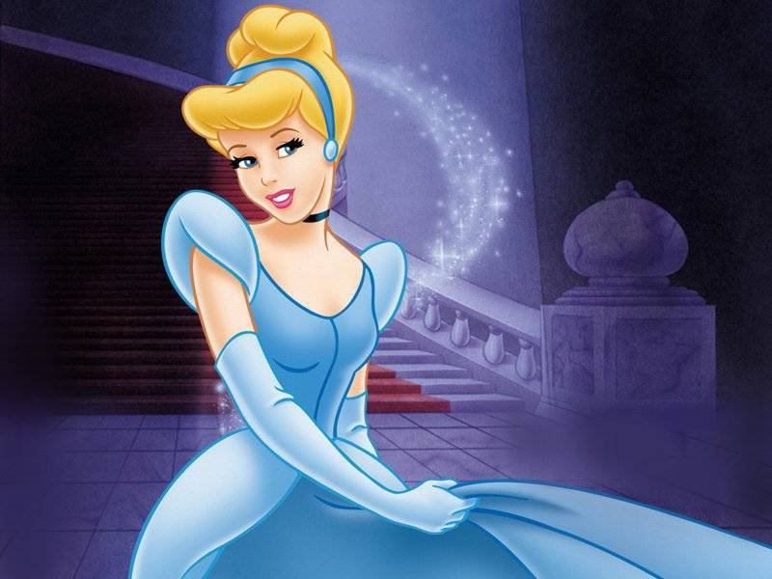
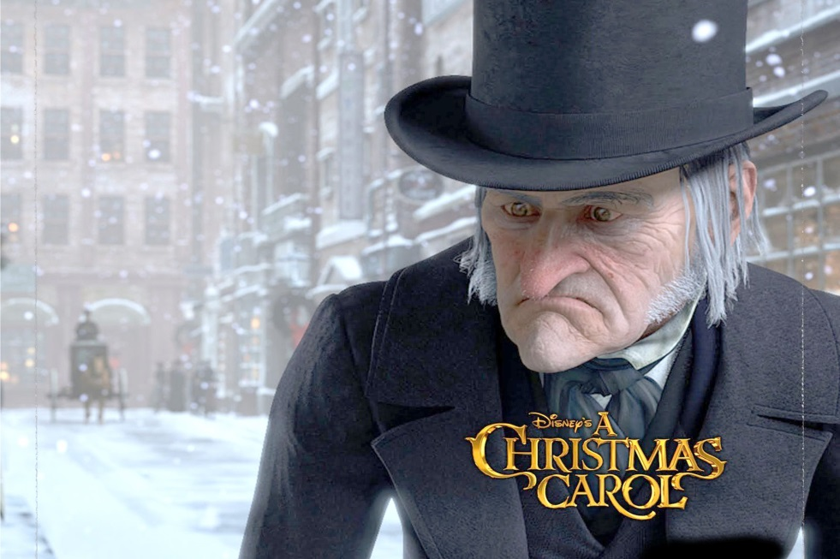
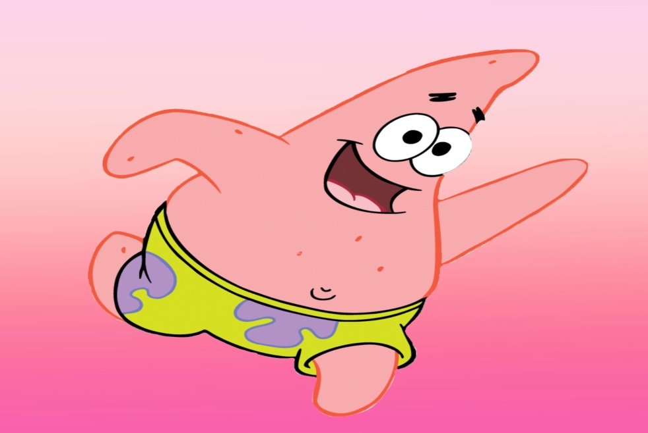
Cinderella
Patrick
Ebenezer
Scrooge
Match the character to the appropriate descriptive words below:
A coach potato
looks like a million dollars
spiteful
foolish
disappointed
greedy
romantic
cruel
Hard-working
An overeater
A troublemaker
Узнать ответ
As hard as nails
Категория 5 / Вопрос за 400

Slide 39
Категория 5 / Вопрос за 400
Cinderella – romantic, hard-working, looks like a million dollars;
Ebenezer Scrooge- greedy, cruel, disappointed, as hard as nails, spiteful;
Patrick – foolish, an overeater, a coach potato, a troublemaker.
Вернуться к выбору тем→

Slide 40
1) I’m wearing round glasses. I have a very thin scar on my forehead in shape of a bolt of lightning. I am keen on playing quidditch, the game played on flying broomsticks.
2) I am trapped in a tower with hair so long. It glows bright and it’s so strong.
3) My lips are red and skin as white as a dove. I’m wishing for my prince to love.
4) I have the power to create and control the snow and ice. I grew up with my sister in a palace.
5) I have an evil stepmother and stepsisters. Too many chores I must do until the prince finds my shoe.
Узнать ответ
Категория 5 / Вопрос за 600

Slide 41
1) Harry Potter; 2) Rapunzel (“Tangled”); 3) Snow White (“Snow White and the Seven Dwarfs”); 4) Elsa (“Frozen”) 5) Cinderella. Категория 5 / Вопрос за 600
Вернуться к выбору тем→

Slide 42
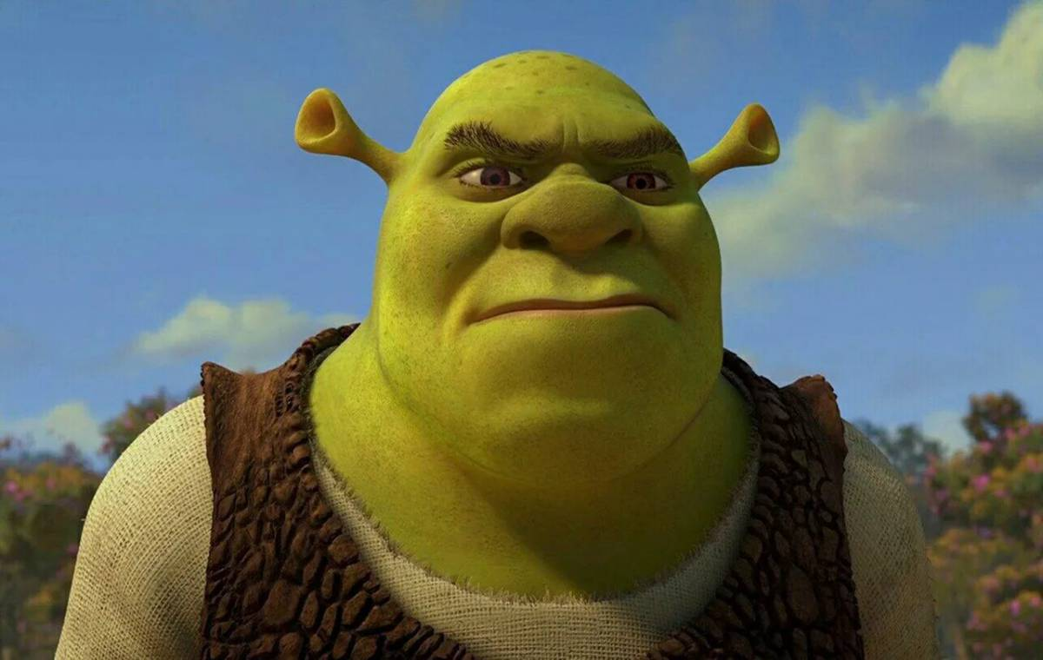
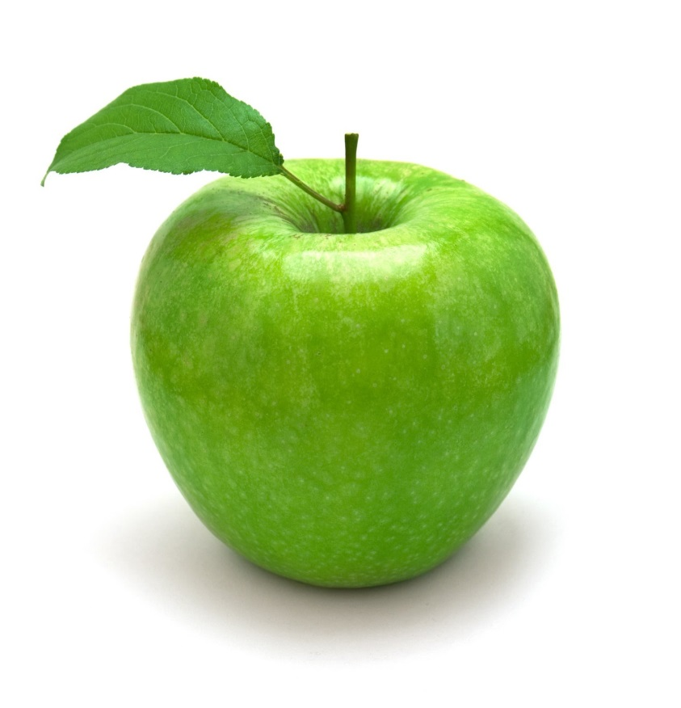
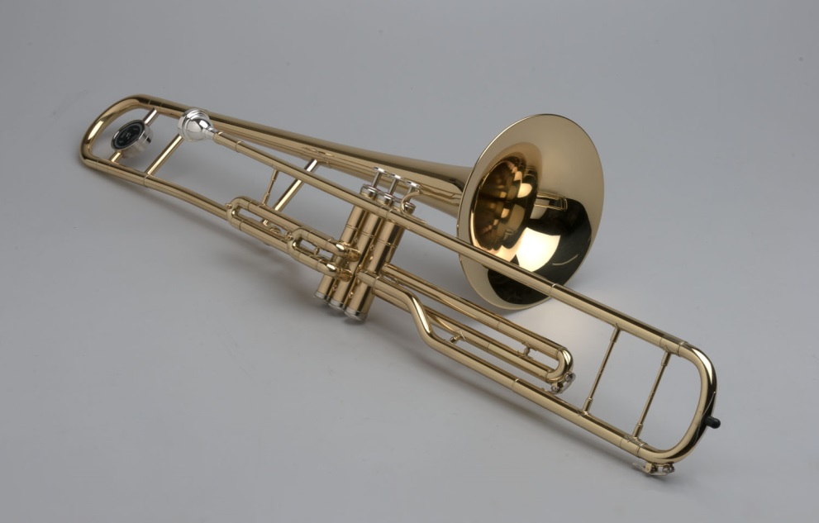
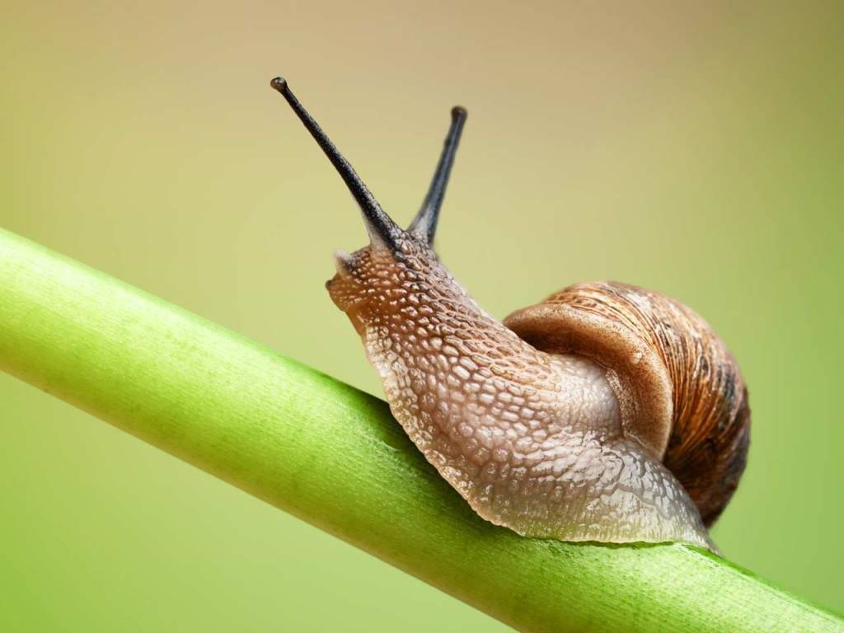
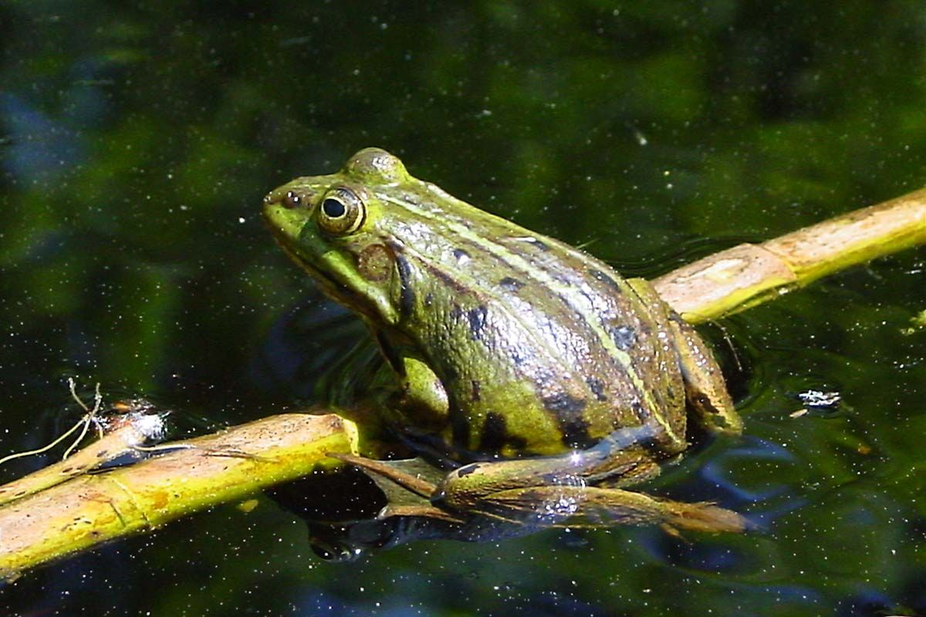
What does Shrek have
in common with these pictures?
Узнать ответ
Категория 5 / Вопрос за 800

Slide 43
Правильный ответ Shrek’s ears look both like snail’s horns and a trombone in shape; His skin is green in colour like the apple and the toad; He lives in a swamp like a toad. Категория 5 / Вопрос за 800
Вернуться к выбору тем→

Slide 44

Правильный ответ Shrek’s ears look both like snail’s horns and a trombone in shape; His skin is green in collie the apple and the toad; H. Категория 5 / Вопрос за 800
3/500
Перейти к вопросам

Slide 45
Put the adjectives in the sentences below in the correct order (300 points): She was an Spanish attractive tall fair-haired young slim woman; He bought an racing German expensive red big brand new high-speed automobile. She’s wearing Italian fashionable leather brown boots.
Ответ

Slide 46
She was an attractive tall slim young fair-haired Spanish woman; He bought an expensive brand new big red German high-speed racing automobile. She’s wearing fashionable brown leather Italian boots. reecolliapd the toad; H Категория 5 / Вопрос за 800

Slide 47
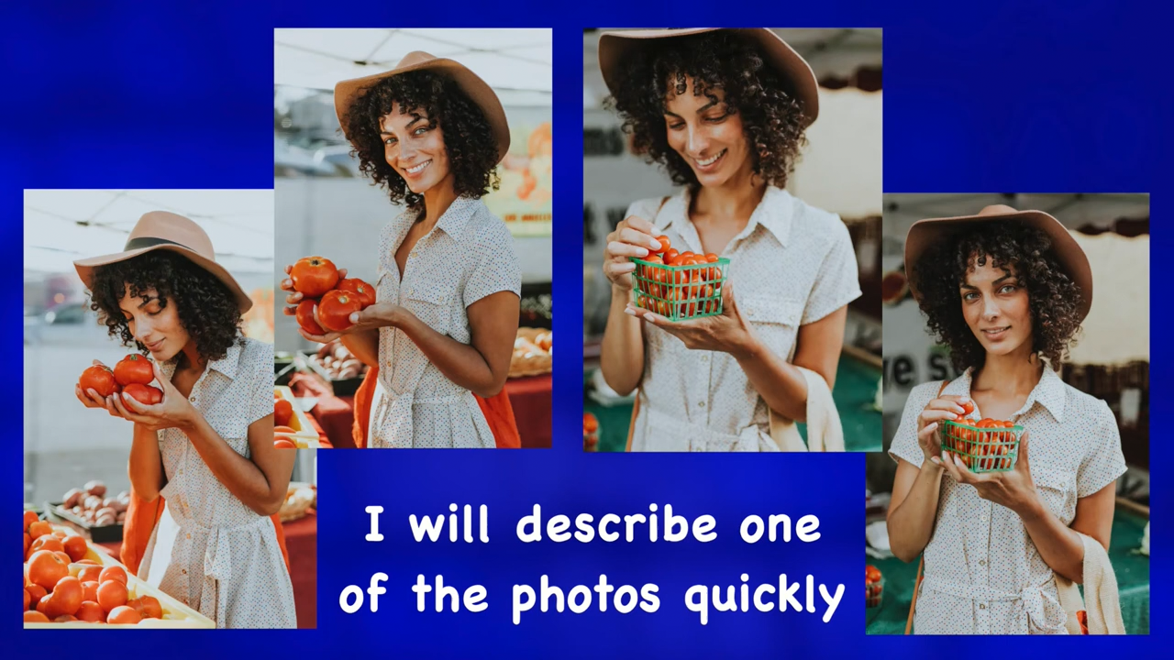
Guess whom it is being told about in the video below
(300 points):

