Slide 1
World-famous London’s art galleries

Slide 2
The National Gallery

Slide 3
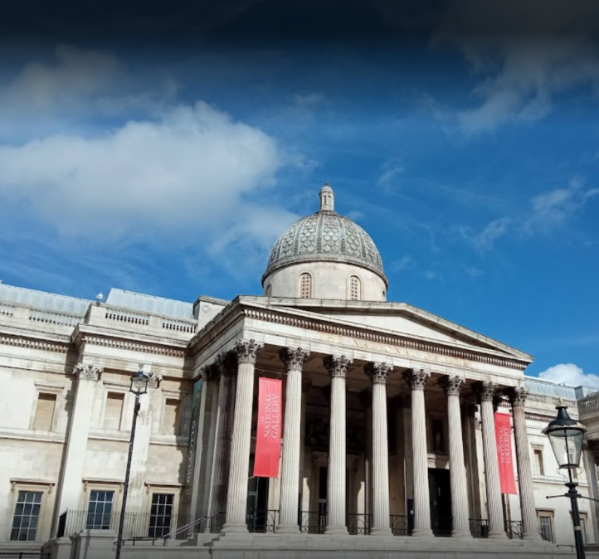
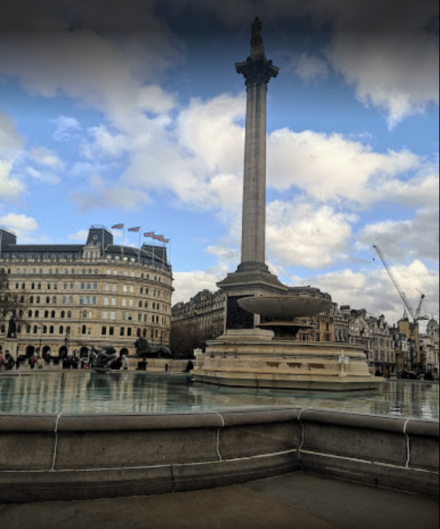

Slide 4
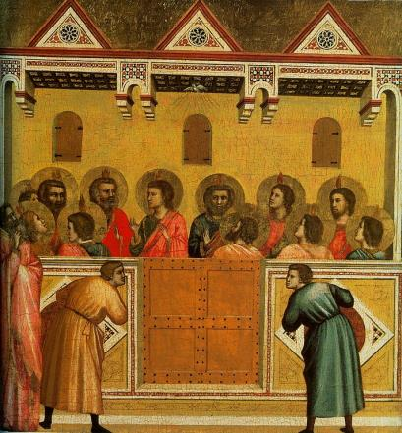
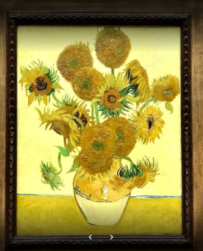
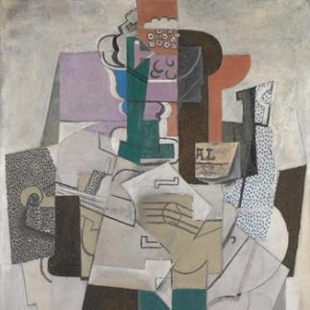
The National Gallery houses the national collection of Western European [jʊ(ə)rəˈpɪən] art, comprising more than 2,000 paintings from the late 13th to the early 20th century, in other words from Giotto to Picasso. The masterpieces belong to the public and access to them is free, as it has been since the Gallery was founded in 1824.
The Gallery’s unique strength lies in the balance of the collection across all European schools.

Slide 5
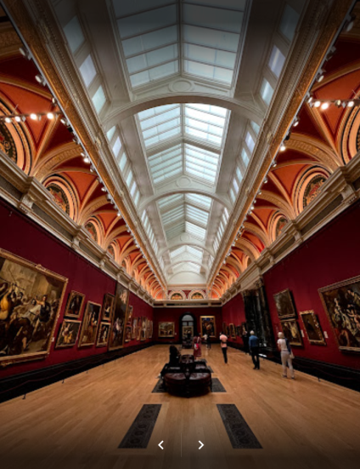
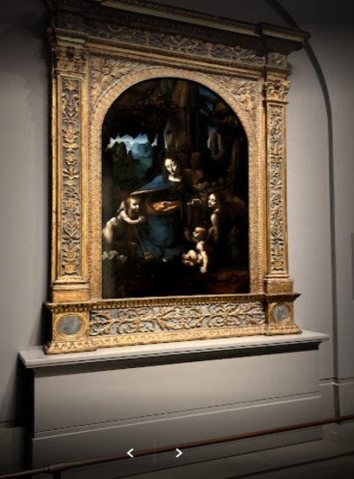
Virtually [ˈvɜːʧʊəlɪ] all great artists are represented by masterpieces, and the collection is hung to emphasize the international nature of European painting at all periods since the Renaissance.

Slide 6
Based on Parliament’s 60,000 pounds purchase [ˈpɜːʧɪs] in 1824 on 38 pictures from the Angerstein collection, the exhibition has been continuously enlarged over the years by loans, bequests [bɪˈkwest] and purchases, often assisted by the National Art-Collections Fund. A series of display cases on the first floor in the entrance hall of the north extension reveals, with letters and documents, the enthusiasm [ɪnˈtjuːzɪæz(ə)m] of early directors and the interest shown by Victorians as diverse [daɪˈvɜːs] as Ruskin and Disraeli.

Slide 7
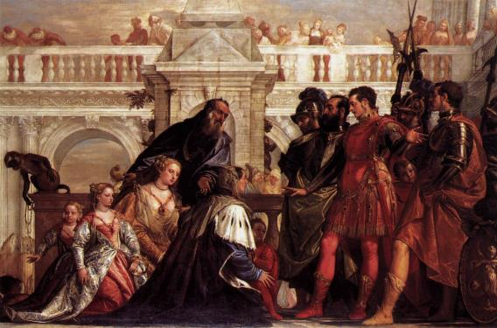
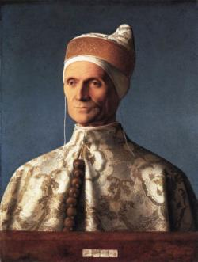
In Italian painting alone the gallery is the richest outside Italy. From the sinuous [ˈsɪnjʊəs] grace of panels by Duccio and his contemporaries, we pass among outstanding examples of work by painters including Paolo Ucello, Leonardo and Veronese’s exuberantly (excessively) heroic Family of Darius before Alexander, several Titian’s finest canvases, and beyond these, a group of works by Giorgione and Bellini (note especially for the compelling (attractive)
Doge Loredano portrait).

Slide 8
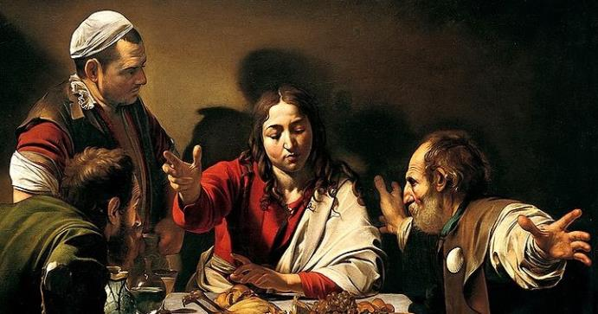
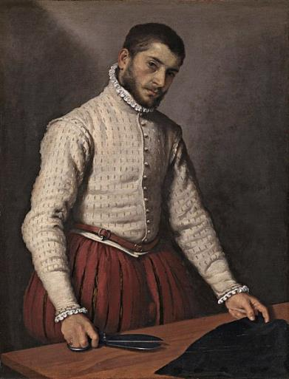
Among the later Italian pieces, Caravaggio’s Supper at Emmaus,
Moroni’s Tailor
and some excellent Canalettos
lie cheek by jowl with the magnificent Flemish, Dutch and English collections.

Slide 9
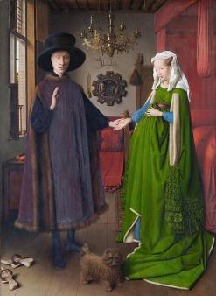
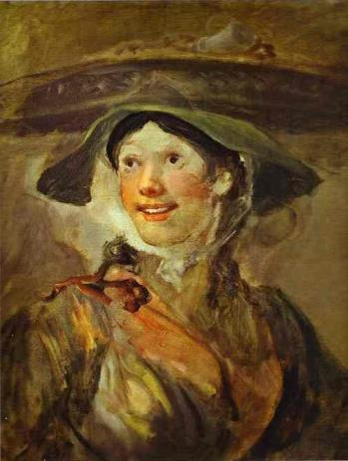
You can find the famous handsomely gowned Arnolfinis by Van Eyck,
a feast of Rubens offsets [ˈɒfsets],
a comprehensive (extensive) display of Rembrandt in all his moods;
Hogarth’s Shrimp Girl,
tumultuous [tjuːˈmʌlʧʊəs] (stormy) Turner opposite
serene Constable,
and a flurry [ˈflʌrɪ] (stream) of Gainsborough and Reynolds –
all reflect an English hankering (aspiration) for a blend of wild nature and elegant urbanity [ɜːˈbænɪtɪ].

Slide 10
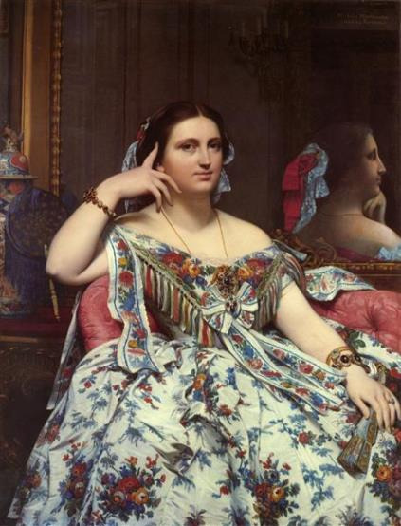
French art in all its periods is well represented in the gallery. In one room canvases by Philippe de Champaigne combine with Claude’s soft landscape tones and Poussin’s learned classical allusion (hint), to represent the Grand Siecle (Великий Век).
In adjacent gallery, another sort of classicism emerges in Ingres’s Pompeii-inspired
Madame Mointessier Seated.

Slide 11
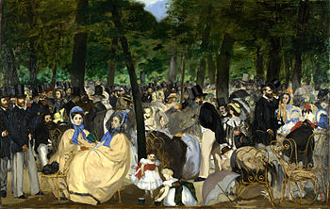
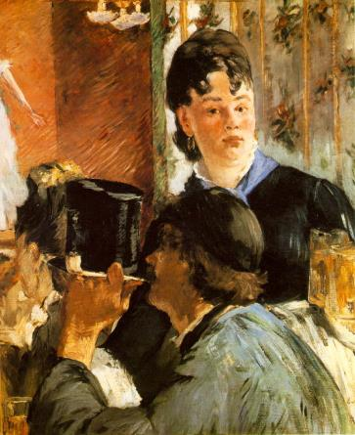
Among the impressionists there is a good selection of painting by Monet, Degas and Cezanne, and especially notable are two important pieces by Manet Musique aux Tuileries and La Servante de Bocks.

