Slide 1
Competition
Try to be the first to reconstruct the words, write out the missing letters and get the theme of the current lesson.
1.
2.
3.
4.
5.
6.
7.
8.
9.
Amon_
Annu_l
Cheek by jow_
By _oans, bequests and purchases
Acc_ss
Rep_esented
Un_que
Cont_mporaries
_erene
galleries

Slide 2
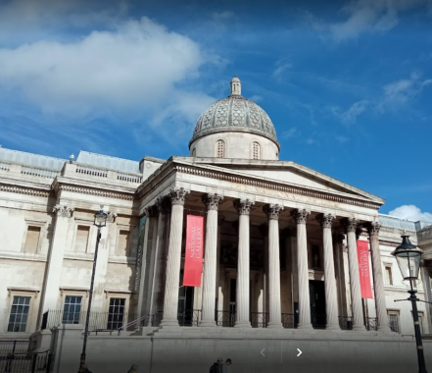
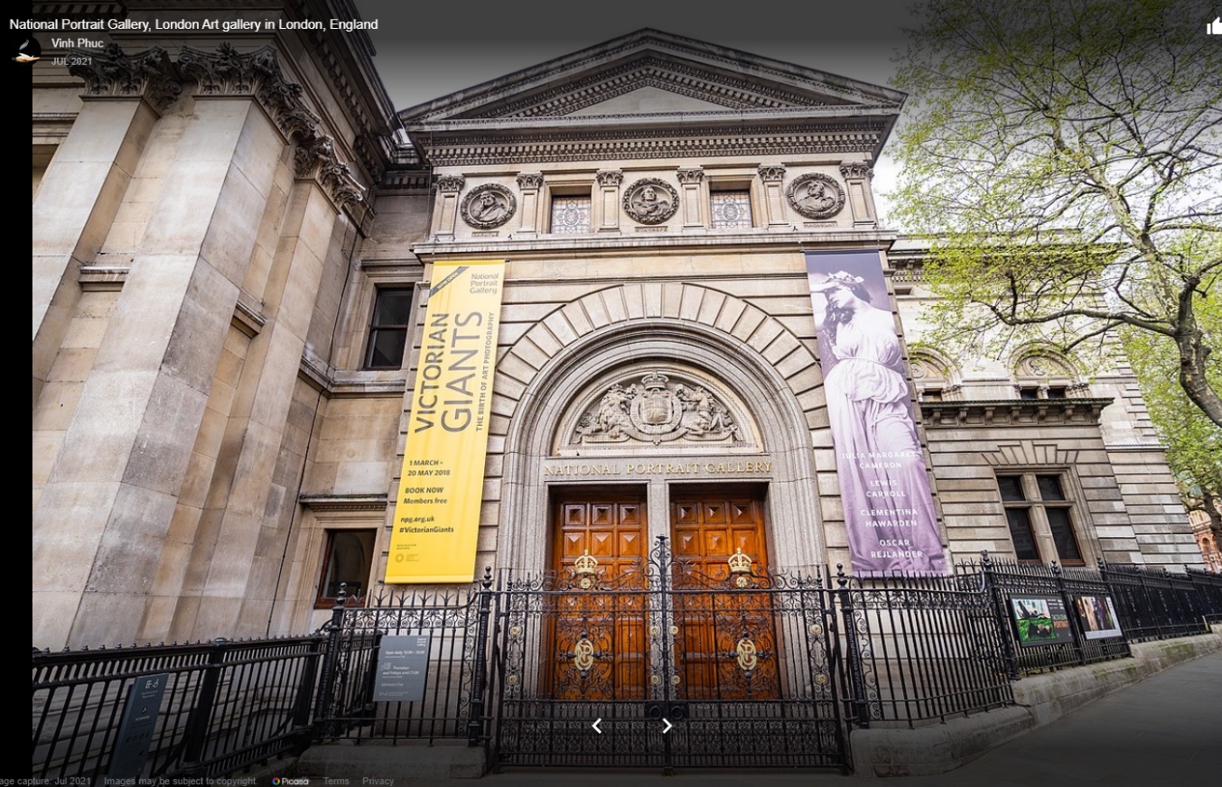
World-famous London’s art galleries
The theme of the current lesson
How many world-class galleries are there in London?
Can you identify the galleries in the photos?
four: the National Gallery, the National Portrait Gallery,
Tate Britain and Tate Modern
the National Gallery and the National Portrait Gallery

Slide 3
Team work
You are given texts about two different galleries.
Read your text and translate it. (10 min)
In turn ask questions to get enough information to be able to tell about the other team’s gallery. (You can take notes, but you mustn't mirror the other team’s questions.) (10 min)
Tell about the other team’s gallery. (6 min)

Slide 4
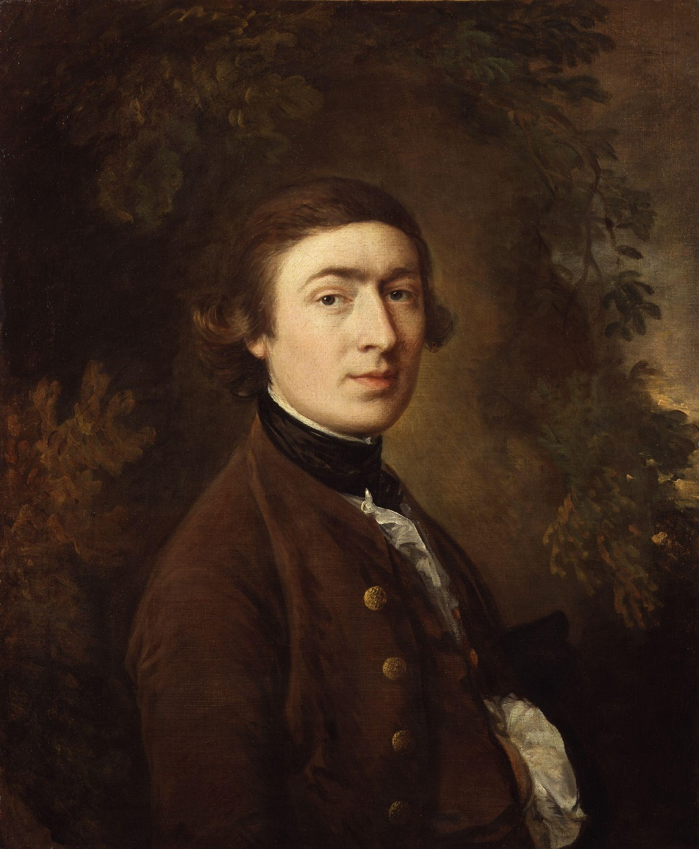
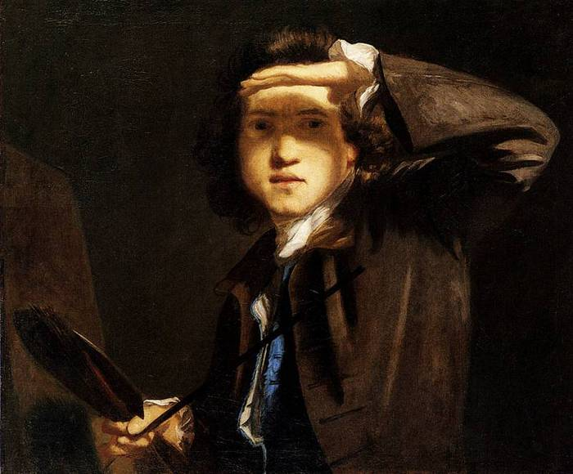
Exercise 1
Scan the texts to find the names of artists mentioned in both of them.
Gainsborough Reynolds

Slide 5
1. Conduct an online research to compare and contrast Gainsborough’s and Reynolds’s art and biographies.
2. Write down (not less than three) statements following the examples we are going to work out later at this lesson.
HOMEWORK:

Slide 6
Discussion
Answer the questions. Justify your opinion.
Which text contains more names of famous artists?
2. What are possible reasons for this?
3. What other differences between the galleries have you noticed?
The text about the National Gallery contains more names of famous artists.
It is possibly because the focus of attention in the collections of the National Portrait Gallery is not on an art school or artistic merits of the portrait, but on the men and women who created the culture of the nation.
There are different genres of art on display in the National Gallery. There are photos and personal items on the exhibit in the National Portrait Gallery.

Slide 7
Compare and contrast the NG and the NPG!
Exercise 2
Both galleries were Ved (3)…, however, the NG was Ved (3), while the NPG Ved (2).
Both of them V, but The NG Vs. On the contrary, the NPG Vs.
Both of these galleries V, yet the NG Vs, whereas the NPG Vs.
Both galleries were founded in the 19th century, however, the NG was opened in 1824, while the NPG met its public in 1856.
Both of them have impressive collections, but the NG houses 2000 works of Western European art. On the contrary, the NPG houses a primary collection of over 9,000 works, as well as an immense archive.
Both of these galleries are associated with famous names, yet the NG exhibits masterpieces created by all great artists (from Giotto to Picasso), whereas the NPG exposes images whose artistic merits are not as important as the personality of the sitters.

Slide 8
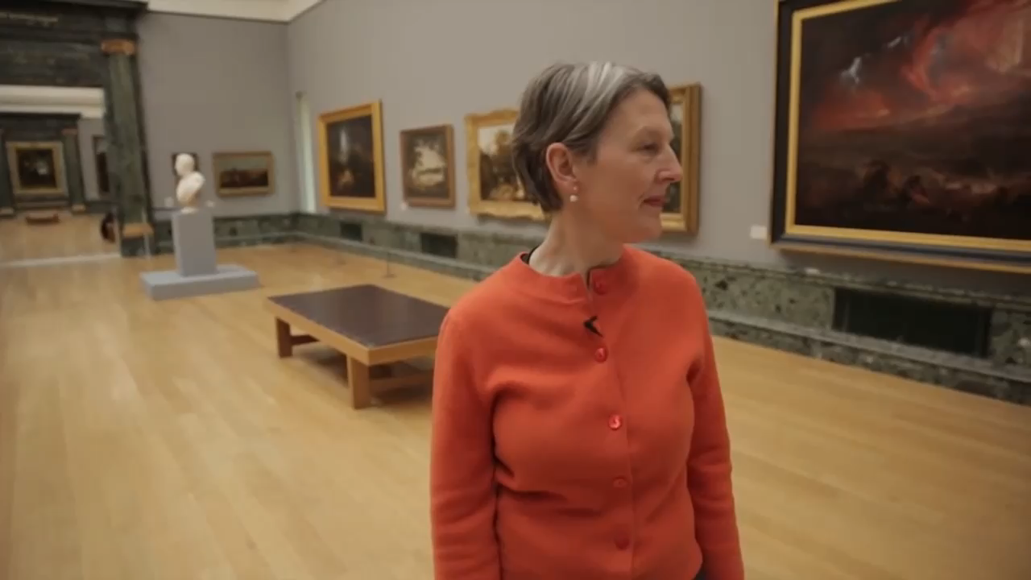

Exercise 3
Watch two videos.
Compare and contrast
Tate Britain
Tate Modern

Slide 9
Exercise 4
https://learningapps.org/watch?v=pg69zks6a21

Slide 10
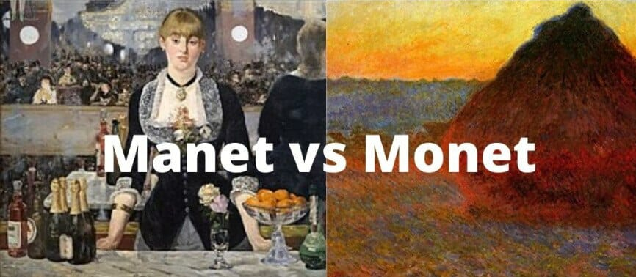
Exercise 5
Compare and contrast Manet’s and Monet’s art.

Slide 11
Exercise 6
Skim the article on the Internet and relate the statements to Claude Monet or Edouard Manet. https://www.artst.org/manet-vs-monet/
    He primarily worked in a studio. There, he meticulously orchestrated many of his paintings. He slaved in his studio for hours until he got his pieces just the way he wanted them.
    He loved to paint seascapes and landscapes.
    His works mostly depict people.
    His masterpieces are known for abrupt contrasts of shadow and light along with harsh contours.
    He was a master of color and light, but tended to use “messier” brush strokes.
1. Edouard Manet, 2. Claude Monet, 3. Edouard Manet, 4. Edouard Manet, 5. Claude Monet

Slide 12
Conclusion
What did you find out about London’s art galleries?
What did you learn to do in the English language?
What was interesting and useful?

