Slide 1
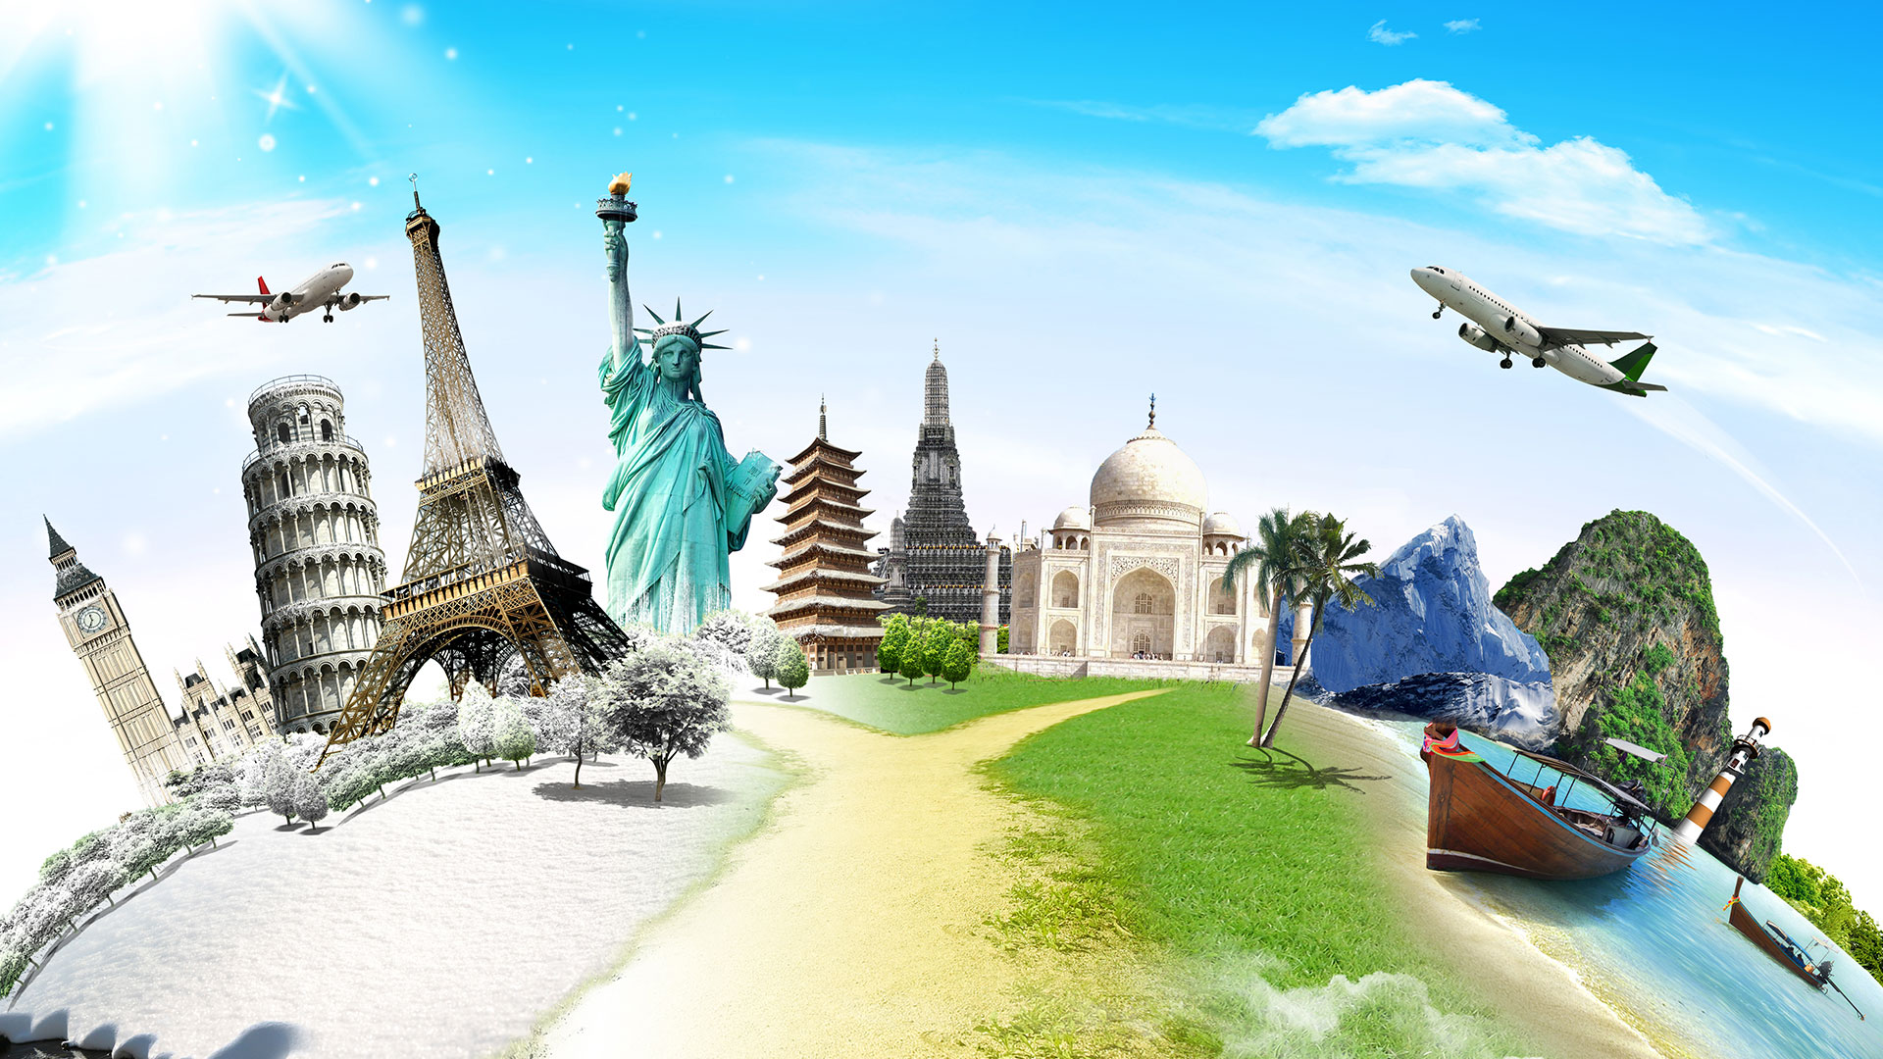
Travel broadens our mind

Slide 3
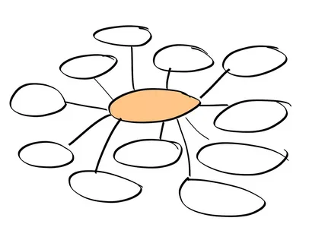
?
?
?
language
rainy weather
?
?
Culture Shock
(reasons)
?
?
?
?
British cuisine
?
Social etiquette
?

Slide 4
“What causes culture shock in the UK?”

Slide 5
Culture Shock
(reasons)
?
Social etiquette

Slide 6
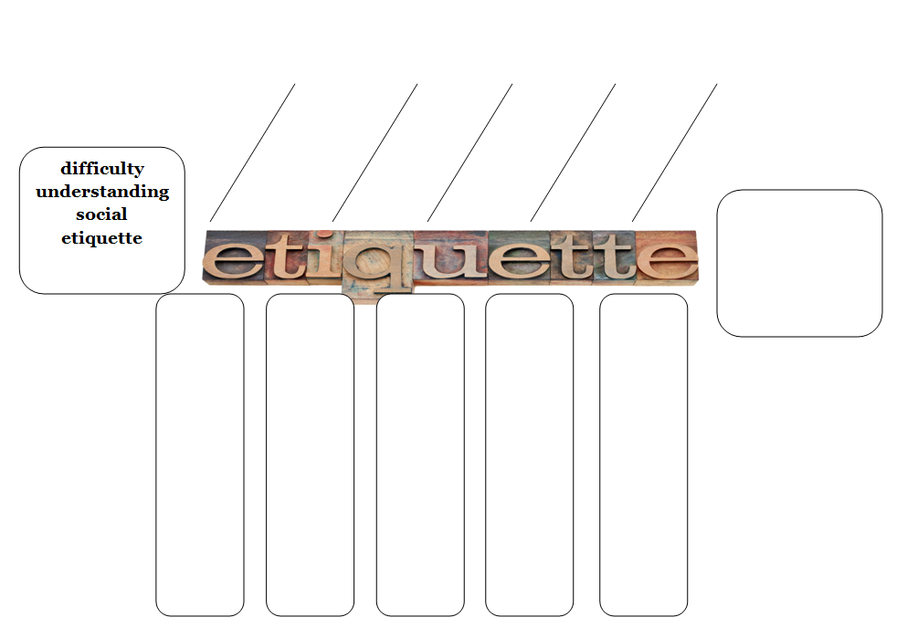
greetings
table manners
behaviour outside
idioms
gestures

Slide 7

British social etiquette

Slide 8


If you are meeting someone for the
first time, kiss the person on the cheek to greet.
2. You’d better make eye contact while speaking.
3. It’s polite to ask people about money.
4. It’s polite to take phone calls during mealtime.
5. You mustn’t talk with your mouth full.

Slide 9
greetings
table manners
behaviour outside
idioms
gestures
?

Slide 10

What should/shouldn’t people do at mealtime in Great Britain ?

Slide 11
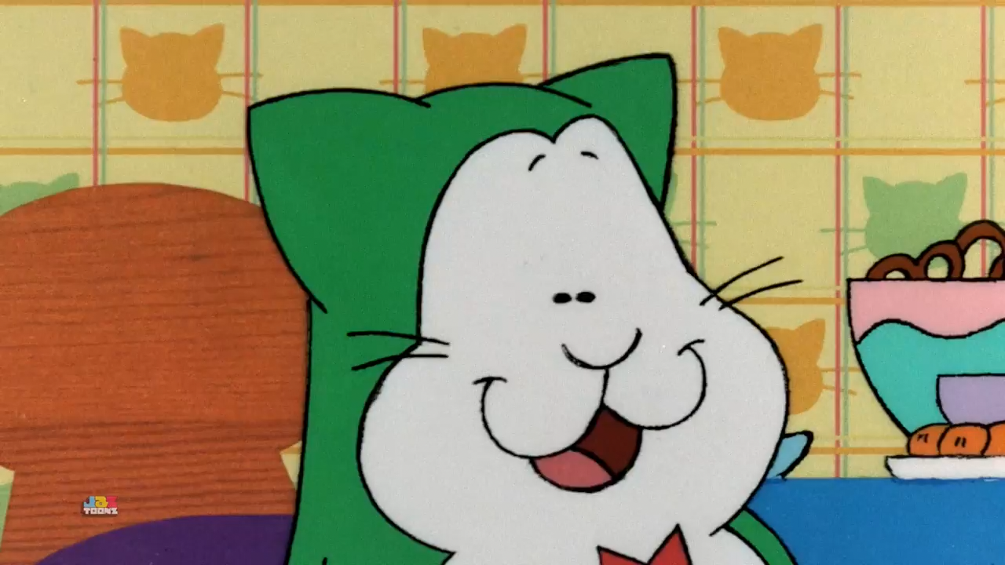

Slide 12
greetings
table manners
behaviour outside
idioms
gestures
?

Slide 13


Enjoy your meal!

Slide 14
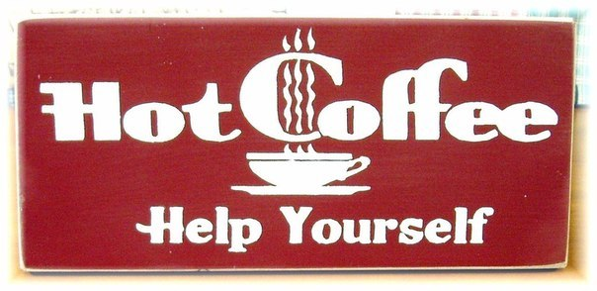
Help yourself (to)!

Slide 15
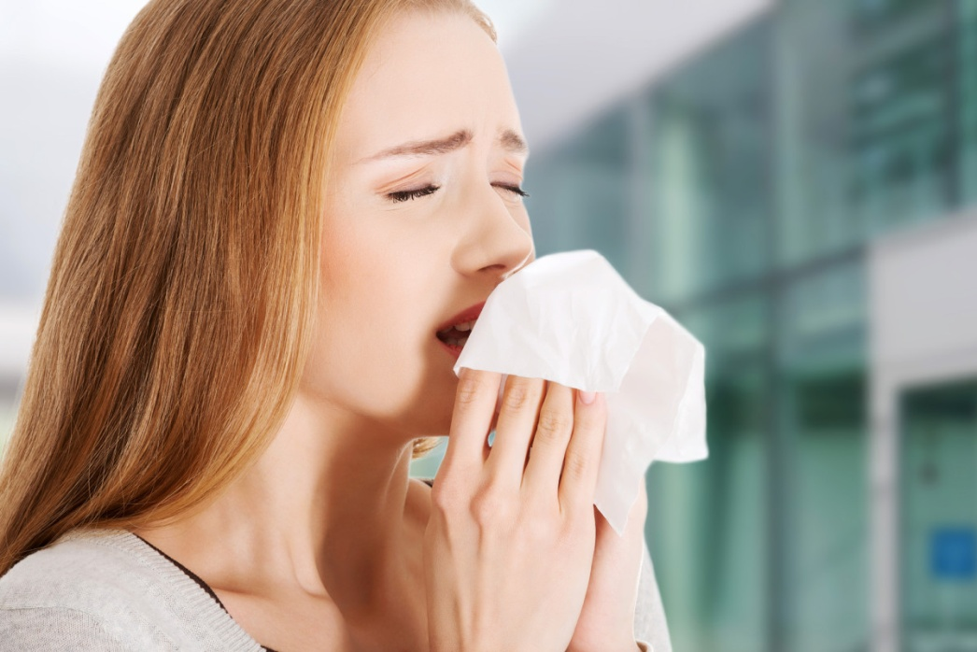
God bless you!

Slide 16

Break a leg!

Slide 17
greetings
table manners
behaviour outside
idioms
gestures
?

Slide 18
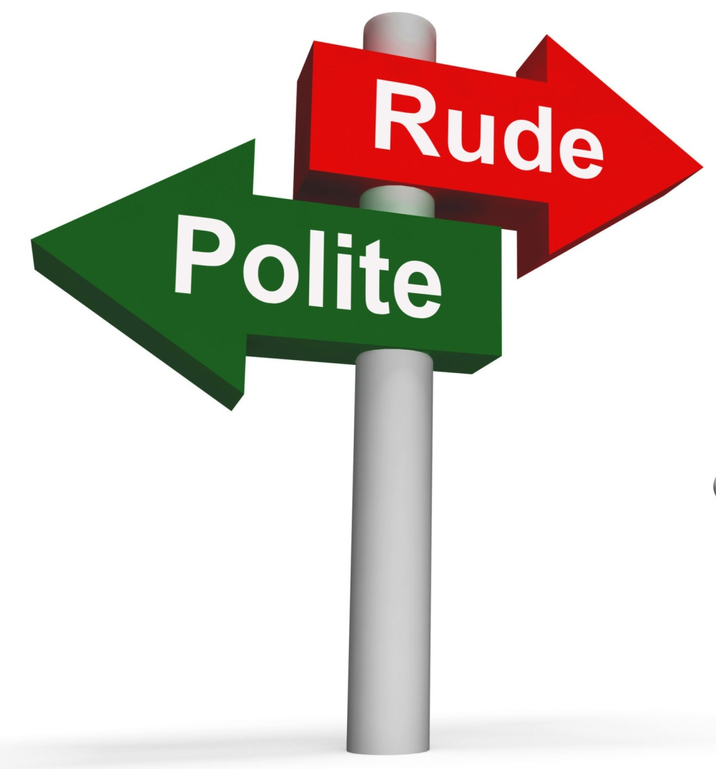

Slide 19
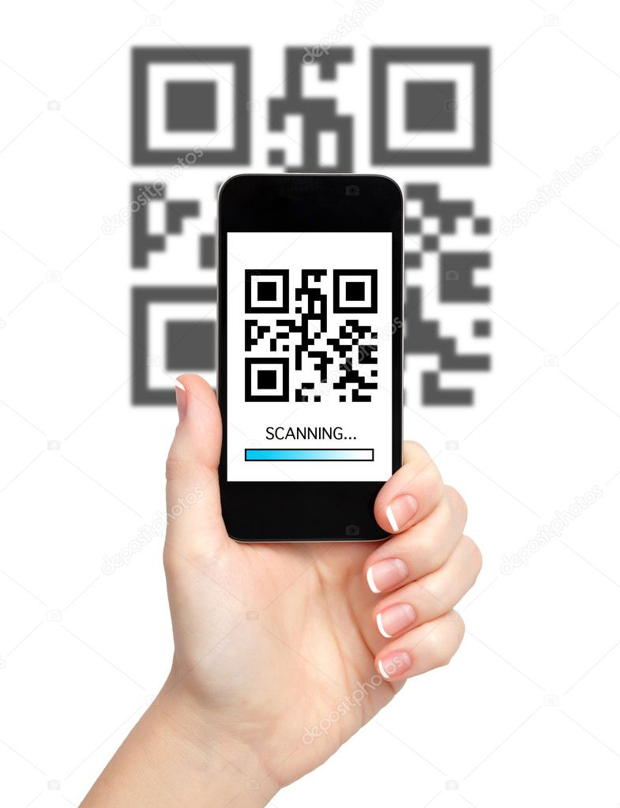

Slide 20
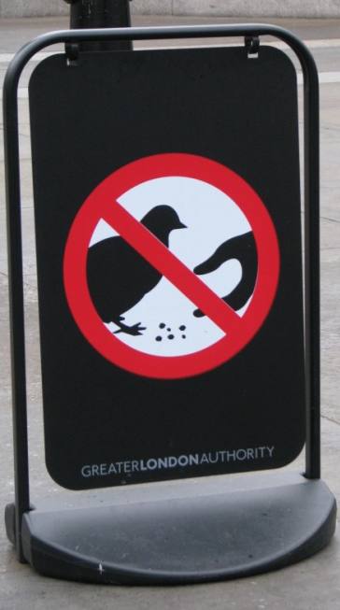


Slide 21
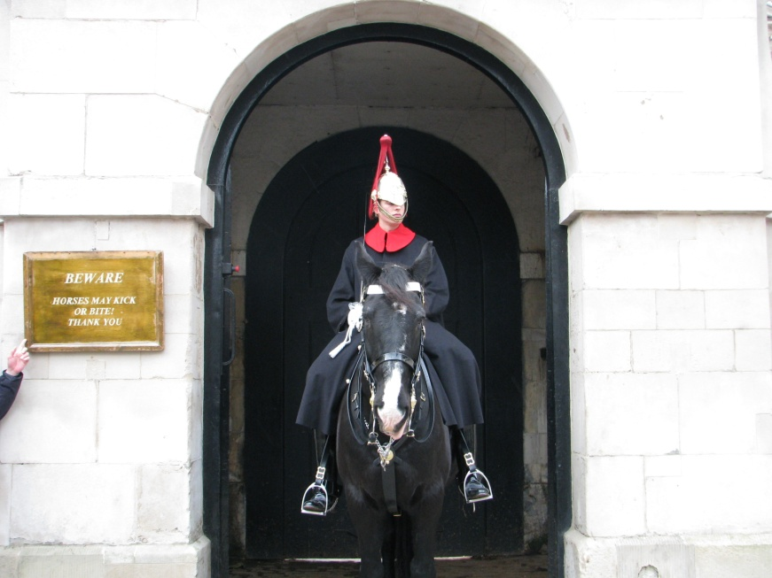

Slide 22
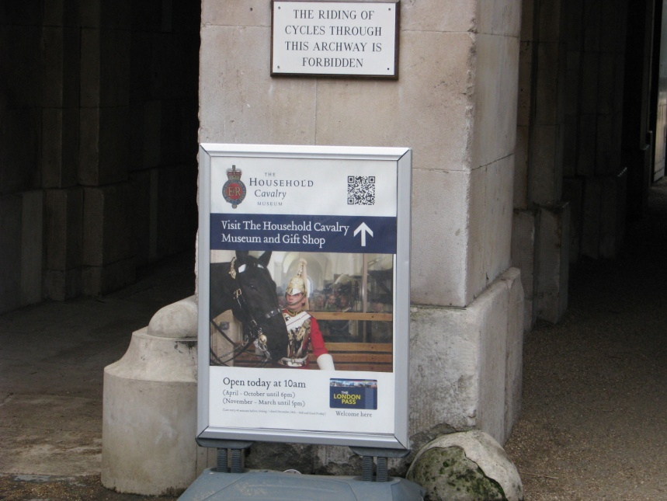


Slide 23
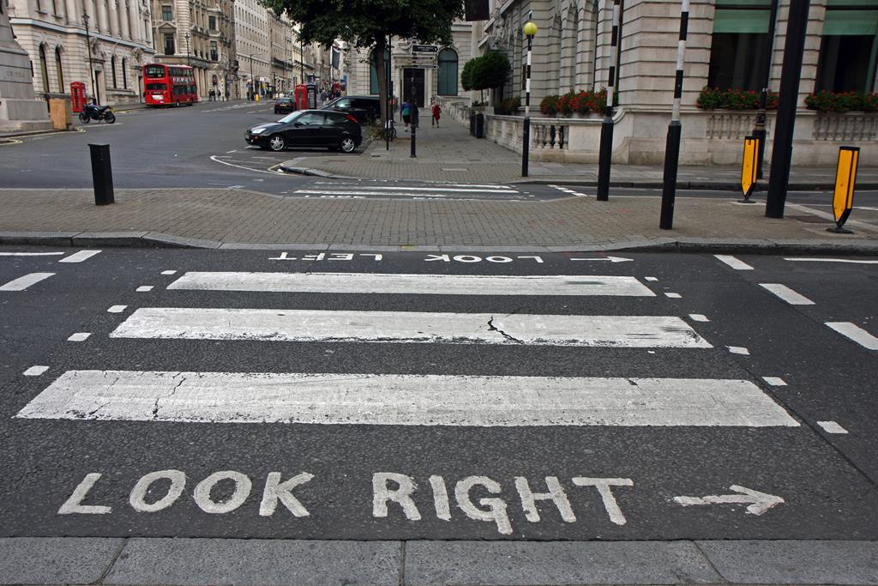

Slide 24


Slide 25
greetings
table manners
behaviour outside
idioms
gestures
?

Slide 26

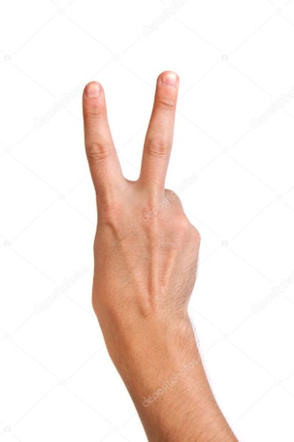

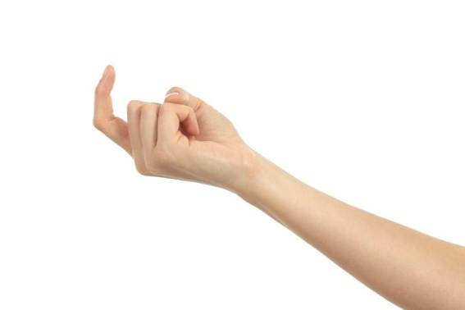
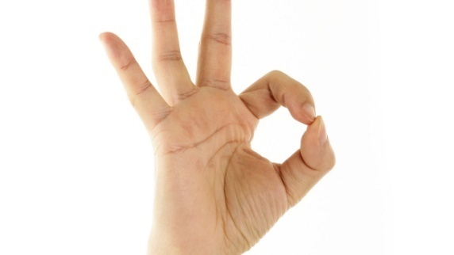
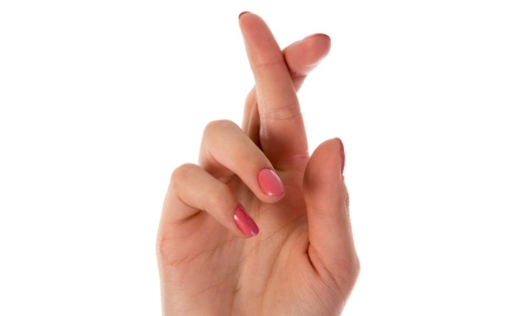
Gestures
Don’t use gestures if you’re not 100% sure what they mean!

Slide 27
greetings
table manners
behaviour outside
idioms
gestures
?

Slide 28
greetings
table manners
behaviour outside
idioms
gestures
It is possible to overcome difficulty by learning
?

Slide 29
You are to write a letter to Liza:
…I am going to study at English Language School in Great Britain this summer.
But I have never been to London and I’ve heard that some people experience the so-called culture shock and I am a bit worried about it.
Write a letter to Liza.
In your letter: • give her 3 tips to overcome the difficulty;
• ask 2 questions about her trip to England.
Write 100—140 words.
Remember the rules of letter writing.

Slide 30
Travel broadens our mind

