Slide 1
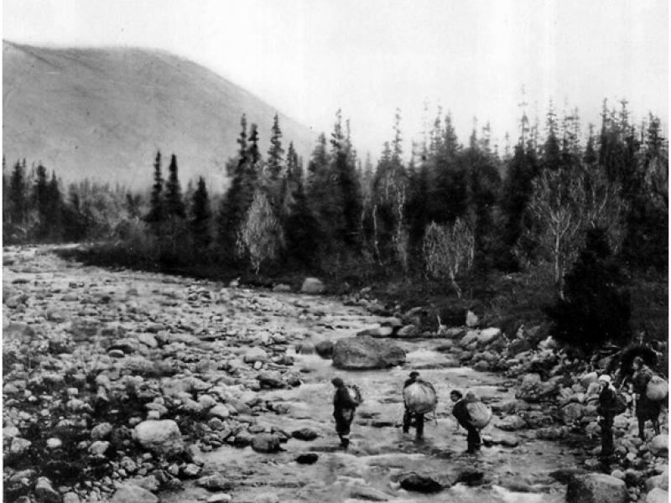
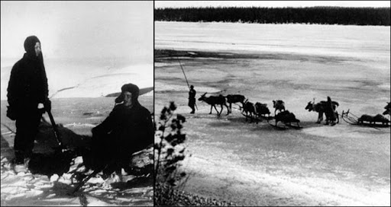
Exploring the Khibiny Mountains

Slide 2
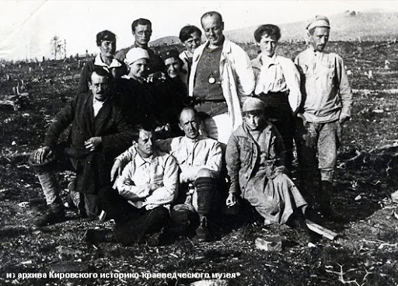
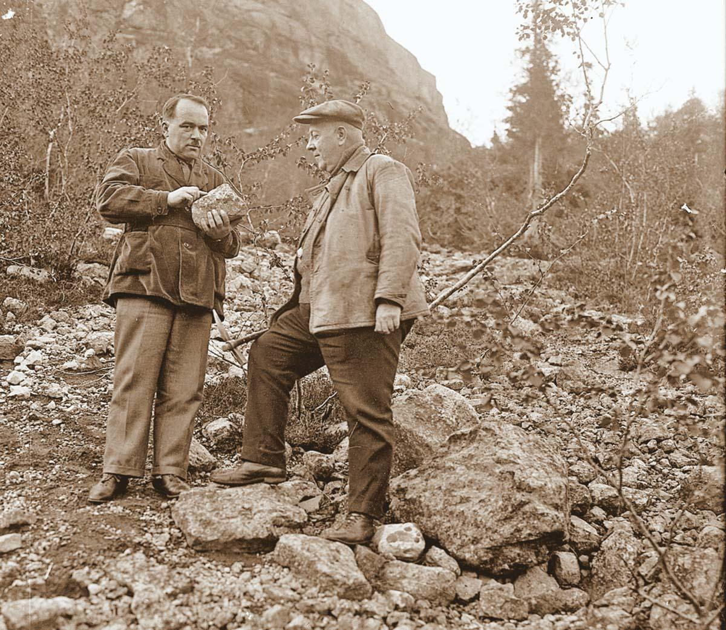
The first expedition
Alexander Fersman's expedition took place in 1920-1921.
took place - состоялась
The expedition discovered deposits of apatite.
- deposits of apatite – месторождения апатита

Slide 3
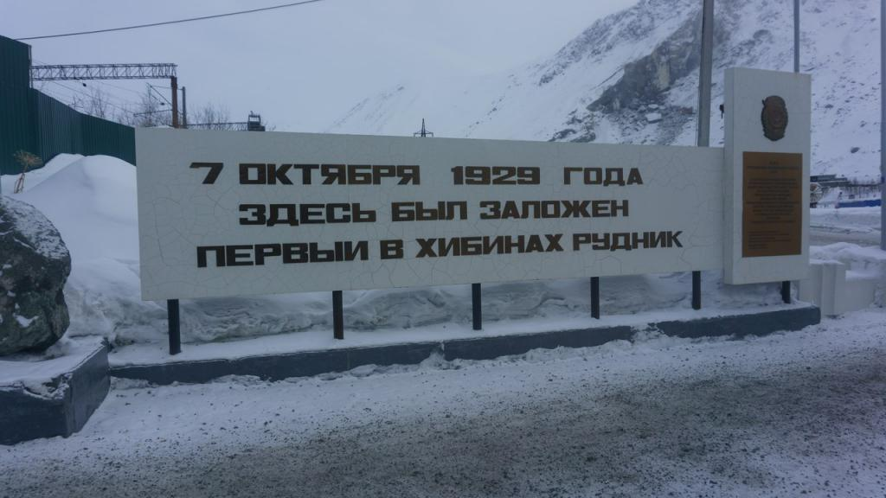
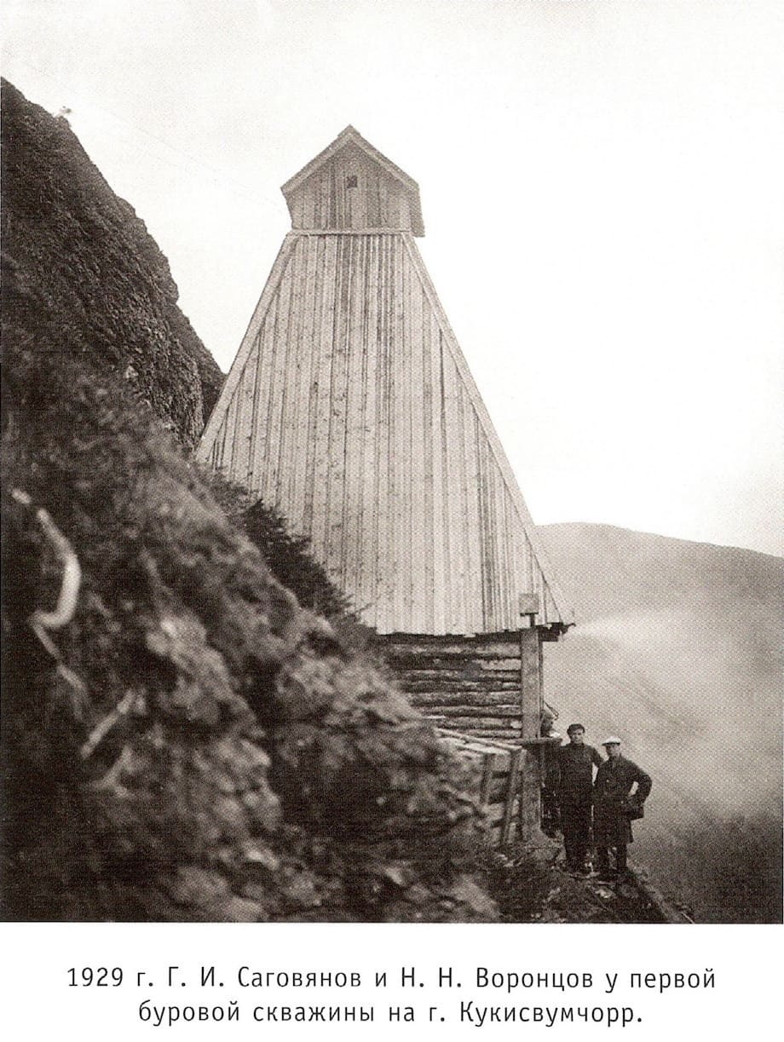
The Kirov mine
The first drilling well was built in the settlement of Kukisvumchorr in 1929.
drilling well – буровая скважина
The Kirov mine was the first enterprise of the Apatit Trust.
-enterprise - предприятие

Slide 4
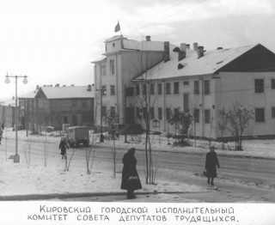
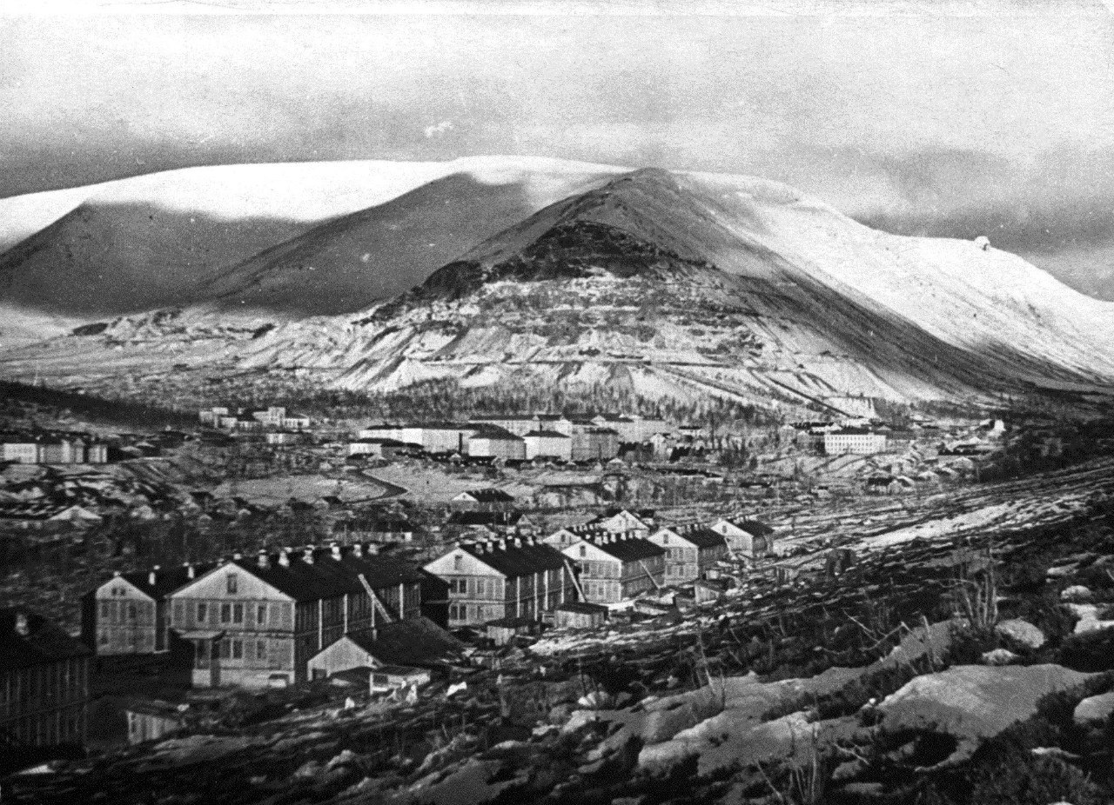
Construction of Kirovsk
The town was renamed Kirovsk in 1934.
Сonstruction of Khibinogorsk began in the summer of 1929.
Construction – строительство

Slide 5
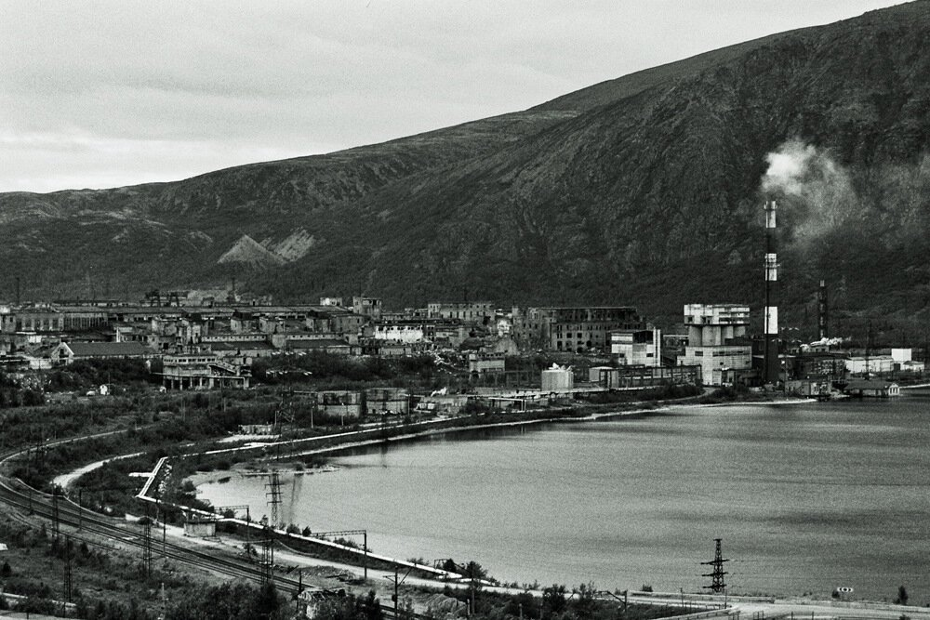
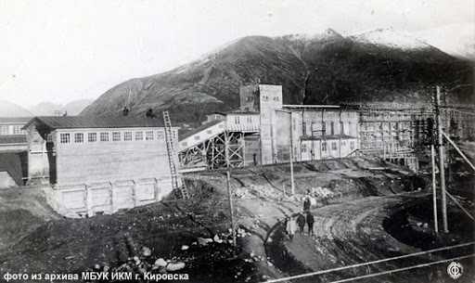
Dressing plant
The ANOF-1 dressing plant was built in 1931.
dressing plant –обогатительная фабрика

Slide 6
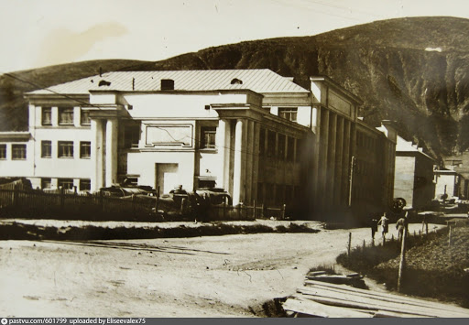
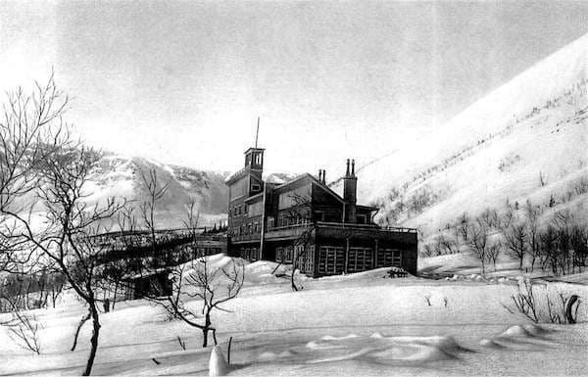
Science and education
Tietta Science Station opened in 1930.
science station – научная станция
The first students entered the Mining and Chemical College in 1931.

Slide 7
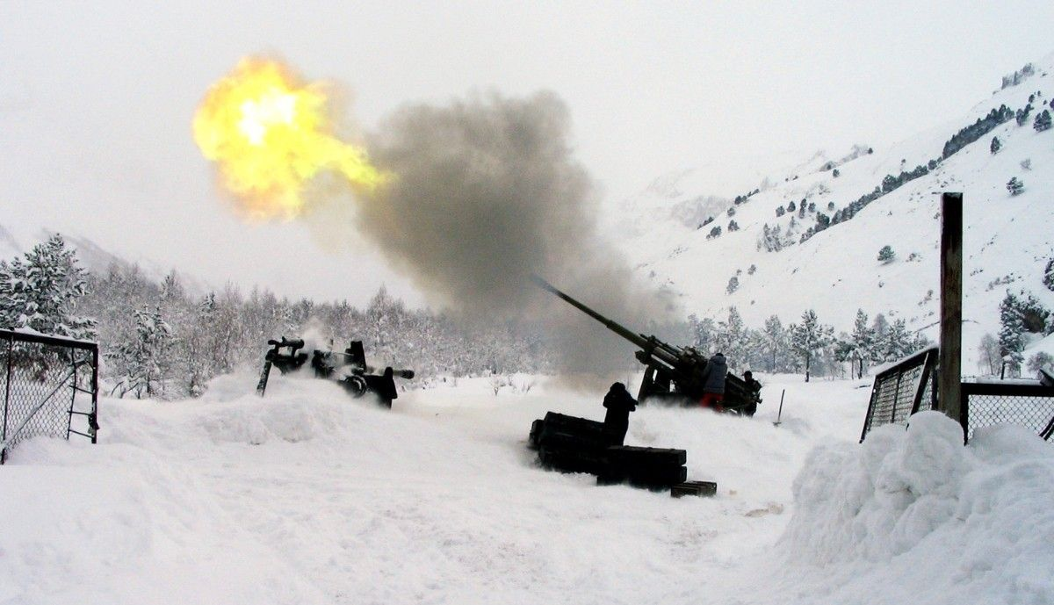
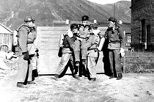
Safety
Mountain rescue was organized in 1935.
Mountain rescue – горноспасательная служба
Rescuers began to use a gun for the descent of avalanches in 1936.

Slide 8
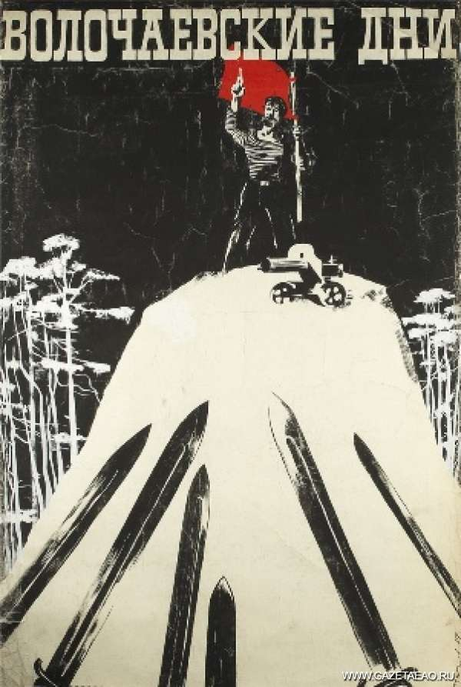
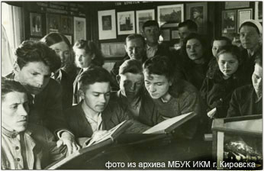
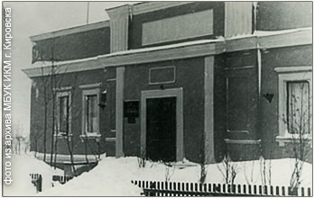
Culture
The first museum and technical library were opened in 1935.
The first film Volochaev Days was created in Kirovsk in 1937.

