Slide 1
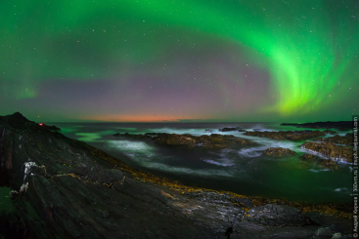
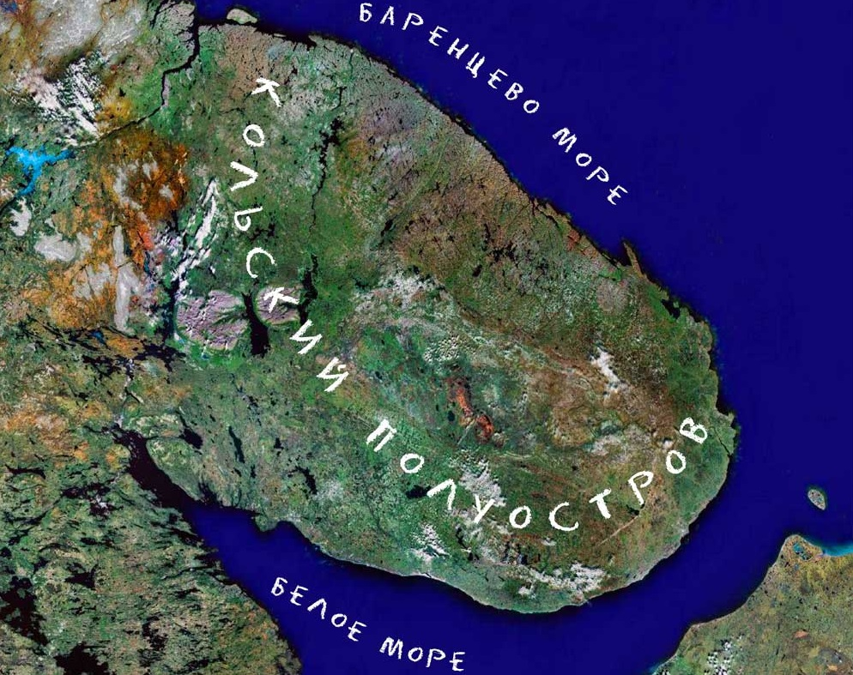
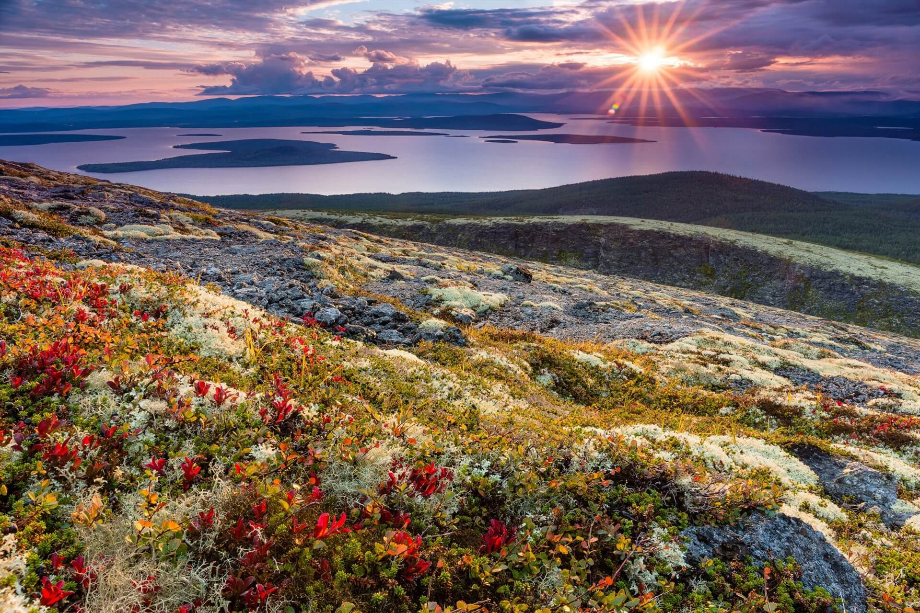
What is the best about your region?

Slide 2
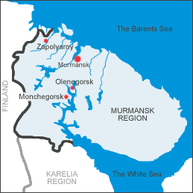
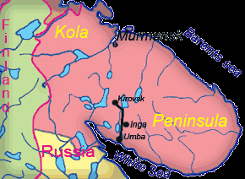
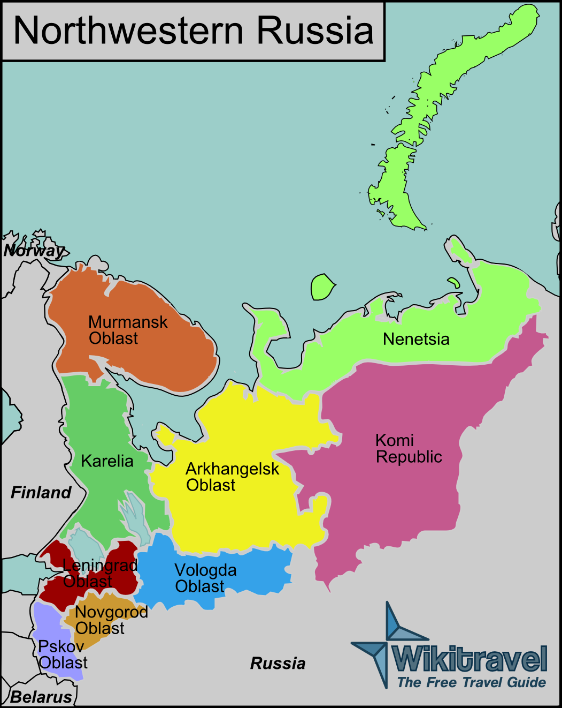
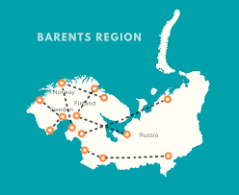
What region do we live in?
We live in Murmansk area.
We live in the north-west of Russia.
We live on the Kola Peninsula.
We live in the Barents region.

Slide 3
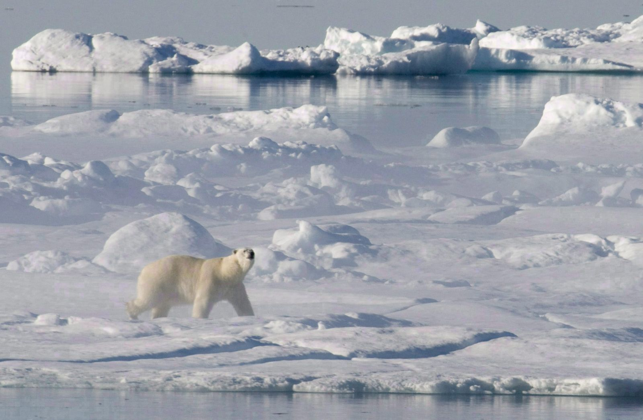
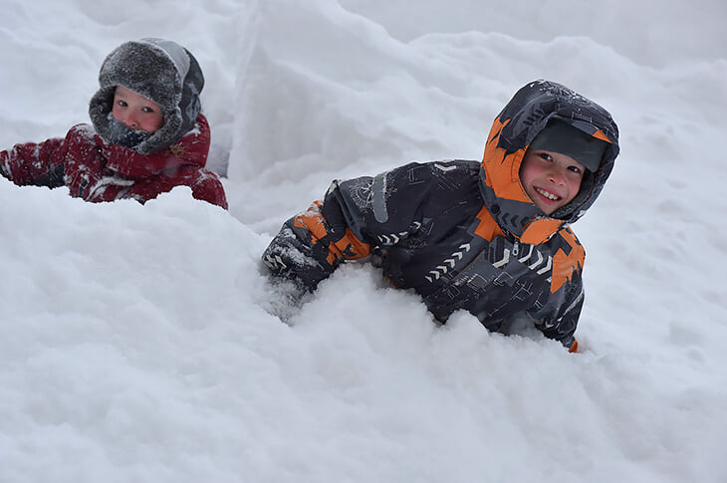
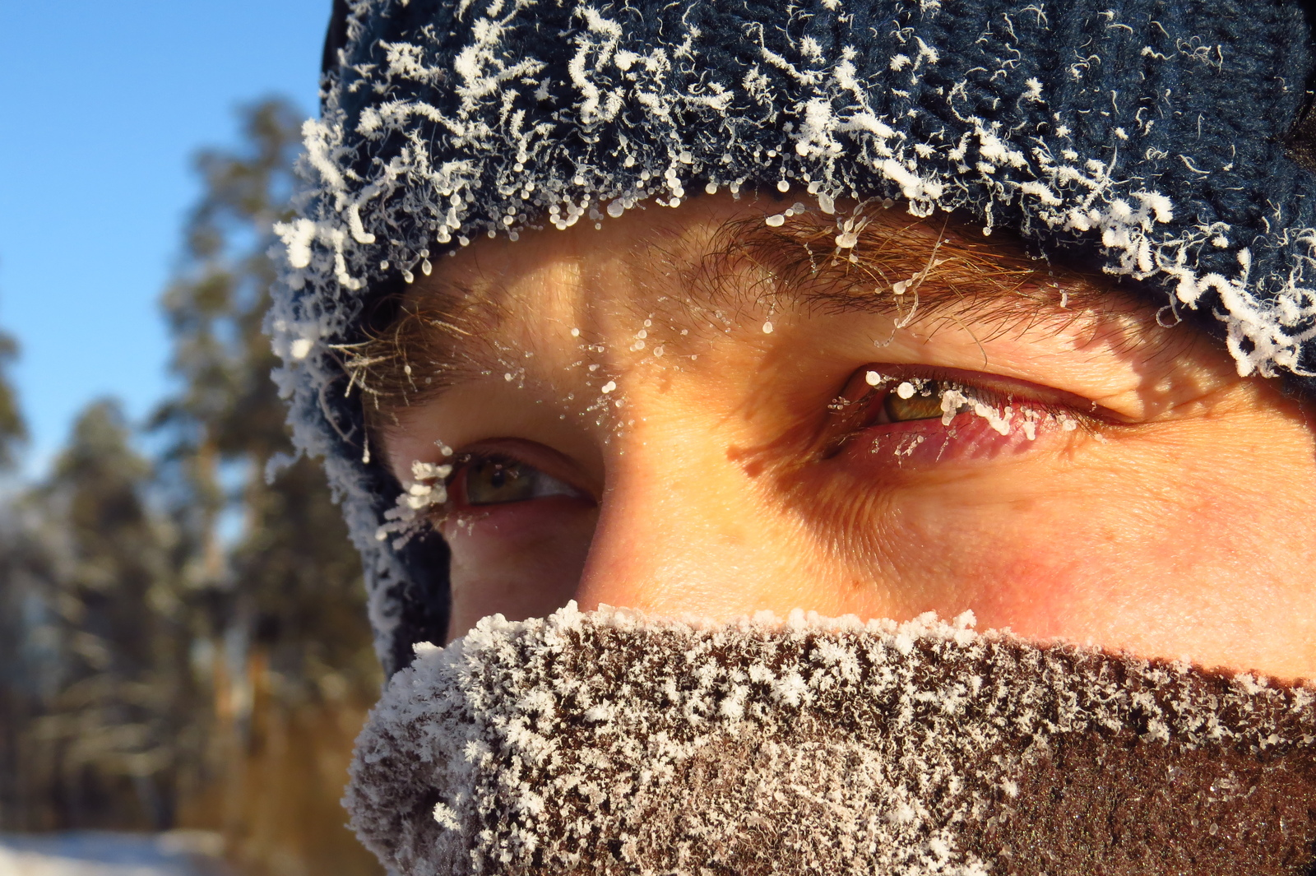
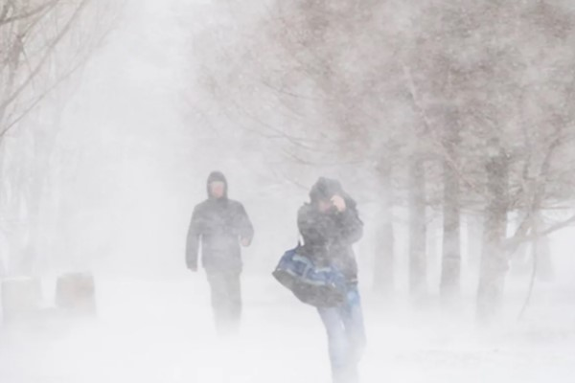
Climate
subarctic climate
low air temperature (frost is often below 30)
large amount of snow
snowstorms

Slide 4
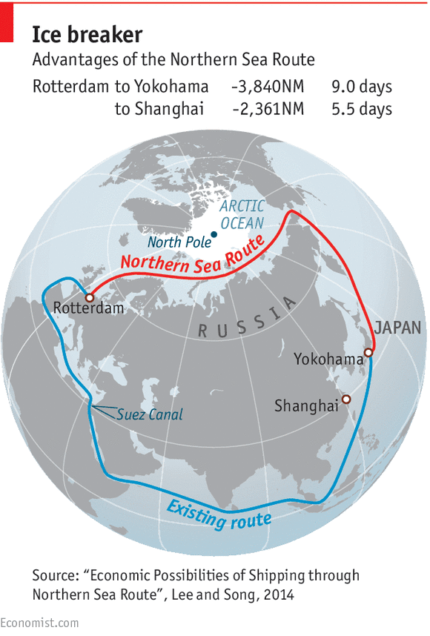
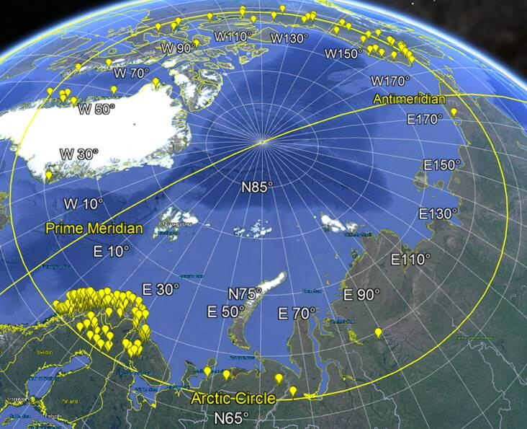
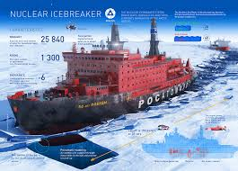
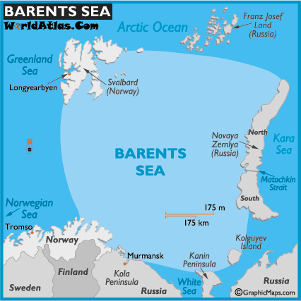
Features of the region
the Arctic circle
the Barents sea
northern sea route
Icebreaker

Slide 5
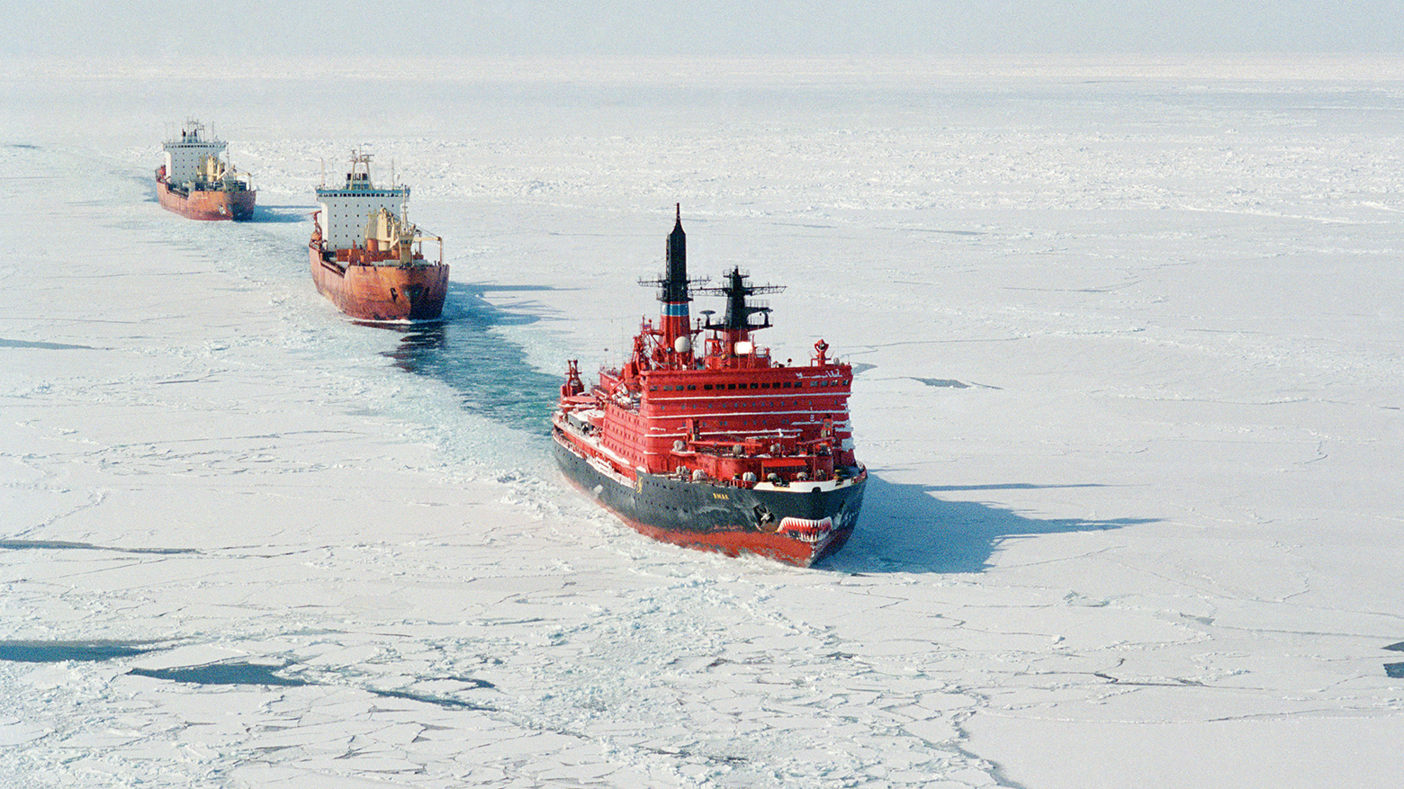
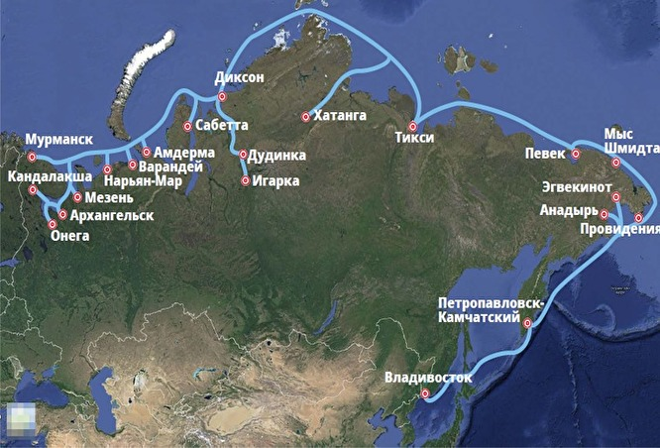
Northern sea route
The Northern Sea Route is a shipping route.
- a shipping route – судоходный маршрут
The Northern Sea Route is the shortest route of transportation from the Far East to Europe.
- the shortest route – кратчайший маршрут

Slide 6
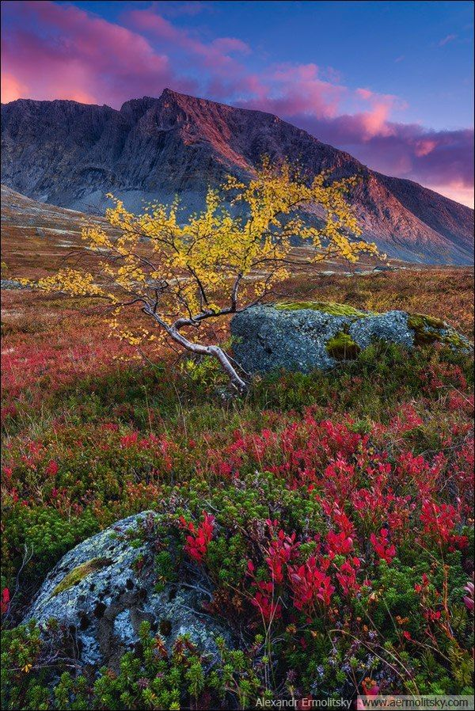
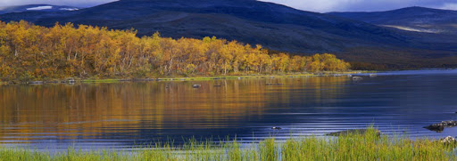
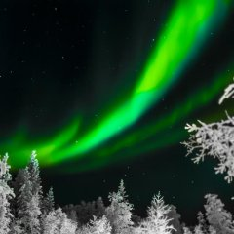
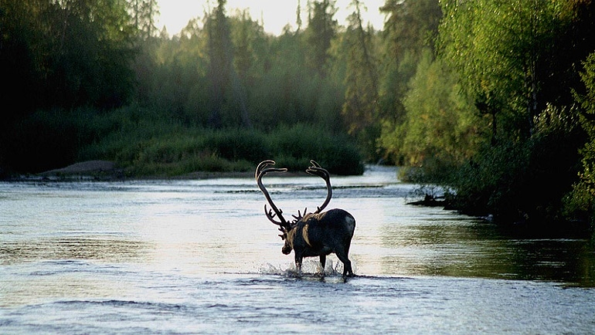
Amazing nature
tundra
Aurora or
polar lights
Lapland nature reserve
reindeer

Slide 7
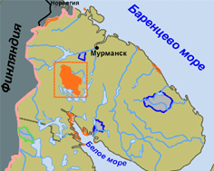
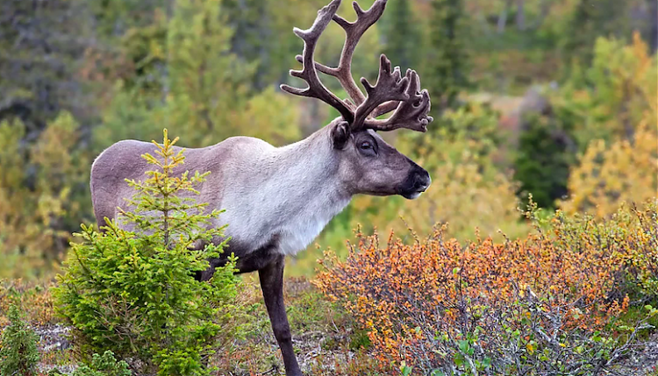
Lapland biosphere reserve
The Lapland Nature Biosphere Reserve is one of the largest in Europe.
one of the largest in – один из крупнейших
The Lapland Nature Biosphere Reserve was founded in 1930 to preserve the population of wild reindeer.
preserve the population – сохранение популяции

Slide 8
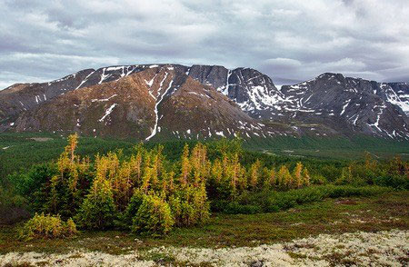
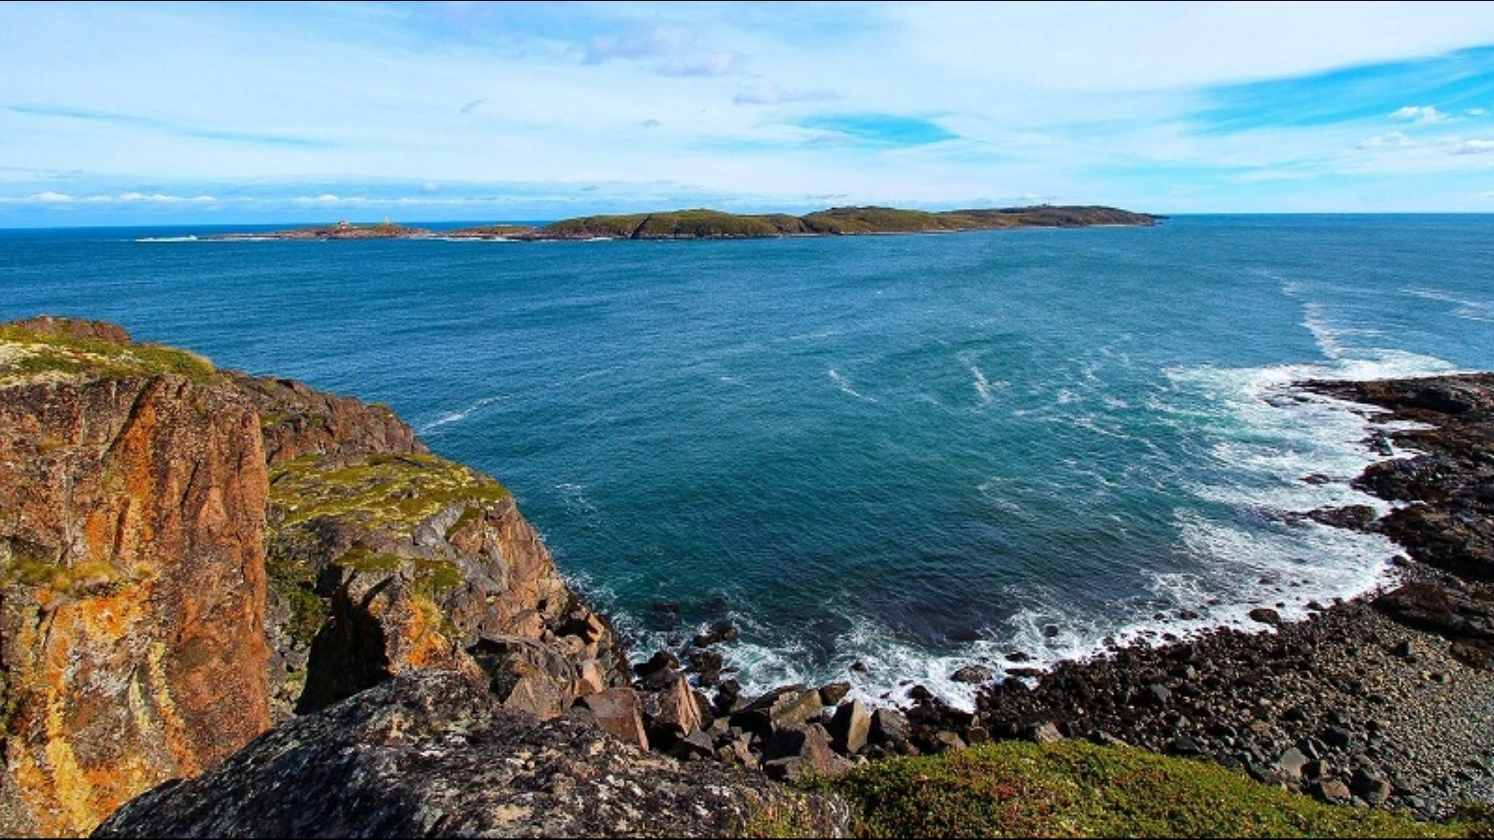
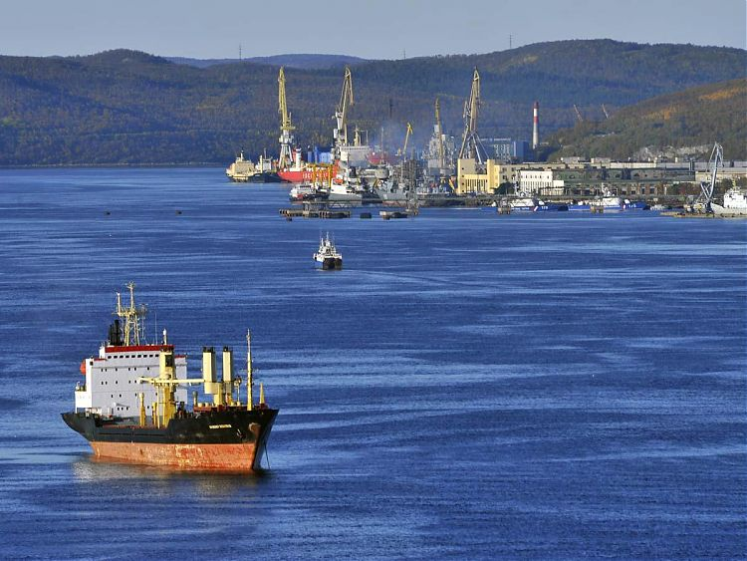
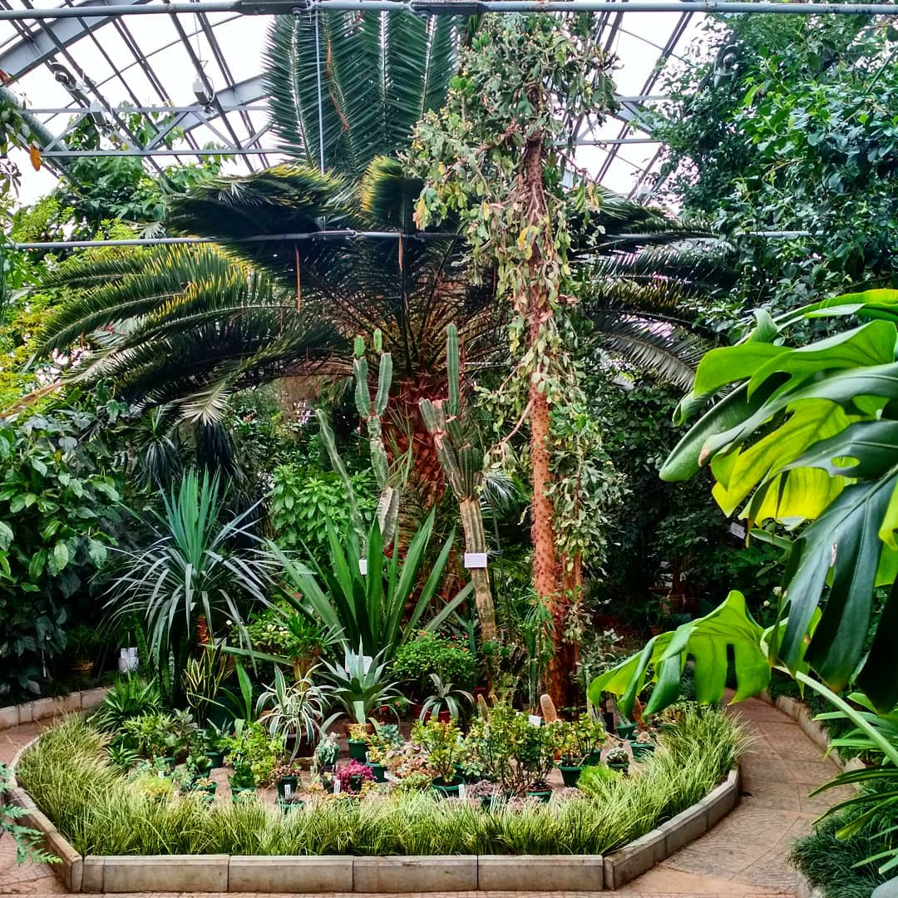
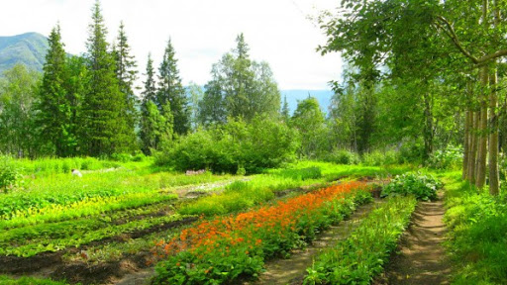
Natural landmark
the Barents sea
Kola bay
The Khibiny mountains
the Polar-Alpine botanical garden

Slide 9
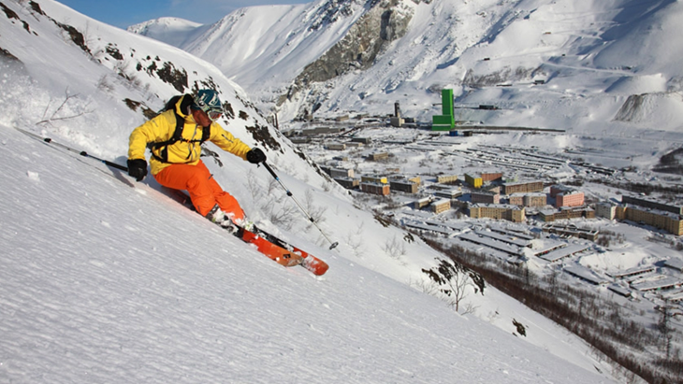
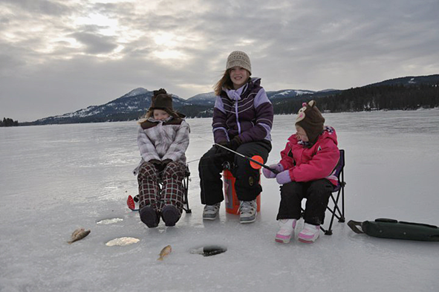
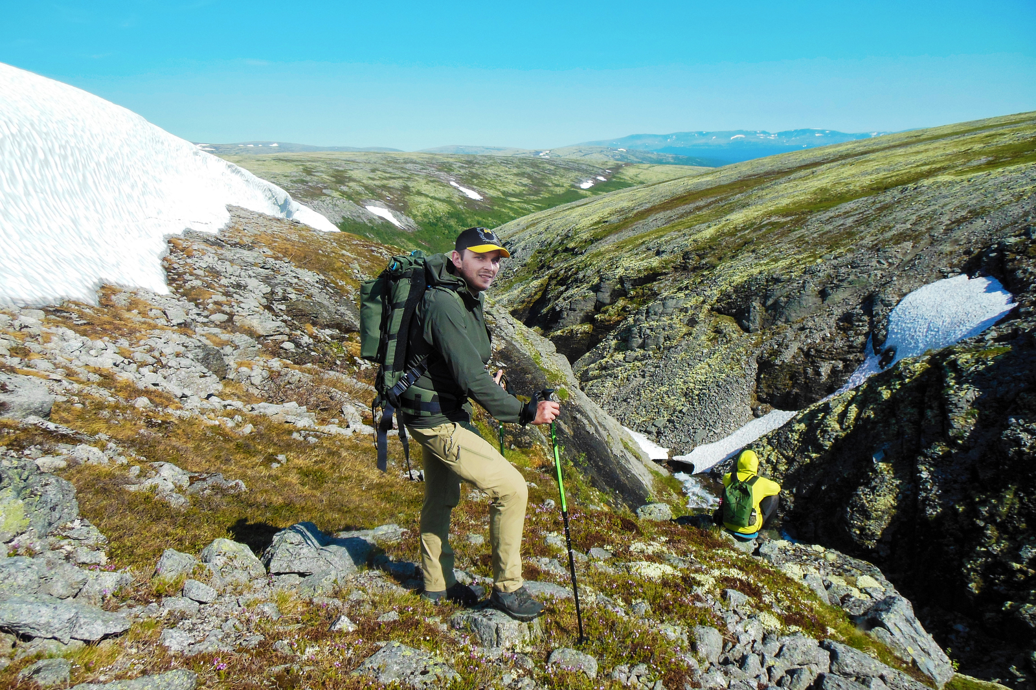
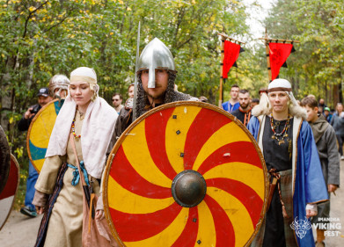
Tourism
ski resort
tourist mountain route
ice fishing
Imandra Viking Fest

Slide 10
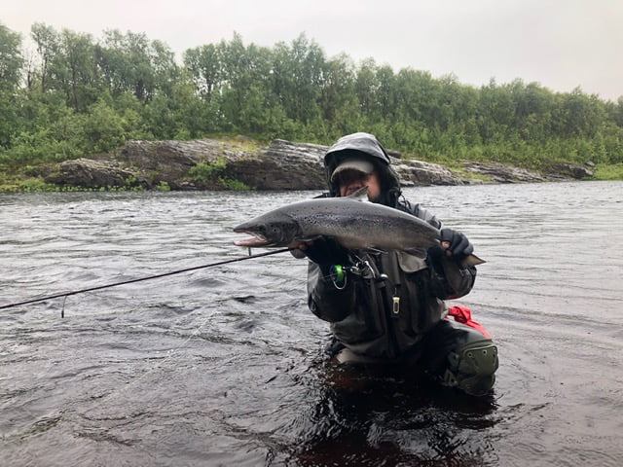
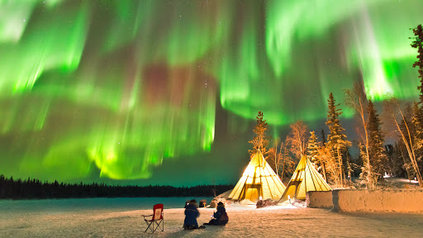
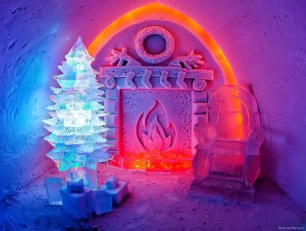
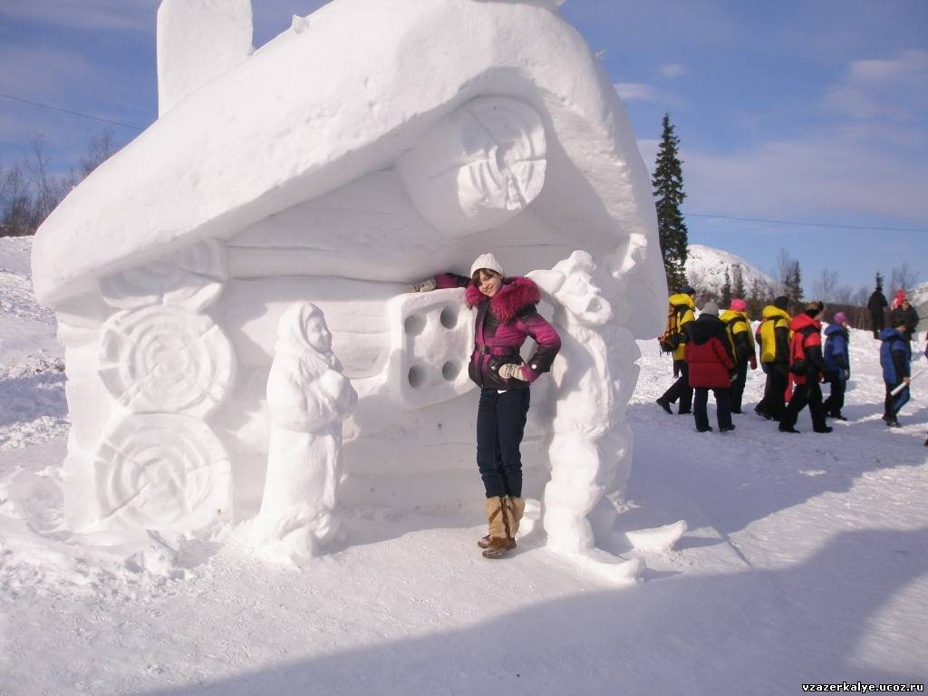
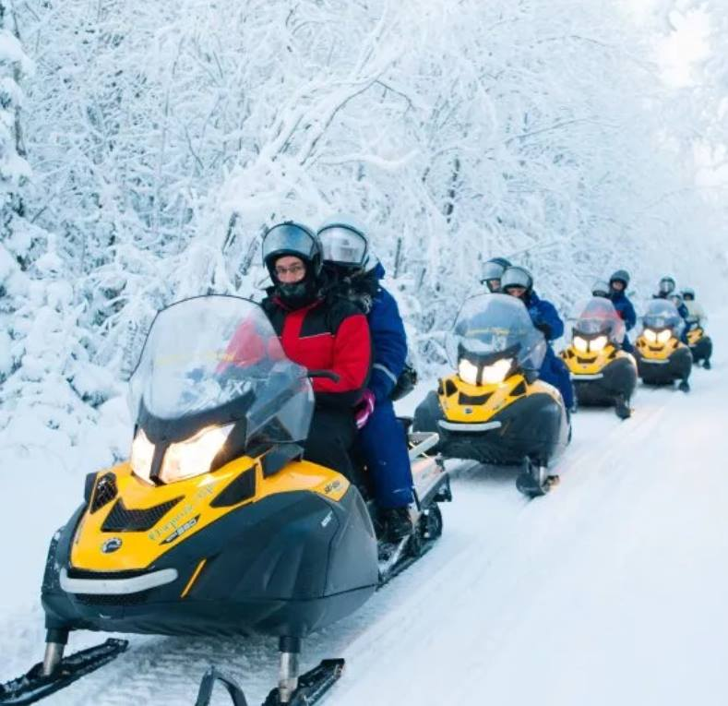
Tourism
salmon fishing
snow village
see the northern lights
Arctic snowmobile safari

Slide 11
Make a story about our region
8. Take a ride on…
9. Admire the northern…
10. Try…
11. Become a guest of…
12. Enjoy the beauty of…
13. Catch a salmon…
14. Have fun at…
15. Get experience in…
We live in…
Climate is…
Our region is known as…
The Northern Sea Route is…
Nature of the Kola Peninsula is
The Lapland Nature Biosphere Reserve is…
Many tourists visit…

