Slide 1
МОБУ СОШ №38 им.Страховой С.Л.
П.Г.Т Сириус
By Sivtseva M.A.
Презентация к уроку « Описание картин».

Slide 2
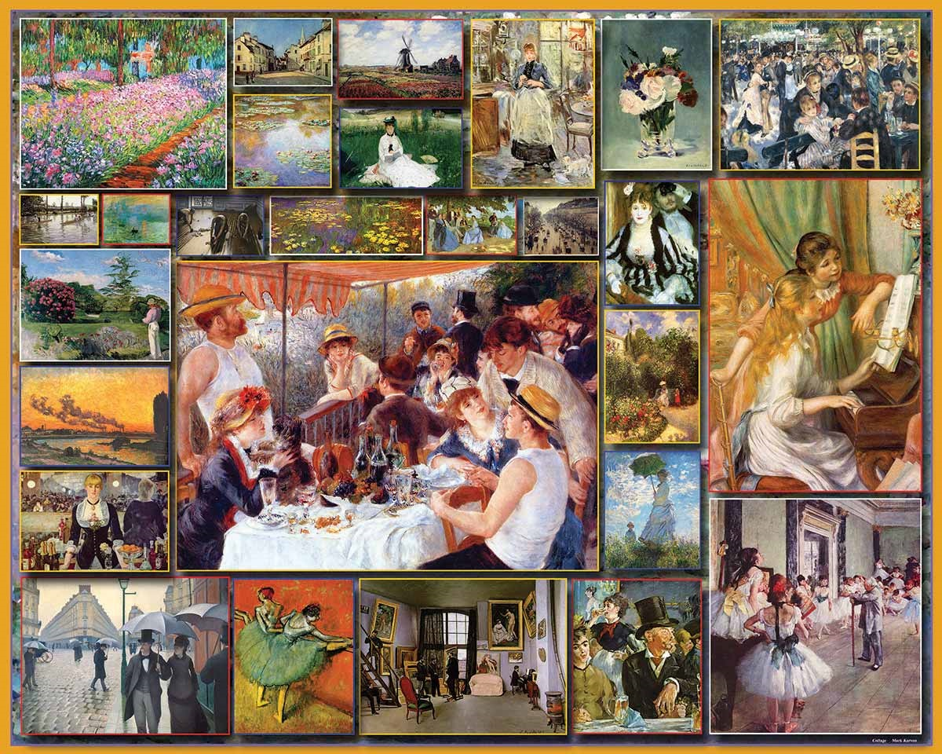
Describing Paintings
according to Spotlight 9
Module 3 d
Speaking
Page 49

Slide 3
Styles of painting
ABSTRACT It’s the art that doesn’t represent recognizable objects.
REALISM It promotes accurate, detailed depiction of nature or contemporary life. It rejects imaginative idealization in favour of close observation.
IMPRESSIONISM It’s the conception of art as imitation of nature. Its subject included landscapes, tress, houses, street scenes. The artists paid attention to effects of light and movement.
CUBISM The key concept of this style is that essence of the object can only be shown from different points of view at once. Its works reject perspective in favour of geometric forms.
POP ART The art in which common objects (such as comic strips, soup cans, road signs, and hamburgers) were used as subject matter.
Surrealism the principles, ideals, or practice of producing fantastic magery or effects

Slide 4
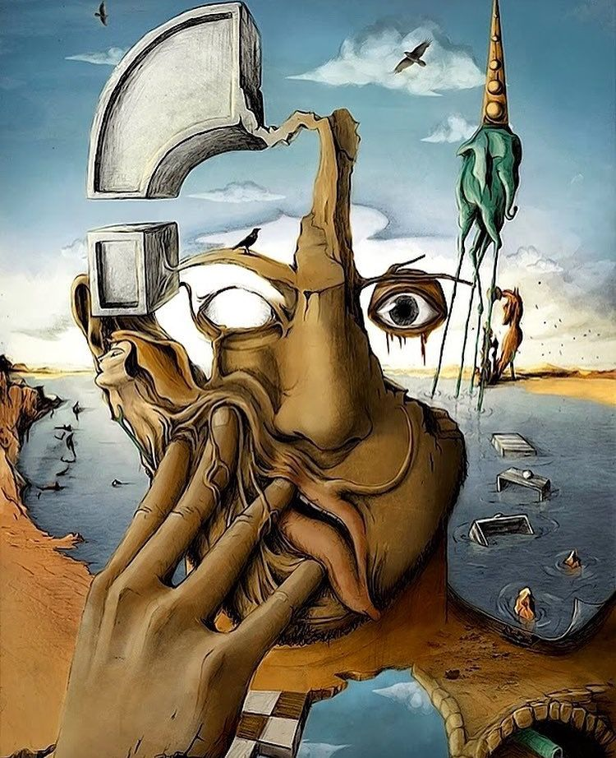
Abstract painting

Slide 5
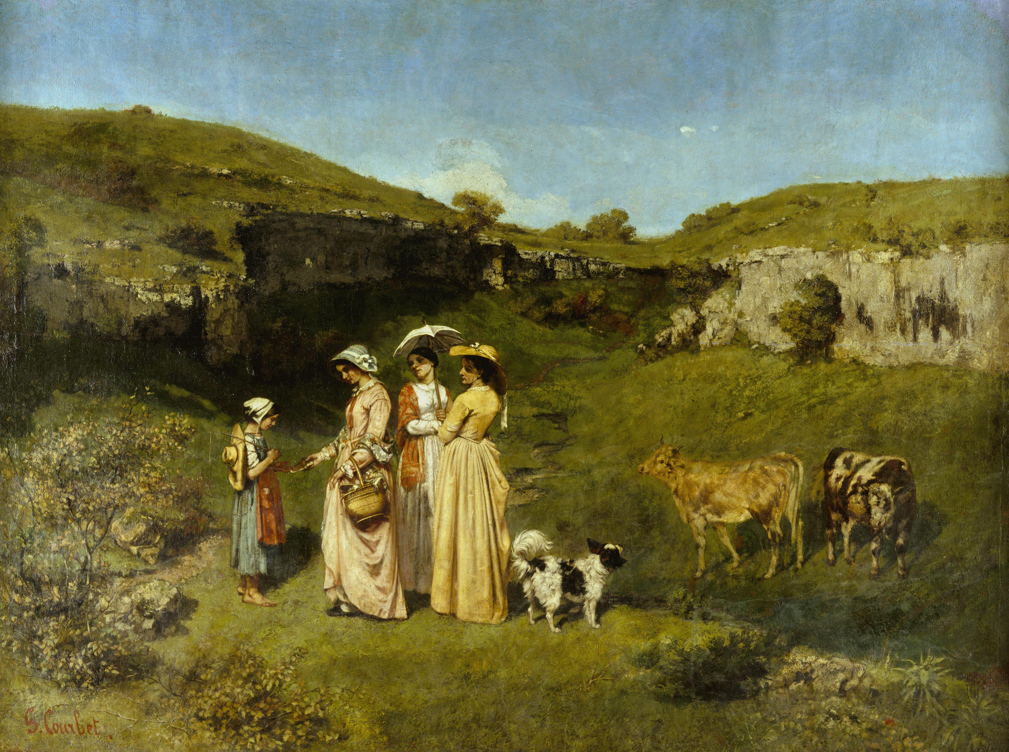
Realism

Slide 6
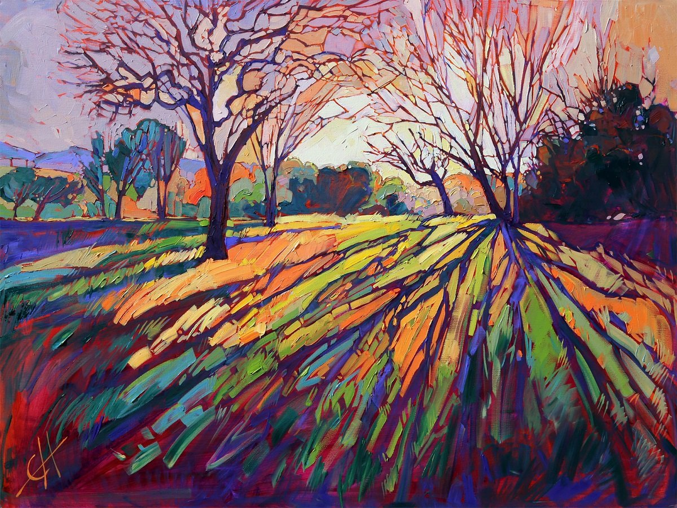
Impressionism

Slide 7
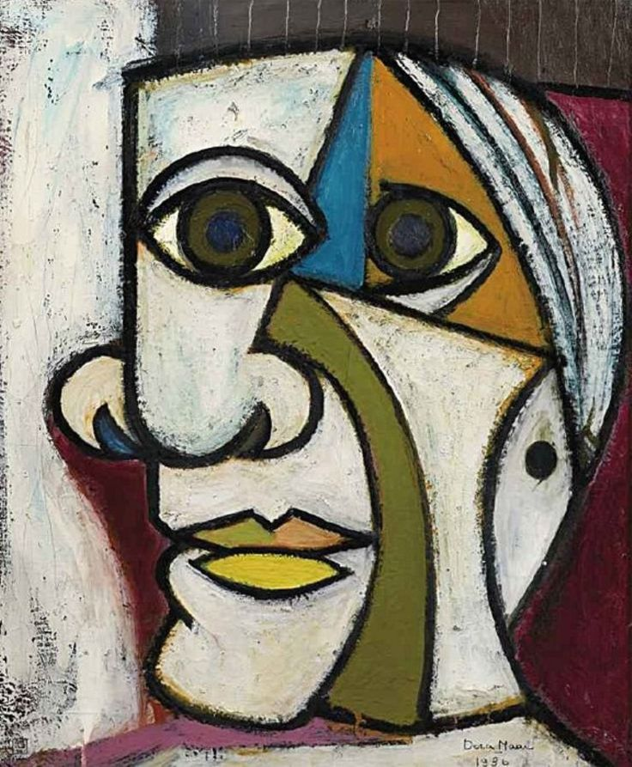
Cubism

Slide 8
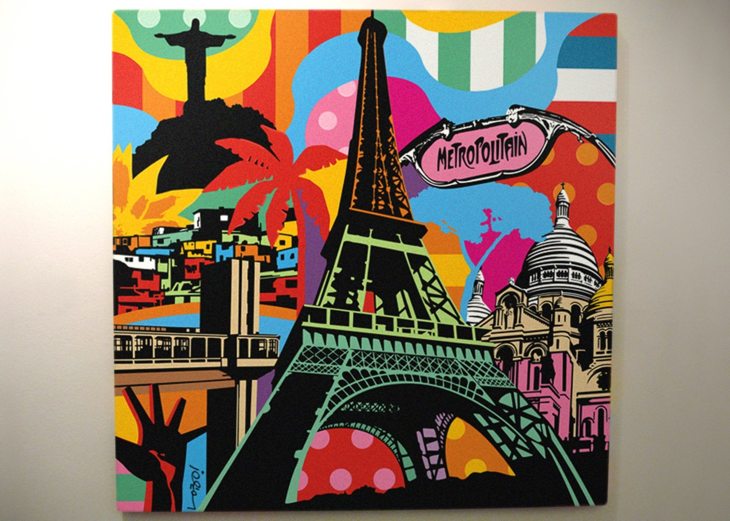
Pop art

Slide 9
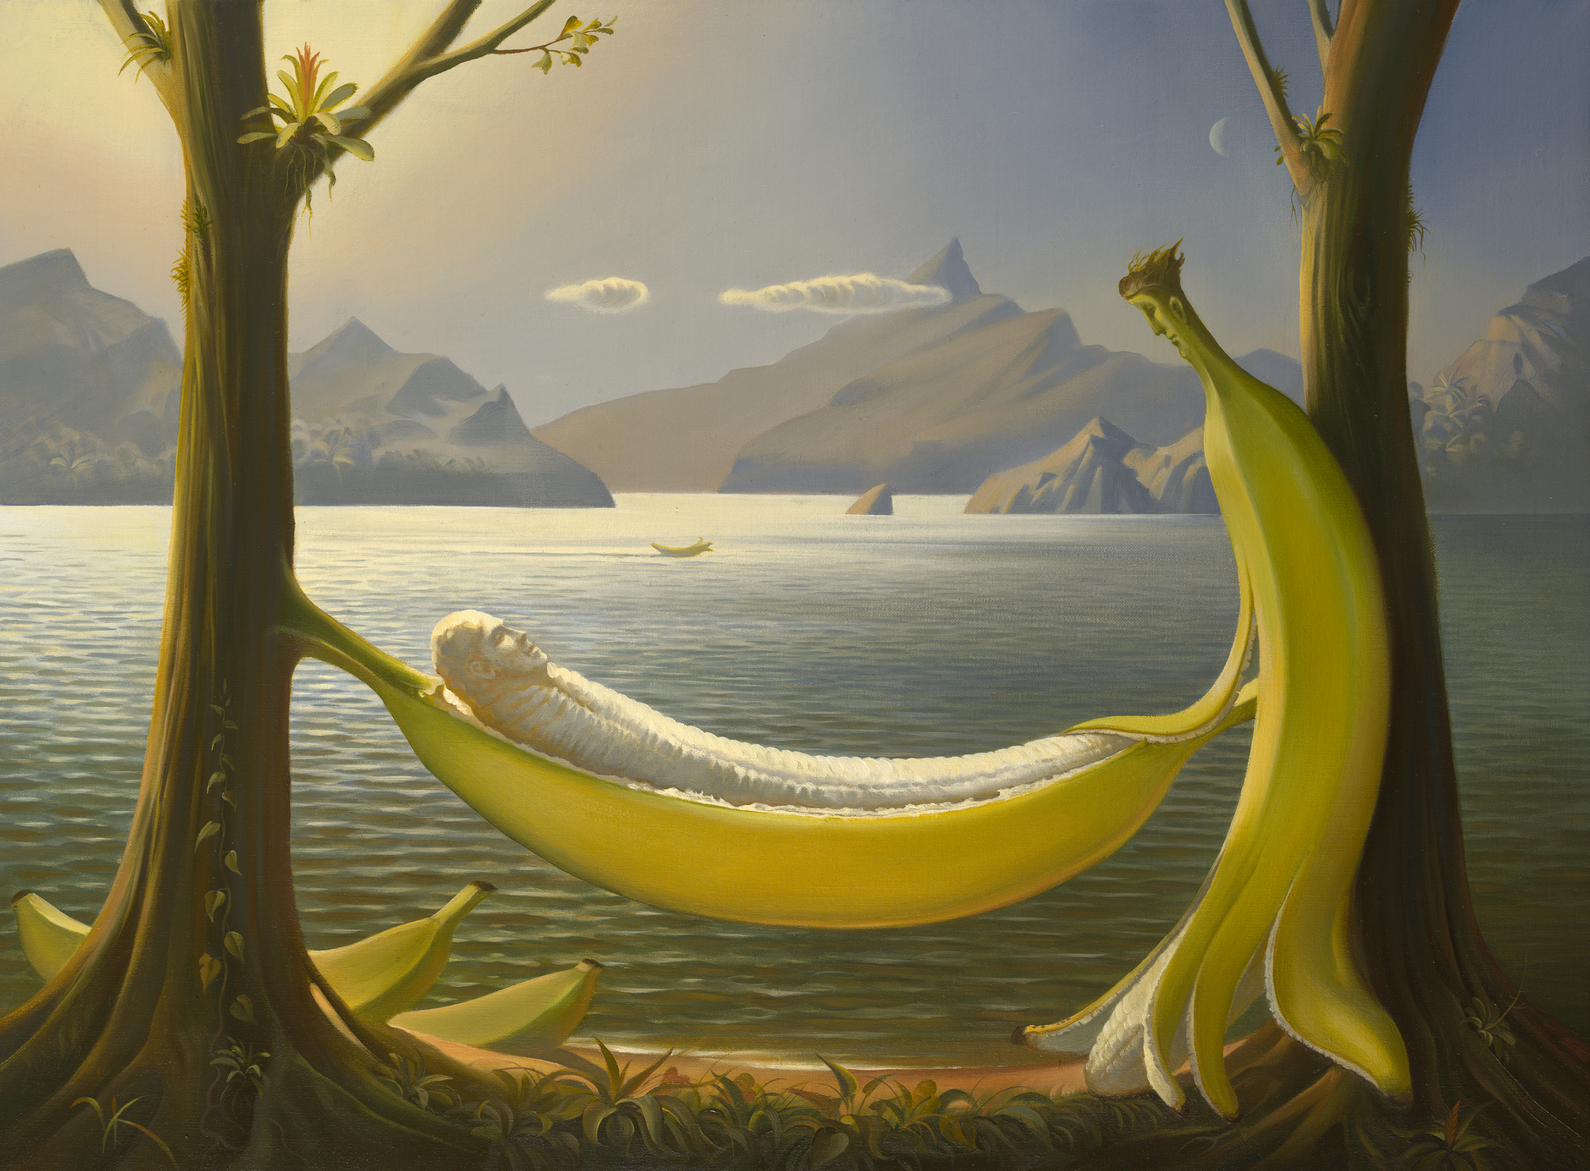
Surrealism

Slide 10
Making Assumptions
must/can’t/may
This picture must be very old.
( I’m sure it’s very old.)
It can’t be original.
(I’m sure it is an original.)
This painting may be expensive.(It’s possible)

Slide 11
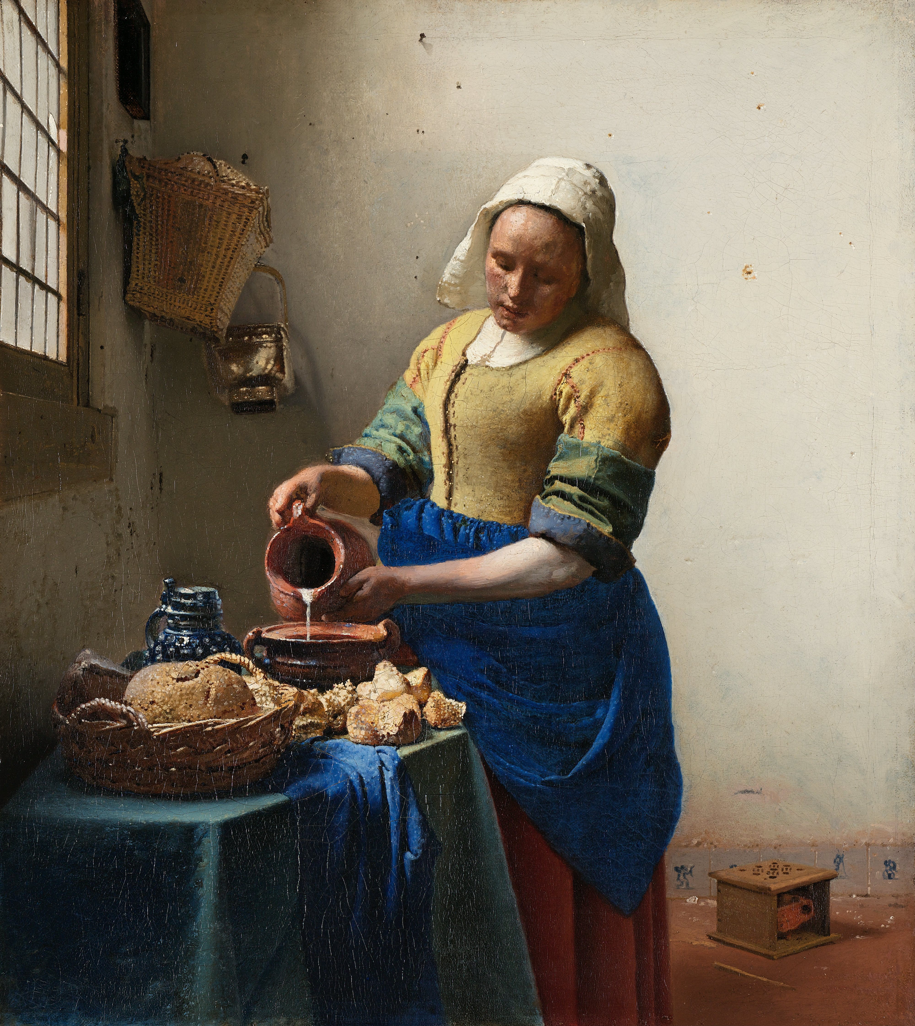
Look at the picture and find the correct word in each sentence.
The painting may/can’t be oil.
The painting must/ can’t be quite old.
The room may/must be the kitchen.
The woman may/must be married.
She must/can’t be rich.
She may/must be making breakfast.

Slide 12
Study skills
Describe a painting according to the plan:
the subject of a painting (what is depicted in it)
the composition (how space is arranged) and the colours
the details
the impression made by the picture

Slide 13
Give your opinion about the painting. Use adjectives:
lifelike = true to life
dreamlike = work of imagination
confusing
colourful
romantic
lyrical
powerful
outstanding
heart-breaking
impressive

Slide 14
Try to describe what you can see in general
In the centre/middle of the painting we can see a ….
In the foreground there is a….
In the background there are….
In the far distance we can make out the outline of a…
On the left/ right stands/ sits…

Slide 15
Colours
warm / cold, cool colours
bold colours
oppressive colours
bright colours
deep colours
light colours
soft and delicate

Slide 16
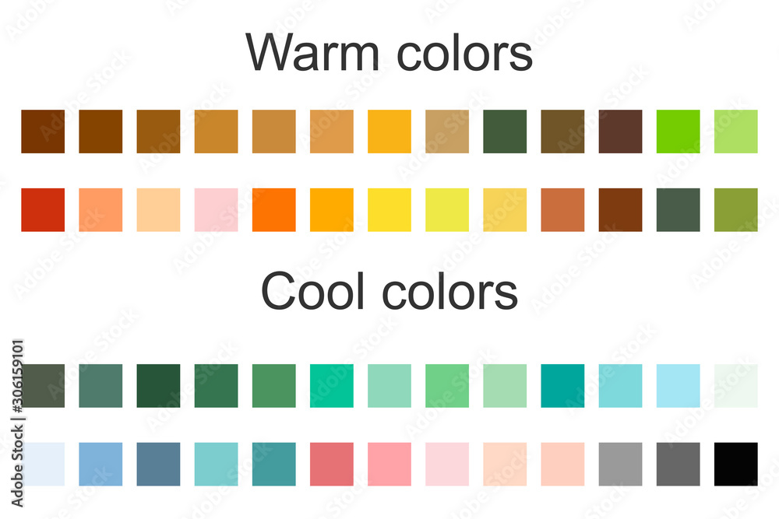

Bold /Bright colours

Slide 17
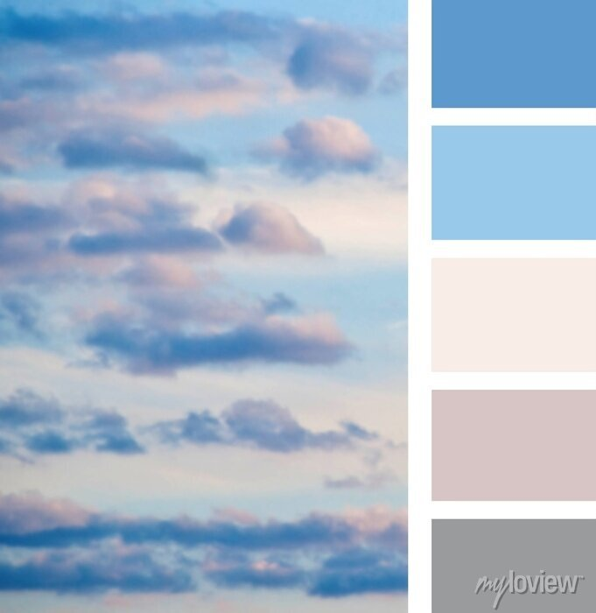
soft and delicate

Slide 18
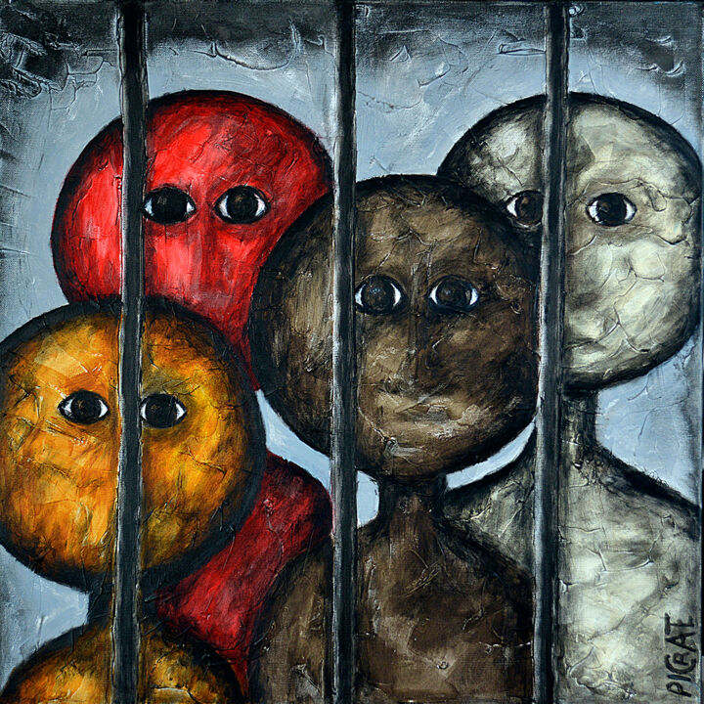
oppressive colours

Slide 19
Using colours in speech:
The picture is painted in colours.
These colours contrast very well.
The dominating colours are .
The colours contrast with each other.
bright colours
red and blue

Slide 20
In the end, give your impression.
Use the words and phrases:
Well, I feel that I am unable to put into words what I feel looking at the painting.
To my mind, it is a masterpiece that could stand the test of time.
Well, it seems to me that I couldn’t put into words the impression made on me by this painting.
I feel extremely impressed by this painting.
It is brilliant, amazing. It is a real masterpiece by (….. the painter).
The picture looks very realistic.
It makes me feel astonished.( amazed)

Slide 21
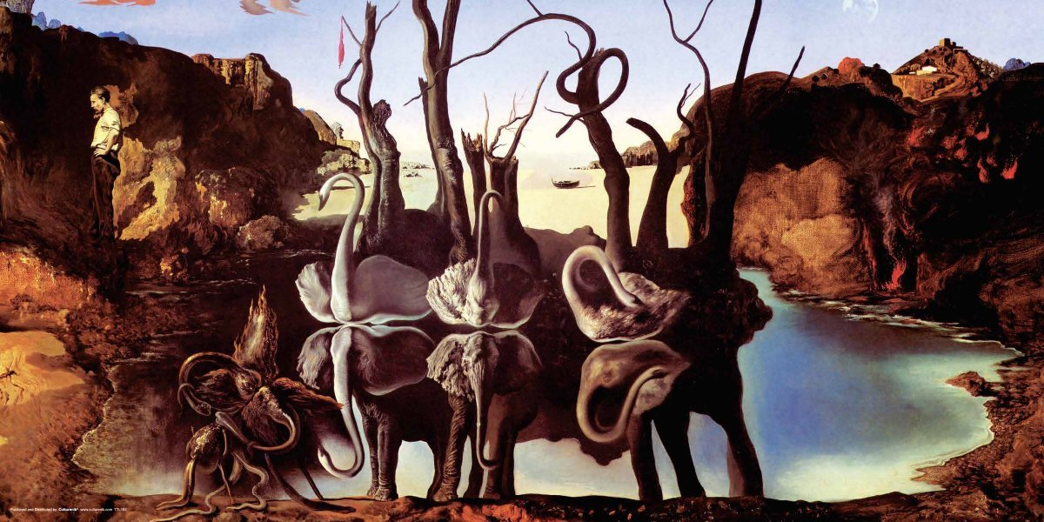
Swan reflecting elephants
This painting belongs to surrealism style.
In the background there is clear blue sky. In the cenre of the picture there are 3 large swans next to each other. We also can see several trees behind swans. The swans and trees are reflection of elephants in the lake. The artist has used bright colours in the painting. It looks really unusual and strange that’s why the picture attracts attention at once. It makes me feel astonished.

Slide 22
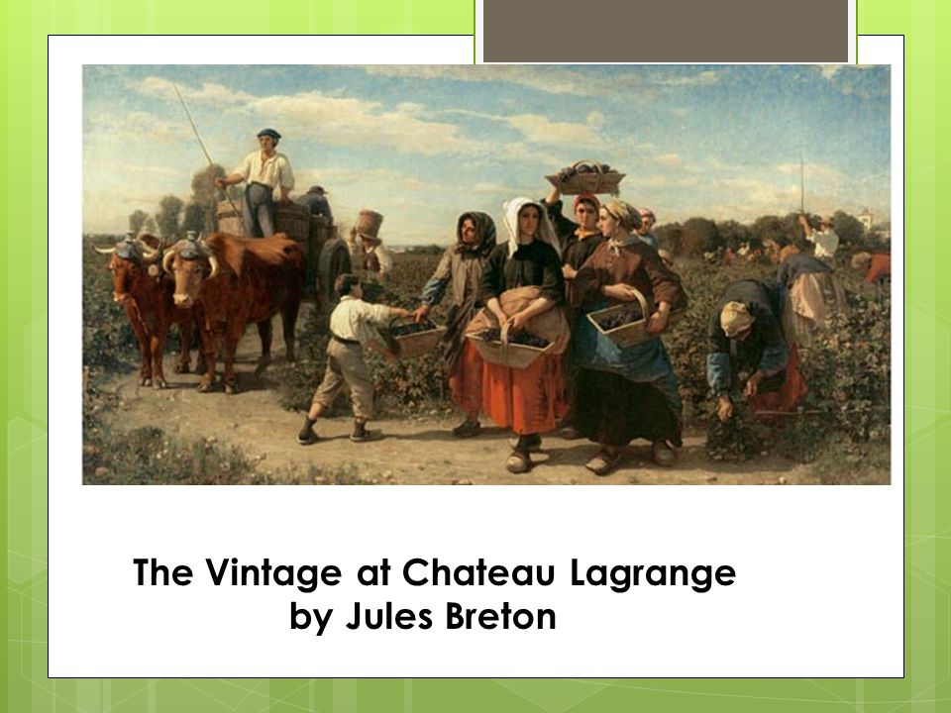
Page 49 ex.5

Slide 23
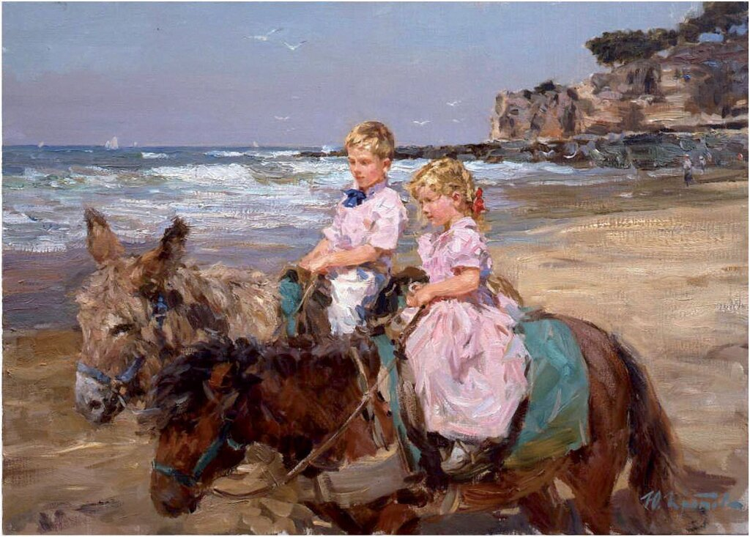
Look at the paintings and describe them.

Slide 24
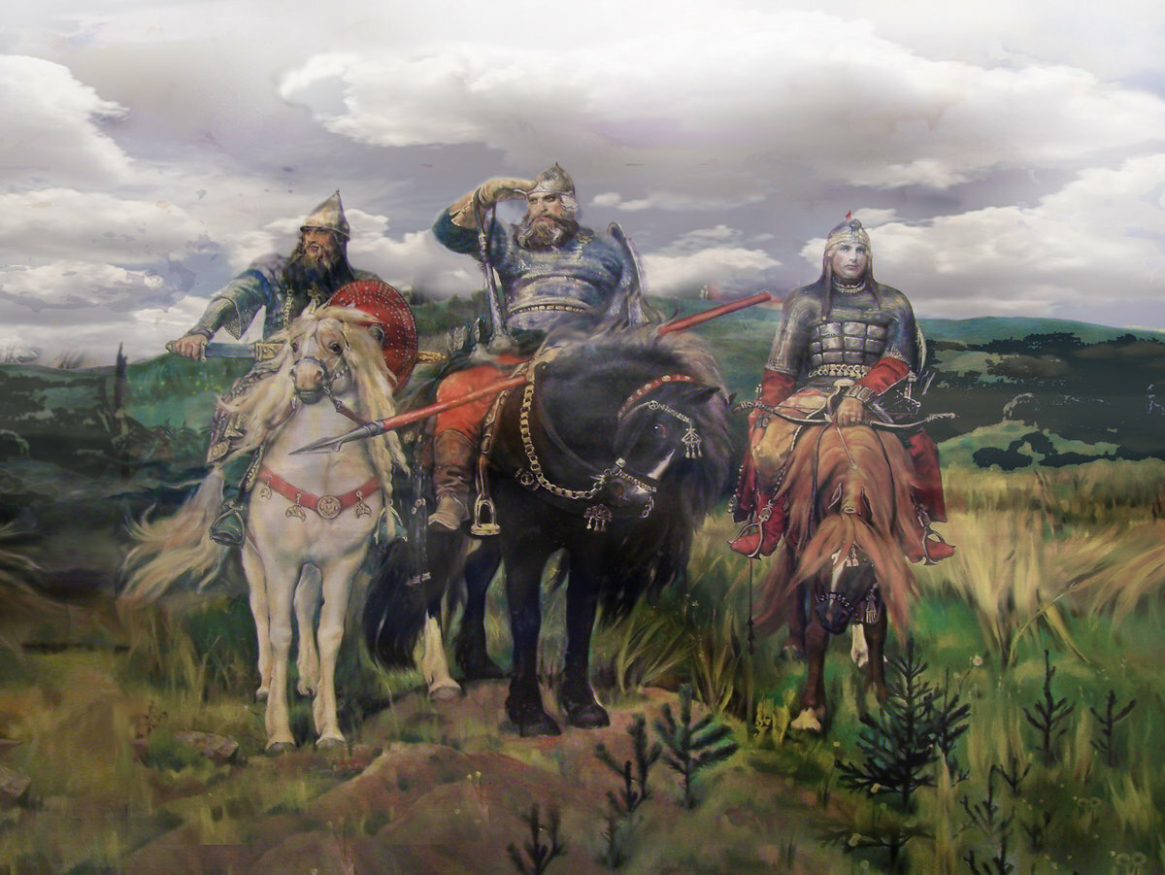

Slide 25
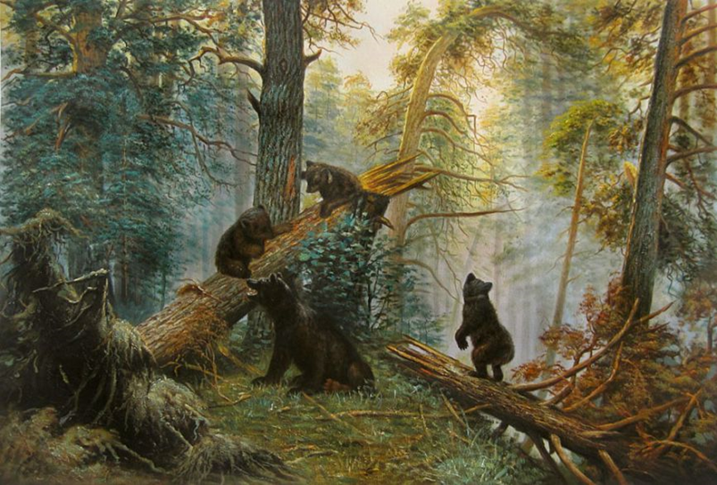

Slide 26
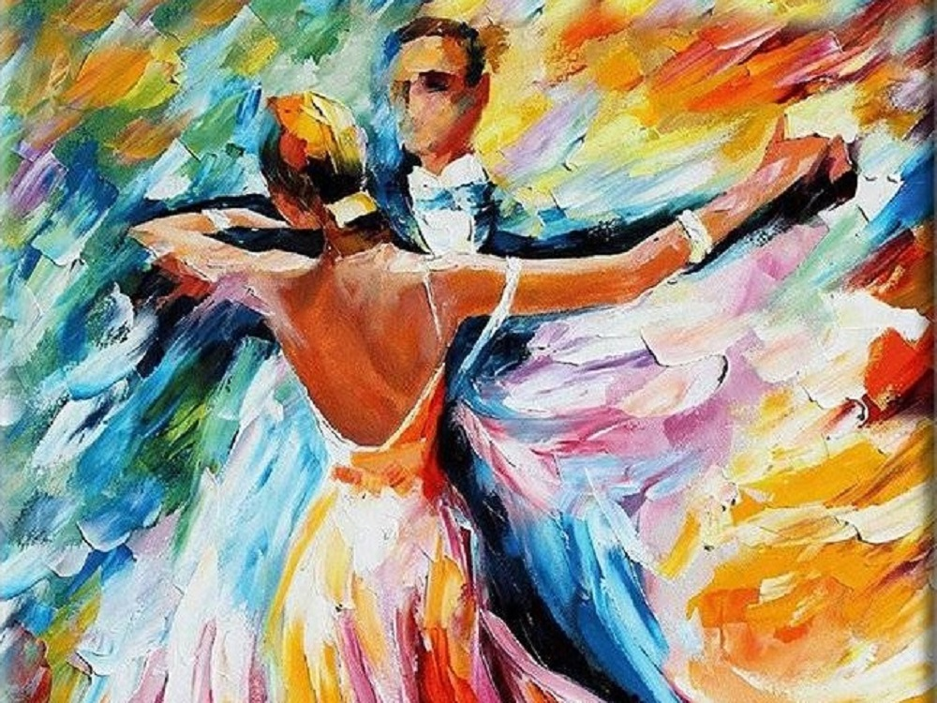

Slide 27
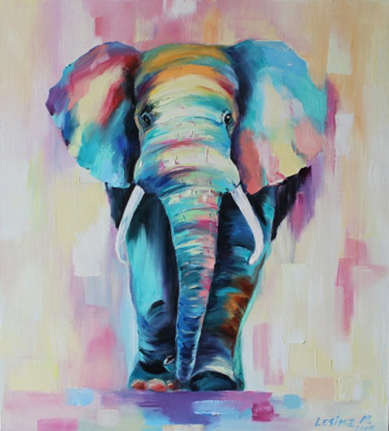

Slide 28
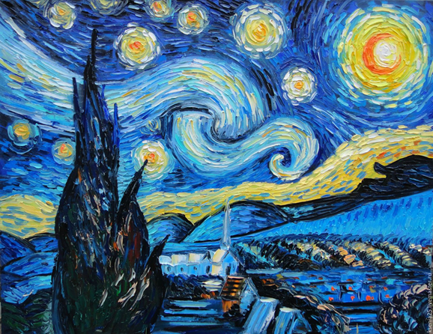

Slide 29
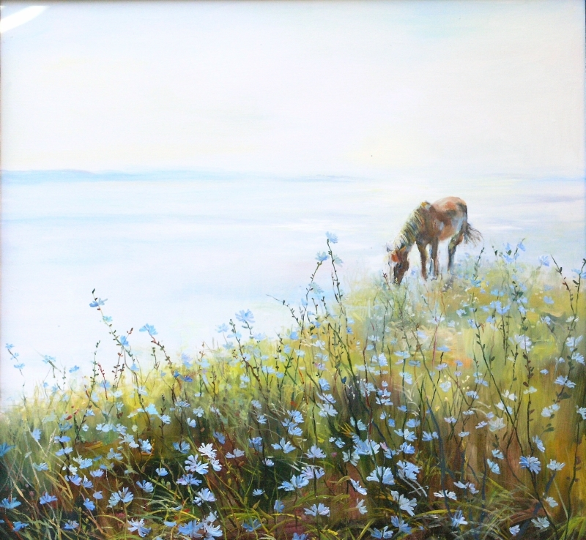

Slide 30
Thanks for attention!

