Slide 1
Guess the riddle
It is big.
It is brown.
It has got four legs, small ears, a small nose, a long tail a big mane.
It lives in Africa.
It can run and jump.
What animal is in my bag?

Slide 2
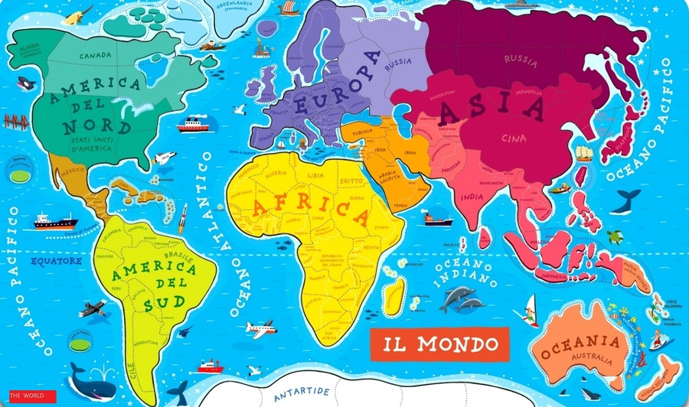
Lions live in Africa

Slide 3
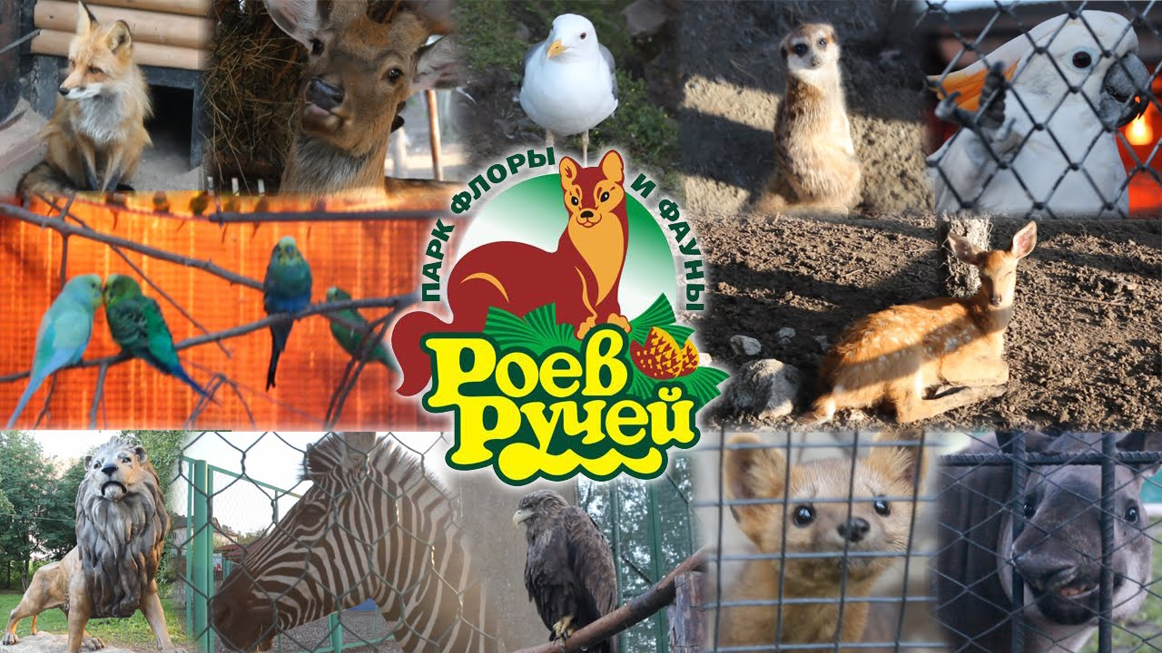
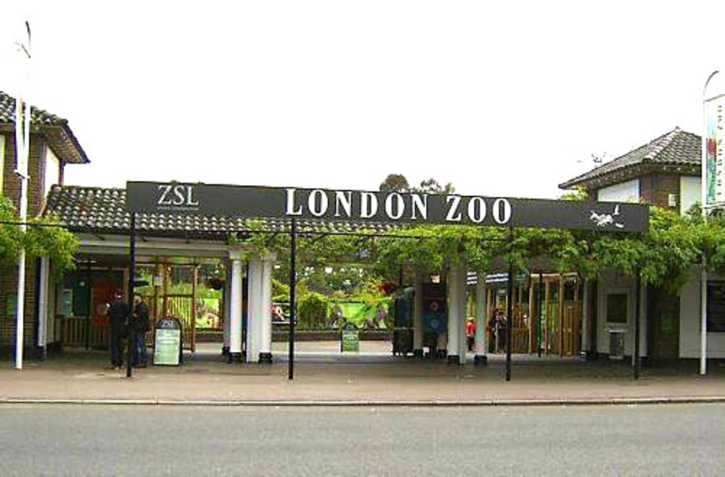

Slide 4
Going on holiday
Start the car
Go by train
Go by plane
Phone for a taxi
Case
Passport
Ticket
The train leaves
The plane arrives

Slide 5
Going on holiday – едем отдыхать
start the car – завести машину
go by train – ехать на поезде
go by plane – лететь на самолете
phone for a taxi – звонить в такси
case - чемодан
passport - паспорт
ticket – билет
the train leaves – поезд отходит
the train arrives – поезд прибывает

Slide 6
Cross the odd word out. Вычеркните лишнее слово
case | passport | ticket | tiger
bear | leave | taxi | arrive
passport | giraffe | case | leave
car | train | kangaroo | plane
hamster | arrive | taxi | leave
taxi | ticket | case | seal

Slide 7
Cross the odd word out. Вычеркните лишнее слово
case | passport | ticket | tiger
bear | leave | taxi | arrive
passport | giraffe | case | leave
car | train | kangaroo | plane
hamster | arrive | taxi | leave
taxi | ticket | case | seal

Slide 8
Divide these words in two groups.
taxi, hamster, car, passport, bear, case, ticket, train, giraffe, leave, kangaroo, plane, seal, arrive, tiger
animal | holiday

Slide 9
Divide these words in two groups.
taxi, hamster, car, passport, bear, case, ticket, train, giraffe, leave, kangaroo, plane, seal, arrive, tiger
animal | holiday
hamster bear tiger giraffe kangaroo seal | taxi ticket car train passport leave case plane

Slide 10
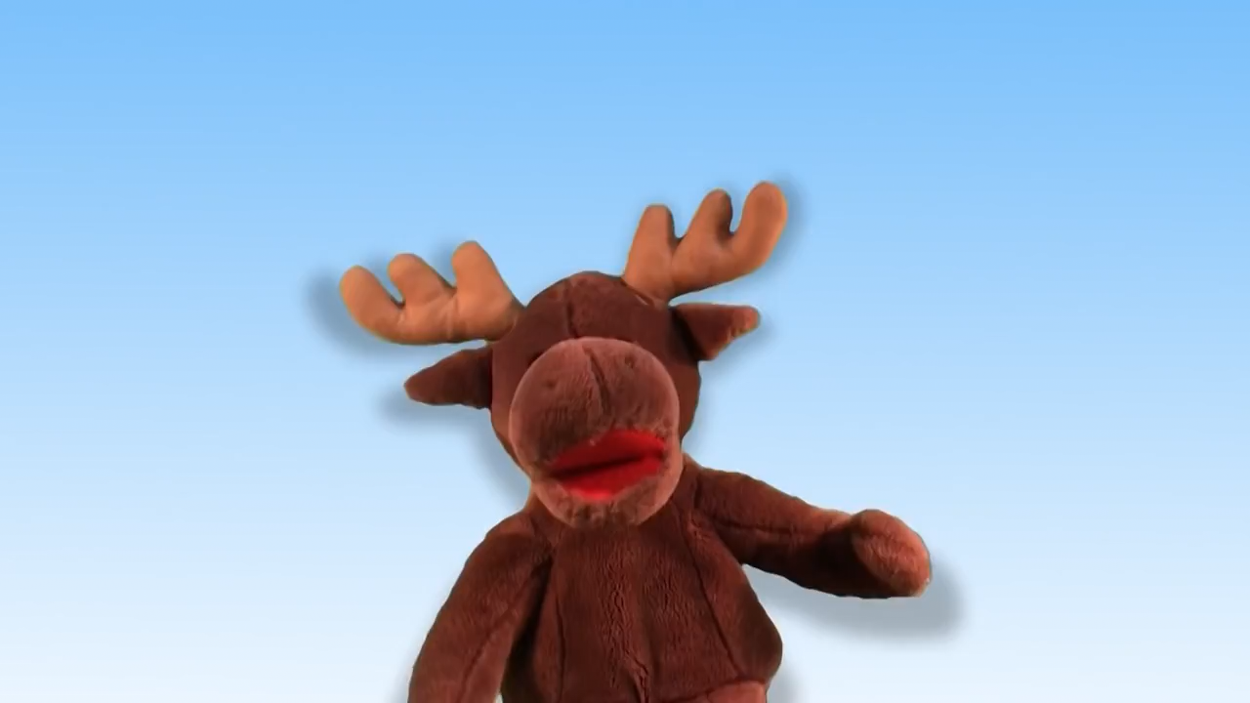
Let’s have a rest!

Slide 11

What is it?
ticket

Slide 12
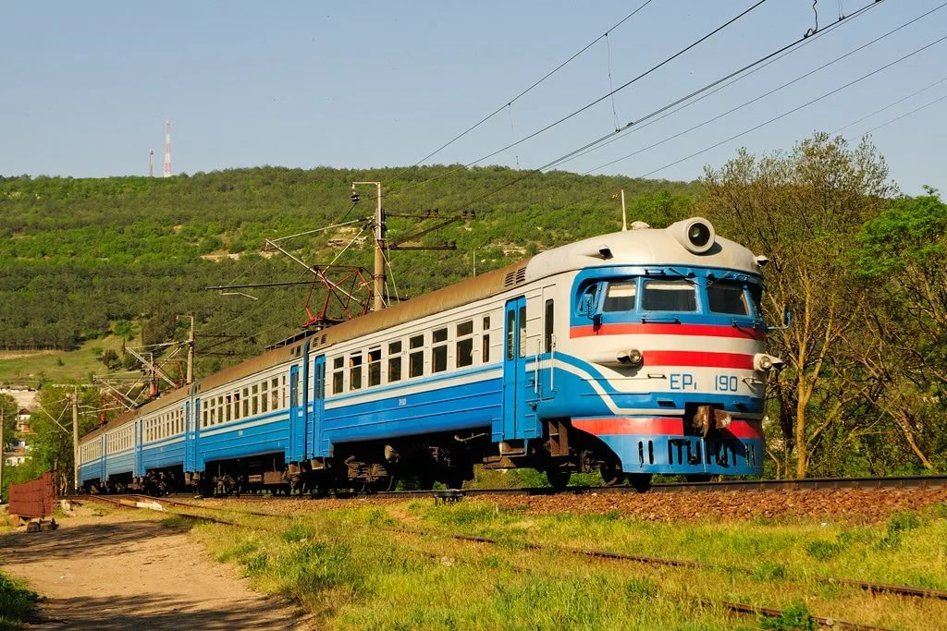
What is it?
train

Slide 13
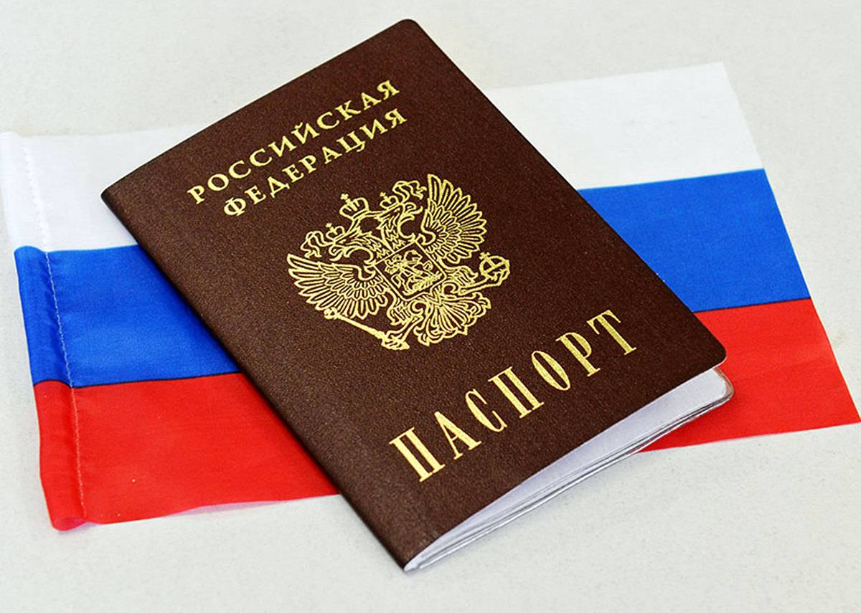
What is it?
passport

Slide 14
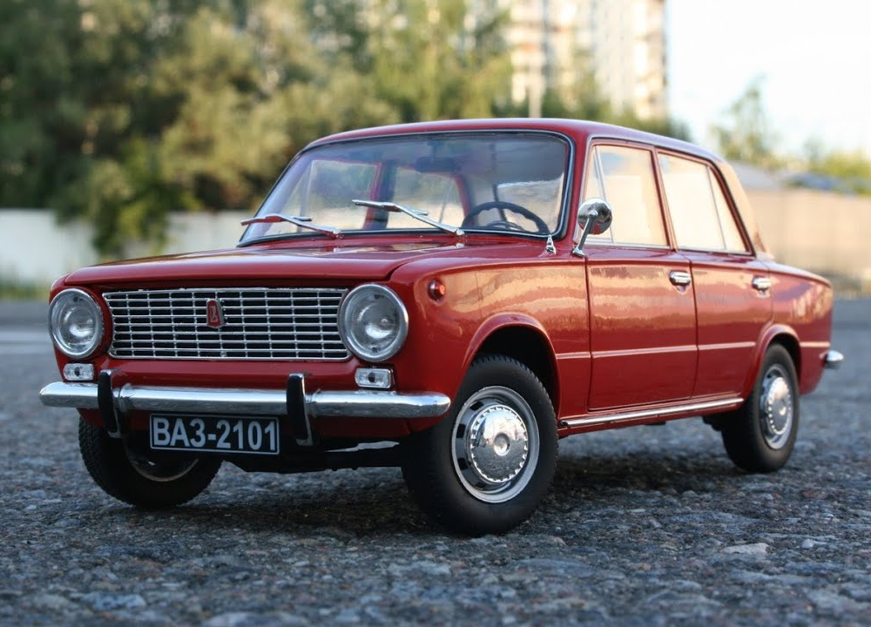
What is it?
car

Slide 15
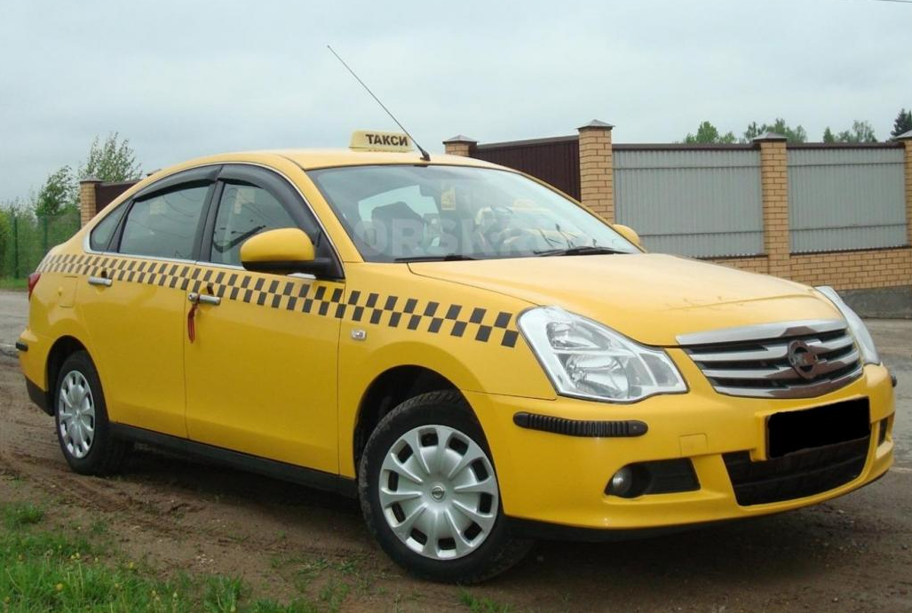
What is it?
taxi

Slide 16
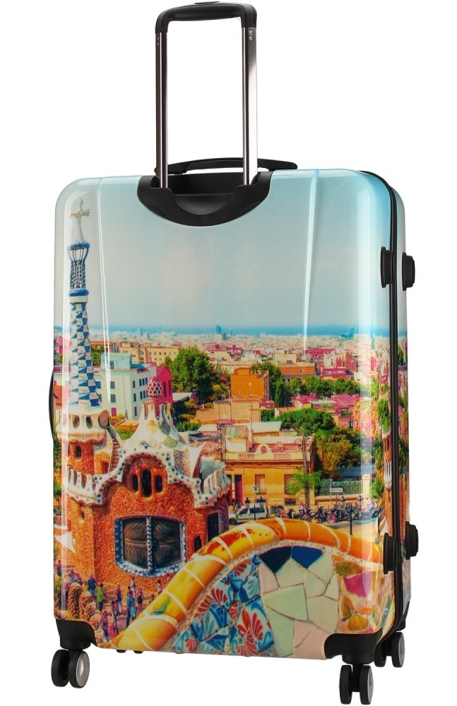
What is it?
case

Slide 17
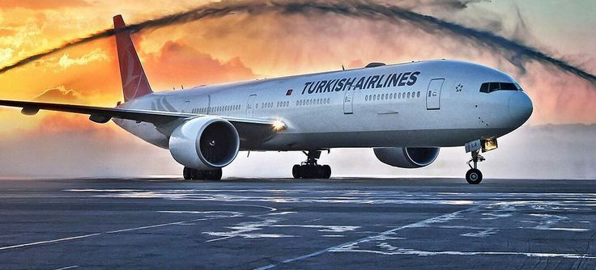
What is it?
plane

Slide 18

SB p.14 ex.1

Slide 19
Going on holiday (translate)
Start the car
Go by train
Go by plane
Phone for a taxi
Case
Passport
Ticket
The train leaves
The plane arrives

Slide 20
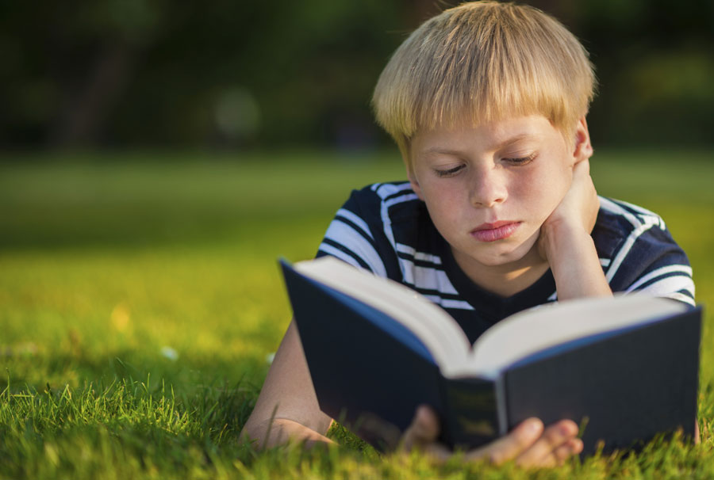

Now I can… I can`t…
Read new words
Write new words

Slide 21
Homework
AB p. 60 ex.B
SB p. 14 ex. 1

